Slide 1
Maths Depends on Culture
Lyron Winderbaum
Notes:
Hi, My name is Lyron Winderbaum, I have a doctorate in mathematics, just so you know.
The title of my talk: There is a common misconception that mathematics spans all cultures and so is independent of culture. Nothing could be further from the truth.

Slide 2
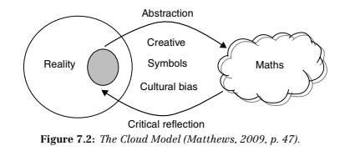
The Process of Learning/Developing Maths
Notes:
Note: Most school-age students are not yet in the Formal Operational Stage of the Piagetian developmental model, and often skip the abstract thinking involved.
There are really two points here:
Maths is subjective (gets into epistemology so I’m not going to get into it),
The process of learning maths is culturally driven.
What is Maths?
It is the process of making observations, abstracting those observations into generalisations, and then investigating the properties of those generalisations and applying them back to reality to answer questions and solve problems.

Slide 3
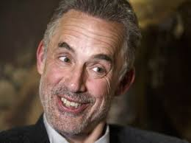
So Where Does Culture Fit?
Our perception of reality is biased by our values.
Our values are largely a product of our culture.
So, Culture → Values → Perceptions → Maths.
This effect can often be masked if teacher and student share a cultural background.
Jordan Peterson
But if they differ in cultural background, students may struggle to find any relevance in the maths as it won’t connect to their values.
Notes:
The simple act of looking at something is placing a value hierarchy on the objects around you, with that thing at the top of that hierarchy.
The cultural importance in teaching maths can often be masked by

Slide 4
Indigenous Students
``Indigenous students continue to be the most mathematically disadvantaged group in Australia’’ --- Matthews (2007)
These poor educational outcomes cause decreased employment opportunities, and are correlated with poor health outcomes and risky behaviours.
Notes:
This is of course related to attendance…
But what I really want to talk about is Relevance, as this is the point that connects to what I am talking about --- values.

Slide 5
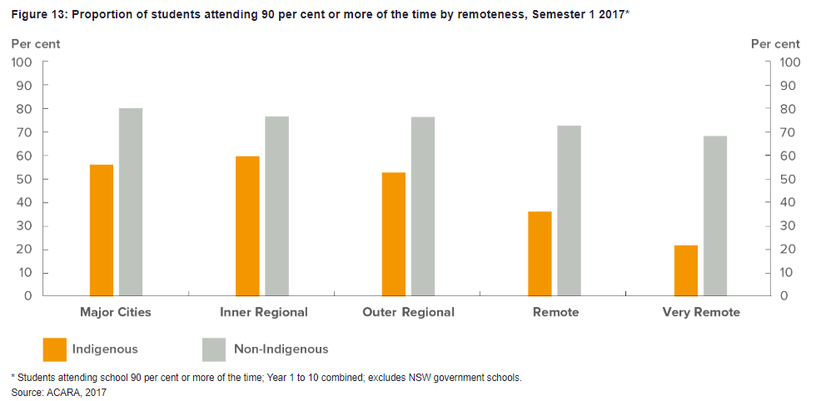

Slide 6
Attendance - Symptom, not Cause.
The fundamental problems in maths education for indigenous students are:
Expectations, and
Relevance
To improve attendance a``build it and they will come’’ approach is needed.
Notes:
To improve attendance we first need to address the shortcomings of our school system that are causing indigenous students to disengage and not attend.

Slide 7
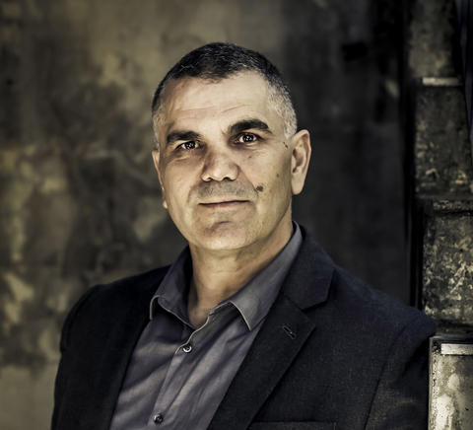

Expectations
Chris Sara has done fantastic work in this area, check out
The Stronger Smarter Institute, and their
High Expectations Relationships Framework
Notes:
White trash = Lazy and incompetant teachers
It takes a deep level of content knowledge and cultural competence to teach maths from different perspectives in different cultures.

Slide 8
Relevance
How can we make learning maths relevant?
Placing in in contexts that have cultural importance to the students.
Using culturally accepted practices to inform pedagogy.
Easier said than done. Some examples:
The Garma Maths program,
Christopher Matthews work.

Slide 9

Garma Maths
Is a program in the Yirrkala Community School in Arnhem Land, Northern Territory.
--- Excerpt from Robinson et. al. (1998)

Slide 10
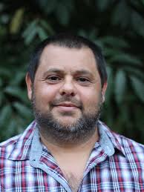
Christopher Matthews
Is a Noonuccal (or Nunukal) man from the Moreton Bay area near Brisbane.
He has a PhD in applied mathematics.
Recently he has been developing strategies for engaging indigenous students in maths through culturally relevant pedagogies.
Notes:
Recently won the Indigenous STEM Professional Award for his innovative work engaging Indigenous students in science and maths. (https://tinyurl.com/y9epohx2).

Slide 11
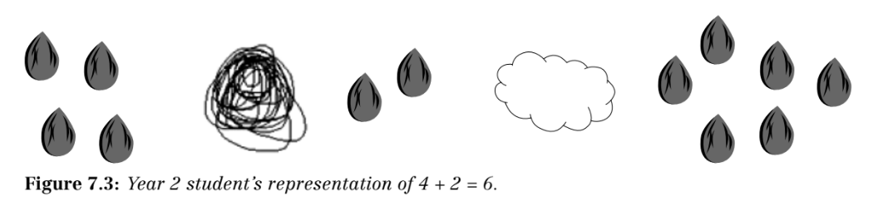
Mathematics through Storytelling and Dance
--- Matthews (2007)

Slide 12
The Role of Language
Maths is often described as a language.
I would say maths has its own language used to describe it, and a large component of learning maths is learning the meaning of words used to describe it.
If English is not a students first language, it is key to discuss terms and concepts across multiple languages in order to compare and contrast their meaning.
Such discussions also offer a critical opportunity to uncover cultural differences. Even if teacher and student share linguistic backgrounds, if they differ in cultural backgrounds the meaning of words can differ.
Notes:
http://zompist.com/amercult.html

Slide 13
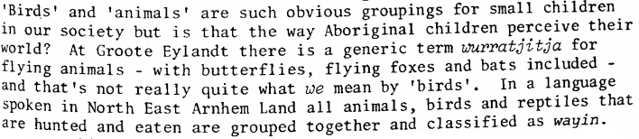
Culture Differences Reflected in Language
--- Excerpt from Graham (1982)
Notes:
People often assume counting is a fundamental concept in maths, but even more fundamental is the concept of categorisation, which is taught from early childhood. In order to answer “How many birds are in this picture?” often first requires an answer to “Is an emu a bird?” etc. This is mathematical thinking, but it is important to realise how deep the cultural differences go.
For more on culture differences:
http://zompist.com/amercult.html

Slide 14
History… and Change?
Indigenous disadvantage in maths education has been discussed in the literature since the 1980’s.
The principles to be followed in terms of addressing this issue have been clearly and consistently laid out as far back as Wilson (1979).
Examples of these principles being put into practice are given since the 90s (see the work of Robinson (1998) and Bucknell (1995) for example, or Matthews (2012) more recently).
Yet, it is still not common practice. Why?

Slide 15
Conclusions
Ultimately I think that taking into account a culture that is not your owns perspective is a very challenging thing to do, and the most important thing is to encourage greater diversity amongst maths teachers.
Failing that however, I think the key things we can do is:
Relationship building supported by cultural competency,
Set high expectations, of both students and teachers.
Engage in collaborative discourse to negotiate terms and meaning.
Set the learning in a culturally relevant context.

Slide 16
References
AIATSIS (https://aiatsis.gov.au/collections/collections-online/digitised-collections/ethnomathematics-australia/contents)
Bishop, A. J. (1988). Mathematics education in its cultural context. Educational studies in mathematics, 19(2), 179-191.
Bucknall, G. (1995). Building bridges between Aboriginal and Western mathematics. The Australian Journal of Indigenous Education, 23(1), 22-31.
Closing the Gap (https://closingthegap.pmc.gov.au/education)
Graham, B. (1982). Can we count on maths?. The Australian Journal of Indigenous Education, 10(2), 4-10.
Howard, P. (1995). Listening to what people have to say about mathematics: Primary mathematics and the thoughts of one Murri student. The Australian Journal of Indigenous Education, 23(2), 1-8.
Matthews, C., Watego, L. A., Cooper, T. J., & Baturo, A. R. (2005). Does mathematics education in Australia devalue Indigenous culture? Indigenous perspectives and non-Indigenous reflections. MERGA.
Matthews, C., Cooper, T. J., & Baturo, A. R. (2007). Creating your own symbols: Beginning algebraic thinking with Indigenous students.

Slide 17
References
Matthews, C. (2012). Maths as storytelling: Maths is beautiful. Aboriginal and Torres Strait Islander education: An introduction for the teaching profession, 94-112.
Morris, C., & Matthews, C. (2011). Numeracy, mathematics and Indigenous learners: Not the same old thing. Indigenous Education: Pathways to Success, 29-33.
Patrick-Rolf, M. (1990). Creating a Good Maths Learning Environment. Aboriginal Child at School, 18(5), 15.
Robinson, J. A., & Nichol, R. M. (1998). Building Bridges between Aboriginal and Western Mathematics: Creating an Effective Mathematics Learning Environment. Education in Rural Australia, 8(2), 9-17.
Rowlands, S., & Carson, R. (2002). Where would formal, academic mathematics stand in a curriculum informed by ethnomathematics? A critical review of ethnomathematics. Educational Studies in Mathematics, 50(1), 79-102.
Stronger Smarter Institute (https://strongersmarter.com.au/)
Wilson, R. (1979). Mathematics Programs for Indigenous Students: Some Guidelines. The Australian Journal of Indigenous Education, 7(5), 33-47.

Slide 18
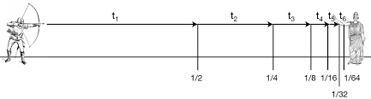
Zeno’s Paradoxes (~450 BC)
Reasoning is not fixed or absolute. We modify our reasoning to match our reality. We make observations of the world around us and let those observations guide our reasoning.
Notes:
An example of this process in action.

Slide 19
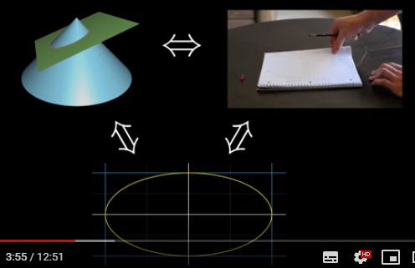
Different Perspectives
Can be incredibly powerful mathematical tools.
https://youtu.be/pQa_tWZmlGs

