Slide 1
UniSA MS Group at FII – Mission, Vision and Values
5th May 2017

Slide 2
Summary
MM Building
PURPOSE:
As a group, to define objectives, standards and expectations that anyone who works in the group (staff, students, visiting collaborators etc.) adheres to
This is the first interactive meeting to define expectations and align processes (GLP, GSP, work behaviour, alignment with University and Future Industries Institute [FII] expectations) for the MS group here at FII
Outline of today’s presentation:
Structure for 2017
Mission Statement
Vision Statement
Core values
X Building

Slide 3
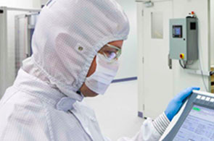
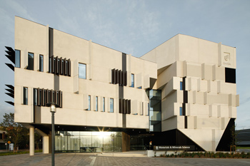
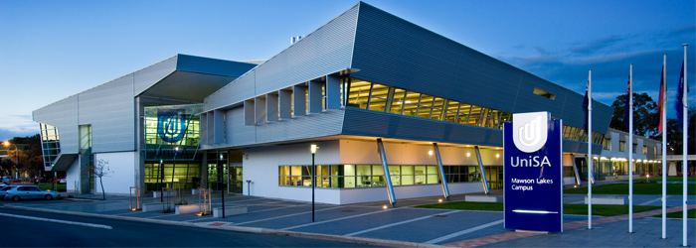
Future Industries Institute (FII)
MM Building
UniSA’s largest investment in research > 200 research staff and students > $70M research infrastructure
The mission of FII is the creation of new industries through discovery and collaboration:
“to transform the industries of today by supporting them to embrace the disruptive technologies that will create the industries of the future”
V Building

Slide 4
MS group at FII: Core principles
MM Building
Hedgehog Concept:
simple, crystalline concept that flows from deep understanding about the intersection of the following three circles
It is an understanding of what you can be the best at
Greek Poet Archilochus: "a fox knows many things, but a hedgehog one important thing"
What do we want to be the best in the world at?
what you cannot be the best in the world at?
1.) WHAT DRIVES US?
Every company—no matter the size, industry, product, or audience—has the ability to become a hedgehog among foxes. The key is focus.
2.) UNIQUE STRENGTHS?
3.) CURRENT KNOWN ECONOMIC POTENTIAL
X Building
What gives us the greatest source of success (financial/ research etc.)?
What are our weaknesses?
JIM COLLINS: Good to Great: http://www.jimcollins.com/books.html

Slide 5




MS at FII: Mission Statement: What and Who?
MM Building
Definition: “A mission statement is a short statement of an organization's purpose, identifying the scope of its operations: what kind of product or service it provides, its primary customers or market, and its geographical region of operation.”
“Google's mission is to organize the world's information and make it universally accessible and useful.”
BRING INSPIRATION AND
INNOVATION TO EVERY
ATHLETE* IN THE WORLD
*IF YOU HAVE A BODY, YOU ARE AN ATHLETE.
"Apple designs Macs, the best personal computers in the world, along with OS X, iLife, iWork and professional software. Apple leads the digital music revolution with its iPods and iTunes online store.
“UniSA educates professionals and citizens to the highest standards; creates and disseminates knowledge; and engages with our communities to address the major issues of our time.”

Slide 6
MS at FII: Vision Statement: Why and how?
MM Building
Definition: “A mission statement is intended to clarify the 'what' and 'who' of a company, while a vision statement adds the 'why' and 'how' as well. As a company grows, its objectives and goals may change. Therefore, vision statements should be revised as needed to reflect the changing business culture as goals are met.”
“to provide access to the world’s information in one click.”
“We believe that we are on the face of the earth to make great products and that’s not changing. We are constantly focusing on innovating. We believe in the simple not the complex. We believe that we need to own and control the primary technologies behind the products that we make, and participate only in markets where we can make a significant contribution. We believe in saying no to thousands of projects, so that we can really focus on the few that are truly important and meaningful to us. We believe in deep collaboration and cross-pollination of our groups, which allow us to innovate in a way that others cannot. And frankly, we don’t settle for anything less than excellence in every group in the company, and we have the self- honesty to admit when we’re wrong and the courage to change. And I think regardless of who is in what job those values are so embedded in this company that Apple will do extremely well.”
“to help NIKE, Inc. and our consumers thrive in a sustainable economy where people, profit and planet are in balance.”
“UniSA will be a leading contributor to Australia having the best higher education system in the world, supporting the world’s best educated and most innovative, cohesive and sustainable society.”

Slide 7
UniSA Values?
MM Building
UniSA defines values that every affiliated employee should aspire to achieve:
Scholarship
UniSA promotes and sustains open intellectual enquiry characterised by high standards of ethics and integrity. academic rigour, excellence and relevance underpin our actions in research and its application, in teaching and learning and in engagement with our communities.
Engagement
UniSA’s teaching and research connect strongly with the issues of our local, national and international stakeholders—students, alumni, staff, partners, professions, government, industry, academic peers and community groups.
Social Justice
UniSA gives effect to reconciliation with indigenous Australians and builds social cohesion by achieving equitable educational access and outcomes across our diverse student community, through research that aims to improve the quality of life and by acting responsibly as a corporate citizen.
Sustainability
UniSA contributes to environmentally, economically, socially and culturally sustainable development, and we work on reducing our own environmental impact.
Innovation
UniSA anticipates change and acts quickly to seize opportunities and solve problems.
Openness
UniSA is outward looking, welcoming diversity and the wide range of perspectives it brings, international in outlook, collaborative, creative, agile and enterprising.

Slide 8
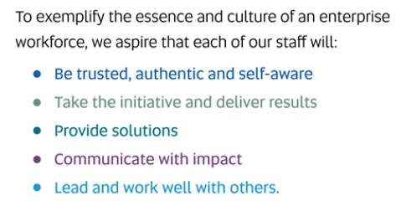
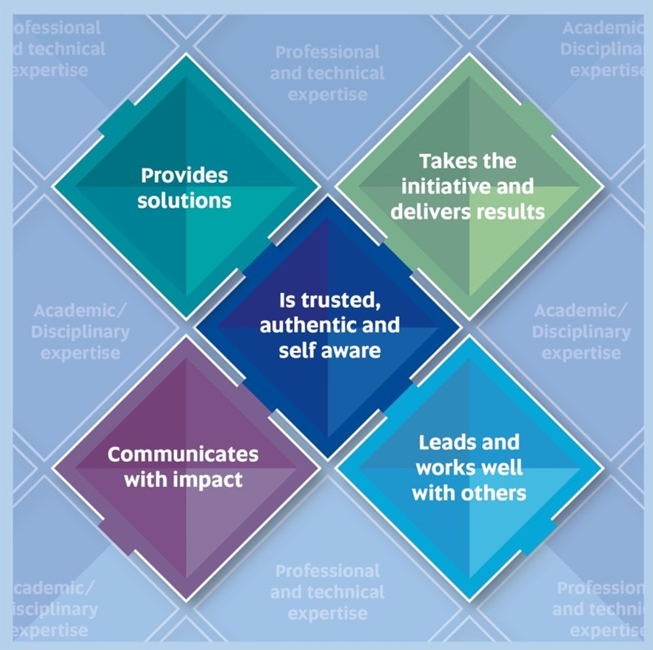
UniSA Core Attributes?
MM Building
http://w3.unisa.edu.au/staffdev/resources/core_attributes.asp

Slide 9
UniSA MS Group at FII – Mission, Vision and Values
Interactive Session!!
Mark Condina, 5th May 2017

Slide 10
MS group at FII: Core principles
MM Building
Being able to link/bridge different paradigms/languages/fields/disciplines/contexts
We should be the best at addressing the challenges at our time for MS
The role model/leaders/pioneers in rigorous reporting and interpretation of experimental analyses/workflows/processes
Influencing other groups to aspire to do the same
Defining practical implementation
A constant refinement of this principle
Providing platform/structure/ to ensure any person coming into the lab/group will be taught to get “up-to-standard”
Willingness to learn
Willingness to teach
Time management/stage-gate
Work/life balance
A culture that rewards challenge (e.g. recognising problems/errors/improvements etc.)
A drive to take our current weaknesses and make them our strengths
What do we want to be the best in the world at?
what you cannot be the best in the world at?
1.) WHAT DRIVES US?
X Building

Slide 11
MS group at FII: Core principles
MM Building
STRENGTHS:
Enthusiasm
Robustness and consistency, integrity
Australian code for responsible conduct of research
Access to FII accelerator grants
MS Imaging
MALDI Biotyper
MALDI-TOF/TOF Expertise
Hardware access
New group – opportunity to create a culture that aligns with our values
Modern approach – openness
Paper folding
Weaknesses:
Small group: FTE (limited in resources)
Hardware access (2x MALDI-TOF, 1x QqQ, shared 2x Qq-TOF)
New group – time required for lab/process setup
Enthusiasm: capacity limitations, time management
Learning to say no (knowing capacity)
Work/life balance
2.) UNIQUE STRENGTHS?
X Building
What are our weaknesses?

Slide 12
MS at FII: Mission Statement: What and Who?
MM Building
Definition: “A mission statement is a short statement of an organization's purpose, identifying the scope of its operations: what kind of product or service it provides, its primary customers or market, and its geographical region of operation.”
MS at FII Mission:

Slide 13
MS at FII: Vision Statement: Why and how?
MM Building
Definition: “A mission statement is intended to clarify the 'what' and 'who' of a company, while a vision statement adds the 'why' and 'how' as well. As a company grows, its objectives and goals may change. Therefore, vision statements should be revised as needed to reflect the changing business culture as goals are met.”
MS at Fii Vision:

Slide 14

MS at FII: Core Values/Attributes?
MM Building
MS group at FII Values should align with the University’s as best as possible but cover all important aspects of our day-today operations:
Integrity
We adhere to best practices in accordance to the Australian code for responsible conduct of research.
Collaboration
XXX.
Social Justice
XXX.
Sustainability
XXX.
Innovation
XXX.
Openness
XXX.

