Slide 1


Slide 2
UniSA MS Group at FII – Mission, Vision and Values
5th May 2017

Slide 3
Summary
MM Building
PURPOSE:
As a group, to define objectives, standards and expectations that anyone who works in the group (staff, students, visiting collaborators etc.) adheres to
This is the first interactive meeting to define expectations and align processes (GLP, GSP, work behaviour, alignment with University and Future Industries Institute [FII] expectations) for the MS group here at FII
Outline of today’s presentation:
Structure for 2017
Mission Statement
Vision Statement
Core values
X Building

Slide 4
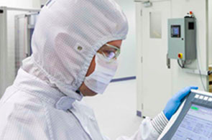
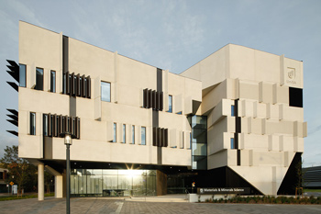
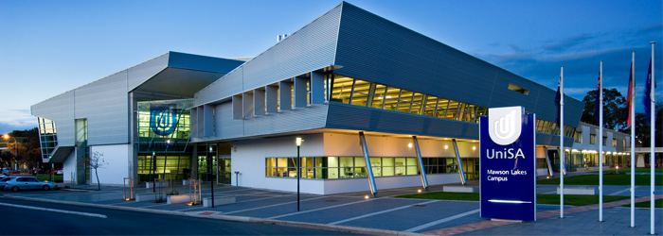
Future Industries Institute (FII)
MM Building
UniSA’s largest investment in research > 200 research staff and students > $70M research infrastructure
The mission of FII is the creation of new industries through discovery and collaboration:
“to transform the industries of today by supporting them to embrace the disruptive technologies that will create the industries of the future”
V Building

Slide 5
FIA:
MM Building
FIA will deliver an innovative model for effective and sustainable research collaboration between universities and business that will
Create jobs and drive economic growth within South Australia
Use academic expertise and research infrastructure to address challenges faced by industry partners
Build research and development capacity in business
Develop entrepreneurial and business capacity in university researchers
Enable co-creation, co-location and sharing of resources between business and the University
Be implemented at a sufficient scale that long-term cultural change is achieved
Notes:
FIA is a $7.5 million investment from the South Australian State Government, which provides a mechanism to drive the transformation of your business through access to infrastructure, research and development funding, and annual mobility grants.

Slide 6

FIA Infrastructure Access Scheme
Open for business now
Companies can access equipment, laboratory space and research infrastructure valued at over $60 million
No direct cost to industry
Access includes advice, training and analysis from dedicated technical staff

Slide 7

FIA R&D Voucher Scheme
Open for business now
Funding of up to $100,000 for projects up to 12 months duration
To address priority industry challenges and/or rapidly develop and test potential product ideas or enhancements
Prioritising benefits and impact for industry and South Australia

Slide 8

FIA Mobility Scheme
Open for business mid-year 2017
Funding placements for up to 12 months
Researchers to work within business, or industry partners to work within FII
Facilitating the transfer of expertise, training and skills

Slide 9
MS group at FII Structure: 2017
Benjamin Thierry
Professor in Bioengineering
Peter Hoffmann
Strand Leader BENM, Lloyd Sansom Chair
Johan Gustafsson
Research Associate (Mass Spectrometry)
Mark Condina
Senior Research Fellow
Silvana Napoli
RA
Lyron Winderbaum
Post-Doc
Post-Doc (TBD)
Adelaide University Students
Matt Briggs
Mitchell Acland
Parul Mittal
Noor Alia Lokman
Angelina Sarris
Student – work experience
Brooke Dilmetz
Honours Student, Part-time
Notes:
Yin Yin Ho and Georgia Arentz still with Adelaide University- Georgia on Maternity Leave

Slide 10
MS group at FII: Core principles
MM Building
Hedgehog Concept:
simple, crystalline concept that flows from deep understanding about the intersection of the following three circles
It is an understanding of what you can be the best at
Greek Poet Archilochus: "a fox knows many things, but a hedgehog one important thing"
What do we want to be the best in the world at?
what you cannot be the best in the world at?
1.) WHAT DRIVES US?
Every company—no matter the size, industry, product, or audience—has the ability to become a hedgehog among foxes. The key is focus.
2.) UNIQUE STRENGTHS?
3.) CURRENT KNOWN ECONOMIC POTENTIAL
X Building
What gives us the greatest source of success (financial/ research etc.)?
What are our weaknesses?
JIM COLLINS: Good to Great: http://www.jimcollins.com/books.html

Slide 11




MS at FII: Mission Statement: What and Who?
MM Building
Definition: “A mission statement is a short statement of an organization's purpose, identifying the scope of its operations: what kind of product or service it provides, its primary customers or market, and its geographical region of operation.”
“Google's mission is to organize the world's information and make it universally accessible and useful.”
BRING INSPIRATION AND
INNOVATION TO EVERY
ATHLETE* IN THE WORLD
*IF YOU HAVE A BODY, YOU ARE AN ATHLETE.
"Apple designs Macs, the best personal computers in the world, along with OS X, iLife, iWork and professional software. Apple leads the digital music revolution with its iPods and iTunes online store.
“UniSA educates professionals and citizens to the highest standards; creates and disseminates knowledge; and engages with our communities to address the major issues of our time.”

Slide 12
MS at FII: Vision Statement: Why and how?
MM Building
Definition: “A mission statement is intended to clarify the 'what' and 'who' of a company, while a vision statement adds the 'why' and 'how' as well. As a company grows, its objectives and goals may change. Therefore, vision statements should be revised as needed to reflect the changing business culture as goals are met.”
“to provide access to the world’s information in one click.”
“We believe that we are on the face of the earth to make great products and that’s not changing. We are constantly focusing on innovating. We believe in the simple not the complex. We believe that we need to own and control the primary technologies behind the products that we make, and participate only in markets where we can make a significant contribution. We believe in saying no to thousands of projects, so that we can really focus on the few that are truly important and meaningful to us. We believe in deep collaboration and cross-pollination of our groups, which allow us to innovate in a way that others cannot. And frankly, we don’t settle for anything less than excellence in every group in the company, and we have the self- honesty to admit when we’re wrong and the courage to change. And I think regardless of who is in what job those values are so embedded in this company that Apple will do extremely well.”
“to help NIKE, Inc. and our consumers thrive in a sustainable economy where people, profit and planet are in balance.”
“UniSA will be a leading contributor to Australia having the best higher education system in the world, supporting the world’s best educated and most innovative, cohesive and sustainable society.”

Slide 13
UniSA Values?
MM Building
UniSA defines values that every affiliated employee should aspire to achieve:
Scholarship
UniSA promotes and sustains open intellectual enquiry characterised by high standards of ethics and integrity. academic rigour, excellence and relevance underpin our actions in research and its application, in teaching and learning and in engagement with our communities.
Engagement
UniSA’s teaching and research connect strongly with the issues of our local, national and international stakeholders—students, alumni, staff, partners, professions, government, industry, academic peers and community groups.
Social Justice
UniSA gives effect to reconciliation with indigenous Australians and builds social cohesion by achieving equitable educational access and outcomes across our diverse student community, through research that aims to improve the quality of life and by acting responsibly as a corporate citizen.
Sustainability
UniSA contributes to environmentally, economically, socially and culturally sustainable development, and we work on reducing our own environmental impact.
Innovation
UniSA anticipates change and acts quickly to seize opportunities and solve problems.
Openness
UniSA is outward looking, welcoming diversity and the wide range of perspectives it brings, international in outlook, collaborative, creative, agile and enterprising.

Slide 14
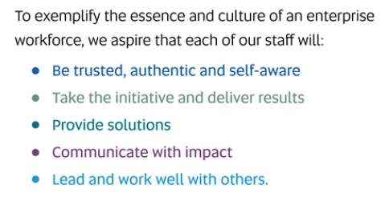
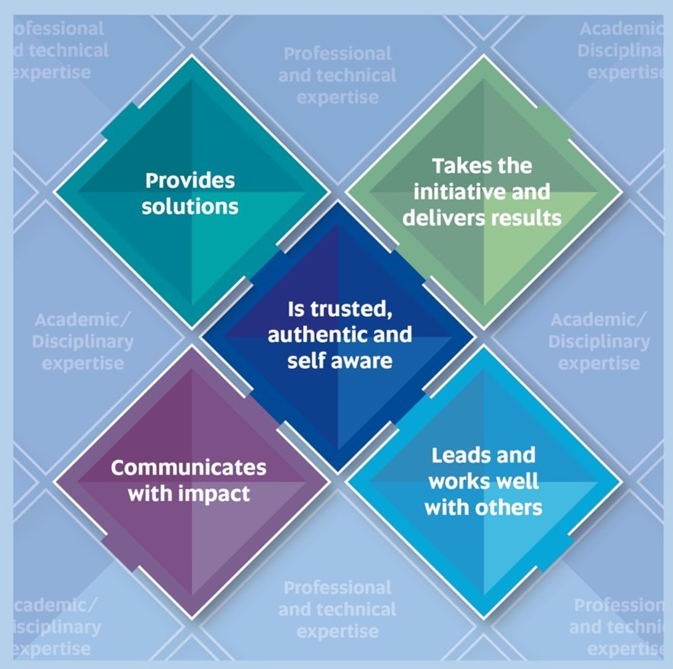
UniSA Core Attributes?
MM Building
http://w3.unisa.edu.au/staffdev/resources/core_attributes.asp

Slide 15
UniSA MS Group at FII – Mission, Vision and Values
Interactive Session!!
Mark Condina, 5th May 2017

Slide 16
MS group at FII: Core principles
MM Building
Being able to link/bridge different paradigms/languages/fields/disciplines/contexts
We should be the best at addressing the challenges at our time for MS
The role model/leaders/pioneers in rigorous reporting and interpretation of experimental analyses/workflows/processes
Influencing other groups to aspire to do the same
Defining practical implementation
A constant refinement of this principle
Providing platform/structure/ to ensure any person coming into the lab/group will be taught to get “up-to-standard”
Willingness to learn
Willingness to teach
A culture that rewards challenge (e.g. recognising problems/errors/improvements etc.)
A drive to take our current weaknesses and make them our strengths
What do we want to be the best in the world at?
what you cannot be the best in the world at?
1.) WHAT DRIVES US?
X Building

Slide 17
MS group at FII: Core principles
MM Building
STRENGTHS:
Enthusiasm
MS Imaging
Weaknesses:
2.) UNIQUE STRENGTHS?
X Building
What are our weaknesses?

Slide 18
MS at FII: Mission Statement: What and Who?
MM Building
Definition: “A mission statement is a short statement of an organization's purpose, identifying the scope of its operations: what kind of product or service it provides, its primary customers or market, and its geographical region of operation.”
MS at FII Mission:

Slide 19
MS at FII: Vision Statement: Why and how?
MM Building
Definition: “A mission statement is intended to clarify the 'what' and 'who' of a company, while a vision statement adds the 'why' and 'how' as well. As a company grows, its objectives and goals may change. Therefore, vision statements should be revised as needed to reflect the changing business culture as goals are met.”
MS at Fii Vision:

Slide 20

MS at FII: Core Values/Attributes?
MM Building
MS group at FII Values should align with the University’s as best as possible but cover all important aspects of our day-today operations:
Scholarship
XXX.
Engagement
XXX.
Social Justice
XXX.
Sustainability
XXX.
Innovation
XXX.
Openness
XXX.

Slide 22
MS at FII: Resources
MM Building
MS group Resources:
Project Definition Template:

