Slide 1

Project Title Medical Store-Distributor-Consumer Network
Proposal and Feasibility Presentation Template
Abdulla Iqbal FA17-BSE-030
Armaghan Hassan FA17-BSE-045
Majid Durani FA17-BSE-021
Supervisor: Sir Kashif Nasir
Department of Computer Science
COMSATS University Islamabad, Abbottabad Campus

Slide 2
Agenda of the Presentation

Slide 3
Motivation
To develop an interactive Website, which will enable both companies and retailers to manage their stock and to get rid of medicine shortage problem. It will make it easier for them to perform to keep track of their inventory and will maintain the data of their buying and selling. This method is all on paper we are digitalizing this all.

Slide 4
Brief Introduction
The (MSDCN) is a medicine stock inventory system which will be used in medical store and Pharmaceutical companies. This website will stores detail of medicine purchase and selling stock. The system will maintain parchare and selling detail w.r.t customer and company. The system will consist of automatic billing and reporting module. Furthermore the website will also help the shopkeeper to automatically place the order if the stock is short from the shop and will be able to track his shipment.

Slide 5
Scope
“What to do” and explicitly mention “what not to do”

Slide 6
Functionalities
Company and Retailer should get register.
Retailer should be able to see his inventory.
Retailer should be able to generate bills for every sale.
Retailer should be able to see reports for his daily, weakly and monthly sale.
Retailer should be able to place order manually to the companies.
If there are few medicine left in the inventory system should automatically place order the previous delivered order company of that medicine.
Retailer should be able to see previous records of buying and selling
Companies should be able to receive order from the shops.

Slide 7
Proposed Tools/Platform
Visual Studio Code
Android Studio
Star UML
MS Visio 2013
LARAVEL Framework

Slide 8
Feasibility
Technical feasibility

Slide 9
Feasibility
Financial feasibility
The tools which we will be using are free and of no cost hence no financial feasibility is present.

Slide 10
Feasibility
Resource feasibility
Human resources Such as Team members and useable equipment (Laptops and Mobile phones) are available for the project.

Slide 11
Feasibility
Operational feasibility
Website and App developed will be officially released and no ethical problems will occur during development, human recourses will be available after the system has been installed.

Slide 12
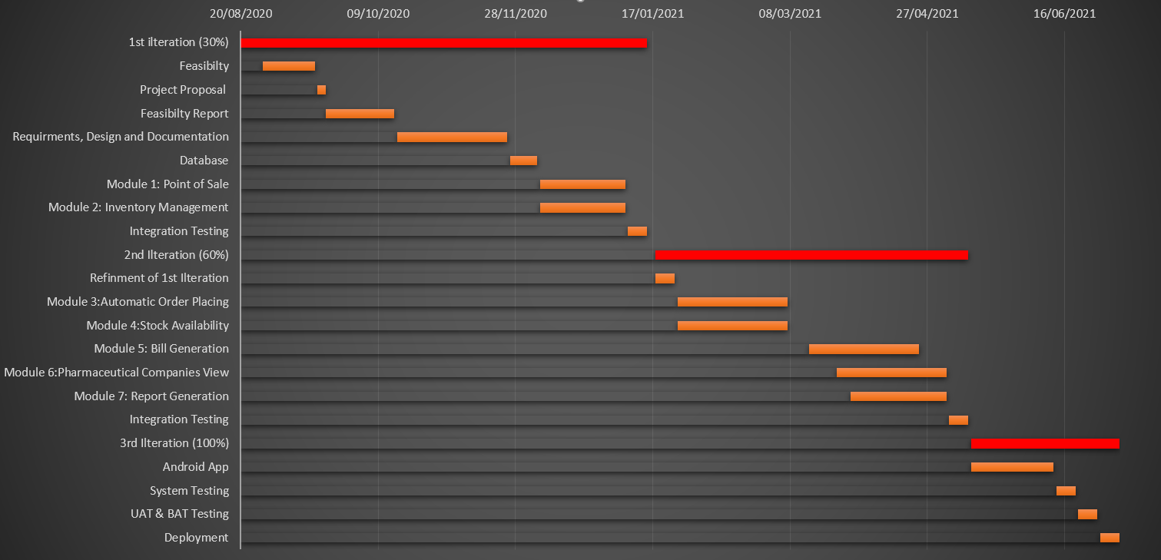
Schedule

Slide 13
Tasks for 1st Iteration (or 30%)
SRS
SDS
Back end logic of at lest Two modules.
Database

Slide 14
Conclusion

