Slide 1
Leveraging student demographic data
Armaly albert & Brett Gammon

Slide 2
Goals
Identification of relevant demographic and personal factors that best relate to a student’s performance in two disciplines, language and math
Understand if these factors differ across disciplines
Data source
Paulo Cortez, University of Minho

Slide 3
Factors considered
famSize | Family Size – Binary, Less or Equal to 3, Greater than 3
Pstatus | Parent’s cohabitation status -- Binary, Together or Apart
Medu | Mother’s Education, 5 categories ranging from none to higher ed degree
Fedu | Father’s Education, 5 categories ranging from none to higher ed degree
Mjob | Mother’s Job – Categorical
FJob | Father’s Job – Categorical
travelTime | Daily Home to School Travel Time – Categorical
studyTime | Weekly Study Time – Categorical
failures | Number of past class failures
schoolSup | Extra Educational Support provided by School – Binary
famSup | Family Educational Support – Binary
freeTime | Free Time after school – Categorical
goOut | Time spent going out with friends – Categorical
Absences | Number of school absences – numeric
G1, G2, G3, gTOT | All 3 course grades, and Total of all 3 course grades, combined

Slide 4
Tableau comparisons

Slide 5
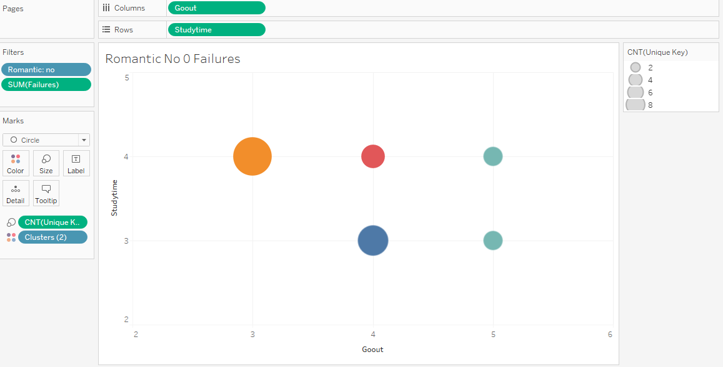

Slide 6
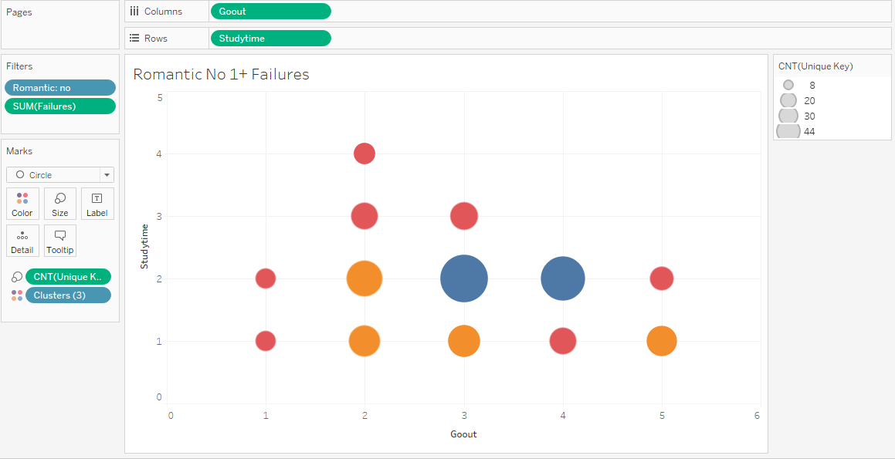

Slide 7
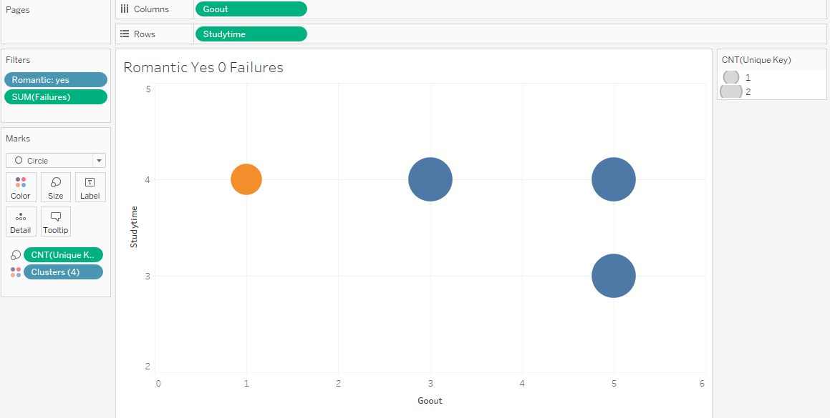

Slide 8
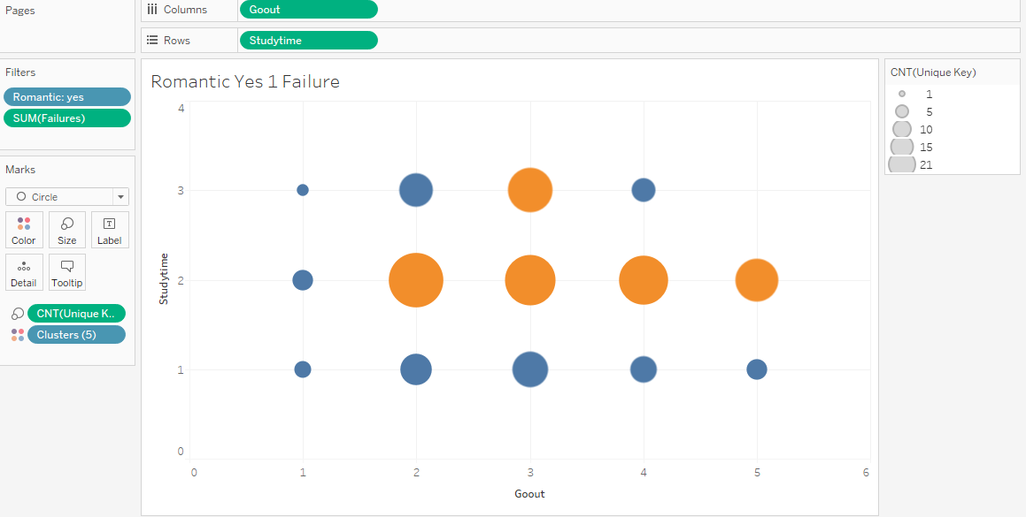

Slide 9
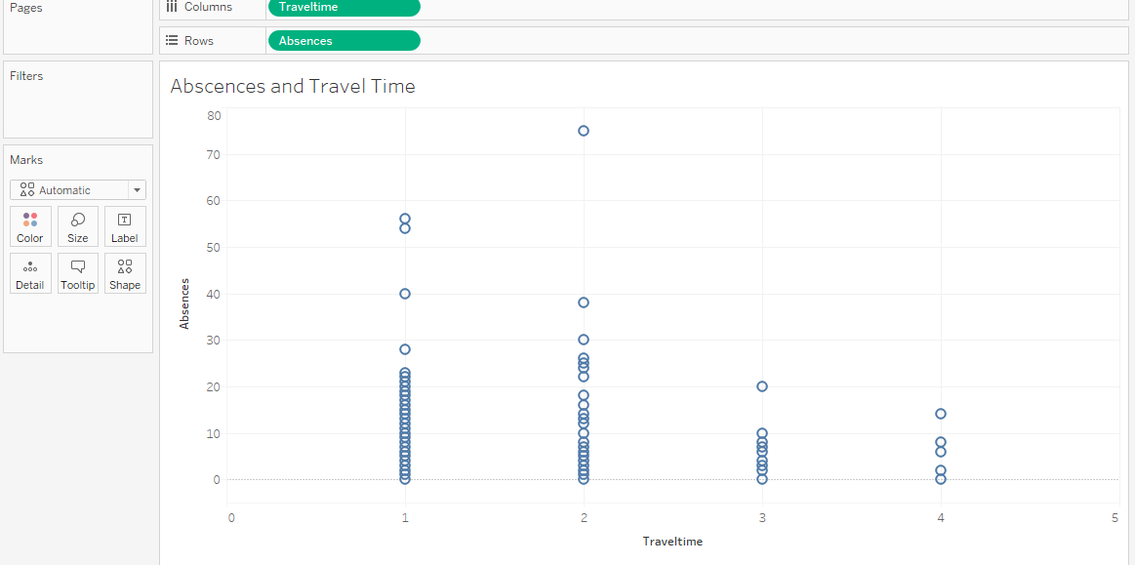

Slide 10
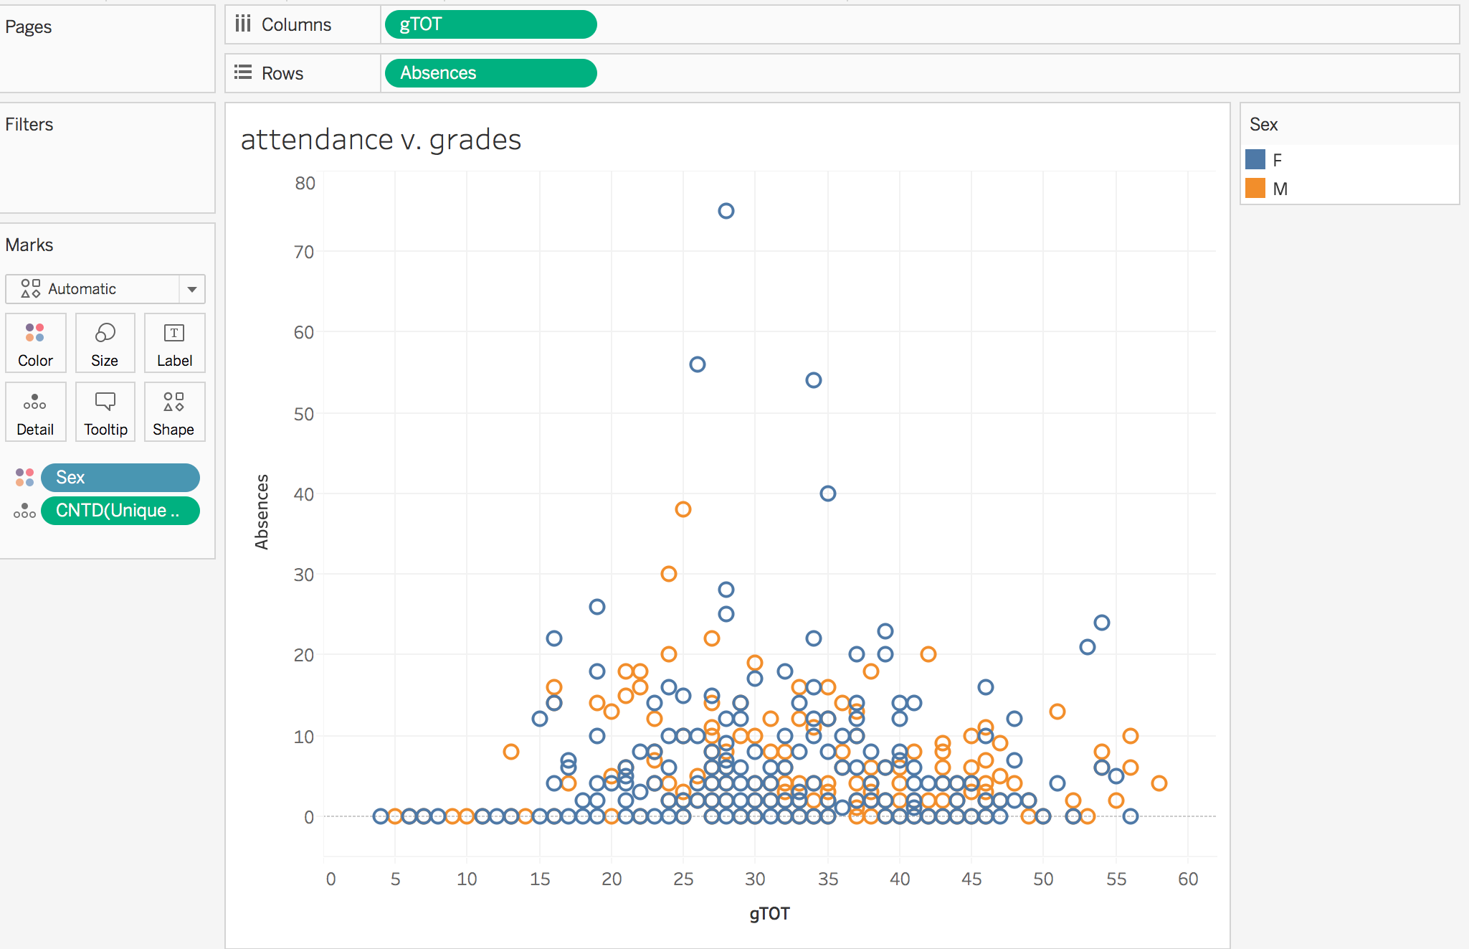

Slide 11
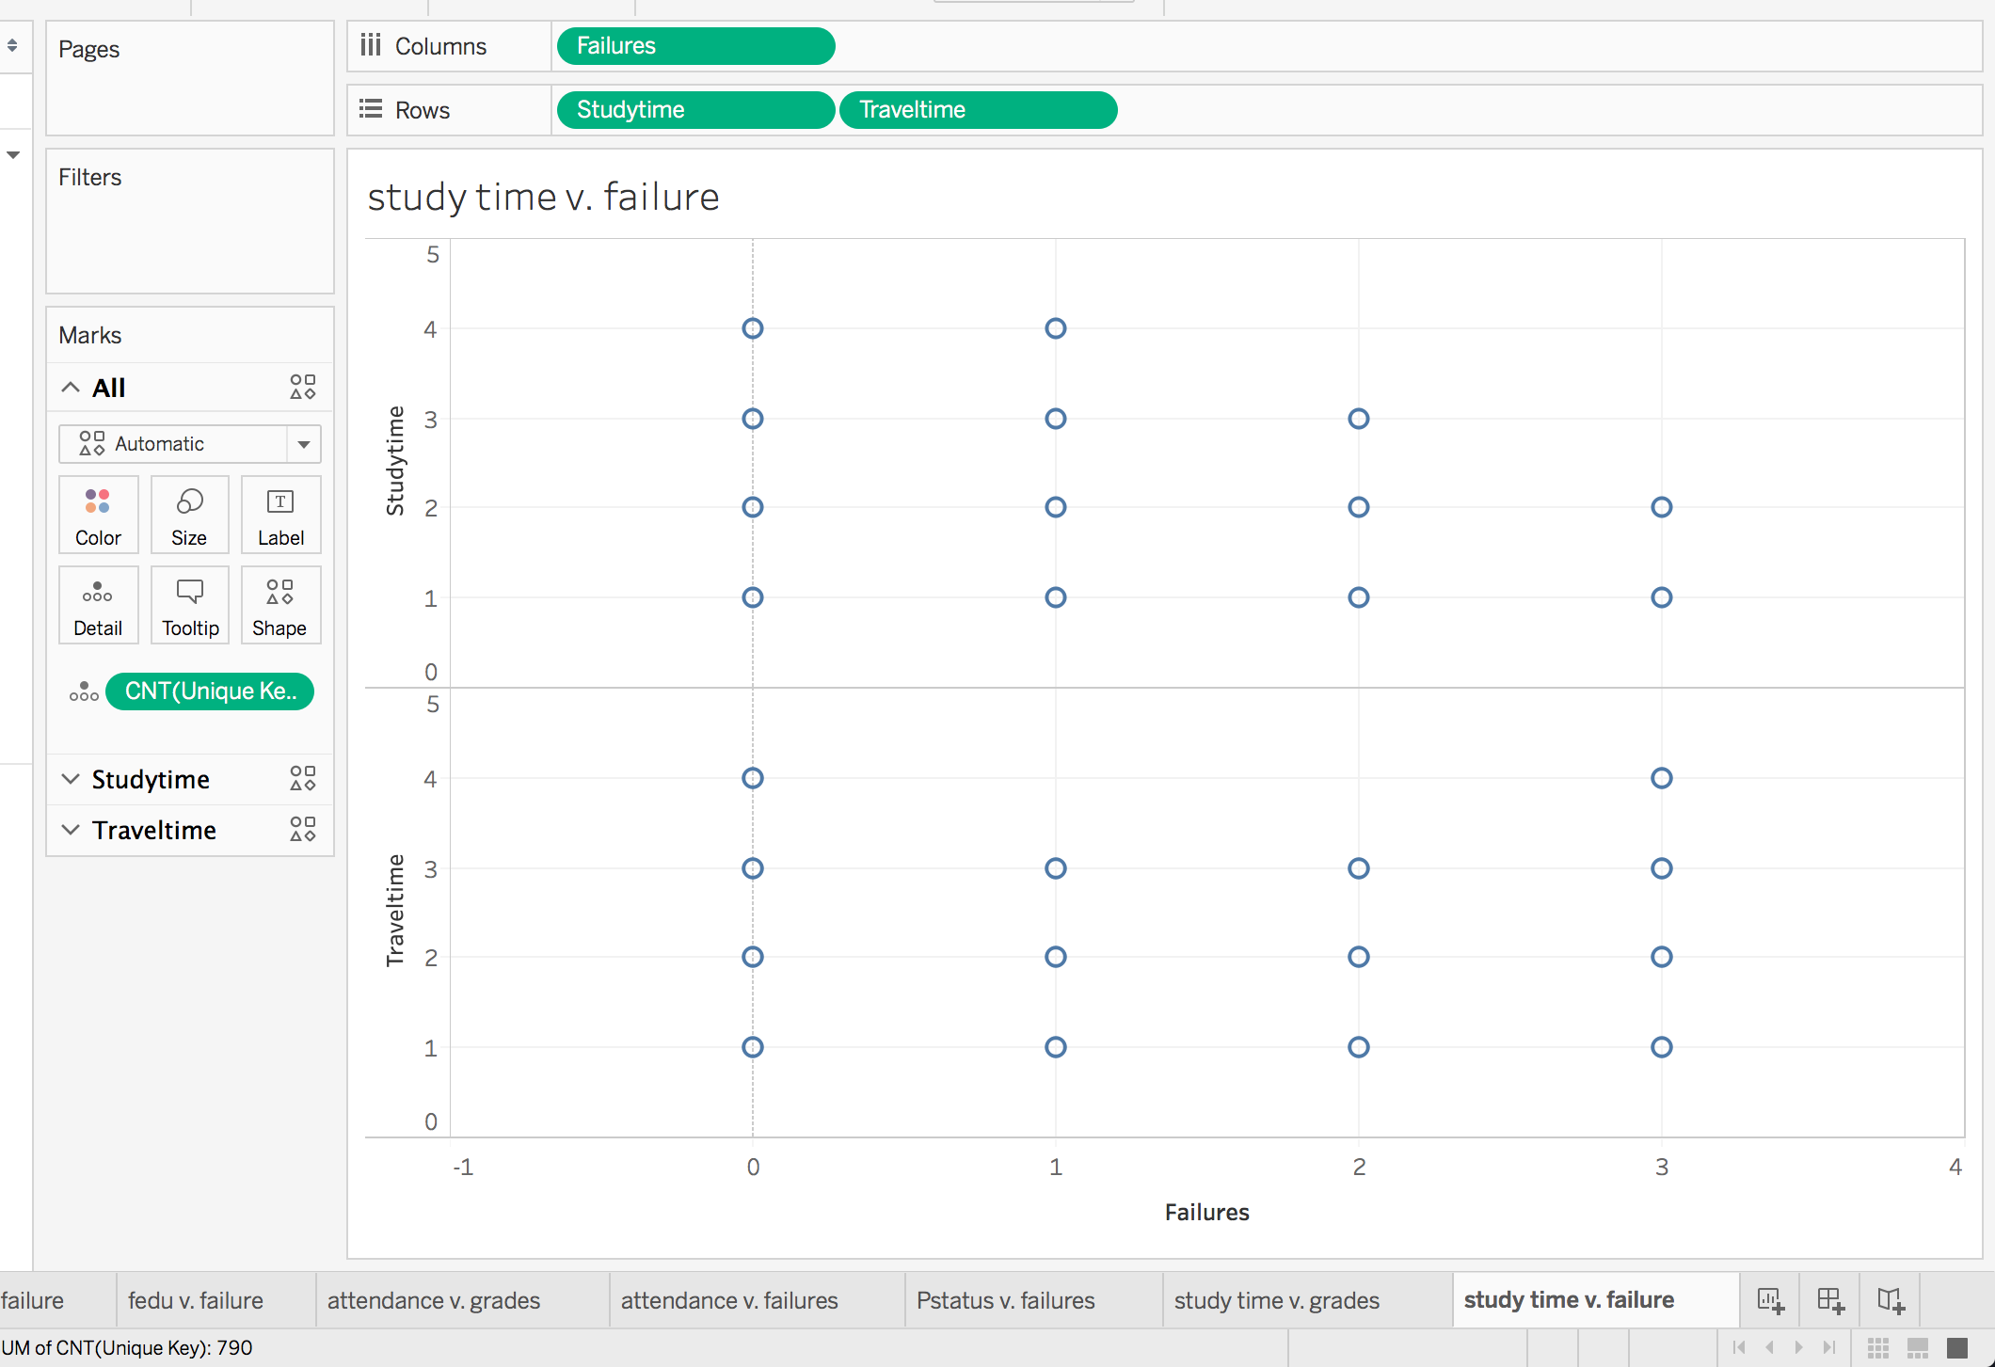

Slide 12
rstudio
The goal of using rStudio was to identify most important factors in a students success by clustering like students together
Ethical questions that came about

Slide 13
