Slide 1
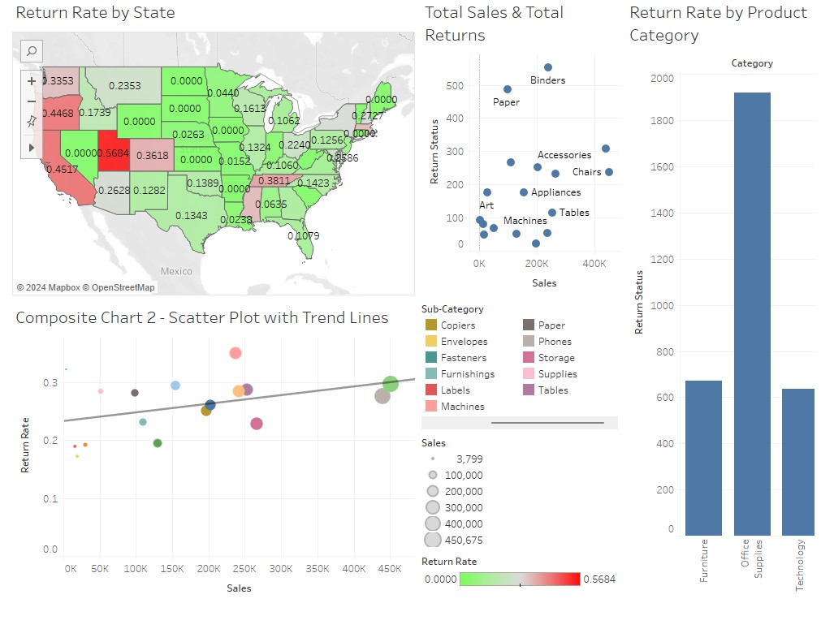
Introduction
The goal of this project is to understand the reason for returns and provide insights on volume of returned orders.
We will focus on return rate, total returns, and potential causes using various measures.

Slide 2
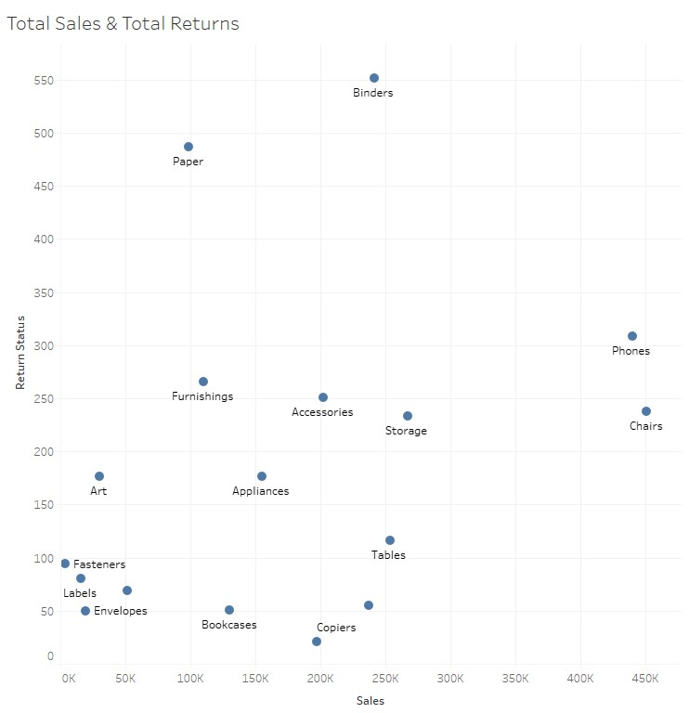
Measuring Returns
Here we can view return rates for each item with regards to their total sales. This view allows us to understand the proportions of returned items through the direct count of returns.

Slide 3
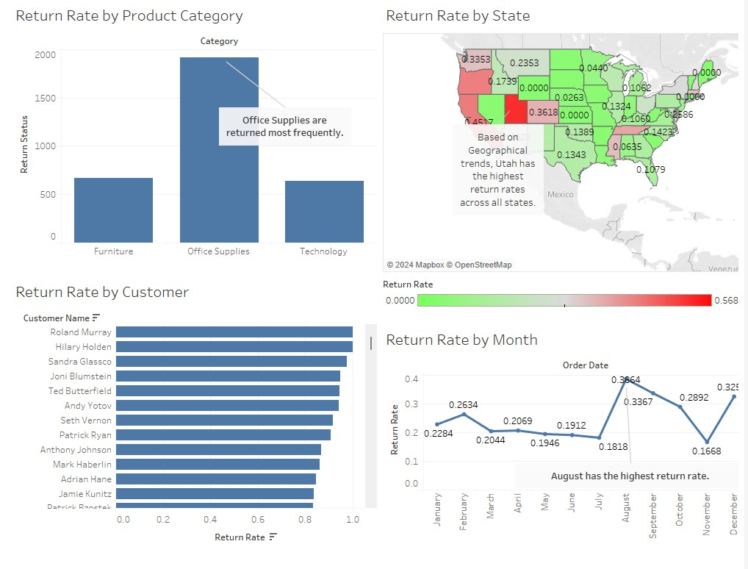
Root Causes of Returns
These views will allow you to assess return rates based on different categories, geographical trends, customer behaviors, and seasonal patterns.

Slide 4
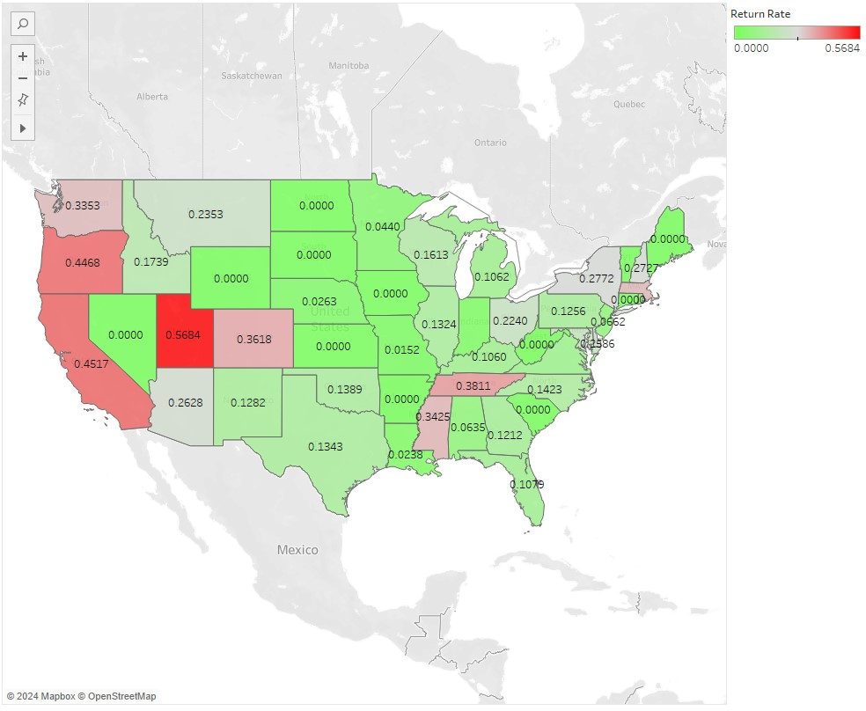
Geographical Trends
The west coast returns items much more frequently than the Midwest and east coast.

Slide 5
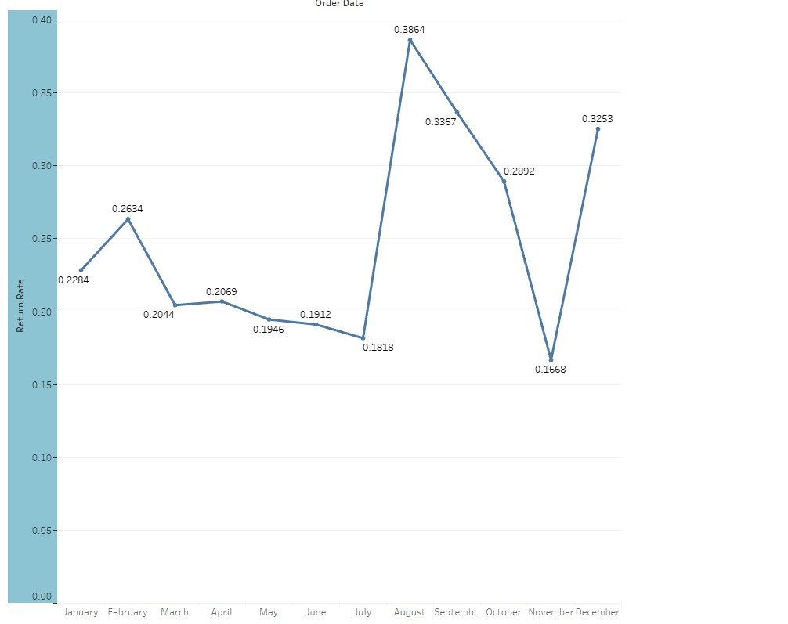
Seasonal Trends
Products are returned more frequently during the fall than any other season. They take a slight dip in November, but the return rates rise again during the holiday season.

Slide 6
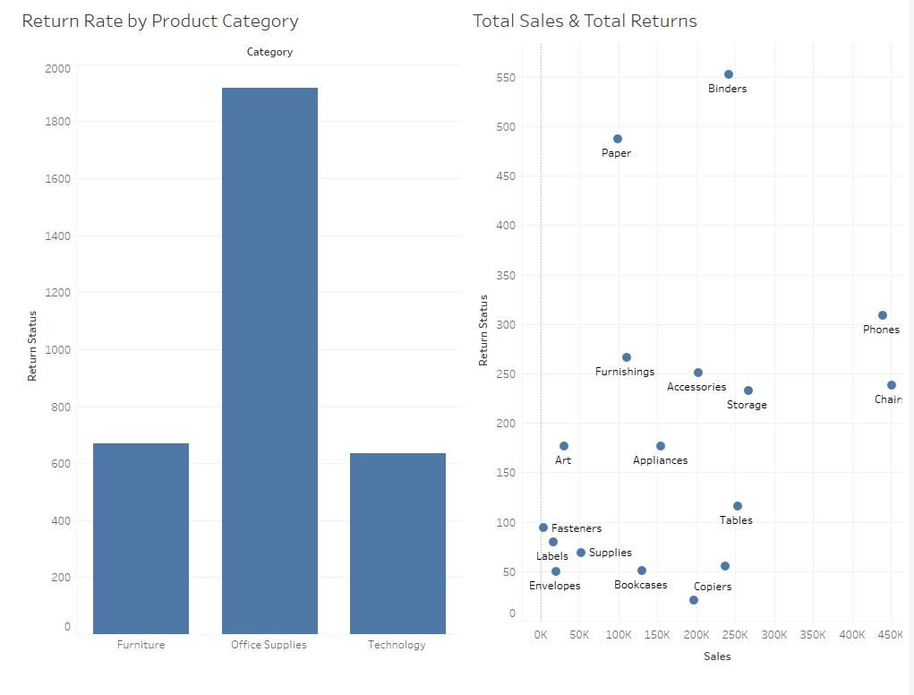
Categorical Trends
Office Supplies are the most returned items amongst the three product categories. We can see a breakdown by specific items in this viewpoint.

Slide 7
Conclusion
Products are most frequently returned in the West Coast during the Fall season, and both are increased when considering Office Supplies specifically.
Using this information, we can tailor our methods to increase the number of products being retained by customers.

