Slide 1

Triple Ten : Final Project
Arman Choudhury

Slide 2

Performance Analysis of Zomato’s Restaurants.
When considering Zomato’s performance, it is important to consider popularity by restaurant location.
We can deduce restaurant popularity using the number of sales and customer reviews.
This analysis seeks to uncover which restaurants are performing well and which require targeted improvements based on customer engagement and sales.
Key Questions:
1. Which restaurants are the most popular?
2. Which restaurants receive the highest customer reviews?

Slide 3
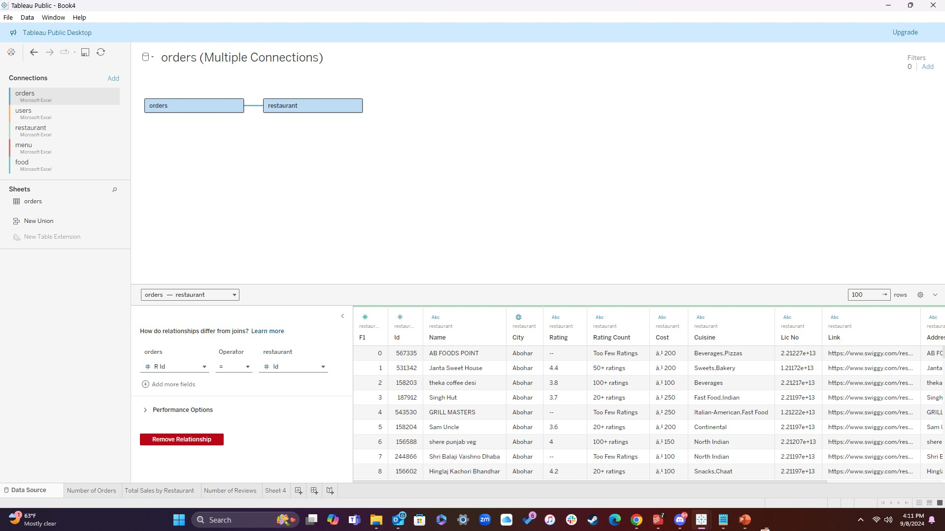
Data Source & Methodology
The key datasets are the “Orders” and “Restaurant” tables.
Joining these tables by restaurant ID allows us to develop insights on a restaurant level.
This provides a foundation for analyzing sales, customer engagement, and geographical performance.

Slide 4
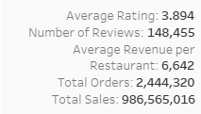
Key Metrics Snapshot (KPIs): Average Rating:
Average Rating:
With an average rating of 3.8, Zomato is performing slightly above average in the restaurant industry, where ratings can range between 1.0 to 5.0.
Reaching or exceeding a 4.0 rating in a competitive market like India can significantly boost customer trust and retention.
Actionable Insight:
Zomato can identify and focus on restaurants with ratings closer to 3.0. These restaurants may need to address customer complaints, improve menu quality, or speed up service.
Restaurants with ratings above 4.0 can provide a blueprint for success.

Slide 5
Key Metrics Snapshot (KPIs): Number of Reviews:
Number of Reviews:
The 148,455 reviews are a strong indicator of customer engagement across the entire platform. It shows that many customer are leaving feedback which can greatly influence other customers’ decisions.
Actionable Insight:
Restaurants with fewer reviews may benefit through encouraging feedback. We can address this issue through digital marketing campaigns, offering incentives for reviews, or increasing engagement through social media.

Slide 6
Key Metrics Snapshot (KPIs): Average Revenue per Restaurant:
Average Revenue per Restaurant - ₹6,642 INR:
The average revenue per restaurant at ₹6,642 INR is relatively low. This is largely attributed to the number of restaurants receiving very few orders. The majority of Zomato’s revenue is being driven by a small group of high-performing restaurants (i.e.. Domino’s Pizza).
Actionable Insights:
Focus on Top Performers: Zomato should focus on identifying the key factors driving success in its high-performing restaurants. These could include location advantages, popular menu items, efficient operations, or strong marketing efforts. By understanding what makes these restaurants successful, Zomato can replicate these strategies across its broader restaurant base.
Tailored Solutions for Underperformers: Zomato should analyze the challenges faced by underperforming restaurants—whether it’s poor location, lack of customer engagement, or unattractive menu offerings—and provide tailored strategies to help them improve. This could involve reworking pricing strategies, adding popular menu items, or improving delivery times to boost customer satisfaction.

Slide 7
Key Metrics Snapshot (KPIs): Total Orders & Total Sales:
The 2,444,320 total orders show strong engagement on the Zomato platform, indicating that there is a high level of demand for food delivery services.
₹986,565,016 INR in total sales showcases the platform’s ability to generate significant revenue. The overall sales volume indicates that Zomato’s restaurant partners are benefiting from the large number of orders placed through the platform.
Recommendations: Zomato can further enhance this performance by focusing on increasing order frequency and maximizing the average order value through strategic promotions and loyalty initiatives.

Slide 8
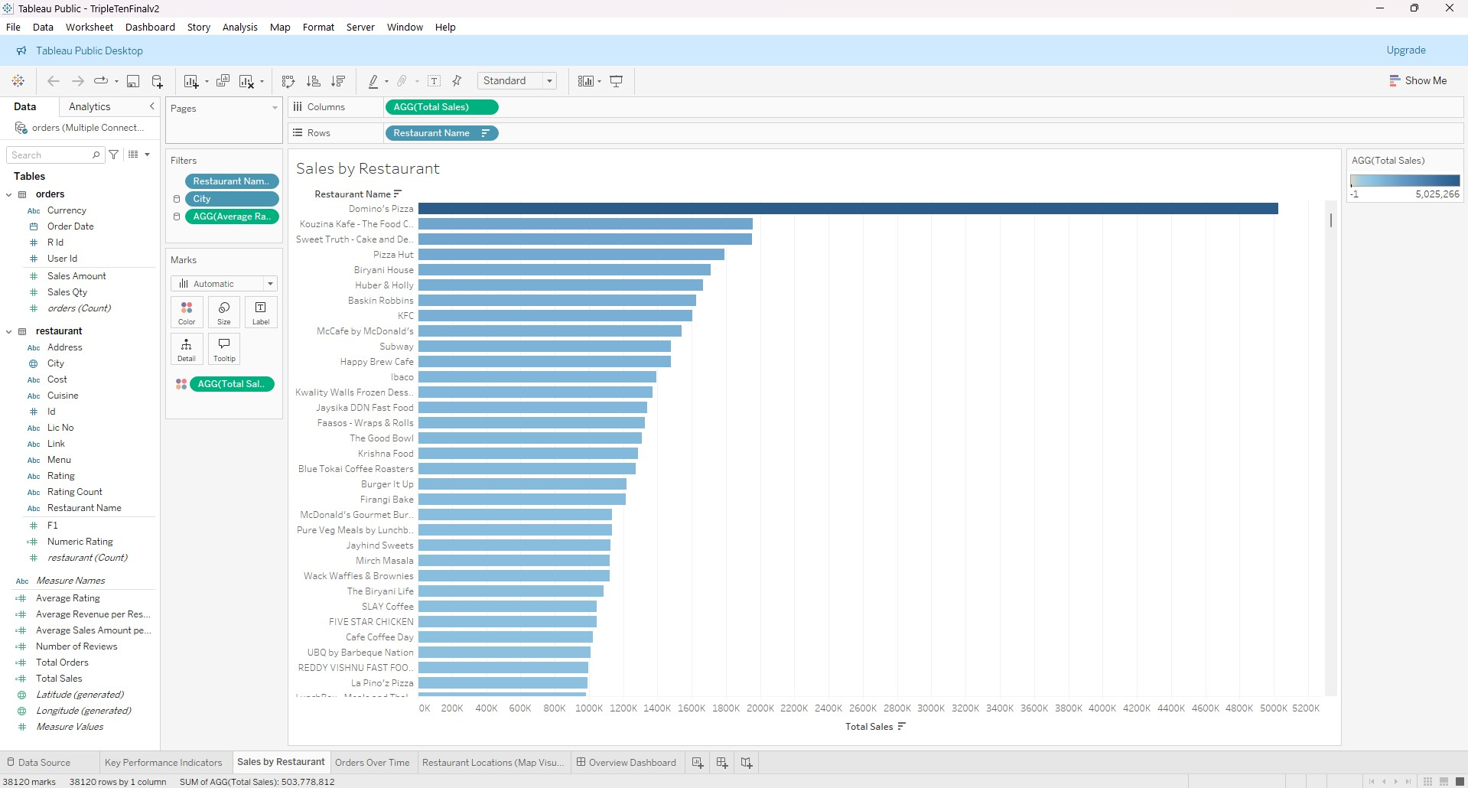
Sales by Restaurant

Slide 9
Sales by Restaurant
Insight:
The Sales by Restaurant bar chart highlights top-performing restaurants on Zomato’s platform, with Domino’s Pizza leading by a significant margin. This suggests that certain restaurants are effective in attracting and converting customers, due to a combination of brand recognition, menu offerings, or location advantages.
The graph also reveals that many restaurants generate far lower sales when compared to the top-performers. This could indicate an imbalance in performance across the platform.
Actionable Insights:
Leverage High-Performers: Zomato should analyze the success factors behind the top-performing restaurants like Domino’s Pizza or Kouzina Kafe. Are they located in prime areas? Do they offer popular menu items or efficient delivery? By replicating these factors in underperforming restaurants, Zomato can work towards improving overall platform performance.
Support Underperformers: Restaurants with lower sales may need targeted assistance. Zomato can help these restaurants by providing additional marketing support, enhancing their app visibility, or offering promotions to drive customer engagement.

Slide 10
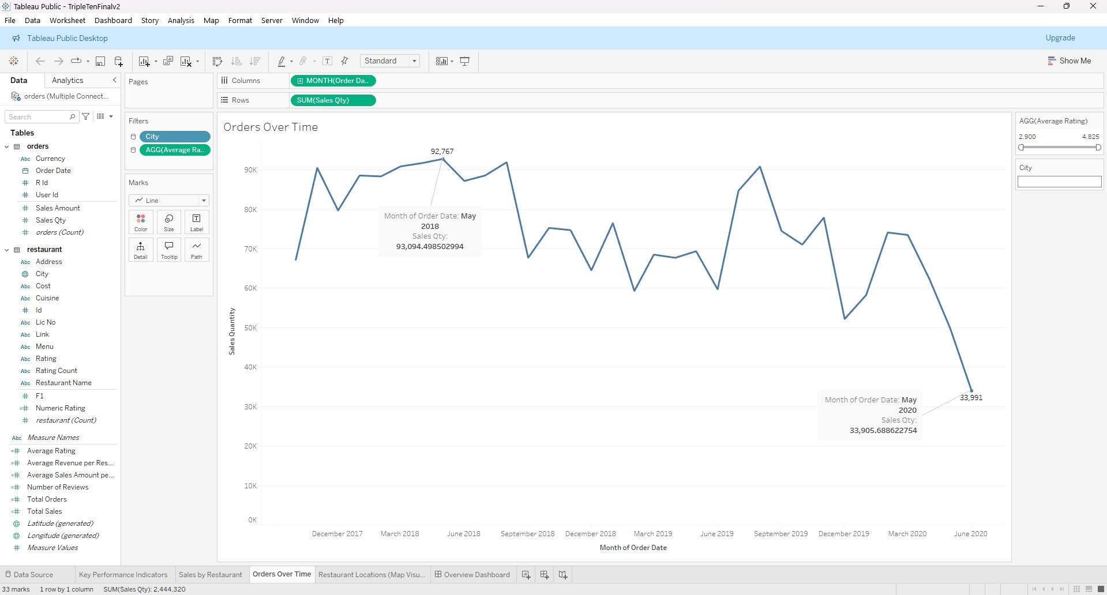
Orders Over Time

Slide 11
Orders Over Time
Insight:
The Orders Over Time line chart shows fluctuations in customer demand with notable peaks and dips. The highest peak occurred in May 2018, which could be linked to a promotional event or seasonal factors.
The graph also indicates a significant drop in orders during May 2020, which could correspond to external factors such as the impact of COVID-19.
Actionable Insights:
Capitalize on High-Demand Periods: Zomato should investigate the factors that led to the peak in May 2018 and replicate similar promotional efforts during other high-demand periods. For example, running seasonal promotions or discounts can help Zomato sustain high order volumes.
Address Low-Demand Periods: For the drop in orders observed in May 2020, Zomato can explore measures to boost demand, such as contactless delivery promotions or partnerships with local restaurants to attract more customers during difficult periods.

Slide 12
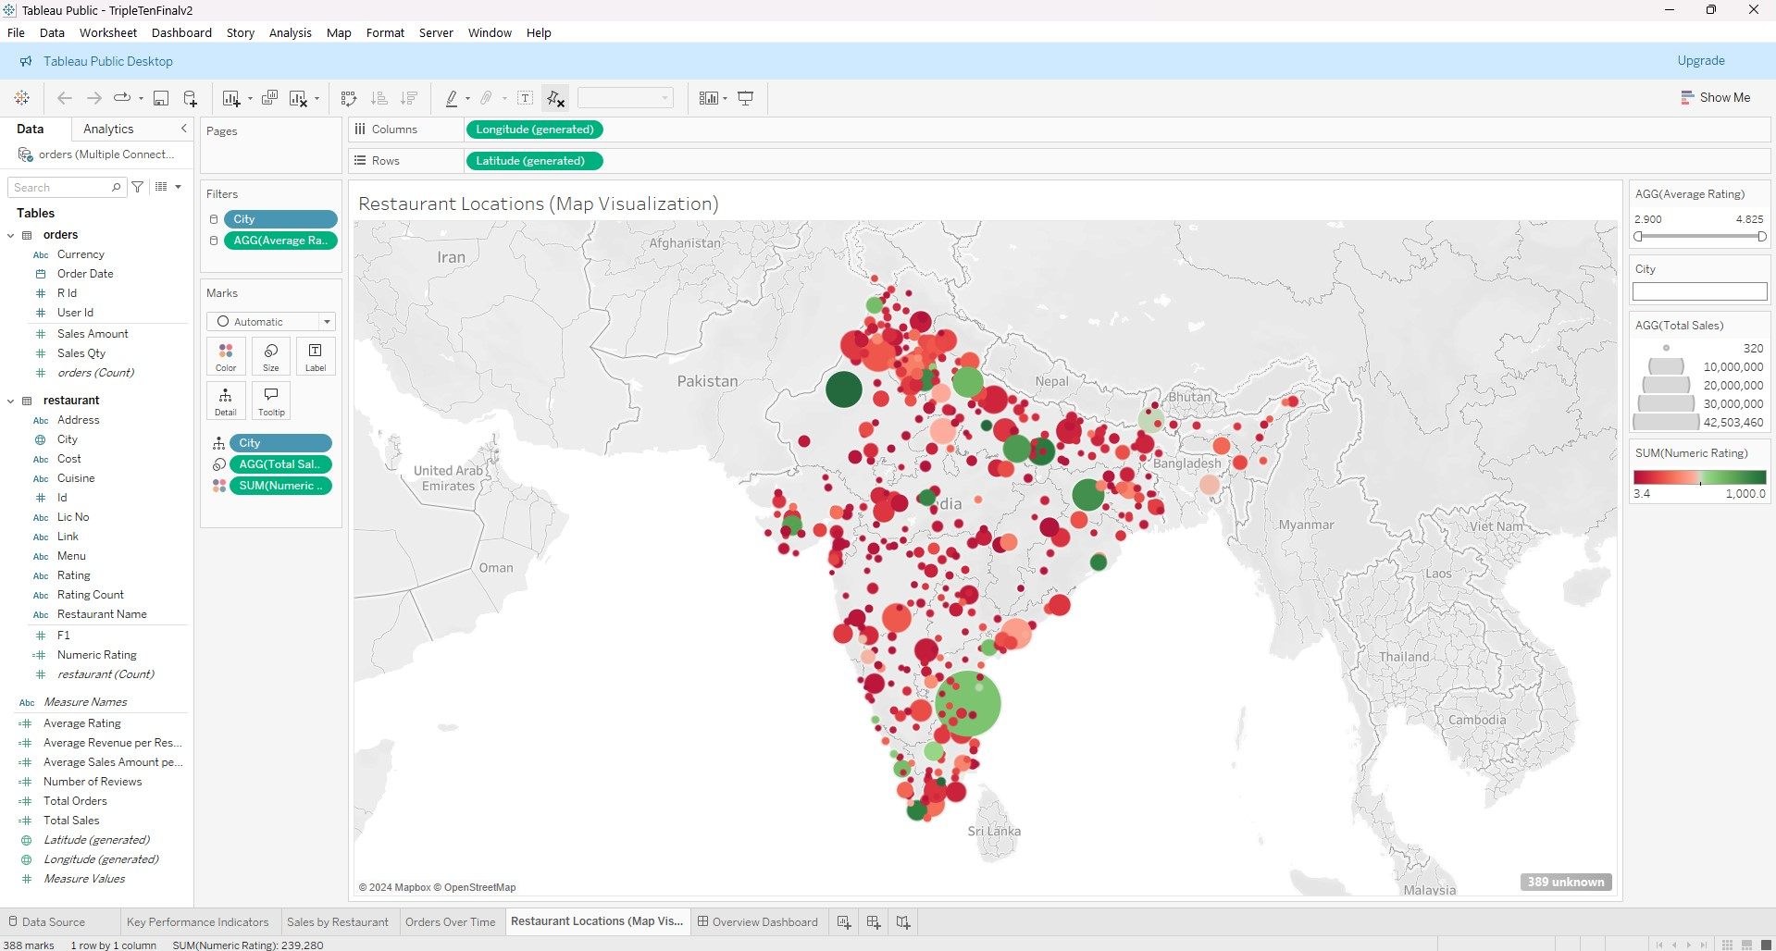
Restaurant Locations (Map Visualization)

Slide 13
Restaurant Locations (Map Visualization)
Insight:
The Restaurant Locations map provides a geographical view of Zomato's restaurant performance across India. Areas with more green markers indicate higher-rated restaurants, while red markers suggest lower ratings.
High concentrations of red markers in certain regions may signal areas where Zomato needs to improve customer satisfaction and service quality.
Actionable Insight:
Focus on Low-Rated Regions: Zomato should prioritize support in areas with more red markers by identifying the key issues (e.g., poor delivery times, inconsistent food quality) and offering targeted solutions. This could involve improving operational efficiencies or launching local marketing campaigns to boost customer satisfaction.
Leverage High-Rated Regions: Conversely, areas with many green markers show that customer satisfaction is already high. Zomato can further capitalize on this by offering premium services or loyalty programs to engage repeat customers and solidify brand loyalty in these regions.

Slide 14
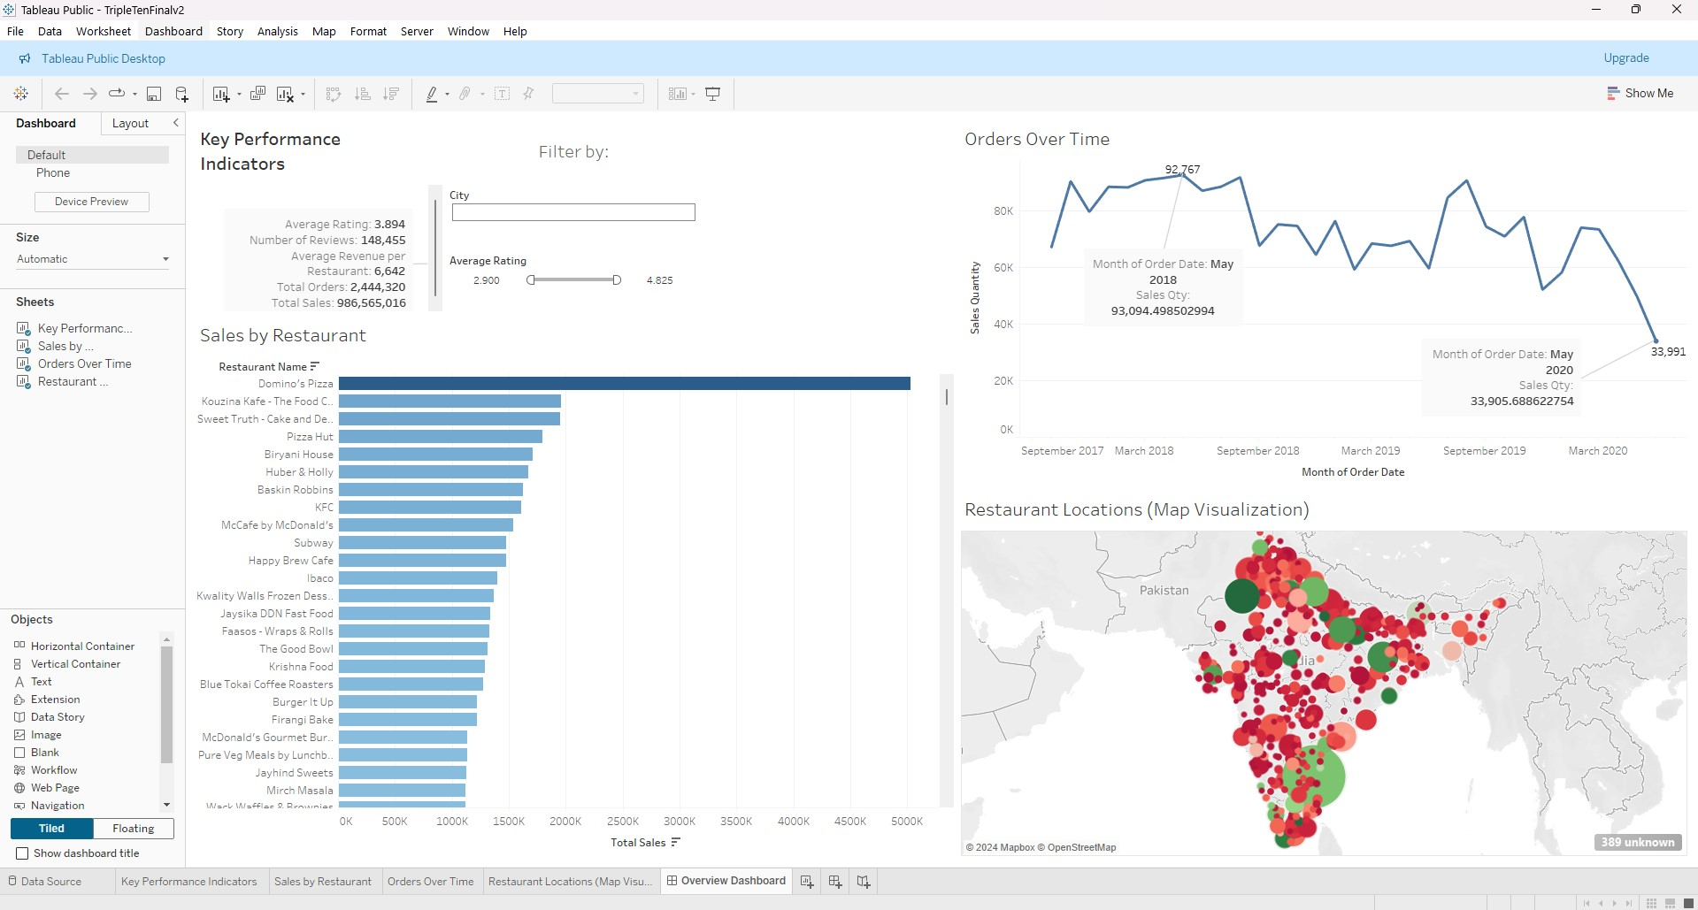
Dashboard Overview

Slide 15
Dashboard Overview
Insight:
The overall dashboard highlights the performance of Zomato’s platform, with the key metrics revealing an imbalance between high and low performing restaurants. While Zomato benefits from significant total sales and orders, these figures are disproportionately driven by a small number of top-performing restaurants.
Actionable Recommendations:
Replicate Success from Top Performers: Zomato can analyze the common factors behind the success of top-performing restaurants (like location, menu, delivery times) and apply these lessons to underperformers.
Targeted Support for Low Performers: Zomato should offer tailored solutions to restaurants that are struggling. This could include localized marketing campaigns, staff training, or revisiting their menu and pricing strategies.
Boost Customer Reviews and Engagement: Zomato can implement strategies to increase customer reviews, such as offering incentives or engaging with customers through digital channels. Restaurants with more reviews tend to have higher visibility and trust, which in turn can drive more orders and revenue.

Slide 16
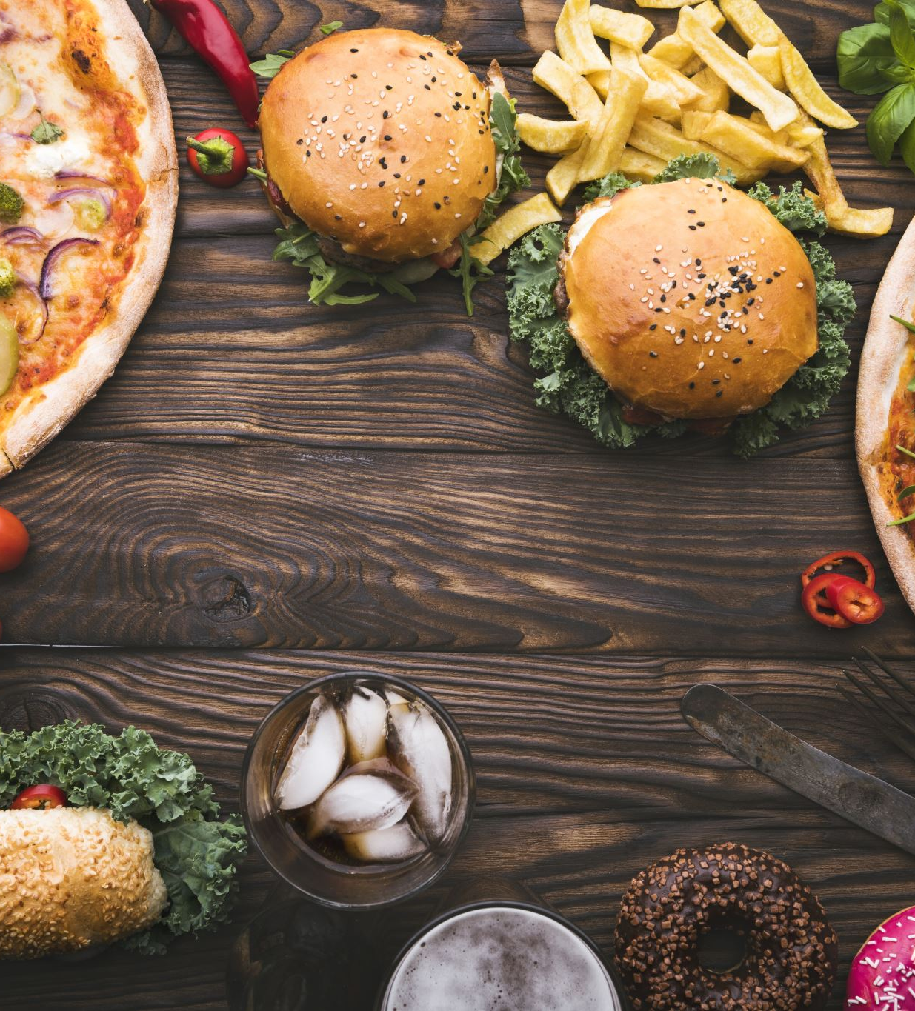
Conclusions
High-Performing Restaurants:
The restaurants with the highest number of orders and sales are likely using successful strategies (e.g., popular menu items, effective promotions, or prime locations). These restaurants should be further analyzed to identify specific tactics or characteristics that can be replicated across other locations to boost overall performance through the Zomato platform.
Underperforming Restaurants:
Restaurants with lower sales and order counts may be struggling due to a variety of factors such as poor location, limited menu appeal, or inadequate marketing efforts. Zomato should focus on helping these restaurants through targeted interventions such as menu optimization, tailored marketing strategies, or operational improvements.
Zomato should continue to track the effectiveness of the strategies it implements and adjust accordingly based on updated data.

