Slide 1
Introduction to Soft Robotics Autumn 2023 Instructors: Jonas Jørgensen, Saravana P.M Babu TA: Aida Parvaresh, Arman Goshtasbi
5 September 2023

Slide 2
Part 1: Arduino 101
5 September 2023

Slide 3
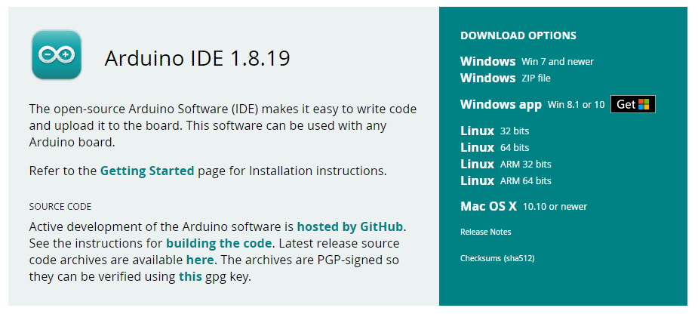
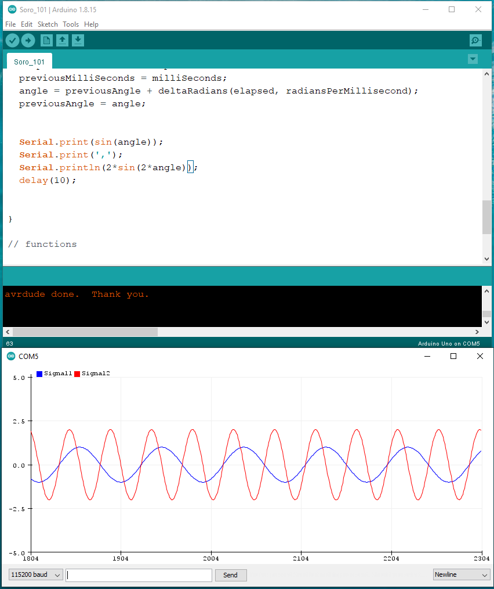

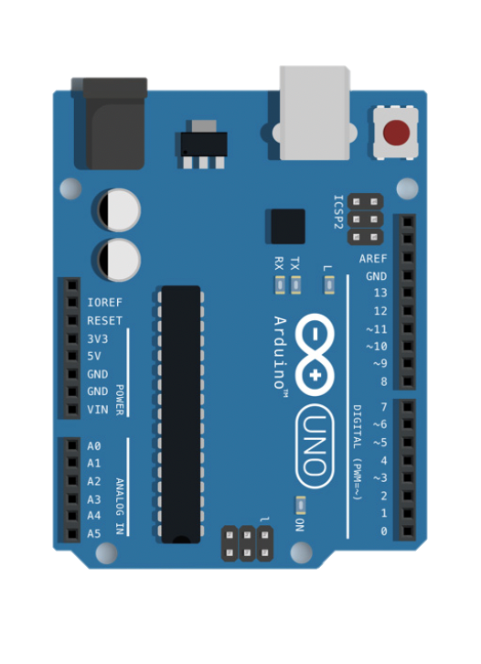



Arduino Uno and Serial communication
Download Link
SoRo_101 QR code
GitHub Link
5 September 2023

Slide 4
Part 2: MPX5100 Integrated Silicon Pressure Sensor
5 September 2023

Slide 5
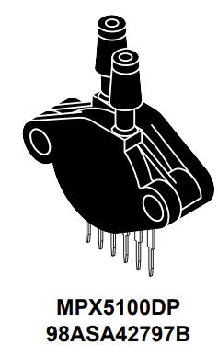
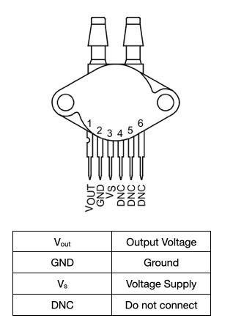
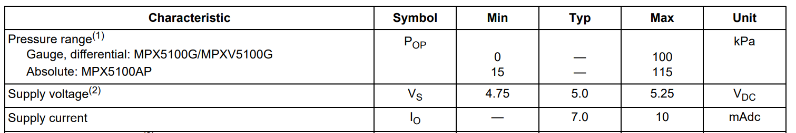
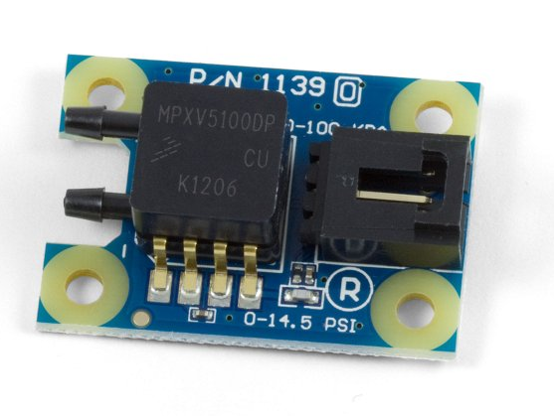
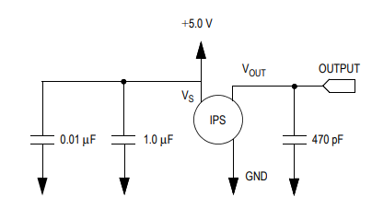
MPX5100, 0 to 100 kPa Pressure Transducer
Right port: GND
Middle Port: 5V
Left Port: Signal
Phidget website
Full data sheet of the pressure sensor
5 September 2023

Slide 6
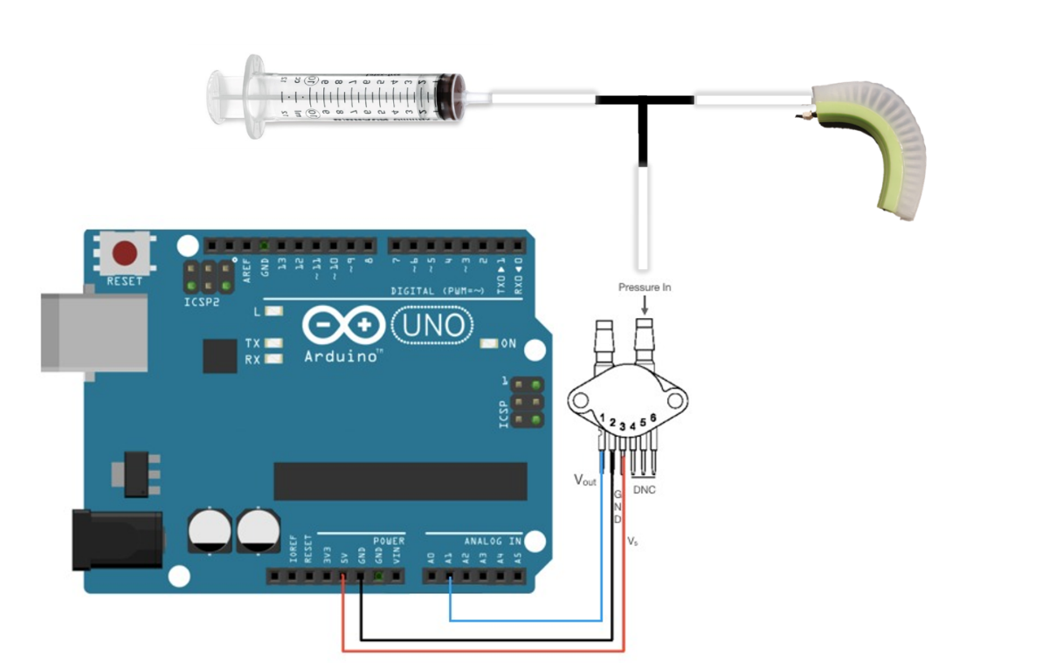
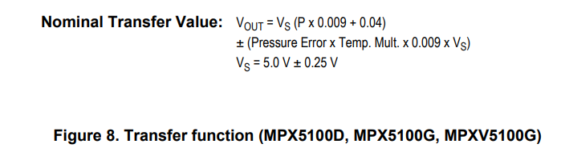
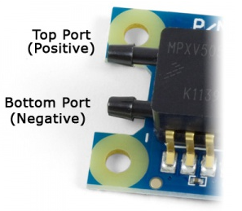
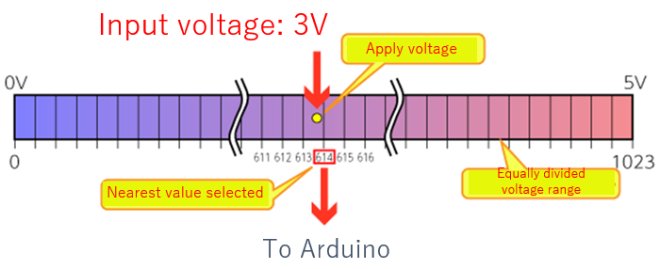
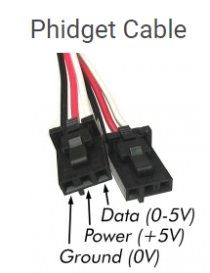

Wiring to Arduino
Voltage to Pressure Conversion
Arduino Bit conversion
Please before connection to Arduino double check with TA for the wire connections
$$Voltage=\frac{5}{1023}∗analogread$$
5 September 2023

Slide 7
Part 3: Conductive Rubber Cord Sensor
5 September 2023

Slide 8
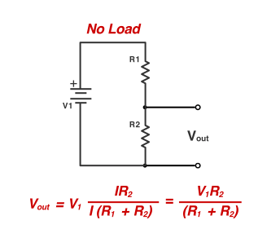

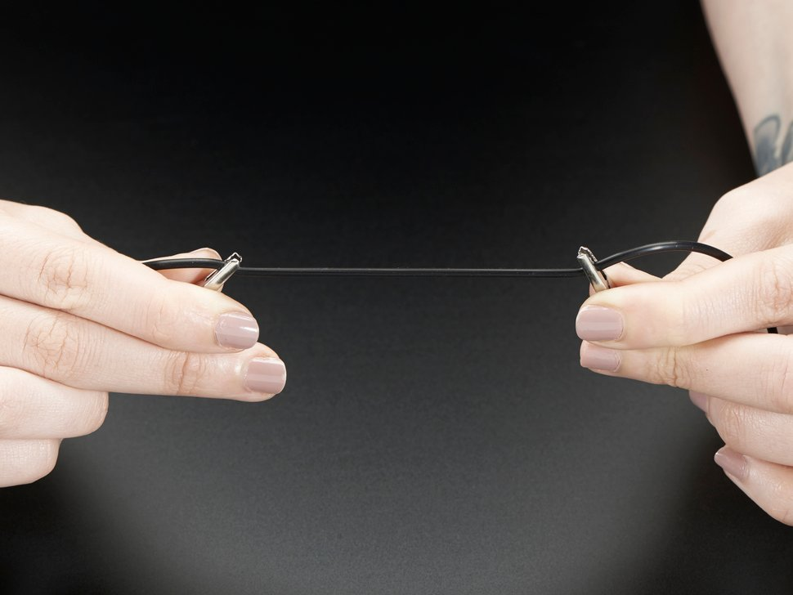
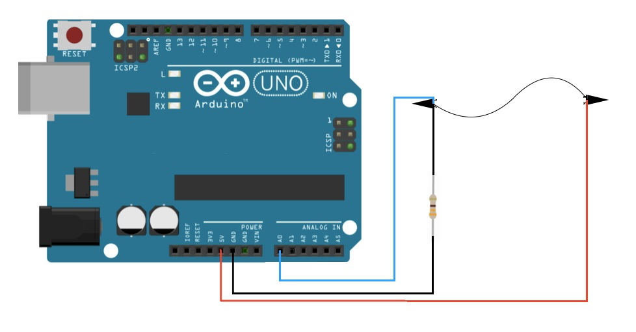
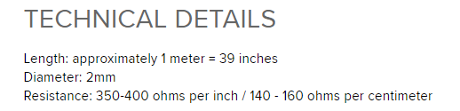
Voltage divider
Voltage divider (Wikipedia)
5 September 2023

Slide 9
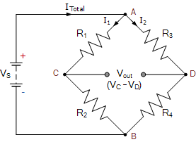
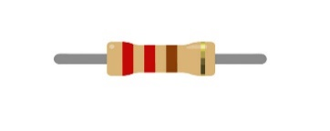
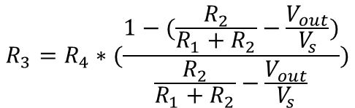
Wheatstone Bridge
Wheatstone bridge instruction (Youtube)
$$R_{3}=R_{4}∗(\frac{1−(\frac{R_{2}}{R_{1}+R_{2}}−\frac{V_{out}}{V_{s}})}{\frac{R_{2}}{R_{1}+R_{2}}−\frac{V_{out}}{V_{s}}})$$
Why Wheatstone bridge over voltage divider (YouTube)
Why Wheatstone bridge over voltage divider (Reddit)
5 September 2023

Slide 10
Part 4: Data Acquisition with MATLAB and Python
5 September 2023

Slide 11
Code Information
MATLAB
Setting up Arduino data collection in MATLAB
Type: a = arduino("com3","Uno") in MATLAB command windows (the com is dependent on your computer COM)
Install the required package if needed (Link)
When the package is installed, you can directly read the voltage of the analog pin of the Arduino via readVoltage (a, ‘analogpin’)
An example code to measure the pressure in Part 2 can be accessed via GitHub and the next slide
5 September 2023

Slide 12
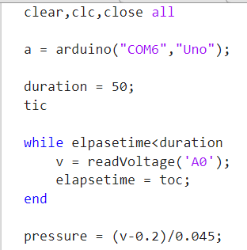
Code Information
MATLAB
5 September 2023

Slide 13
Code Information
Python
Setting up Arduino data collection in Python
Type $ pip install pyserial in you Python console to install it.
If you are using Anaconda Prompt use the following code : conda install pyserial
Import Serial, time, matplotlib.pyplot for acquiring the data and plotting.
An example code to measure the pressure in Part 2 can be accessed via GitHub and the next slide
5 September 2023

Slide 14
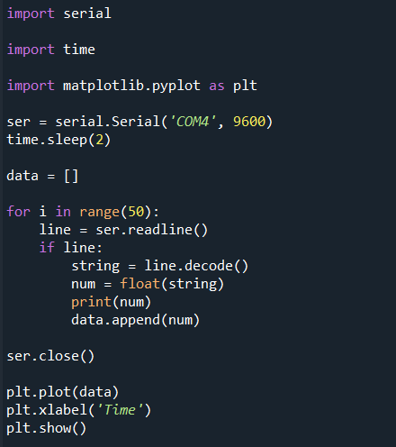
Code Information
Python
5 September 2023

