Slide 1
SPARKS FOUNDATION
#GRIPSEPT2021 - WEBDEVELOPMENT TASK
TASK 3 -> PAYMENT GATEWAY INTEGRATION

Slide 2
HELLO, I’M ARMAN ALI KHAN WEBDEVELOPMENT INTERN GRIPSEPTEMBER_BATCH SPARKS FOUNDATION

Slide 3
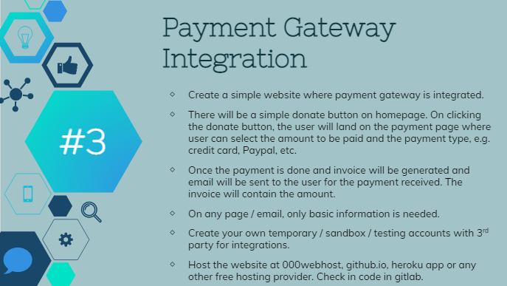
TASK -3

Slide 4
THANK YOU

