Slide 1
Crowd Evacuation in Stadium
CSE 562: Project Presentation
Group Members : Arifuzzaman Arman (ID: 2215222650)
Fayezah Anjum (ID: 2016558050)

Slide 2
introduction
The simulation of an emergency evacuation system effectively studies the real-world scenario of crowd evacuation in the shortest possible time and ensures a minimum death rate.
In our project, we implemented an agent-based model and simulation using NetLogo for crowd evacuation in the Stadium.
We have taken into account two possible scenarios:
i) For a sudden outbreak of fire in the gallery.
ii) A bomb blast/ explosion.

Slide 3
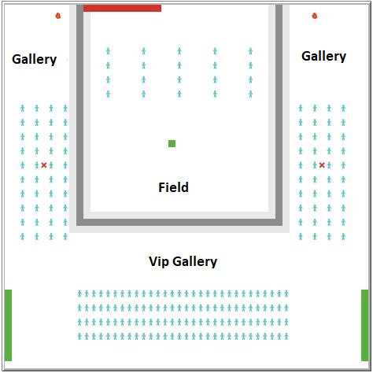
World Design

Slide 4
Assumptions of the model
In the crowd evacuation model, we have assumed the following:
The location from which the fire starts remains constant
The location of the exits does not change.
The size of the exits stays the same.
Everyone in the crowd moves at the given constant speed.

Slide 5
State Variables and Performance Measure
There are 3 state variables in our simulation :
People movement speed
Fire spread speed (here we implemented how many times they are slowed)
Starting time of the fire (in ticks)
And 3 performance measures :
Number of deaths
Number of evacuees
Total evacuation time

Slide 6
Experiments
As fire approaches closer to people they start to wiggle randomly and increase their speed.
Because of this random motion of people no two experiment yields the same exact results when people come in close proximity to the fire.
So we ran the simulation 10 times for 80 different combination of state variables ( in total 800 experiments).
We did this using the behavior space feature in Netlogo.
Then we calculated the mean and standard deviations for 10 repetitions with each set of state variables using python pandas.

Slide 7
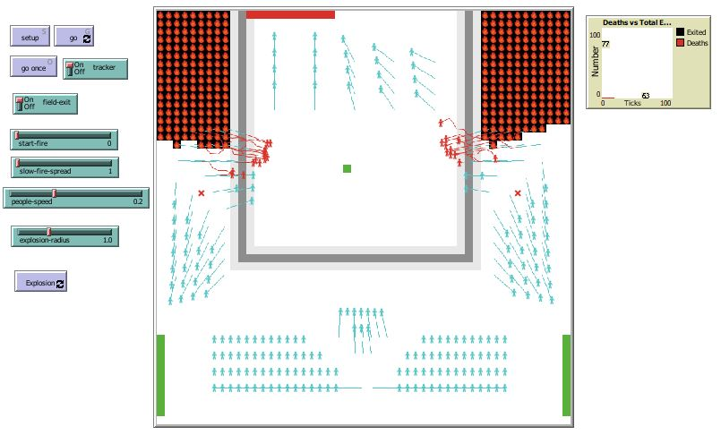
Simulation Running

Slide 8
Observation

Slide 9
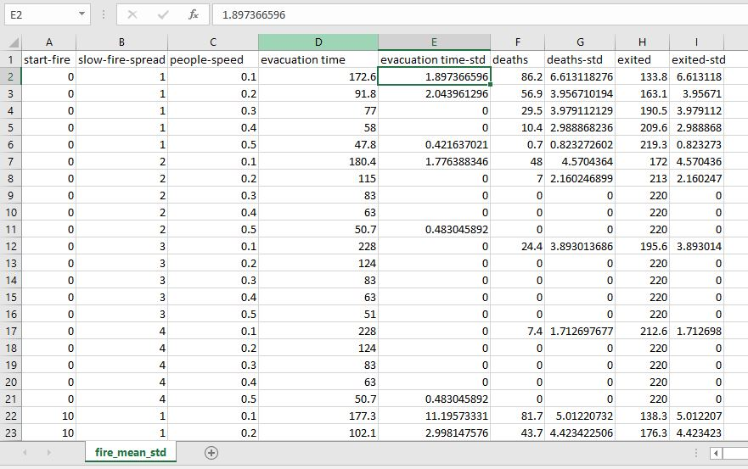
Simulation Table

Slide 10
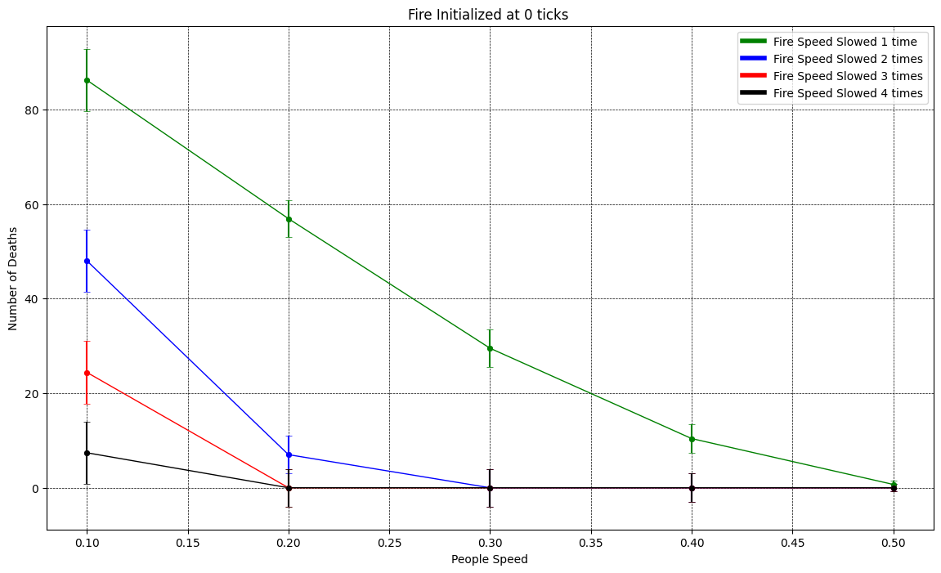
Number of deaths decreases with increase in people moving speed (Inversely Proportional)
Number of deaths decreases with decrease in fire spread speed (Directly Proportional)

Slide 11
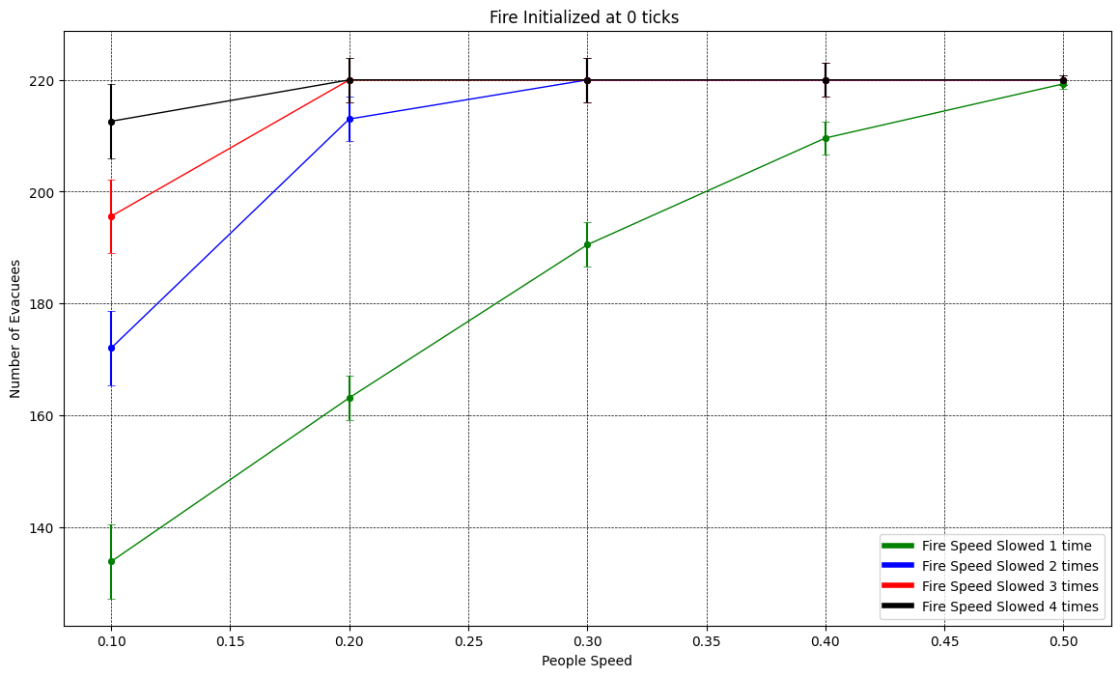
Number of Evacuees increases with increase in people moving speed (Directly Proportional)
Number of Evacuees increases with decrease in fire spread speed (Inversely Proportional)

Slide 12
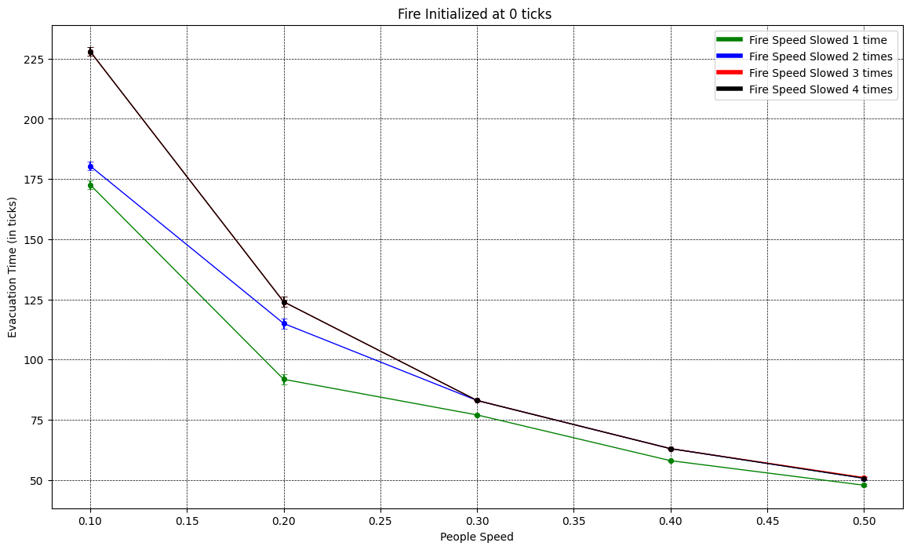
Total Evacuation Time decreases with increase in people moving speed ( Inversely Proportional )
Total Evacuation Time increases slightly with decrease in fire spread speed (Inversely Proportional )

Slide 13
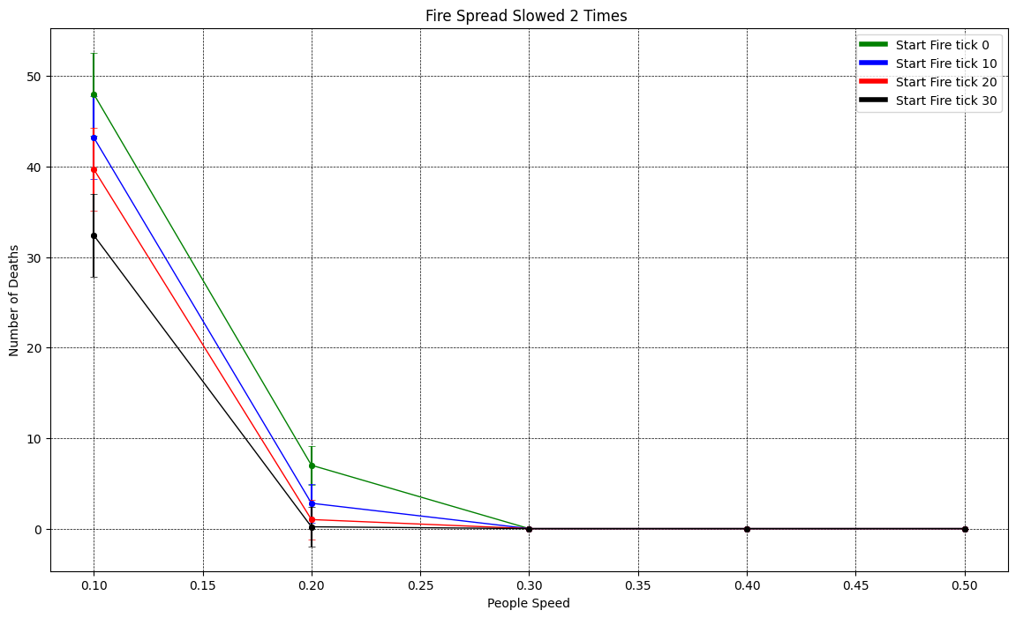
Number of Deaths decreases when Fire starts spreading late

Slide 14
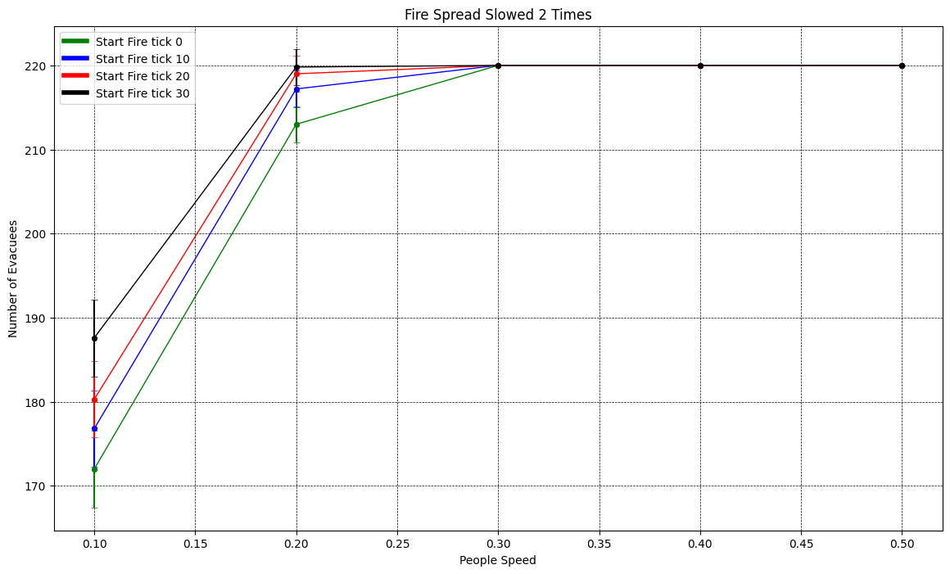
Number of Evacuees increases when Fire starts spreading late

Slide 15
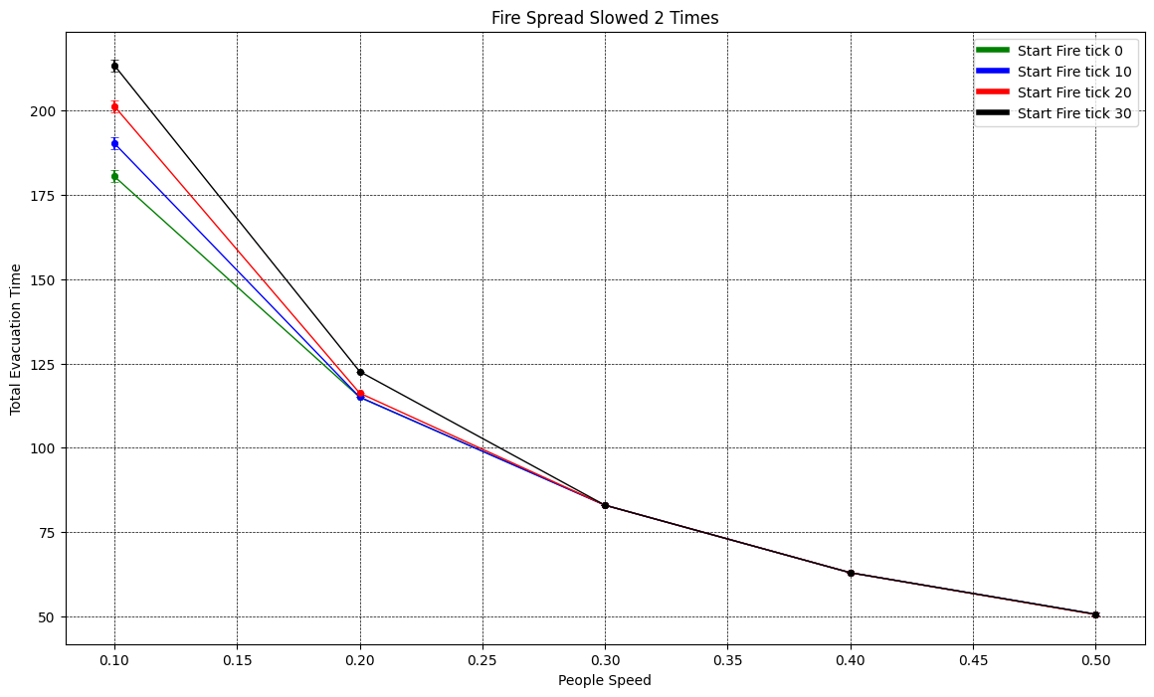
Total Evacuation Time increases slightly when fire starts spreading late
This is because the number of people who are panicked decreases so less people run or increase their speed to reach the exit

Slide 16
References
Large Event Halls Evacuation Using an Agent-Based Modeling Approach(DOI: 10.1109/ACCESS.2022.3172285)
Simulating metro station evacuation using three agent-based exit choice models (https://doi.org/10.1016/j.cstp.2021.06.011)
Modification of evacuation time computational model for stadium crowd risk analysis (https://doi.org/10.1205/psep06026)
Crowd Evacuation in Hajj Stoning Area: Planning through Modeling and Simulation ( https://doi.org/10.3390/su14042278)

Slide 17
Thank You

