Slide 1
BILAR EMERGENCY RESPONSE APPLICATION USING DYNAMIC CLUSTERING PROTOCOL (BERA)
MEMBERS:
JUMAWID, ARMANDO
PEROCHO, RONELYN
PEREZ, MARK HENRY
ADVISER:
DARREL A. CARDAÑA, MIS

Slide 2
CHAPTER 1

Slide 3
BILAR EMERGENCY RESPONSE APPLICATION (BERA)
The BERA is a mobile application designed to facilitate emergency response operations. It utilizes a dynamic clustering protocol, which likely refers to a method of organizing and managing resources dynamically based on the changing conditions of an emergency situation. The application aims to improve the efficiency and effectiveness of emergency response operations through dynamic coordination and resource allocation.

Slide 4
Literature Background
Republic Act No. 10121, also known as the "Philippine Disaster Risk Reduction and Management Act of 2010," this legislation provides a robust legal and policy framework for disaster risk reduction and management in the Philippines. By adhering to the provisions of this act, the application aims to contribute to enhancing the country's disaster preparedness, response, and recovery efforts.

Slide 5
Literature Background
According to Xu and Wunsch's influential research on clustering algorithms, cluster analysis emerges as a crucial tool for comprehending unlabeled data, with their exploration of hierarchical structures and group formation emphasizing specific goals while acknowledging ongoing efforts to address associated challenges (Xu & Wunsch, 2005). In another study by Xu, D., & Tian, Y. (April 2015), an overview of commonly used clustering algorithms is presented, introducing their basic ideas, specifying sources, and analyzing the advantages and disadvantages of 19 selected categories, aiming to offer readers a systematic and clear understanding of this important data analysis method.

Slide 6
Literature Background
There are numerous related applications that are running in different organizations and institutions. Among these significant studies where:
Citizen – This App provides COVID contact tracing, real-time safety alerts, and 24/7 assistance at your fingertips.
Emergency + – This national app utilizes the GPS built into smartphones to display users' location coordinates.
EchoSOS – EchoSOS was created to improve first contact and communication between people requesting help and the emergency services.
SirenGPS – Dialing 911 from a mobile phone doesn't bring instant aid, because dispatchers need some location info to find you. SirenGPS (Android, iOS) puts them at the touch of one big red button.

Slide 7
Statement of the Problem
This study aimed to design and develop an application called BERA for Bilar Search and Rescue Unit (BISARU) in BISU to improve communication, coordination, and response times during emergencies.

Slide 8
Significance of the Study
This project is to bring positive implications to the society in the issue of requesting for help during critical or emergency situations. In particular, the following entities may benefit from this study:
Affected Individuals and Communities
Researchers
Future Researcher

Slide 9
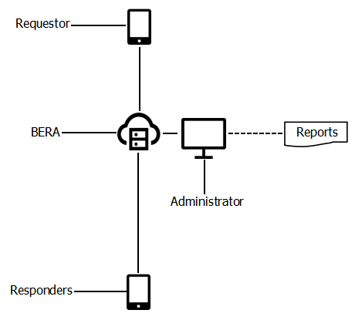
BLOCK DIAGRAM OF THE STUDY
/Witness

Slide 10
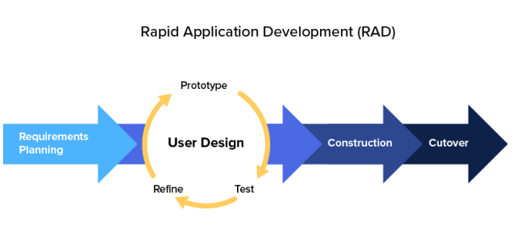
Development Model and Approaches
The researchers use a development strategy called Rapid Application Development (RAD) which puts an emphasis on immediate feedback and rapid prototyping over lengthy development and testing cycles. This ensures a quality and client-focused end product. Rapid Application Development or RAD means an adaptive software development model based on prototyping and quick feedback with less emphasis on specific planning.

Slide 11
SOFTWARE DEVELOPMENT TOOLS
The following are the tools used in the development of Bilar Emergency Response Application using Dynamic Clustering Protocol of Bohol Search and Rescue Unit (BISARU) in Bilar, Bohol.
Android Smartphone (API 21)
Google Chrome (v111.0.5563.8)
Visual Studio Code (v1.75)
Flutter (SDK 3.3.5)
Dart (SDK 2.18.2)
Git (v2.93.1)
Firebase (v12.7.0)
Google Map

Slide 12
Environment and Participants
The study was conducted at Bilar, Bohol. It has an estimated of 5-10 emergencies per month and working forces which consist of paramedics, emergency medical technicians (EMTs) and staff. The participants of the study included the staff, paramedics and emergency medical technicians (EMTs).

Slide 13
Data Collection
Table 1. Distribution of System Usability Respondents
Respondents | Frequency
Bilar Search and Rescue Unit Paramedic Bilar Search and Rescue Unit EMT Bilar Search and Rescue Unit Staff Bilar Search and Rescue Unit End-Users | 1 1 1 12
Total | 15

Slide 14
Data Collection
Table 2. Interpretation Guide of the System Usability
Weight | Range | Description | Interpretation
5 | 4.6– 5.0 | Strong Agree | The respondents strongly believe and confident that the system is very usable.
4 | 3.7– 4.5 | Tend to Agree | The respondents tend to believe that the system is usable.
3 | 2.8– 3.6 | Neither Agree nor Disagree | The respondents are neutral in trusting that the system usable.
2 | 1.9-2.7 | Tend to Disagree | The respondents tend not to trust that the system is usable.
1 | 1.0–1.8 | Strongly Disagree | The respondents strongly believe that the system is not usable.

Slide 15
System Usability Result
Criteria for System Usability |  | Weighted Mean | Rating Strongly Agree
FunctionalitySuitability
 | Functional completeness | 4.8 | Strongly Agree
 | Functional correctness | 5 | Strongly Agree
 | Functional appropriateness | 4.6 | Strongly Agree
Performance Efficiency
 | Time behavior | 4.8 | Strongly Agree
 | Resource utilization | 4.6 | Strongly Agree
 | Resource utilization | 4.6 | Strongly Agree
Compatibility
 | Co-existence | 4.7 | Strongly Agree
 | Ineroperability | 4.5 | Agree

Slide 16
System Usability Result
 | Appropriateness Recognizability | 4.9 | Strongly Agree
 | Learnability | 4.6 | Strongly Agree
 | Operability | 4.5 | Agree
 | User error protection | 4.3 | Agree
 | User interface aesthetics | 4.7 | Strongly Agree
 | Accessibility | 4.5 | Agree
Reliability
 | Maturity | 4.7 | Strongly Agree
 | Availability | 4.7 | Strongly Agree
 | Recoverability | 4.8 | Strongly Agree

Slide 17
System Usability Result
Security
 | Confidentiality | 4.7 | Strongly Agree
 | Integrity | 4.9 | Strongly Agree
 | Accountability | 4.7 | Strongly Agree
 | Authenticity | 4.8 | Strongly Agree
 | Non-repudiation | 4.6 | Strongly Agree
Maintainability
 | Modularity | 4.8 | Strongly Agree
 | Reusability | 4.8 | Strongly Agree
 | Analyzability | 4.5 | Agree
 | Modifiability | 4.5 | Agree
 | Testability | 4.5 | Agree
Portability
 | Adaptability | 4.7 | Strongly Agree
 | Installability | 4.5 | Agree
 | Replaceability | 4.6 | Strongly Agree
 | Overall Mean | 4.66 | StronglyAgree

Slide 18
CHAPTER 2

Slide 19
Needs of the Existing Operation
The present process will employ a cross-platform application-based approach, which can be customized to better suit user needs. The researcher’s observations led to the identification of the following needs: 1. To develop an app with communication and location tracking capabilities for users in need of assistance, ensuring that responders have accurate information about their situation. The goal is to enhance safety through effective communication and provide precise location details.

Slide 20
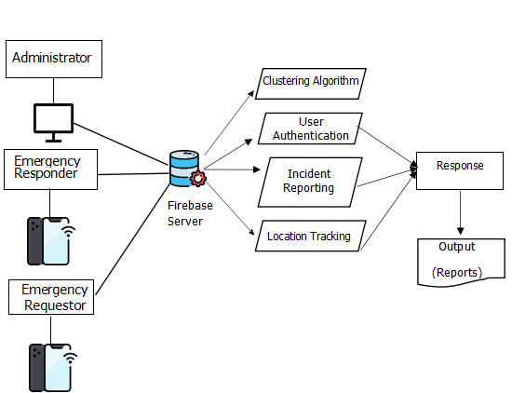
CONCEPTUAL DIAGRAM OF THE STUDY

Slide 21
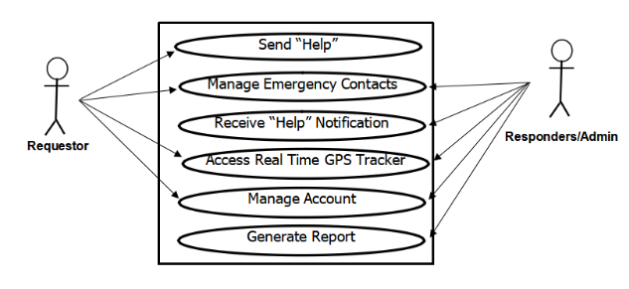
USE CASE DIAGRAM
/
Witness

Slide 22
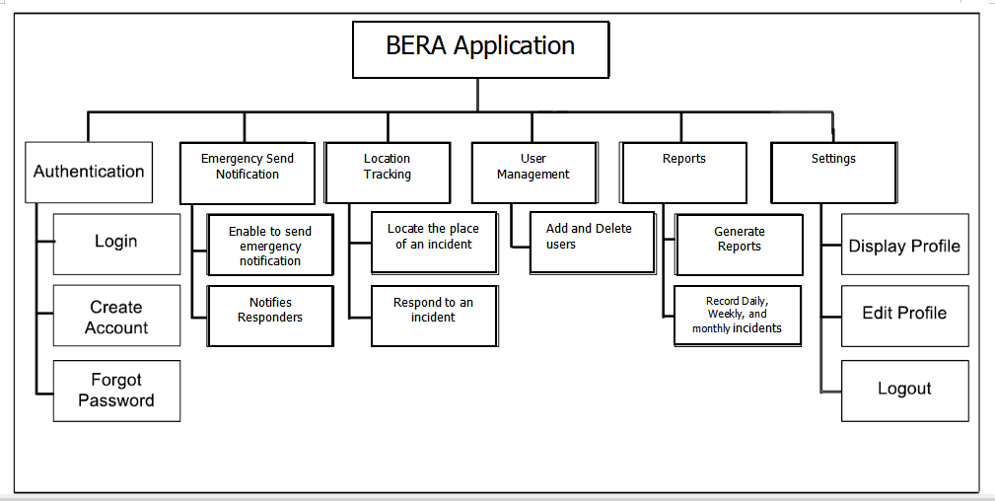
Program Hierarchy
Add, Edit, View

Slide 23
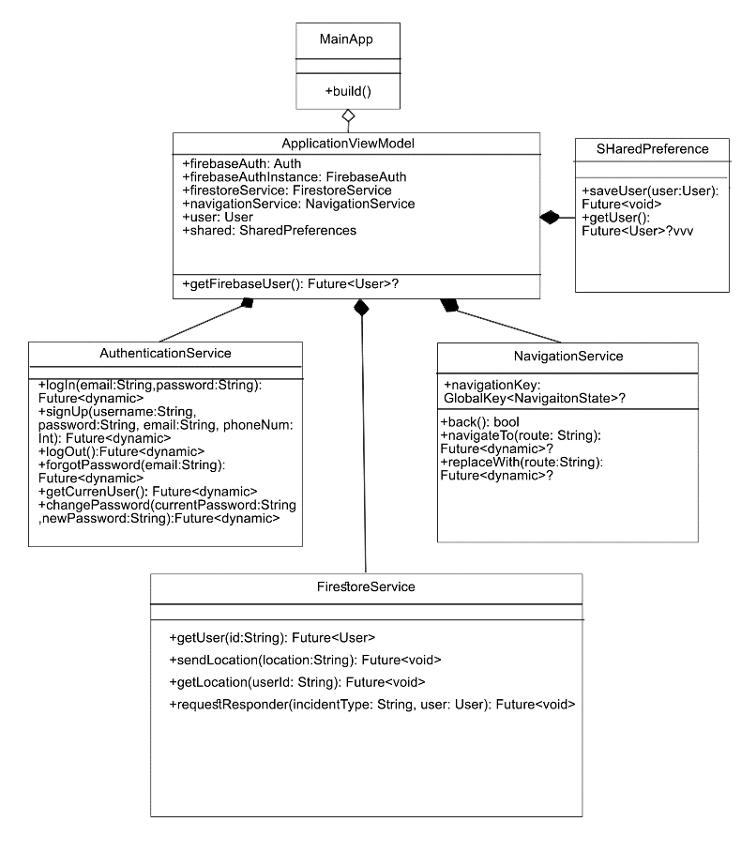
Class Diagram

Slide 24
System Requirements
Table 14. Minimum Android Hardware Specifications
COMPONENT | SPECIFICATION
CPU | DUAL CORE AND UP
RAM | 2GB
ROM | 4GB
CONNECTIVITY | WIFI or LTE

Slide 25
CHAPTER 3

Slide 26
Summary of Findings
Based on the identified needs of BISARU, the “Bilar Emergency Response Application using Dynamic Clustering Protocol” was developed with the modules notification, location tracking, account management and reports. The developed system was pilot tested and evaluated in terms of system usability. Based from the results of the survey, the respondents gave a general rating of with an interpretation of “strongly agree”. The result generally indicated that the application was usable in handling user’s information.

Slide 27
Conclusion
The study concluded, in essence, that BISARU's emergency response and dispatch was inadequate and depended on ineffective manual procedures. However, the introduction of the BERA application met BISARU's expectations and requirements by improving user management efficiency and response time through location tracking. Furthermore, because of its small initial investment and low running costs, the application was regarded as economical and affordable.

Slide 28
Recommendations
It is recommended that Bilar Search and Rescue Unit (BISARU) should adopt the new application BERA, to improve their response to an emergency.
It is advised to hold an orientation and training seminar for the target users to guarantee a seamless transition to the new system. The purpose of this seminar is to familiarize users with BERA's functionality. Staff members can become proficient users of the application and maximize its features with training and orientation, which will improve emergency response and dispatch.
Considering the diverse needs and preferences of users, it is recommended to develop web and desktop versions of BERA alongside the mobile application.

Slide 29
THANK YOU!!!

