Slide 1



Slide 2
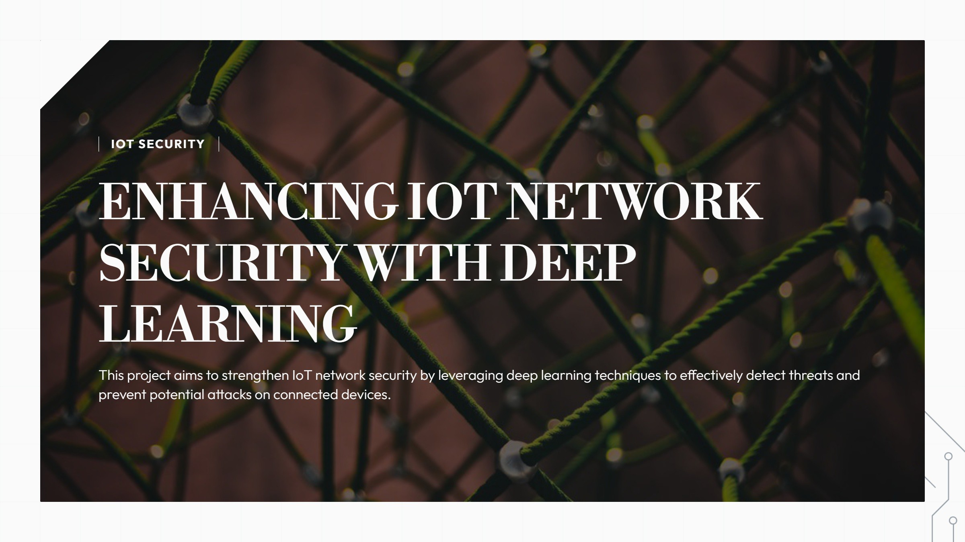

Slide 3
PROJECT OVERVIEW: IOT SECURITY
Exploring the critical aspects of loT security and our project insights
WHAT ISIOTAND WHY IT NEEDS SECURITY?
IoT devices often lack robust security mechanisms, making them susceptible to attacks such as DDoS (Distributed Denial of Service), ransomware, and botnets.
Limited computational resources in IoT devices mean traditional security

Slide 4


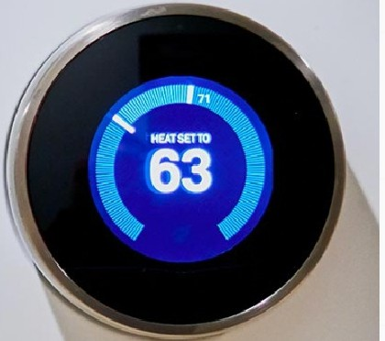



OVERVIEW OF IOT AND SECURITY CHALLENGES
Understanding loT, its vulnerabilities, and proposed Al solutions
WHAT IS IOT?
loT (Internet of Things) interlinks devices like smart homes, vehicles, ond industrial systems for doto sharing.
THE PROBLEM
Many loT devices lack security, making them vulnerable to hacking, DDoS ottocks, ond data breaches.
WHY OUR PROJECT?
We aim to develop an Al-driven solution that detects and mitigates attacks on loT devices.
r

Slide 5

01 THE CHALLENGE
loT devices ore proliferating, but security remains inadequate.
02 REAL-TIME ATTACK DETECTION
Detecting complex and evolving attacks in real-time is crucial for loT safety.
03 HIGH FALSE ALARMS
Traditional security systems often generate high false alarms, reducing trust.
04 DATA MANAGE MENT CHALLENGES
lv1anaging large amounts of network data poses significant challenges.
os OUR GOAL
To create a smart intrusion detection system that is fast, accurate, and scalable.

Slide 6
BUILD A SYSTEM THAT DETECTS THREATS WITH HIGH ACCURACY (>99%)
Aim to create a robust detection system that minimizes false negatives.

Slide 7


CICIDS-2017 DATASET OVERVIEW
Key Features and Data Preparation
DATASET SELECTION
We utilized the CICIDS-2017 dataset, which features
authentic loT network traffic data.
DATASET COMPOSITION
Contains details of both normal and attack traffic, crucial for network analysis.
TRAFFIC FLOW METRICS
Includes metrics like traffic fiow duration, bytes transferred,
and packet lengths.
DATA CLEAN UP PROCESS
Errors and irrelevant data were removed to enhance the dataset's quality.
DATA SCALING TECHNIQUES
Data was scaled appropriately to ensure optimal
performance for modeling.

Slide 8




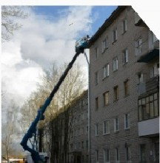
FRAMEWORKSTEPSFORIOTSECURITY
A systematic approach to enhancing loT security
COLLECTING DATA
Utilize the CICIDS-2017 dataset to gather network intrusion data for analysis.
DATA PREPROCESSING
Cleanse and normalize the data to ensure compatibility with deep learning algorithms.
MODEL TRAINING
Implement and evaluate CNN, RNN, and BERT models for effective intrusion detection.
RESULT ANALYSIS
Conduct o thorough comparison of model performances to identify the most effective approach.
SYSTEM DEPLOYMENT
Develop a scalable and robust solution aimed at enhancing loT security measures.

Slide 9



DEEP LEARNING MODELS OVERVIEW
Key Insights on Model Applications
CONVOLUTIONAL NEURAL NETWORK
(CNN)
Ideal for pattern recognition in structured data, such as analyzing packet lengths and traffic flow durations.
RECURRENT NEURAL NETWORK (RNN)
BERT (BIDIRECTIONAL ENCODER REPRESENTATIONSFROM TRANSFORMERS)
Best suited for detecting low-frequency and nuanced attack patterns due to its attention mechanism. Extracts meaningful features from data to identify complex attack patterns.
Effective with sequential data like network logs;
employs LSTM for enhanced accuracy a^{nd} handling of long dependencies.
Highly effective for identifying volumetric attacks, thanks to its spatial hierarchy learning capabilities.

Slide 10


ENHANCES DATA PROCESSING SPEED
Feature selection reduces the overall data size, leading to faster processing times.
BOOSTS MODEL ACCURACY
Focusing on critical features enhances the predictive accuracy of machine learning models.
UTILIZES RANDOM FOREST METHOD
The Random Forest algorithm efficiently identifies feature importance far selection.
IDENTIFIED KEY FEATURES
Key features include Flow Duration, Total Bytes Transferred, and Source/Destination
IPs.

Slide 11

DATADMSION AND MODEL EVALUATION
Understanding the Importance of Data Division and Evaluation Metrics
DATA Dimensions OVERVlEW
The dataset is split into training and testing sets to evaluate model performance effectively.
TESTING SET ALLOCATION
20% of the data is reserved for testing, allowing for unbiased evaluation of the model's performance.
COMPREHENSIVE APPROACH
Combining strong training data and robust metrics leads to better model performance and reliability.
Created using
p'I presentations.lt!I

Slide 12





MODEL ACCURACY COMPARISON
Performance of Different Models
99.2
CNN
98.9 99.6
RNN BERT
(LSTM)
97.8
Random Forest
MODEL

Slide 13

KEY CHALLENGES IN DEEP LEARNING
Understanding the obstacles in deep learning technology
IIlGH COMPUTATIONAL COSTS
Deep learning models require significant processing power and expensive hardware, making implementation costly.
a _{complicating}^{LARGE}Handling millions_{doto}^{DATASET}_{management.}dotoof ^{PROCESSING}time-consumingbeconpoints and resource-intensive,
ATTACK VARIABILITY
The emergence of new and unknown attacks presents a challenge in detection, requiring constant updates to models.
REAL-TIME PERFORMANCE
Striking a balance between speed and accuracy in real-time significant hurdle in deep learning.
... .. - . .

Slide 14

DEVELOPMENT OF LIGHTWEIGHT MODELS
IMPLEMENTATION OF FEDERATED LEARNING
Utilize federated learning techniques to ensure data privacy while training Al models across decentralized devices.
Focus on creating models that can efficiently run on small loT devices, enhancing performance.
INTEGRATION OF EXPLAINABLE AI
Add Explainable Al features to clarify the reasons behind attack detection, improving trust in the system.
REAL-WORLD TESTING ON IOT NETWORKS
Conduct extensive testing on actual loT networks to gather insights and refine detection mechanisms.

Slide 15



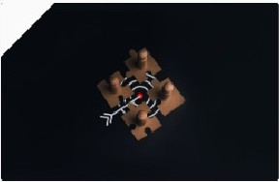

CONCLUSION HIGHLIGHTS AND KEY MESSAGE ON IOT SECURITY
Summary of Findings
NEED FOR ENHANCED IOT SECURITY
lo T devices face increasing cyber threats, necessitating robust protection layers. Handling imbalanced datasets, where certain attack types are underrepresented, remains a challenge.
EFFECTIVENESS OF DEEP LEARNING MODELS
Models like BERT demonstrate high efficiency in detecting cyberattacks on loT networks.
Ensuring real-time intrusion detection in diverse and dynamic IoT environments.
ACHIEVEDIIlGH ACCURACY
Our system shows promising results with high accuracy rates in intrusion detection.
POTENTIAL FOR FUTURE IMPROVEMENTS
Further enhancements are possible, indicating a pathway for continuous security advancement. Expand datasets to include real-world IoT attack patterns, improving model generalizability.
Develop lightweig

Slide 16

Q&.A SESSIO
ENGAGE WITH US: QUESTIONS AND ANSWERS
Thank you for your attention during our presentation. We now welcome any questions you may have, encouraging an interactive discussion and deeper insights.

