Slide 1
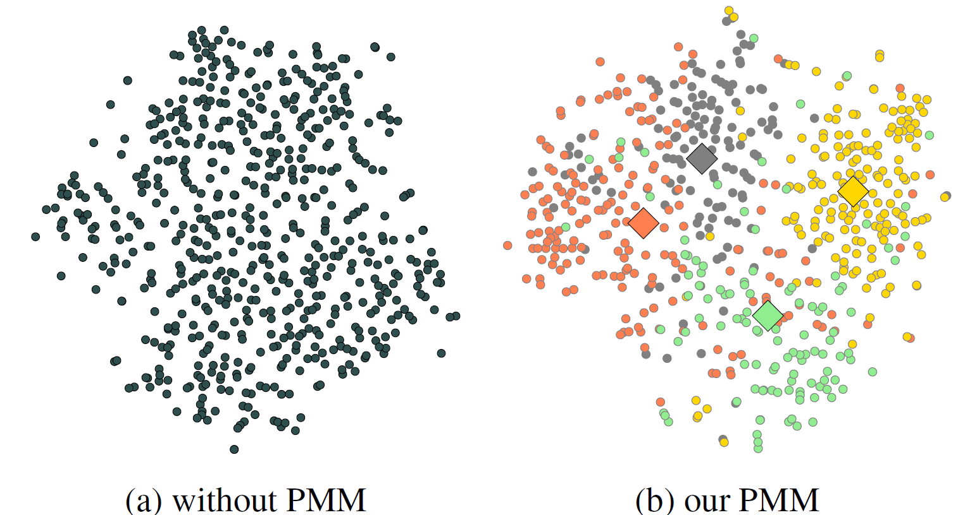

























Slide 2
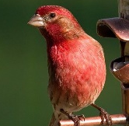

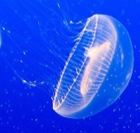

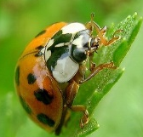
…
Initial training
…
…

Slide 3
Initial training
…
…
…
feature space

Slide 4
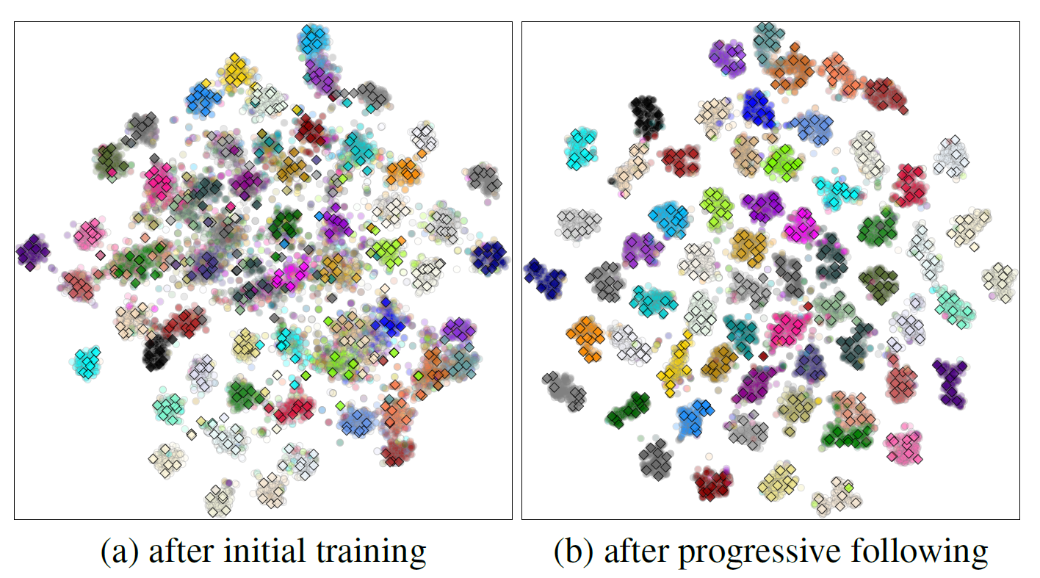
Initial training
…
…
…

Slide 5





updating the best model
updating the component set
Progressive following
…
…
…
$${\text{ℒ}}_{pr}$$
$${\text{ℒ}}_{pr}$$
training time (epoch)

