Slide 1
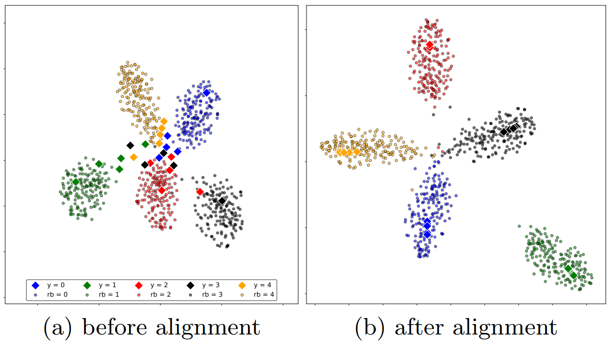


Slide 2



Detecting related bases
Notes:
Finally, we select B number of highly related base classes for each of the novel classes.
For example, here B is equal to 1.

Slide 3
Associative alignment
shared weights
classification criteria
classification criteria
alignment criteria
Notes:
Here, you see an illustration of the centroid alignment, which the novel categories (in diamond) are aligned to the center of their related bases (in circles).

