Slide 1
Lie Detector Project
NAME- Arman Ashutosh
SAP ID- 590026401
Subject: Programming in C

Slide 2
Introduction
Simple lie detector simulation using C.
Checks correctness and response time.
Marks answers as truthful or suspicious.

Slide 3
Objectives
Develop a lie detection simulation.
Compare answers with expected truth.
Measure response time for each question.

Slide 4
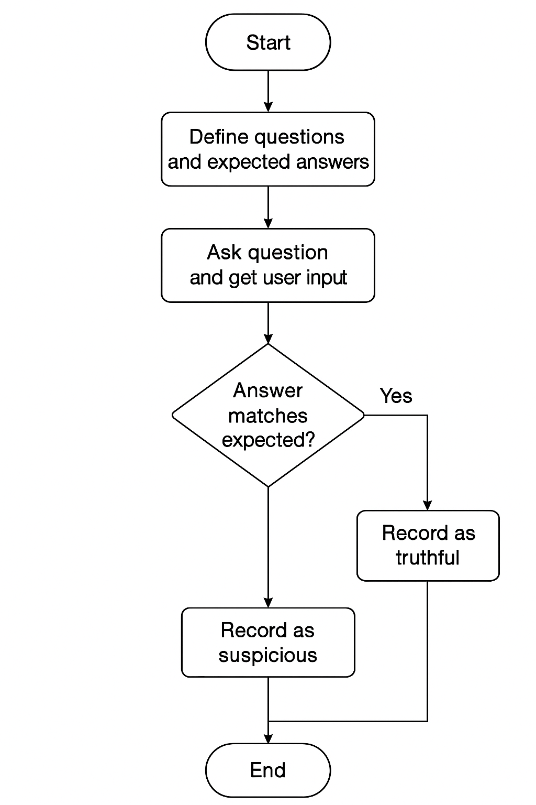
Flowchart

Slide 5
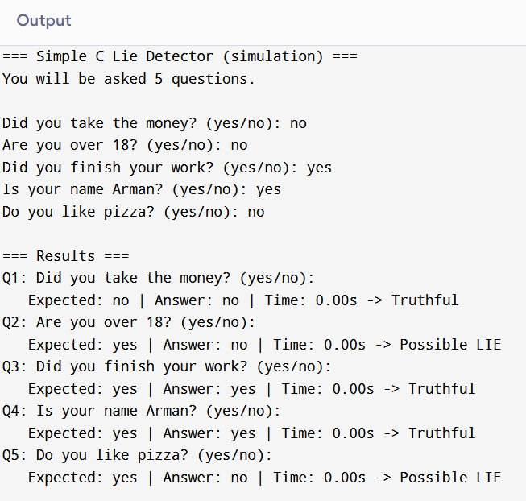
OUTPUT:

Slide 6
Features
Multiple questions.
Response-time measurement.
Suspicion detection.
Clear final summary.

Slide 7
Conclusion
Successfully simulates basic lie detection.
Educational and useful for beginners in C.
Demonstrates strings, timing, and logic.

