Slide 1
Project Scouting System

Slide 2
Introduction
The core goals of my code were to establish an effective framework for football player data management. This encompassed integrating features for seamless addition, removal, and retrieval of player information. The code strived to provide a robust and user-friendly platform for simplifying the complexities of player management. Additionally, it incorporates a feedback mechanism based on player points and writes comprehensive player details, along with feedback, to a file for reference and analysis.

Slide 3
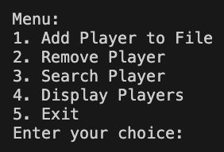
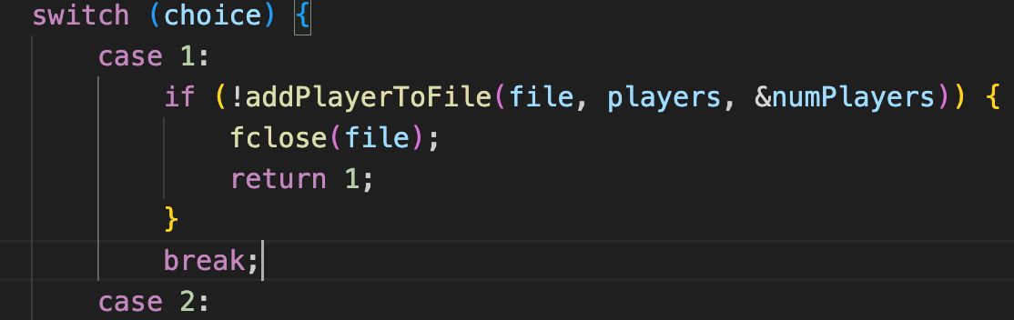
Menu
When first running the program, you will get this output where you will have to enter a number from 1 to 5
Depending on your input the program will continue
The menu functionality is implemented using a “switch” statement

Slide 4
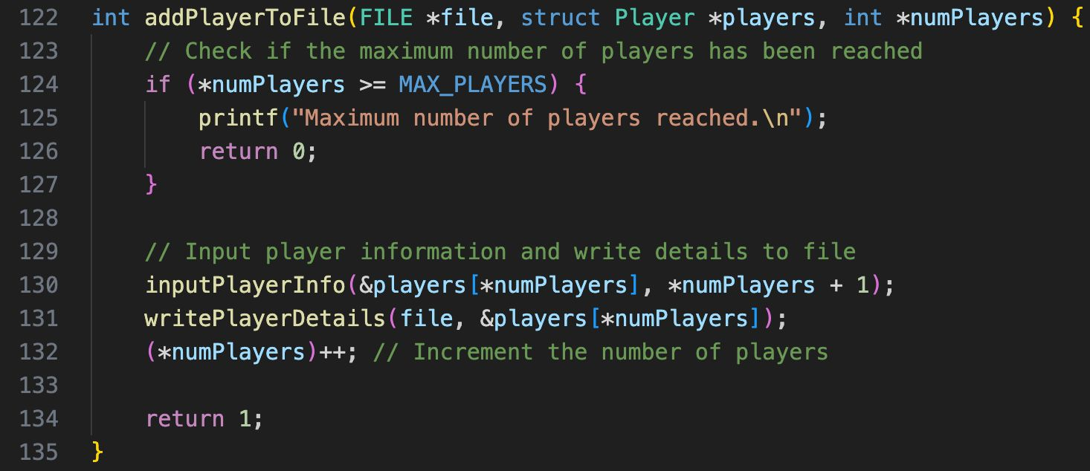
Add player
The "add" function seamlessly incorporates new player details into the system.
After adding the player, function increments “numPlayer” variable.
The function returns 1 to indicate that the addition was successful

Slide 5
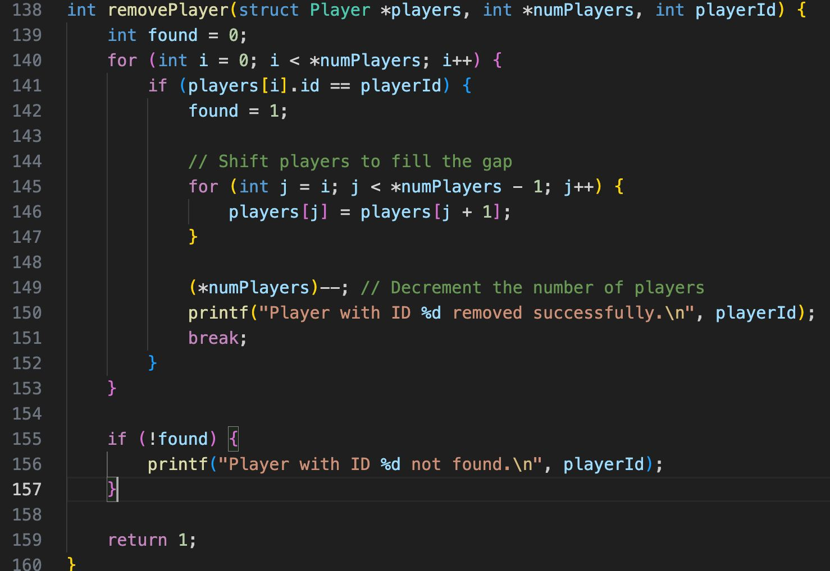
Remove player
The “remove” funciton is designed to remove a player from the array of players.
It initializes a variable “found” to 0, for indicating if the player was found.
If the player with such ID was not found the program prints the message.

Slide 6
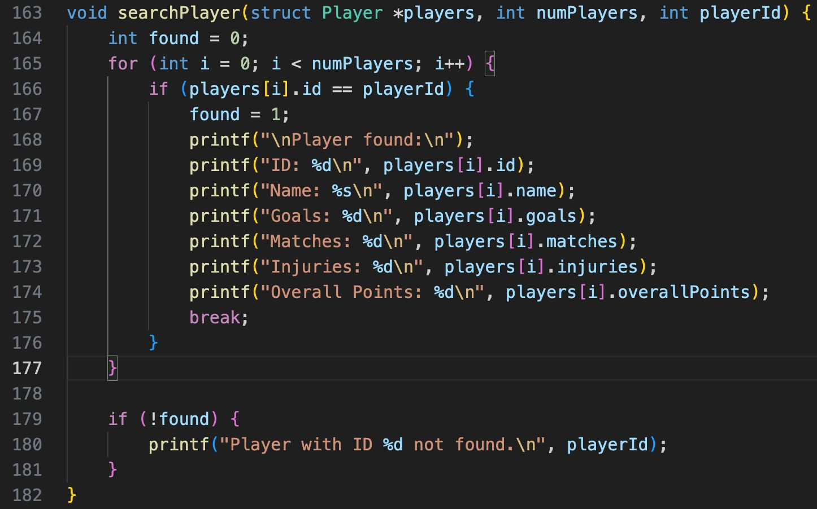
Search player
The “searchPlayer” function is designed to search for a player with specified ID
It uses the same technique to find the player as the remove function
If it finds the player, it prints a message along with the details of the players

Slide 7
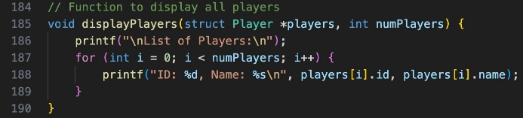

Display players
The “display” function is responsible for displaying a list of players with their IDs and names
This is how it looks like

Slide 8
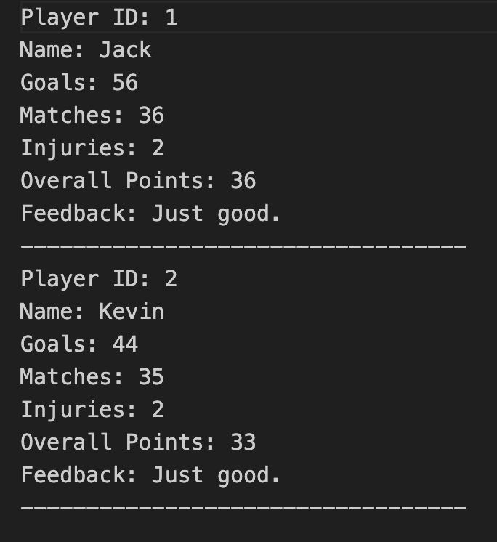
Exit
When choosing option 5 the program will stop
Function: write all players with their details and feedbacks to the file
Purpose: Terminates the program

Slide 9
THANK YOU!

