Slide 1
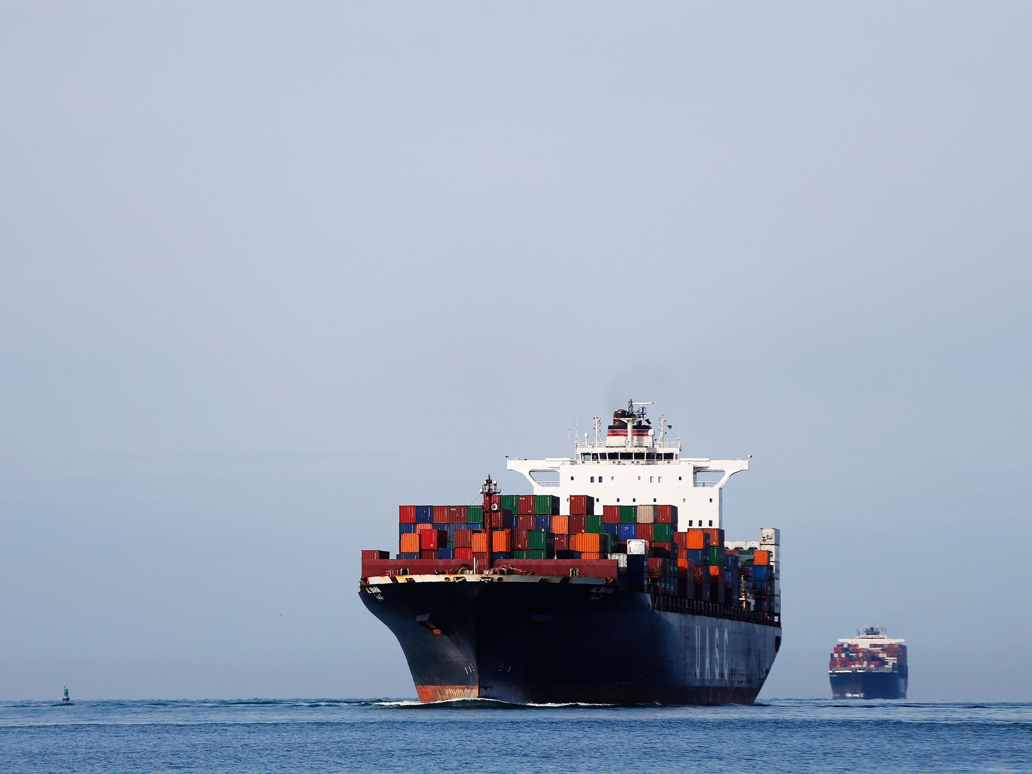
Ship Detection using Satellite Imagery

Slide 2
Background
Ship detection is an essential part of maritime surveillance
Allows for the monitoring of maritime traffic, illegal fishing and sea border activities
Typically carried out using Automated Identification Systems (AIS) which use radio frequencies and VHF transponders
These methods are very effective as ships are legally required to install a VHF transponder however without one the system cannot function
So how do you detect these ‘dark’ ships?

Slide 3
Project Goals
In the last decade, numerous companies have deployed surveillance satellites to improve monitoring capabilities
I propose two models that seek to automate the detection of ships from satellite images
Identifying images that contain ships and those that do not
Detecting and delineating each ship from its background
Using satellite imagery, in conjunction with traditional AIS monitoring, stakeholders can benefit from a clearer, more complete picture of the seas

Slide 4
Our Data
Ship Class
No Ship Class

Slide 5
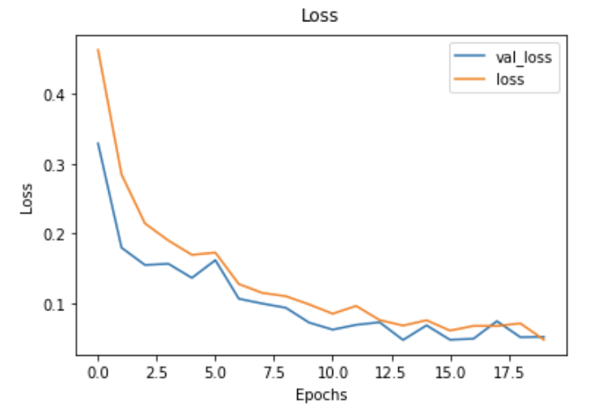
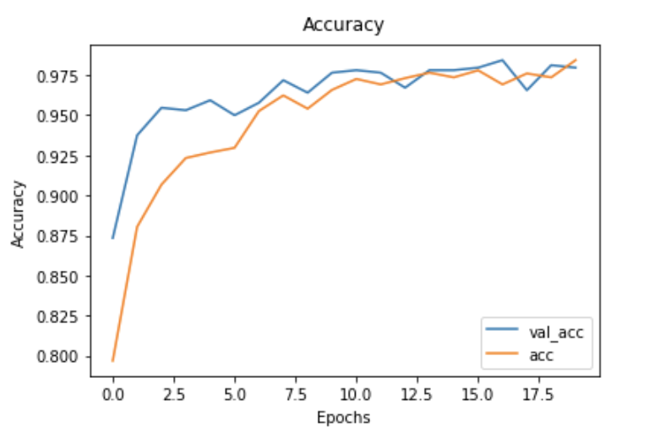
Satellite Image Classification: Ship or No-Ship
Final Model
Using 4000+ images
Baseline model: Decision Tree Classifier
Validation accuracy: 86.25%
Final model: Convolutional Neural Network
Validation accuracy: 97.9%
Test accuracy: 97.8%

Slide 6
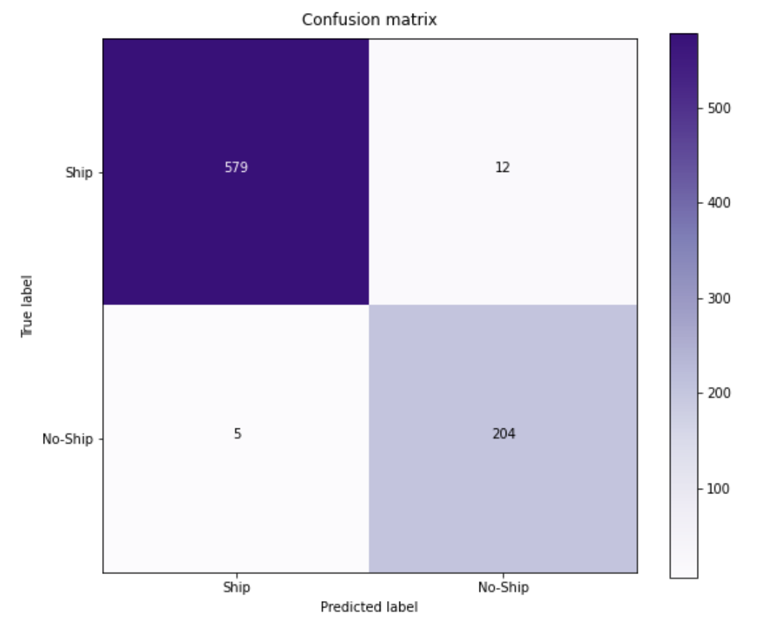
Evaluation Metrics
Accuracy: 98%
The model correctly classified images 98% of the time
Recall or True Positive Rate: 98%
The model was able to correctly identify ships when they were present 98% of the time
Sensitivity or True Negative Rate: 98%
The model was able to correctly identify images that do not contain ships 98% of the time

Slide 7
Instance Segmentation

