Slide 1

Presentation Topic: Redball bounce java game
Bangladesh Army International University of Science and Technology
Course Title : Object Oriented Programming Language Sessional-ll (Java)
Course Code: CSE-220

Slide 2
Submitted By : Submitted To:
Md. Arman Islam Mustafizur Rahman Milton
ID : 1105088 Lecturer
Dept of CSE, BAIUST

Slide 3
Feature :
Introduction to redball game.
Its Limetation’s.
ADVANTAGE

Slide 4
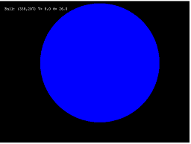
Introduction to redball:
Get ready for a platformer that will test your
skills intensively, despite looking deceptively
Easy!
If you are a fan of the classic redball bounce game,
Bounce classic game will bring you back old memories.
Bounce Classic is game for you.
firstly The player controls a redball,after the 5steps ball colours
are 2 type black add so 2 balls...
Can you win ?
It’s a game.

Slide 5
LIMETATIONS :
Dissecting BouncingBallSimple.java:
I assume that you understand Java Graphics programming (AWT/Swing and custom painting), and the multi-threading issues involved.
Our main class extends the J Panel, so as to override the paint Component() for our custom rendering codes.
In the constructor, we setup the UI components (set the preferred size for the Jpanel ). We then start a new thread to run the game update (moving the ball).
For each update step, we move the ball according to its speed and check for collision. If it exceeds the bound, we react by adjusting the ball's new position and speed. In this simple case, the ball reflects horizontally if it exceeds the x-bound, and reflects vertically if it exceeds the y-bound. We then invoke repaint() to refresh the screen, which in turn calls the paint Component().
We override paint Component() to perform our custom rendering. We use fill Rect () to draw the rectangular container box; fill Oval() to draw the round ball, and draw String() to display a status message.
In the main() method, we construct a J Frame as the application's main window. We set our custom J Panel as the content pane for the J Frame. The UI codes are run in the Event Dispatcher Thread (EDT), via javax.swing.Swing Utilities.invokeLater(), as recommended by Swing developers.
This program, although works, is poor in design (in terms of modularity, reusability and expansibility). Moreover, the collision detection and response algorithm is crude. There is also no timing control

Slide 6
Use Sector :
Java supported application
Androide

Slide 7
Procedure :
The Box class has the following public methods:
A constructor which accept the top-left corner (x, y), width, height and color. It is safer to use x, y, width and height, instead of min X, min Y, max X and max Y, to define a rectangle.
A set() method to set or reset its bounds.
A draw(g) method, to draw itself with the given graphics context g (of java .awt.Graphics).

Slide 8
Procedure :
The Ball class has the following instance variables:
x, y, radius and color, which represent the ball's center (x, y) coordinates, radius and color, respectively.
Speed X and speed Y, which represent the speed in the x and y directions, measured in pixels per time-step.
The numbers will be truncated to integral pixel values for display.
The Ball class has the following public methods:
A constructor that accepts x, y, radius, velocity in the polar coordinates of speed and move Angle and color.
A draw(g) method to draw itself with the given graphics context.
A to String () to describe itself, which is used in printing the ball's status.
A move One Step With Collision Detection(Box box) which moves the ball by one step, with collision detection and response.

Slide 9
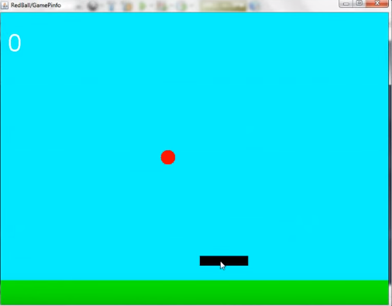
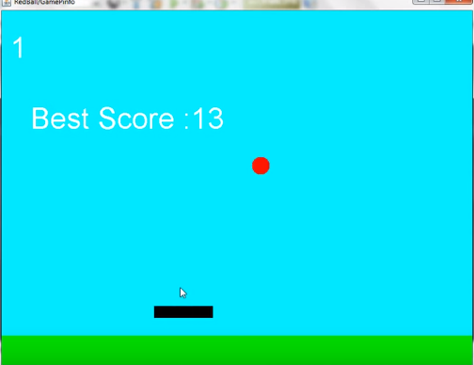
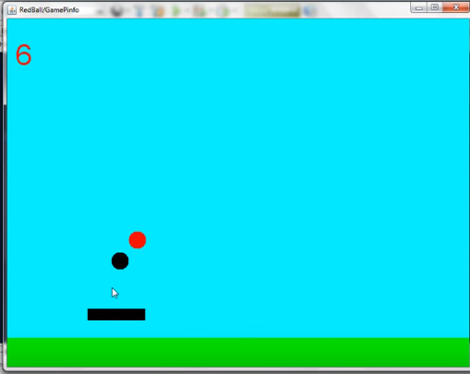
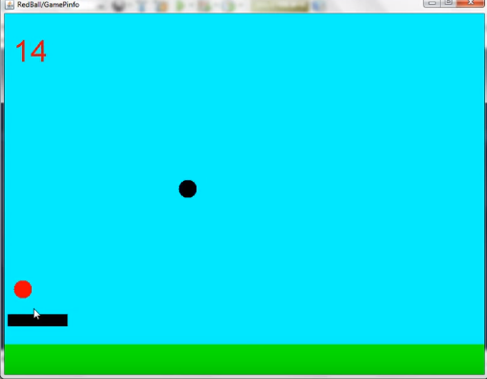

Slide 10
…………… Thank you ☺☺

