Slide 1
Keyword Recognition using Tiny Machine Learning
Detecting Words: Silence, King, Noise, Clockwise, Drive
A Machine Learning Approach
Markosyan Arman

Slide 2
Introduction
Arduino TinyML enables on-device AI for keyword recognition.
Focus on detecting words like Silence, King, Noise, Clockwise, Drive.
Possible applications: Voice assistants, IoT devices, Smart home systems.

Slide 3
Methodology
Dataset: Audio samples of selected keywords from Edge Impulse and recorded wia TinyMl.
Model: Lightweight neural network optimized for TinyML.
Hardware: Arduino TinyMl Microcontroller with low-power AI capabilities.

Slide 4
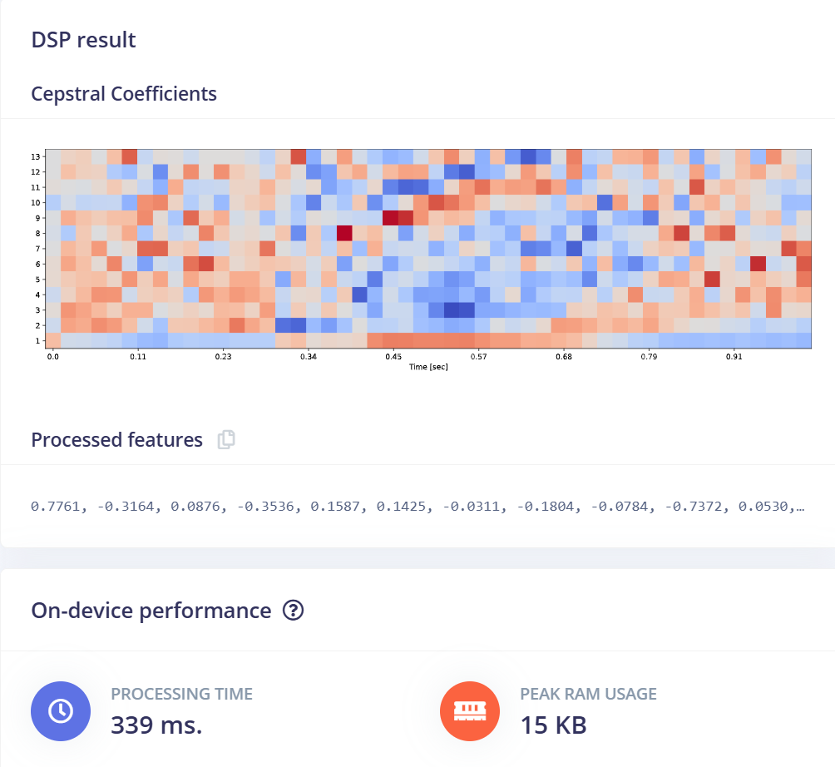

Slide 5
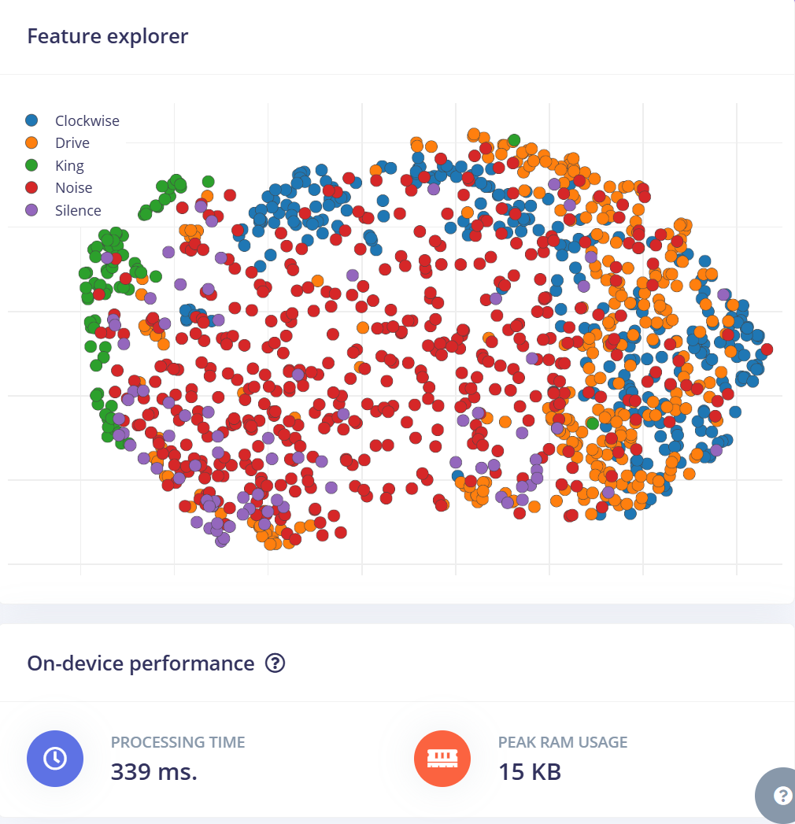

Slide 6
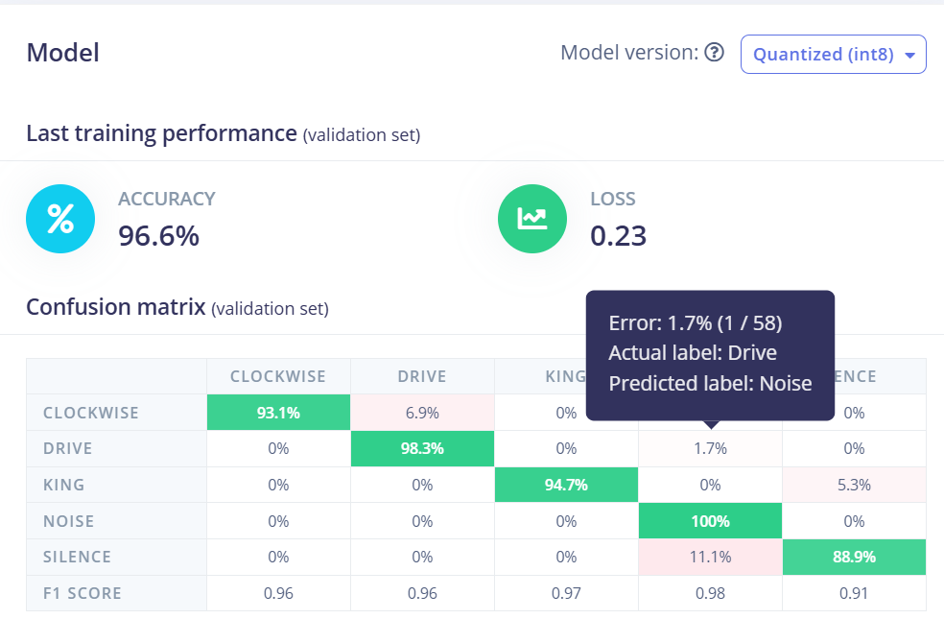

Slide 7
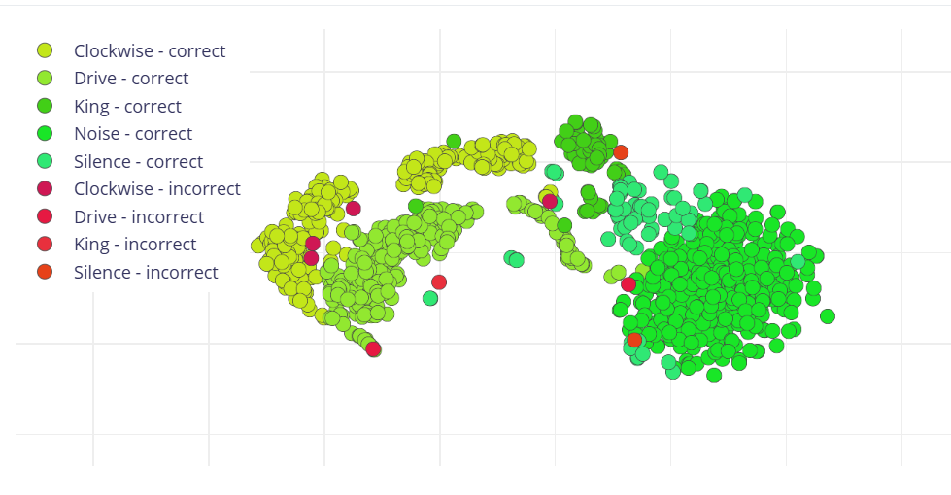

Slide 8
Results
Accuracy: Achieved >90% keyword recognition accuracy.
Latency: Low inference time suitable for real-time applications.
Deployment: Successfully implemented on an Arduino Nano 33 BLE embedded system.

Slide 9
Conclusion
TinyML is capable of making real-time keyword recognition feasible on edge devices.
Future work: Expand vocabulary, improve noise resilience.
Potential applications: Smart assistants, security systems, hands-free control.

