Slide 1
دینامیک گاز ها

Slide 2
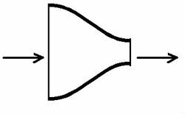
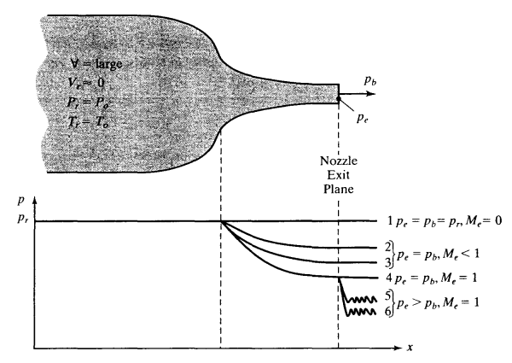
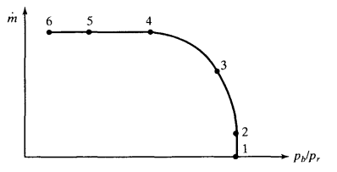


$$P_{0} =x kPa$$
$$P_{e} =y kPa$$

Slide 3
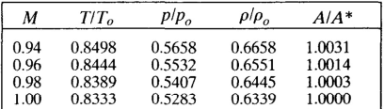
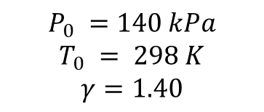
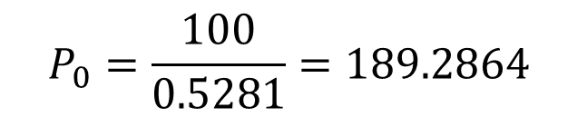


Q1
$$P_{0} =140 kPa$$
$$T_{0} = 298 K$$
$$γ=1.40$$
$$P_{e} =100 kPa$$
$$P_{0}=\frac{P_{b}}{\frac{P^{∗}}{P_{0}}}$$
$$P_{0}=\frac{100}{0.5281}=189.2864$$

Slide 4
Q1
$$P_{0} =140 kPa$$
$$T_{0} = 298 K$$
$$γ=1.40$$
$$P_{e} =100 kPa$$
$$\frac{P_{e}}{P_{0}}=\frac{100}{140}=0.7143, M_{e}=0.7103, T_{e}=0.9083\left(298\right)=270.6734$$

Slide 5

Q1
$$P_{0} =140 kPa$$
$$T_{0} = 298 K$$
$$γ=1.40$$
$$P_{e} =100 kPa$$
$$ρ_{e}=\frac{P_{e}}{RT_{e}}=\frac{100}{0.2968∗282.8616}=1.1911\frac{kg}{m^{3}}$$
$$V_{e}=M_{e}.\sqrt{γRT_{e}}=0.5171.\sqrt{1.4∗296.8∗282.8616}=177.2791\frac{m}{s}$$
$$m^{.}=ρA_{e}V_{e}=1.1911∗56∗{10}^{−4}∗177.2791=1.1825\frac{kg}{s}$$

Slide 6


Q2
$$P_{0} =200 kPa$$
$$T_{0} = 298 K$$
$$γ=1.40$$
$$P_{e} =100 kPa$$
$$P_{e}>P_{choke}, M_{e}=1.0, T_{e}=0.8333\left(298\right)=248.3234 K$$
$$P_{e}=0.5283∗200=105.6600 kPa$$
$$ρ_{e}=\frac{P_{e}}{RT_{e}}=\frac{105.66}{0.2968∗248.3234}=1.4336\frac{kg}{m^{3}}$$
$$V_{e}=M_{e}.\sqrt{γRT_{e}}=1.\sqrt{1.4∗296.8∗248.3234}=321.2216\frac{m}{s}$$
$$m^{.}=ρA_{e}V_{e}=1.4336∗56∗{10}^{−4}∗321.2216=2.5788\frac{kg}{s}$$

Slide 7



Q2
$$P_{0} =140 kPa$$
$$P_{e} =100 kPa$$
$$P_{0} =200 kPa$$

Slide 8
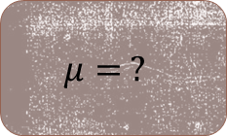
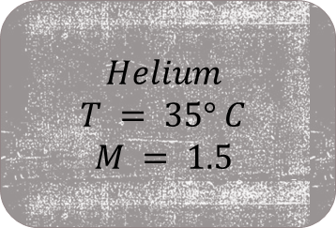
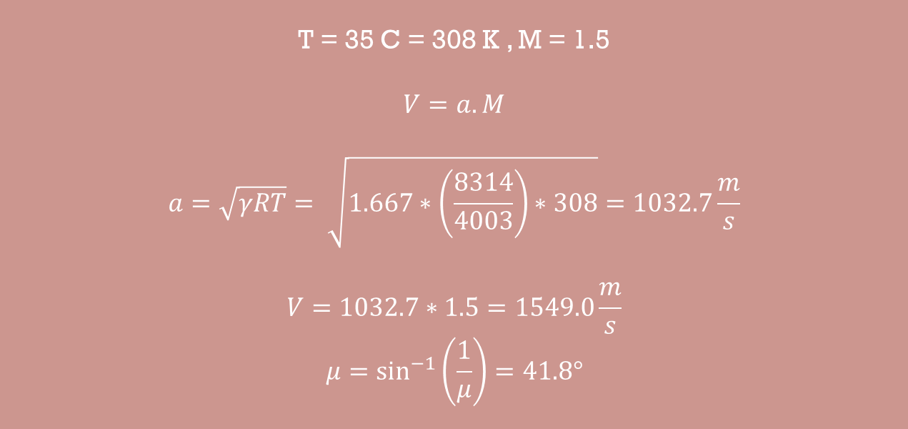
$$Helium$$
$$T = 35° C$$
$$M = 1.5$$
Q3
T = 35 C = 308 K , M = 1.5
$$V=a.M$$
$$a=\sqrt{γRT}= \sqrt{1.667∗\left(\frac{8314}{4003}\right)∗308}=1032.7\frac{m}{s}$$
$$V=1032.7∗1.5=1549.0\frac{m}{s}$$
$$μ=\sin^{−1}\left(\frac{1}{μ}\right)=41.8°$$
$$μ= ?$$

