Slide 1
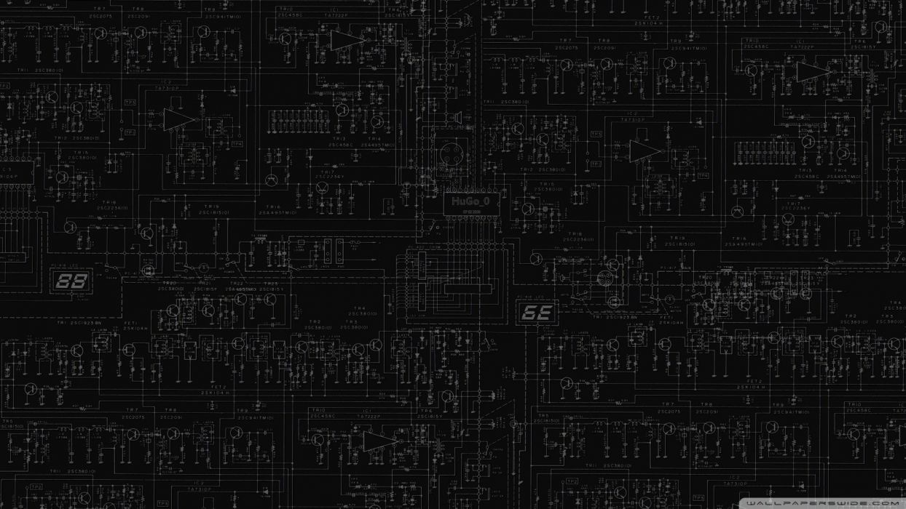
SAG DRONING
MMA8451-Triple Axis Accelerometer.

Slide 2
INTRODUCTION
We will talk about MMA8451(TRIPLE AXIS ACCELEROMETER)
It is used to measure the x, y, z readings on any ground
I wanted to collaborate with Gursehaj and Shubham to create a extension device for drone that will have combinations of multiple sensors.

Slide 3
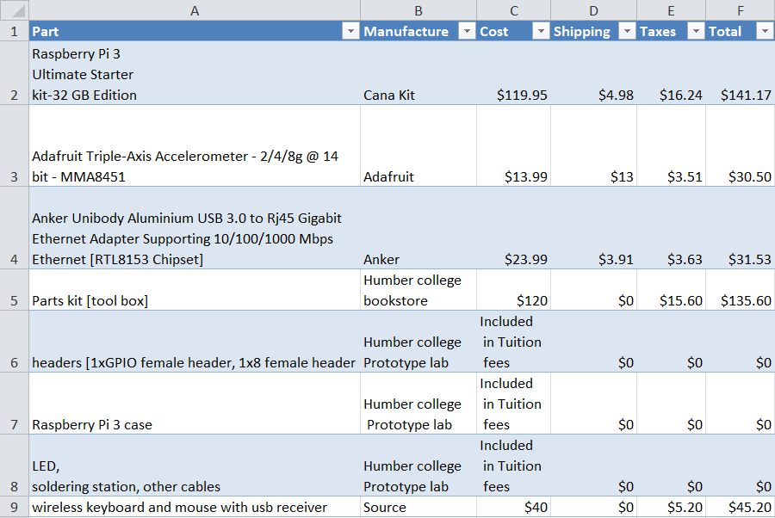
BUDGET

Slide 4
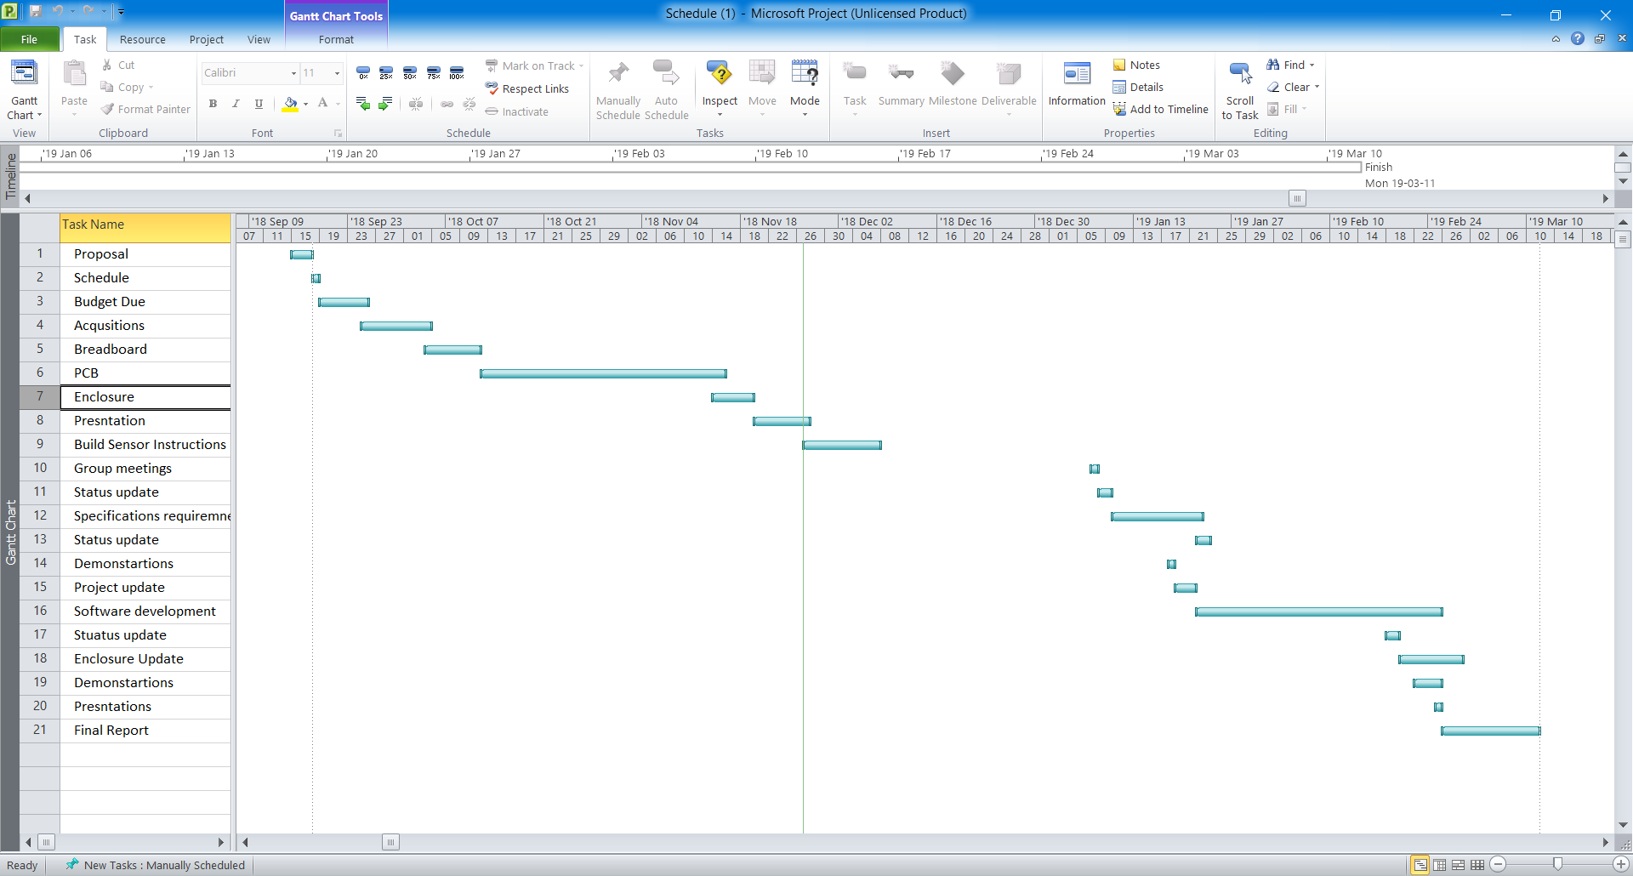
SCHEDULE

Slide 5
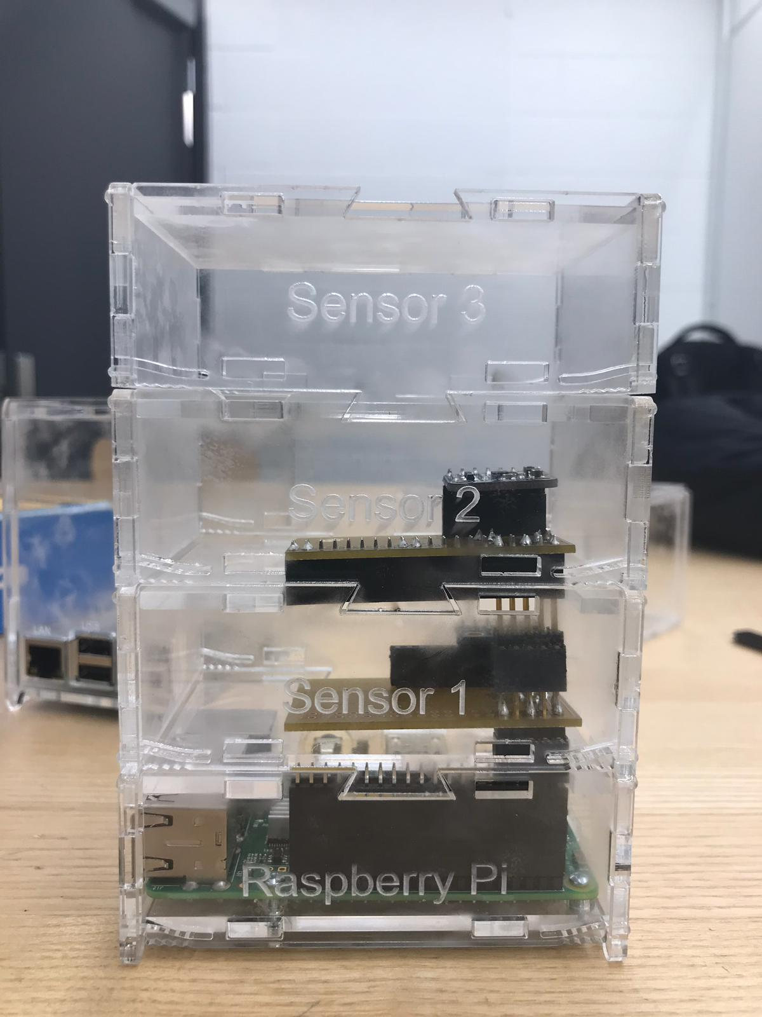
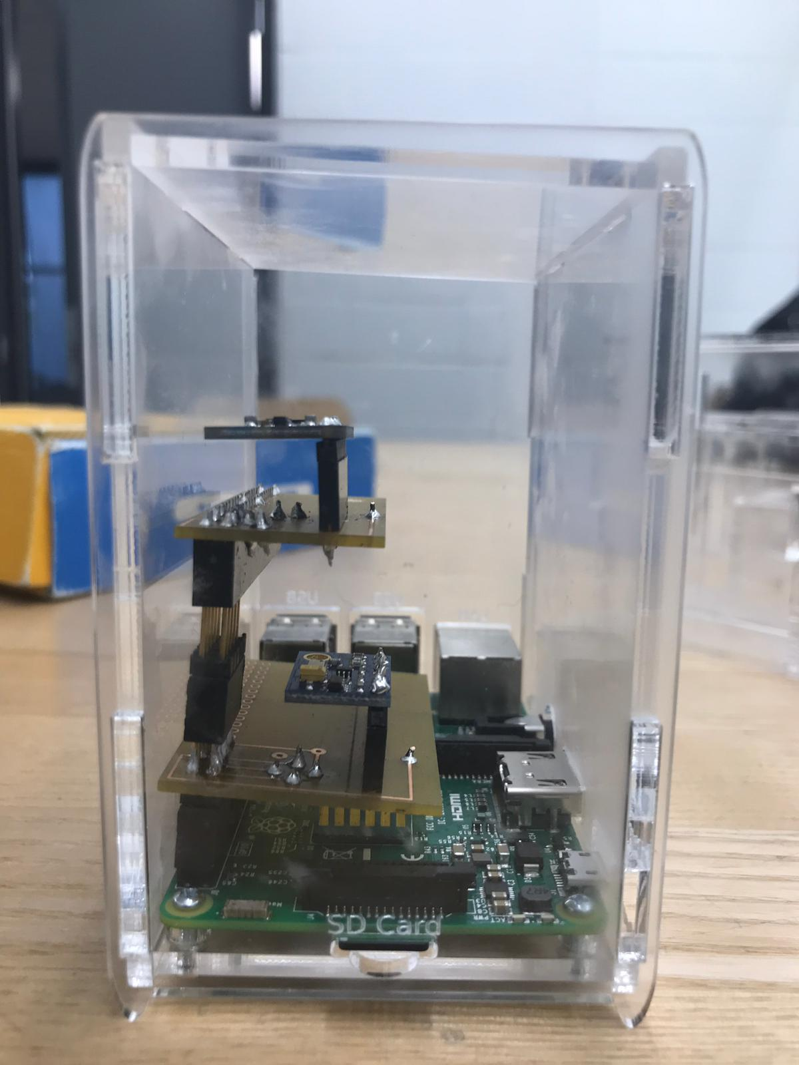
PRODUCT

Slide 6
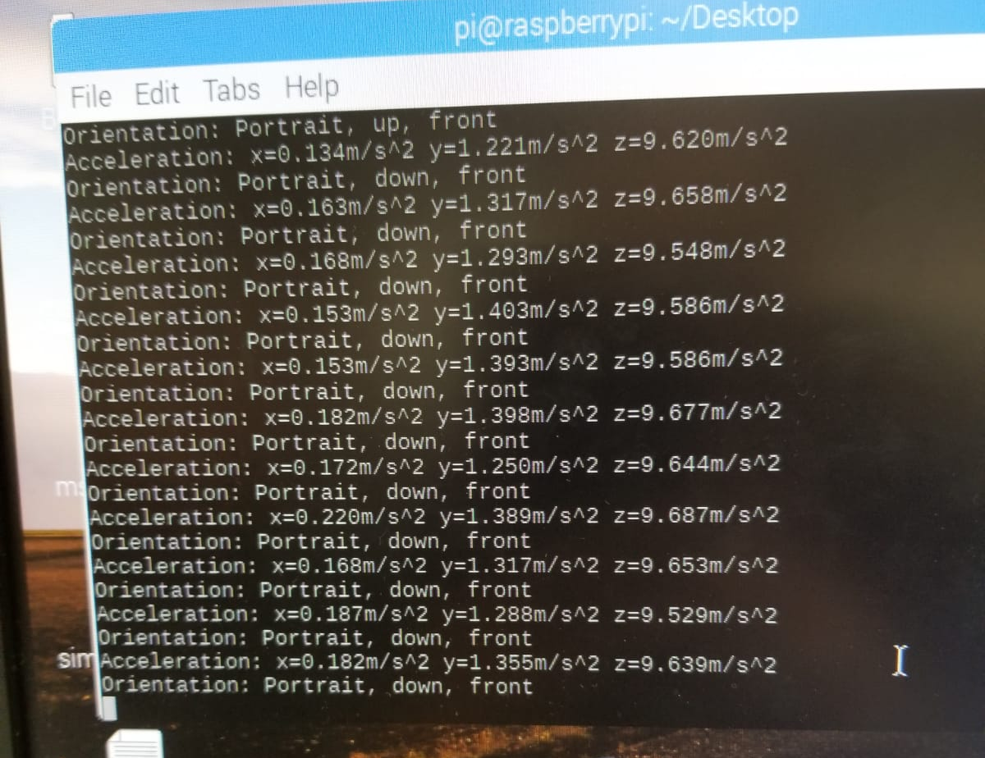
SENSOR READINGS

Slide 7
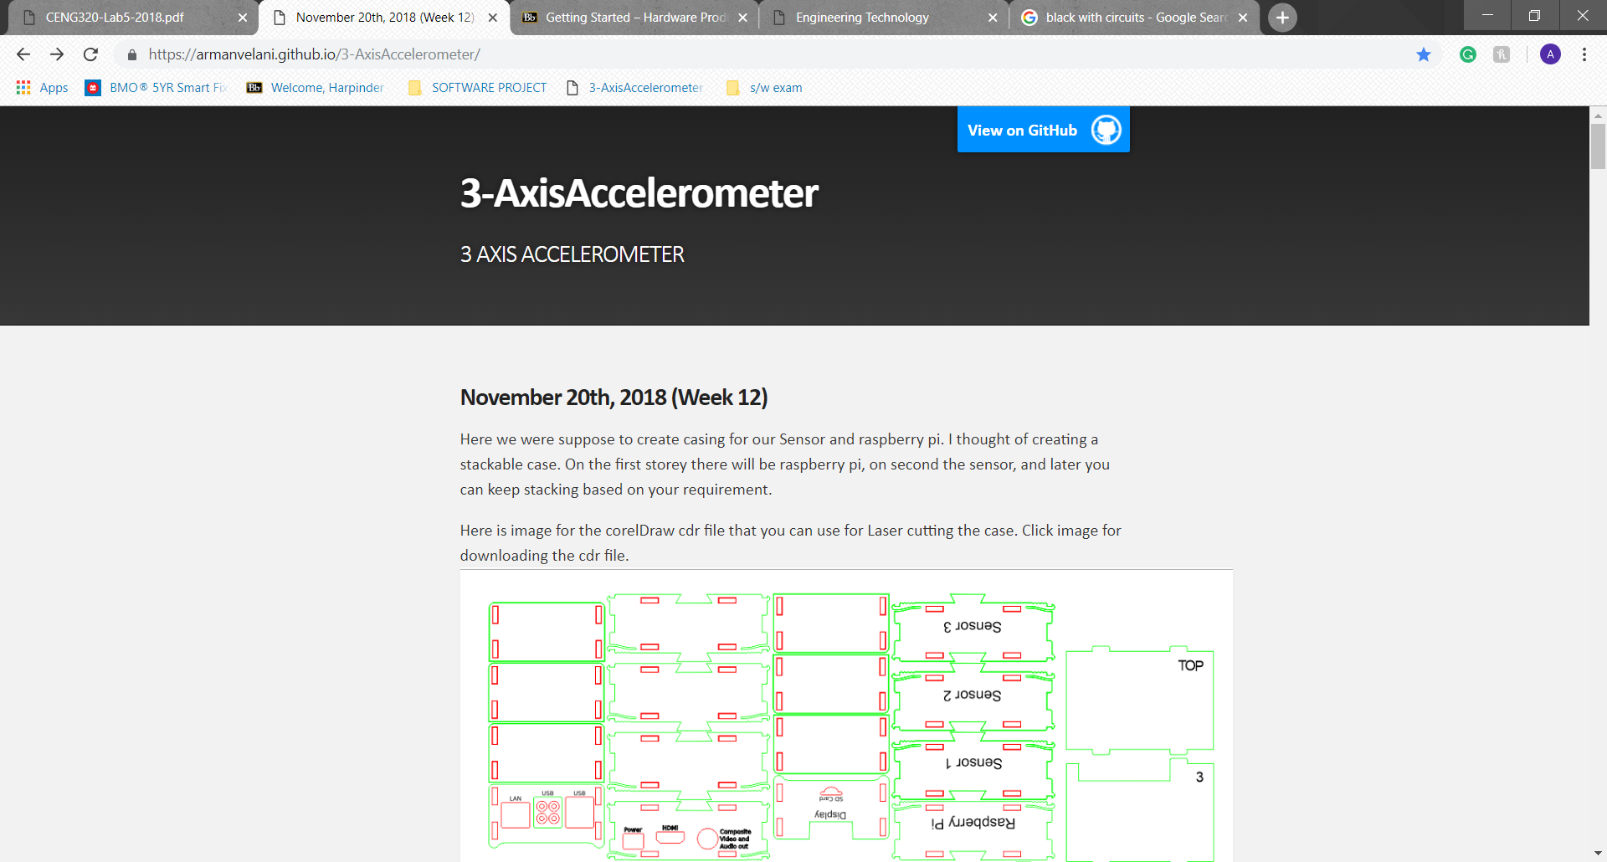
GITHUB.
https://armanvelani.github.io/3-AxisAccelerometer/

Slide 8
Thank you
***.This is the end.***

