Slide 1

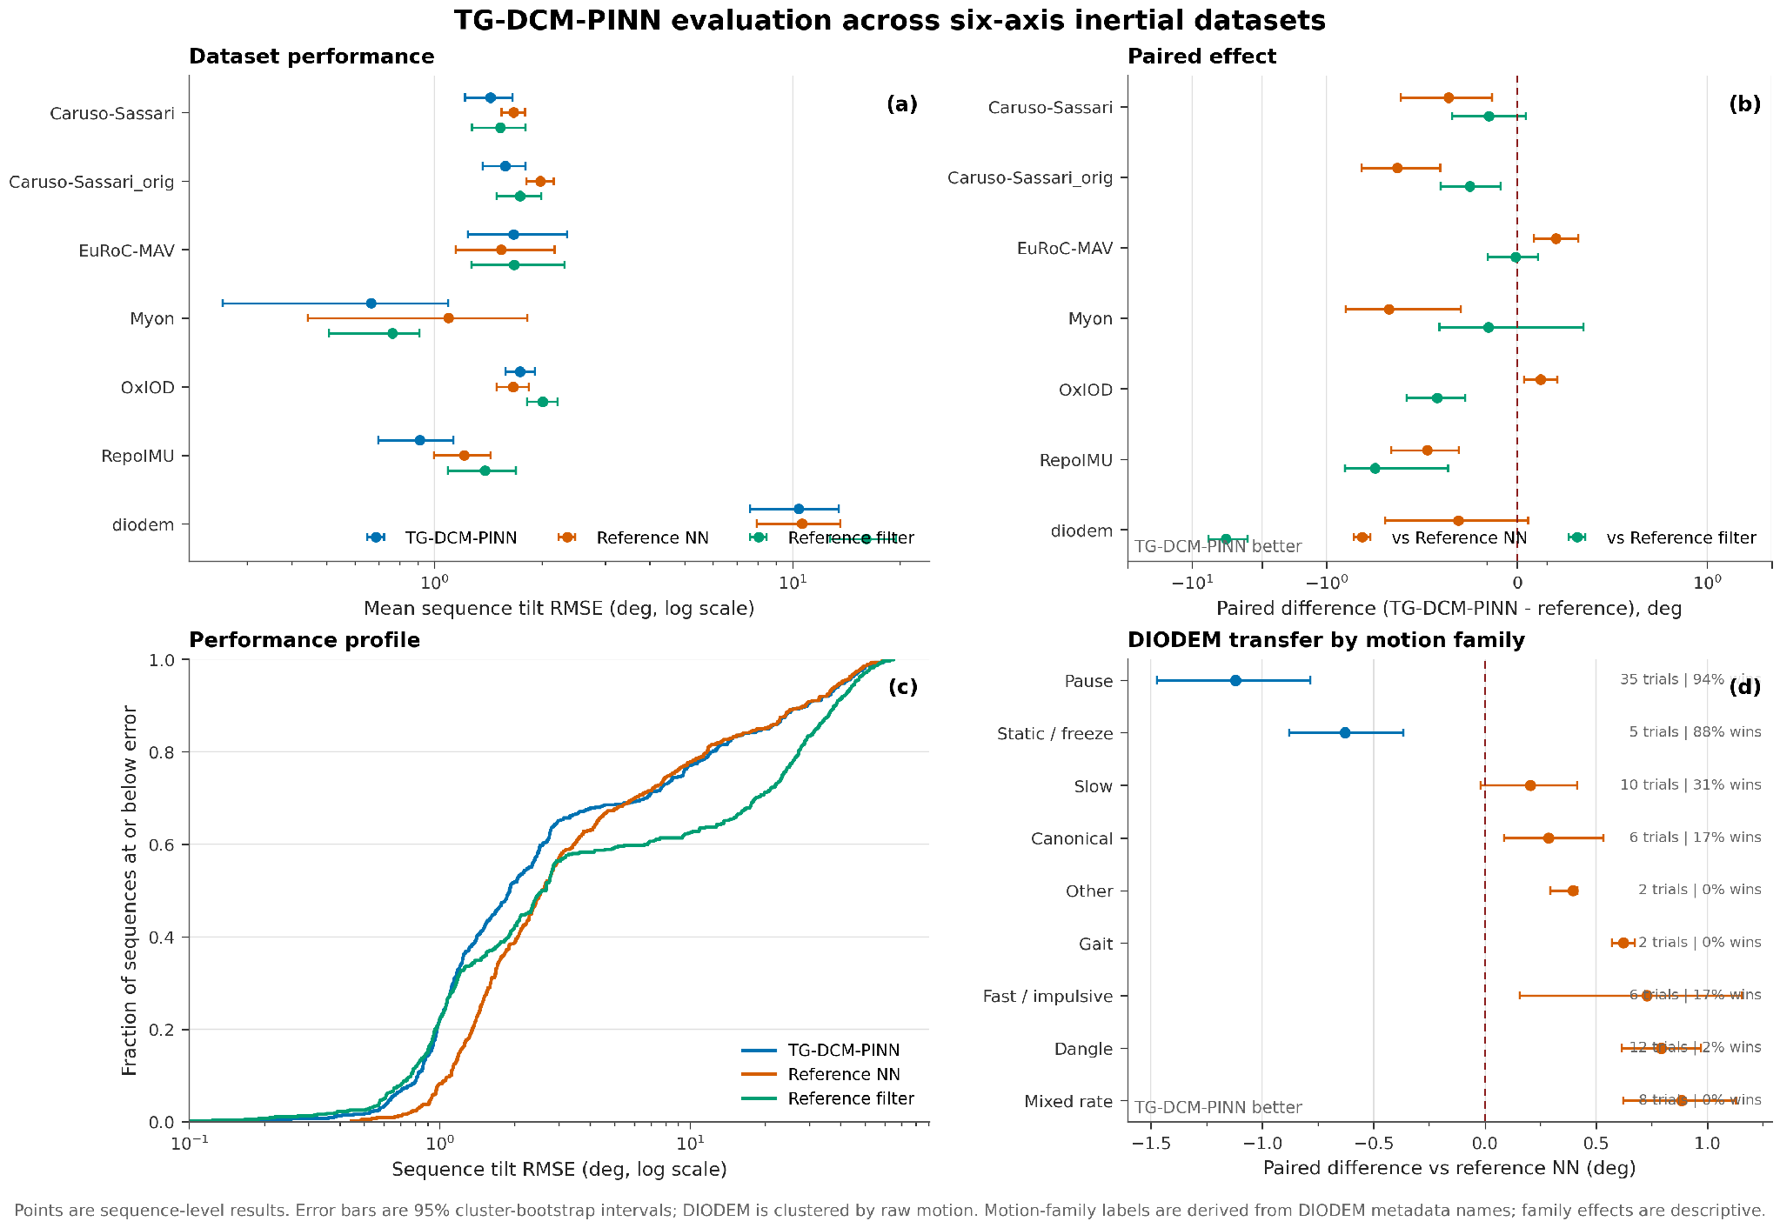





July 20–21, 2026 • Koç University, İstanbul
7th Turkish Robotics Conference
Poster ID: 95
TG-DCM-PINN: Target-Gated Direction-Cosine Physics for Six-Axis Inertial Attitude Estimation
Arman Asgharpoor Golroudbari¹ • ¹GinkgoQ
Presenter: Arman Asgharpoor Golroudbari • ai-team@GinkoQ.com
PROBLEM
METHOD
EVALUATION
Pointwise supervision can produce accurate individual tilt estimates without enforcing gyro-consistent motion between frames, while accelerometer-based correction becomes unreliable when dynamic acceleration contaminates gravity.
IMU window
Neural estimator
Prediction
Primary metric: sequence-level tilt RMSE. Paired bootstrap intervals use sequences on the standard split and raw-motion clusters on DIODEM.
acceleration · angular rate · Δt
2-layer GRU · hidden 200
quaternion → vertical direction
RESEARCH QUESTION
Vertical direction used by both gates
Can a learned estimator improve tilt by enforcing inertial relationships only when the measurements support them?
CONTRIBUTIONS
A TARGET-GATED GYRO DYNAMICS
1 Direction-cosine tilt physics
1. Propagate the labelled tilt with the measured angular increment.
Convert each predicted quaternion into its body-frame vertical direction, so every physical term acts directly on the observable tilt geometry.
2 Target-gated gyro dynamics
2. Accept the transition only when propagation matches the next labelled tilt.
Use labelled transitions to identify when gyro propagation is trustworthy, then enforce prediction consistency only on accepted pairs.
3 Confidence-gated gravity
3. For accepted pairs, propagate the prediction and penalize disagreement between propagated and next predicted vertical directions. Ignore the first 0.15°.
Build a continuous confidence from acceleration magnitude, jerk, and angular rate before applying the gravity anchor.
Dataset means, paired effects, performance profile, and DIODEM motion families. Negative paired change favors TG-DCM.
4 Robust composite objective
Purpose: enforce measured rotational evolution only on trustworthy target transitions.
Combine supervised tilt, unit-quaternion regularization, two gated physics terms, dead zones, and Charbonnier penalties.
STANDARD SPLIT
5 Regime-aware evidence
B CONFIDENCE-GATED GRAVITY
Mean tilt RMSE decreases by 0.091°. The paired interval excludes zero.
Evaluate 559 sequences and expose dataset, motion-family, confidence-interval, and tail behavior instead of reporting one pooled mean.
1. Estimate whether acceleration is a credible gravity observation.
DATASET DEPENDENCE
WHY CHARBONNIER?
Caruso-Sassari, Myon, and RepoIMU improve; EuRoC-MAV and OxIOD regress.
Acceleration magnitude checks proximity to gravity; jerk detects changing linear acceleration; angular rate suppresses correction during fast rotation.
DIODEM TRANSFER
2. Align predicted vertical with normalized acceleration using this continuous weight.
Mean change is −0.195°, but the raw-motion-clustered interval crosses zero.
Small residuals receive a smooth quadratic penalty; large residuals grow linearly. Difficult or corrupted samples therefore cannot dominate the gradient.
MOTION DEPENDENCE
Near zero
Purpose: use gravity strongly in calm motion and suppress it during dynamic acceleration.
Pause and static segments improve most. Sustained and impulsive motion remains the weak regime.
Large residual
COMPLETE TRAINING OBJECTIVE
CONCLUSION
PHYSICS-INFORMED REGULARIZER
Reliability-gated physical constraints improve average standard-domain tilt accuracy. The gain concentrates in low-dynamics regimes; the next method must learn when and how strongly to correct tilt during sustained and abrupt motion.
The DCM appears only inside the auxiliary loss. Each normalized quaternion is mapped to the body-frame world-vertical direction h(q). Dynamics compares the gyro-propagated prediction with the next prediction; gravity compares h(q) with normalized acceleration. Both terms constrain the observable tilt direction without constructing a full rotation matrix.
Dead zones: dynamics 0.15° · gravity 0.20° · Charbonnier scale 0.50°
IMPLEMENTED GATED TRAINING LOGIC
SCOPE AND RESEARCH BOUNDARY
SEQUENCE INPUT
RECURRENT ESTIMATOR
DCM VERTICAL ROW
COMPOSITE OBJECTIVE
TRAINING-TIME PHYSICS, LEAN DEPLOYMENT
acceleration · angular rate · Δt
training target quaternion
2-layer GRU · hidden 200
predicted quaternion sequence
normalize q, then compute h(q)
shared tilt representation
supervised tilt + norm
conditional dynamics + gravity
The DCM projection, target validation, confidence calculation, and both physics losses exist only in training. Deployment receives acceleration, angular rate, Δt, and recurrent state; it returns a normalized quaternion. No target, gate, or separate physical filter is required.
ALWAYS ACTIVE ON ITS VALID SUPPORT Labelled frames: supervised tilt loss. Every prediction: unit-quaternion regularizer weighted 0.01.
A DYNAMICS BRANCH · PAIR-LEVEL · TARGET-GATED
LIMITATIONS SUPPORTED BY CODE AND RESULTS
PAIR VALID?
TARGET TEST
PREDICTION TEST
ROBUST RESIDUAL
BRANCH OUTPUT
The three confidence scales and 10⁻⁴ floor are fixed globally, not calibrated to sensor or motion regime. The target gate needs consecutive valid labels. Low-jerk sustained acceleration near |a| = g can remain plausible to the gravity gate. No controlled ablation isolates either physics term or the training stack. DIODEM remains heavy-tailed: median 2.70°, p95 44.20°, maximum 62.38°.
two finite labels
finite gyro and Δt
gyro-propagate target
accept only if error ≤ 2°
gyro-propagate prediction
compare vertical directions
remove first 0.15°
Charbonnier scale 0.50°
masked mean × 0.10
failed decision → exact zero
B GRAVITY BRANCH · FRAME-LEVEL · CONFIDENCE-GATED
INPUT VALID?
THREE FACTORS
GATE DECISION
TILT RESIDUAL
BRANCH OUTPUT
finite acceleration, gyro
and Δt
|a| near 9.81 · low jerk
low angular rate
multiply confidences
accept only if > 10⁻⁴
h(q) versus a/|a|
remove first 0.20°
confidence × Charbonnier
masked mean × 0.05
NEXT EXPERIMENTS
LOSS EXECUTION
Active terms are summed and backpropagated; an empty mask returns zero instead of an invalid mean. The target gate is binary. The gravity gate is binary at the floor and continuous above it.
Run controlled multi-seed ablations for supervised-only, dynamics-only, gravity-only, dead zones, confidence factors, training budget, and EMA. Replace fixed gravity confidence with a temporally calibrated estimator that models sensor bias and sustained specific force while retaining physically interpretable inputs. Select and report models with motion-balanced and tail-risk criteria, not mean tilt alone.
TRAINING
INTERPRETATION
EXACT ZERO-CONTRIBUTION CASES
• 512 epochs, 300 batches/epoch, 9000-sample windows, TBPTT length 1800.
• Ranger; gradient clipping 1.0; BF16/TF32 on CUDA
• EMA checkpoint selected at epoch 491.
• Val: 557 sequences
• The dynamics gate is label-derived: it tests whether gyro propagation agrees with the next target.
• The gravity gate is input-derived: it estimates confidence from acceleration magnitude, jerk, and angular rate.
• Gate values regulate training gradients; they are not evaluation-time quality scores.
• Dynamics is zero for fewer than two frames, invalid consecutive targets, non-finite gyro/timing, or target-propagation error above 2°.
• Gravity is zero for non-finite inputs or combined confidence at or below 10⁻⁴; accepted frames retain continuous confidence weighting.
• Residuals inside the 0.15° dynamics or 0.20° gravity dead zone are zero before robustification.
TG-DCM-PINN treats physics as conditional evidence: validates gyro transitions | estimates gravity reliability | applies each tilt constraint only where it is credible.
Observed result: lower mean tilt error on the standard split, with remaining failures concentrated in dynamic motion.

