Slide 1

K-Means Clustering
Sequential and parallel implementations
Armand Palla-7042287

Slide 2
Clustering via K-Means
K-means clustering is a type of unsupervised learning, which is used when we have unlabeled data (data without defined categories or groups).
The goal of this algorithm is to find groups in the data, with the number of groups represented by the variable ’K’.
The results of the K-means clustering algorithm are:
The centroids of the K clusters, which can be used to label new data.
Labels for the training data (each data point is assigned to a single cluster).

Slide 3

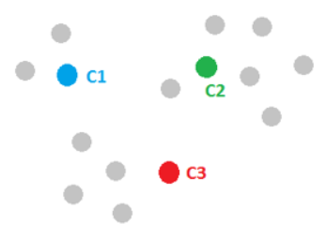
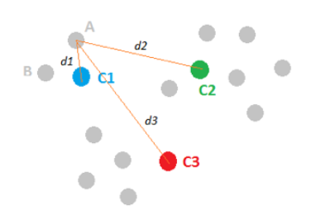
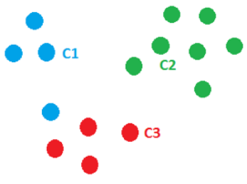
Understanding the algorithm
Step one: Initialize cluster centers and pick randomly 3 points.
Step two: Assign observations to the closest cluster center.
We can assign each point to the clusters based on the minimum distance to the cluster center. This leads to the following picture:

Slide 4
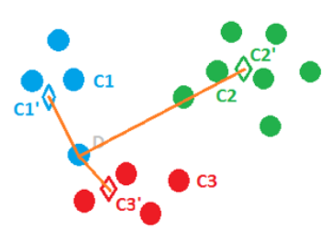
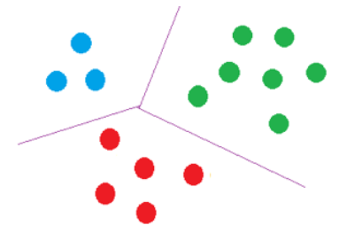
Understanding the algorithm
Step three: Revise cluster centers as mean of assigned observations.
We can find the center mass of the blue cluster by summing over all the blue points and dividing by the total number of points, which is four here. The same for green and red clusters.
Step four: Repeat step 2 and step 3 until convergence.
With the new centers point D becomes closer to C3’ and can be assigned to the red cluster. Finally we get:

Slide 5
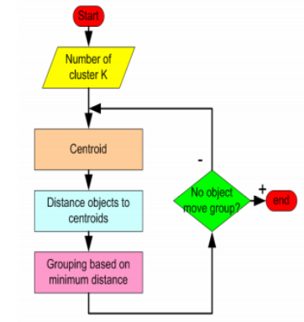
Understanding the algorithm

Slide 6
The Idea of Sequential Algorithm.
Create dataset of points and initialize clusters.
Add the points to the nearest cluster.
Revise cluster centers.
Output the results.

Slide 7
The Idea of Parallel Algorithm.
Create dataset of points and initialize clusters.
Create n threads as are the number of clusters.
For every thread assign the points to the nearest cluster.
Revise clusters centers.
Output the results.
Every thread updates the clusters

Slide 8
The way to parallelize
I decided to use OpenMP as a library for multithreaded computing for these reasons :
OpenMP offers the possibility to be able to directly modify the sequential version of the algorithm in order to make the code run on multiple threads instead of a single one.
Each thread executes the parallelized section of code independently.
Allowing the programmer to make use of multithreading by using some specific OpenMP compiler directives such as:
#pragma omp parallel

Slide 9
Conclusions
The main intention of this project is to use more data at the same time using parallel computing.
K-Means is one of the most simple algorithm to understand clustering of data with the same characteristics or features.
K-Means clustering is one of the most simple algorithm to understand the parallel execution of a program.
The main reason that we do parallel programming is to execute code efficiently, since parallel programming saves time and allows the execution of applications in a shorter time.

