Slide 1
Betclick churn Modeling

Slide 2
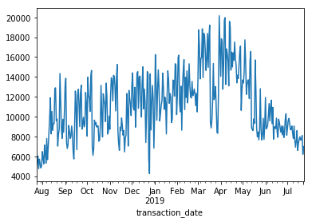
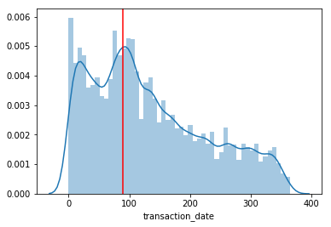
Labelling
Number of transaction by date
To label churners we get:
the date of the last transaction of each user
the last date of the dataset
=> we compute the number of days between both values for each user. Flag true if > 90 otherwise False
it is also necessary to drop all transactions occurring after the '27/06/2019’, Indeed in our training setting those transactions represents future unseen values and could induce target leakage.
A few stats:
on a random sampled 200K transactions:
60% of the customers actually churned (36K/60K)
only 4% of transactions are dropped because leaky
Number of transaction by date
Distribution of days since last activity (red line=90)

Slide 3
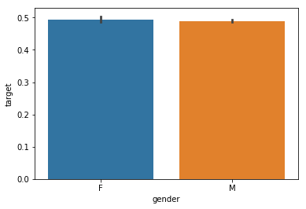
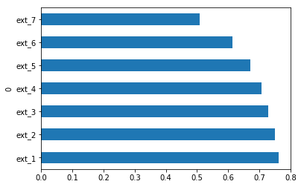
Feature choice and Exploration(1/3):
Proportions of churners by gender
Gender
The dataset contains many more men than women. Not much difference between churn rate and target.
Acquisition channel :
channels [12, 20, 17, 10, 11, 16, 14] occurred for less than 200 customers are too rare to draw conclusions
on the remaining ones the proportion of churners seems to be homogenous among channel.
customer segmentation
one customer can have several segment ids, so we decide to consider the segment of the last transaction only (most recent)
it seems to be the around the same number of customers in each segment (by construction?)
Proportion of churners among segments

Slide 4
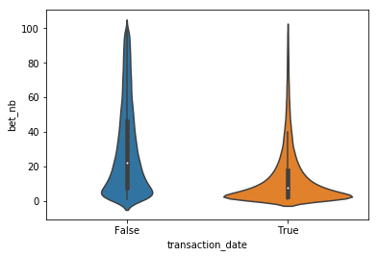
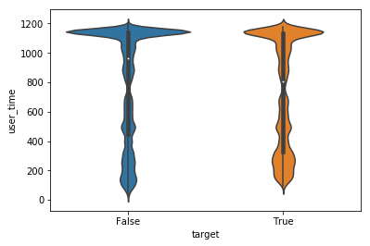
Feature choice and Exploration(2/3):
Distribution of bet numbers churner vs non churners
User activity
The number of bets or the seems to be very discriminative (correlation with user activity).
(similar for deposits numbers, number of days including transactions)
Their variance and variation seems to be predictive (non churners are more constant)
User Loyalty and age :
The time since registration date is a good proxy for user loyalty, and seems highly indicative but truncated at around 1100 days.
On average churners are also more recent customers
We can also notice that churners are younger on average
(34 vs 36 y.o.)
Days Since first registration

Slide 5
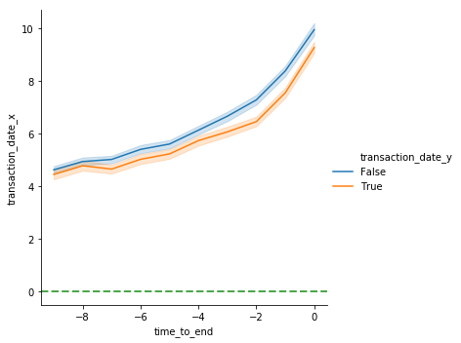
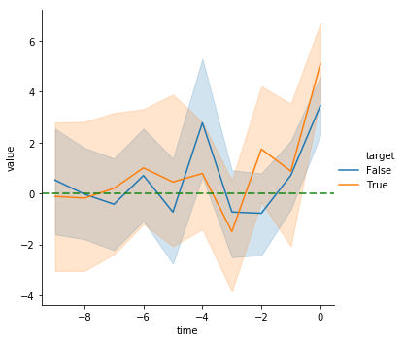
Feature choice and Exploration(3/3):
Normalized inverse betting frequency (orange: churners)
Custom variables
Nb of days between transaction dates (inverse betting frequency)
the graph shows that the time interval between bets of churners is lower than bet frequency of non churner (orange below blue)
X axis is Normalized on last transaction
0 : is the date of last transaction
-1 : previous transaction
Y axis is the nb of days between bets
Normalized variations:
We could see changes in the behavior of bettors near the last transactions.
Ex: Evolution of _1 shows an increase near the last transaction.
Note: some of this custom variables were not included in the modeling (the error analysis indicates errors are very high on customers having a single row in the dataset..)
Evolution of _1

Slide 6
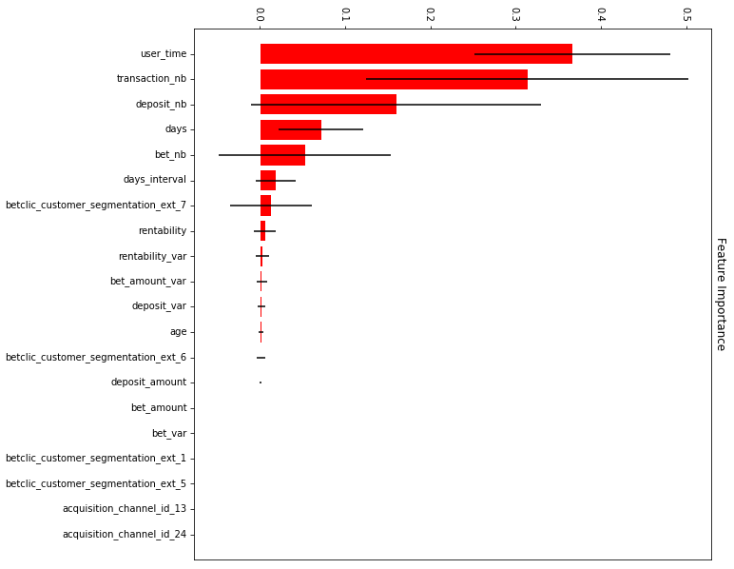
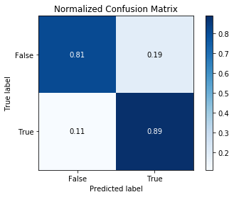
Modeling:
Model selection and Parameters tuning
Features importance of Random Forest.
Model selection & parameters tuning
- Features selection performed with iterative features elimination.
Scaling is performed via feature-wise normalization.
- Model and hyper parameters selection performed via bayesian Optimization on a subsample.
Candidates are all scikit-learn classifiers, search spaces are pre-defined (hyperopt)
The scoring function optimized is the negative log loss since it includes the distance of probabilities to targets.
Best models are Ensemble of Classification trees (Random Forest, Extra Trees, Gradient boosted trees...).
Evaluation on cross validation yields near 85% accuracy, after threshold manipulation the number of correctly predicted churners (True Positives/positives) reaches 89%
.
For more information see notebooks on github

