Slide 1
Self - Navigating
Armando, Mikhail, Samantha & Shajidul

Slide 2
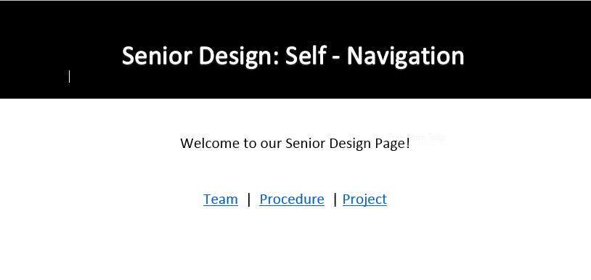
Website : Bootstrap

Slide 3
Reinforcement Learning
Deep Learning : Predictions
https://youtu.be/n7370dzCZ1o
Reinforcement Learning : Maximize Rewards
https://youtu.be/Ipi40cb_RsI
Notes:
Deep Learning : image recognition, speech

Slide 4
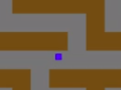
Data
Data used for neural network is a binary representation of the maze in an NxN array. Walls are 1, Roads are 0.
0 | 1 | 1 | 1 | 1 | 0
0 | 0 | 0 | 0 | 1 | 1
1 | 1 | 1 | 0 | 1 | 1
0 | 0 | 0 | 0 | 0 | 0
1 | 1 | 0 | 1 | 1 | 1
1 | 1 | 0 | 0 | 0 | 0

Slide 5
GUI MAZE

Slide 6
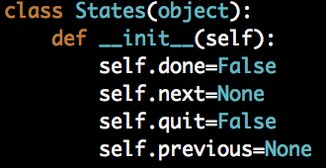
Controls:
Set up
Configuration for pygame
State Change
Look at figure. Think of it as a linked list
Update
If there are any changes in the state. E.g going to a new one
Event loop
Keystrokes, mouse events, etc..
Main loop
Iterates:
Event Loop
Update

Slide 7
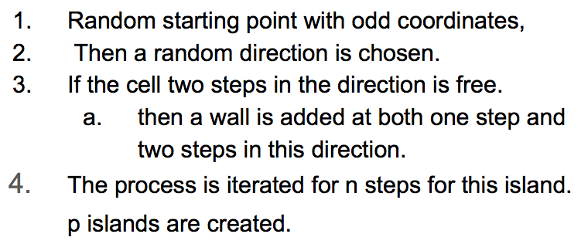
Base Maze: Abstract
Algorithm.
Right side
Construction.
Prints 0 and 1, 1=wall, 0=road
Re-construction of the Maze.
When changing the complexity or density.
Requesting new maze with the same patterns.
Typical getter and setters.

Slide 8
Car: Abstract kinda…
Can move up/down and left/right.
Typical getters and setters.
Some getters such as y1 knows it’s (x and y) location in the rendering.
Needed this so the vehicle could more freely in a wider “road”

Slide 9
All boils down to the Maze:

Slide 10
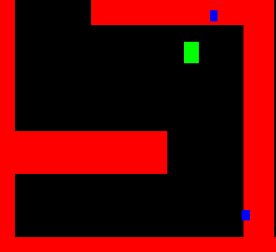
Self Steering
New mazes are more complex, requiring more complex steering choices
Steering will be handled by trained neural network

Slide 11
Steering Neural Network
Input Layer
Hidden Layer
Output Layer
Map Data
1 | 0 | 0 | 0 | 1 | 1
1 | 1 | 1 | 0 | 1 | 1
0 | 0 | 0 | 0 | 0 | 0
1 | 1 | 0 | 1 | 1 | 1
1 | 1 | 0 | 0 | 0 | 0
1 | 1 | 1 | 1 | 1 | 1
Direction

Slide 12
Training the Steering Neural Network
We generate random mazes and solve them
For each move, the program saves map data and our selected direction
This data is then used to train the Steering Neural Network

Slide 13
Self Navigation
Choice from several options:
Part of Steering Neural Network
Separate Algorithm
Algorithm that influences Steering Neural Network by adding data to its input

Slide 14
Option 1: Part of Steering Neural Network
Easiest to implement
Simply rely on the Steering Neural Networks decision to find the solution on its own
Least likely to be successful
Neural Network will not be able to navigate the maze because it cannot see the whole maze

Slide 15
Option 2: Separate Algorithm
More difficult to implement
Need to design a new algorithm
Algorithm should see the entire maze to decide on an optimal path
Needs to somehow influence Steering Neural Network or replace it completely

Slide 16
Option 3: Influence Steering Neural Network
Easy to implement
Simply track where the Steering Neural Network has been and "wall" off old paths
Success proven
Is basically the Reinforcement Learning from previous attempts

