Slide 1
Group Assignment

Slide 2
Logic Reasoning
In Huffman encoding algorithm (sort the symbols in order and merge the top two symbols iteratively until only one node is left), prove that for two symbols A and B with probabilities p(A) >= p(B), then the resultant sequence according to Huffman encoding procedure, the length of symbol A is no longer than that of symbol B.

Slide 3
Basic Step
We assume A and B are the only symbols.
There are two possible scenarios for Huffman trees with only two elements.
Case 1: P(A) > P(B)
Case 2: P(A) = P(B)

Slide 4
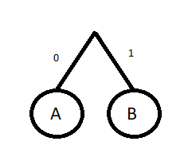
P(A)>P(B)
Since the probability of A is larger than B, A will appear on the tree before B.
Since there are only two symbols, A will be on the same level as B.

Slide 5
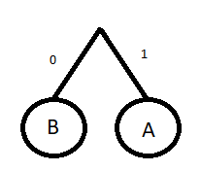
P(A)=P(B)
Since the the probability of A and B are equal, they will appear on the same level.
No matter which symbol appears first, both will have equal length.

Slide 6
Inductive Step
Given that P(A) >= P(B), we assume that A and B are part of a sub tree in a Huffman Tree.
Symbols with smaller probabilities are added first
Items are added only to the root of the tree
Symbols with greater probability will always be added after lesser ones
B will always be added before or at the same time as A
Thus, the length of A will always be lesser or equal to B.

Slide 7
Double-Blind Testing
Apply double-blind testing method to compare the performance of any two search engines (either image search or content search) or translators that you are free to choose

Slide 8
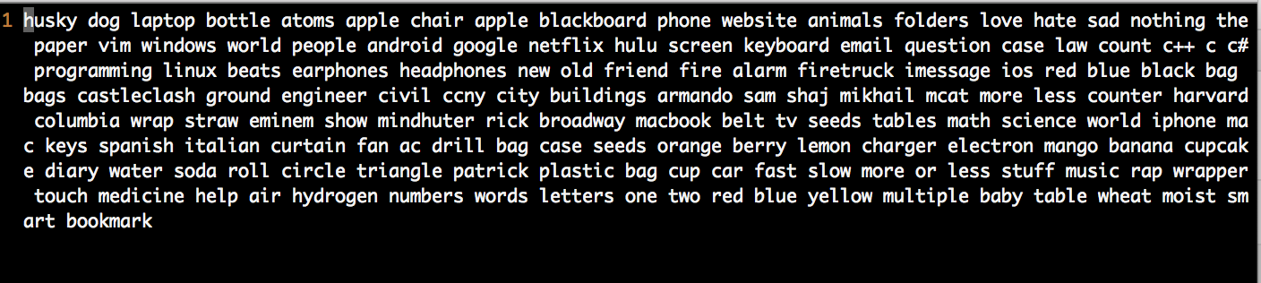
Random Input Data

Slide 9
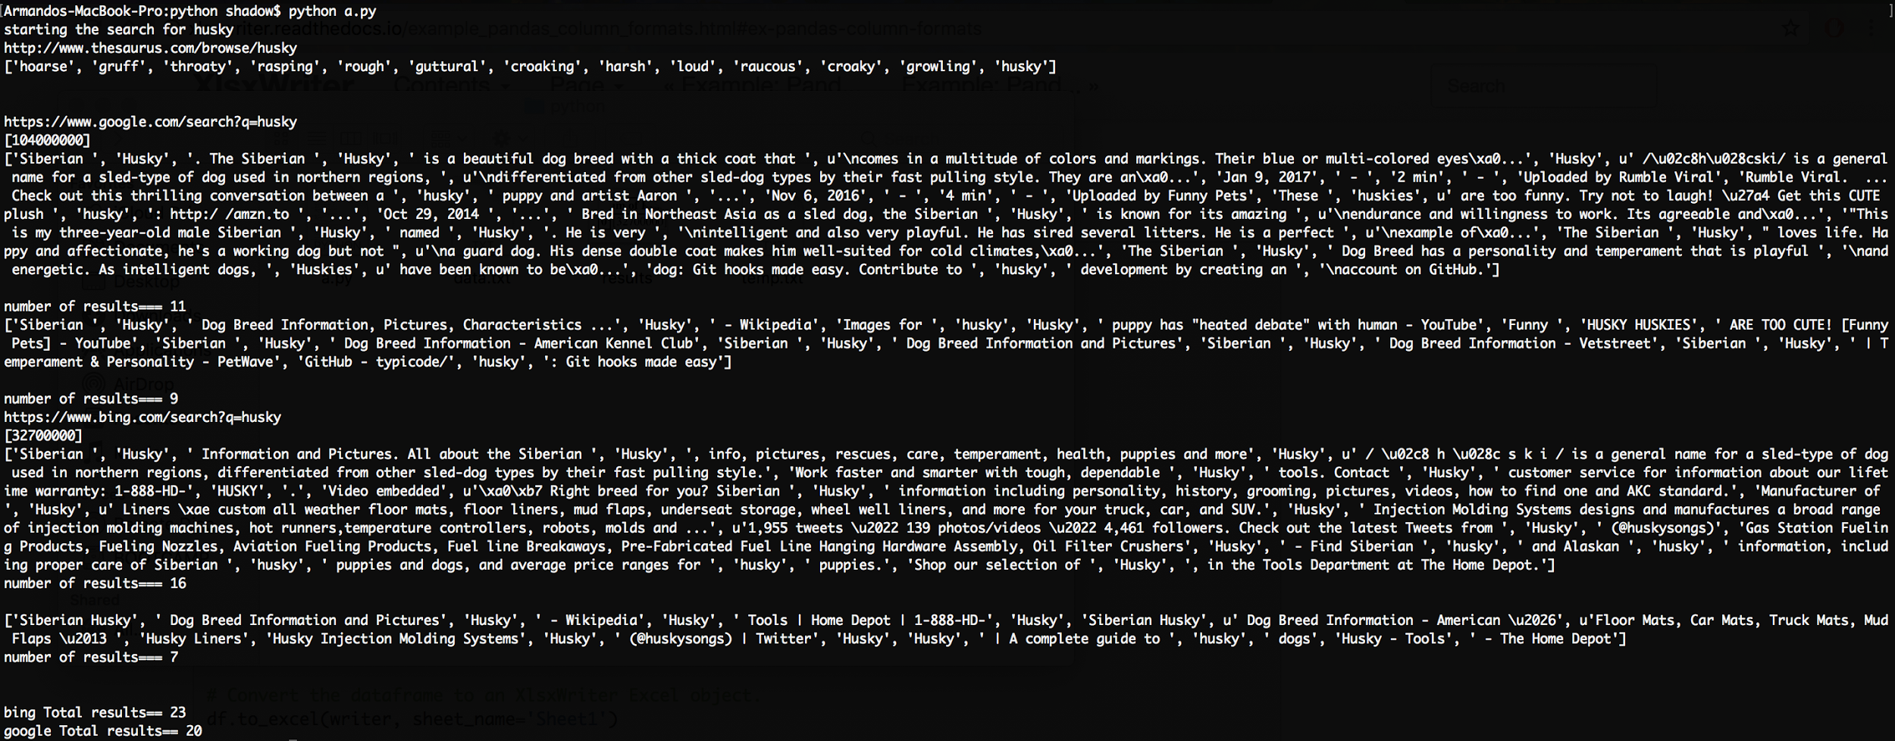
Results of one search.

Slide 10
Small sample set of 143 samples
 | GOOGLE |  | BING
 | Search Results | Matches | Search Results | Matches
LAPTOP | 796 Million | 14 | 103 Million | 7
WEBSITE | 5.11 Billion | 35 | 1.7 Billion | 21
ANIMALS | 1.51 Billion | 18 | 159 Million | 4
THE | 25.27 Billion | 29 | 3.2 Billion | 20
ANDROID | 2.76 Billion | 21 | 320 Million | 14
COUNTER | 1.72 Billion | 25 | 173 Million | 30
LEMON | 453 Million | 19 | 75.9 Million | 20
DIARY | 526 Million | 26 | 88.3 Million | 25
WATER | 4.32 Billion | 23 | 406 Million | 28
CAR | 5.01 Billion | 22 | 589 Million | 13

Slide 11
Results(S=143)
 | Google | Bing
Search Result Total | 466,077,590,000 | 56,826,218,000
Search Result Average | 3,236,649,931 | 394,626,513.9
Match Total | 2,729 | 2,448
Match Average | 18.95138889 | 17

