Slide 1
Self Navigating
Armando, Mikhail, Samantha & Shajidul

Slide 2
Background

Slide 3
Grand Theft Auto
Feed Forward
Free world
Open CV
Sentdex
Mario
Recurrent
Path
Mimic Game Play
15 Hours of game play
Backpropogation
SethBling

Slide 4
System Overview

Slide 5
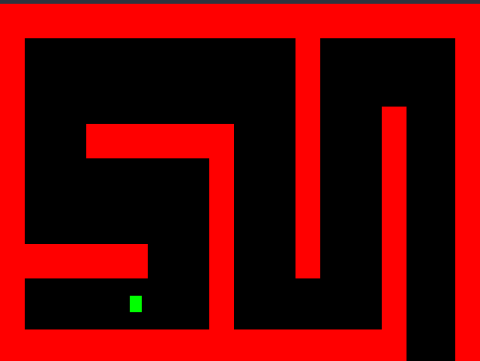

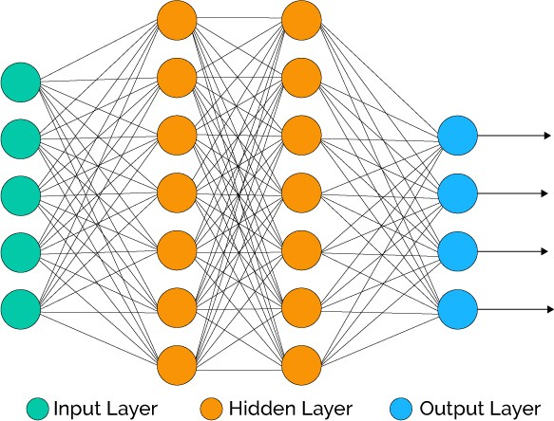
System Overview
Map
Process Image
Model
Output
At each iteration the program:
Processes an image depicting the current state of the map
Sends the image to a Neural Network
Receives an output (decision for a movement) from the Neural Network
Applies the decision and updates the map

Slide 6
Neural Network Parameters
Input Layer:
Image depicting the current state of the Map
Image may be of a limited field of view
Output Layer:
A cardinal direction for the car to move in

Slide 7
Data Collection

Slide 8
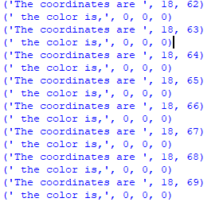

Image decomposition:
Take an image of the map as an input for analysis.
Take each pixel of the map as input for data.
Location of each pixel will help define the map for the algorithm.
Each pixel will be used to determine if there is an obstacle or not.

Slide 9
Random Maze Generator

Slide 10
Maze Generator:
Parameters:
Width: The width of the Maze
Height: The height of the Maze
Density: Creates n number of islands of length p(complexity)
-The lower the density the rooms(paths) are bigger
Complexity: The length of an island.
-The lower the complexity the easier to solve the maze
Algorithm:
Random starting point with odd coordinates,
Then a random direction is chosen.
If the cell two steps in the direction is free.
then a wall is added at both one step and two steps in this direction.
The process is iterated for n steps for this island. p islands are created.

Slide 11
Maze and car Interaction:
Run application:
You can run the application by installing numpy and pygame.
More instructions in the github
Then execute by “python3 main.py”

