Slide 1
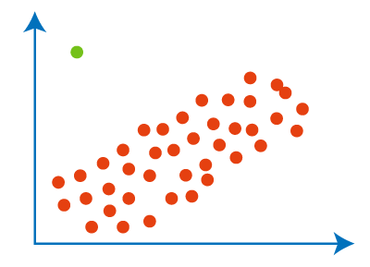
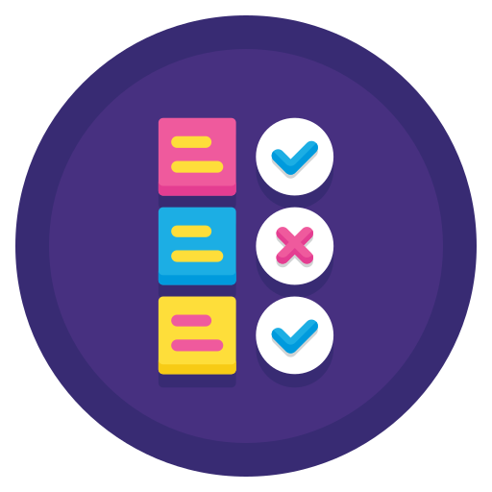



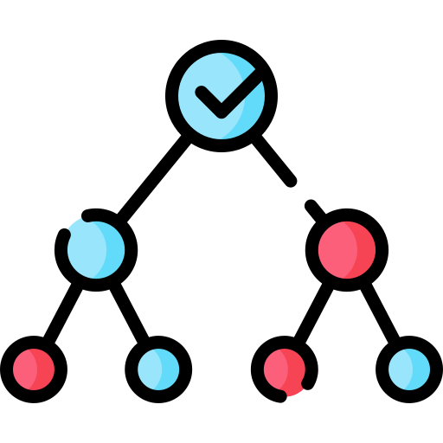

Data Processing
Regression Model
Optimization
ROUND 1
Qty
9M
Regression Model
Data Processing
Optimization
Qty
ROUND 2
10M
Optimization
Classifier Model
Data Processing
Probs

