Slide 1

Parallel Supermarket Checkout Simulation
By Armando Phacule, Antonio Andre And Luan Pechisso

Slide 2
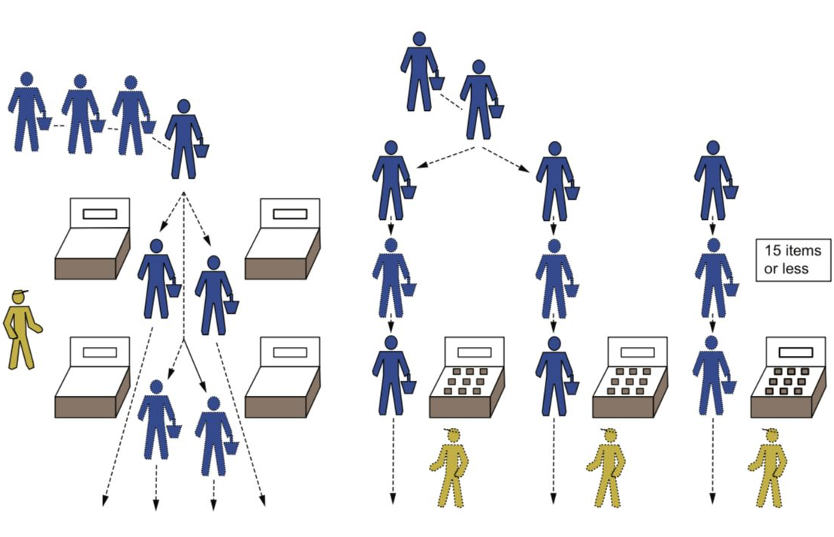
This presentation explores the implementation of a parallel computing approach to simulate the checkout process in a supermarket. By leveraging Python's multiprocessing module, the simulation creates separate processes for different checkout lanes, including self-checkout, traditional cashier, and a 15-item express lane. The goal is to illustrate the benefits, costs, and limitations of implementing parallel computing in this context.

Slide 3
Parallel Computing Approach
Checkout Lane Functions
1
The code defines three main functions to simulate the processing of customers in each checkout lane: self_checkout_cashier(), traditional_cashier(), and fifteen_item_cashier().
2
Customer Processing Functions
Three additional functions are defined to simulate the actual processing of individual customers in each lane: left_processing_customer(), central_processing_customer(), and right_processing_customer().
3
Process Creation and Execution
The main part of the code creates separate multiprocessing.Process instances for each checkout lane, passing the corresponding function and customer list as arguments. These processes are then started concurrently and the main process waits for them to complete.

Slide 4
Checkout Lane Functions
Self-Checkout
Traditional Cashier
The self_checkout_cashier() function simulates the processing of customers in the self-checkout lane, where customers can scan and pay for their items independently.
The traditional_cashier() function simulates the processing of customers in the traditional cashier lane, where a store employee handles the checkout process.
15-Item Express
The fifteen_item_cashier() function simulates the processing of customers in the 15-item express checkout lane, which is designed for customers with a smaller number of items.

Slide 5
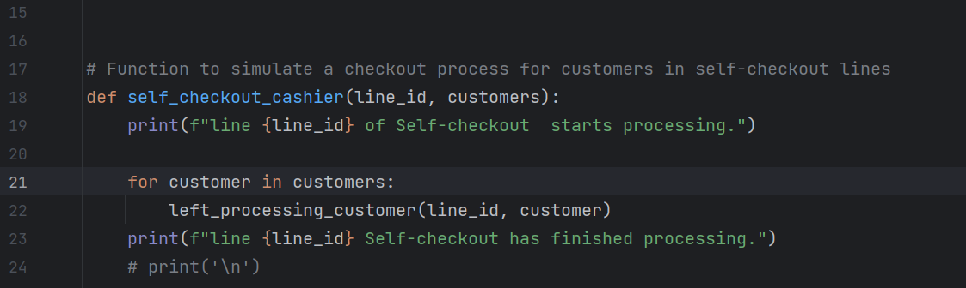
Parallel Computing
Checkout Lane Functions

Slide 6



Customer Processing Functions
Left Processing
Central Processing
Right Processing
The left_processing_customer() function simulates the processing of customers in the self-checkout lane.
The central_processing_customer() function simulates the processing of customers in the traditional cashier lane.
The right_processing_customer() function simulates the processing of customers in the 15-item express lane.

Slide 7
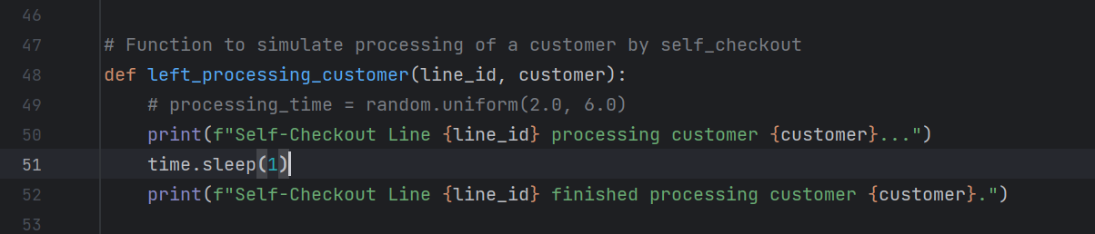
Parallel Computing
Customer Processing Functions

Slide 8




Process Creation and Execution
Process Instances
The main part of the code creates separate multiprocessing.Process instances for each checkout lane, passing the corresponding function and customer list as arguments.
Concurrent Execution
These processes are then started concurrently using the start() method, allowing for parallel execution of the checkout lane tasks.
Waiting for Completion
The main process waits for the checkout lane processes to complete using the join() method, ensuring all tasks are finished before the simulation ends.

Slide 9
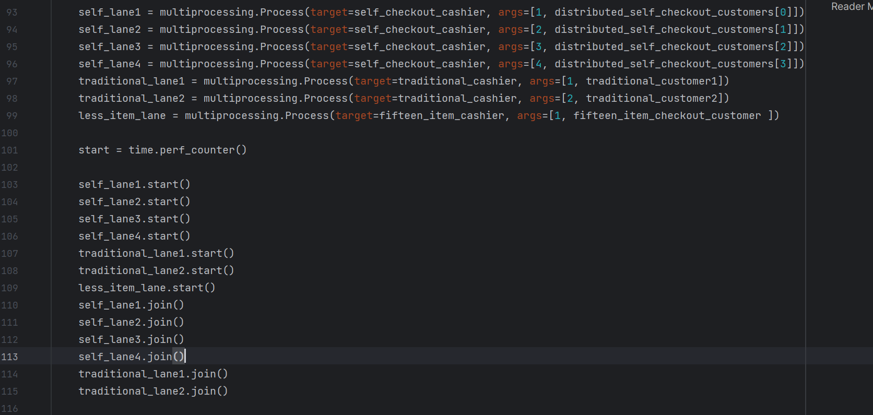
Parallel Computing
Process Creation

Slide 10
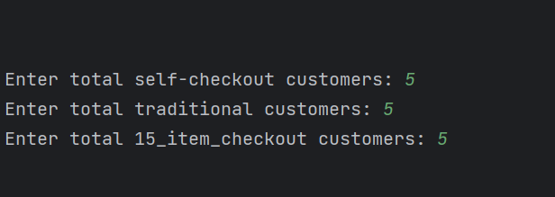
Parallel Computing
Execution

Slide 11
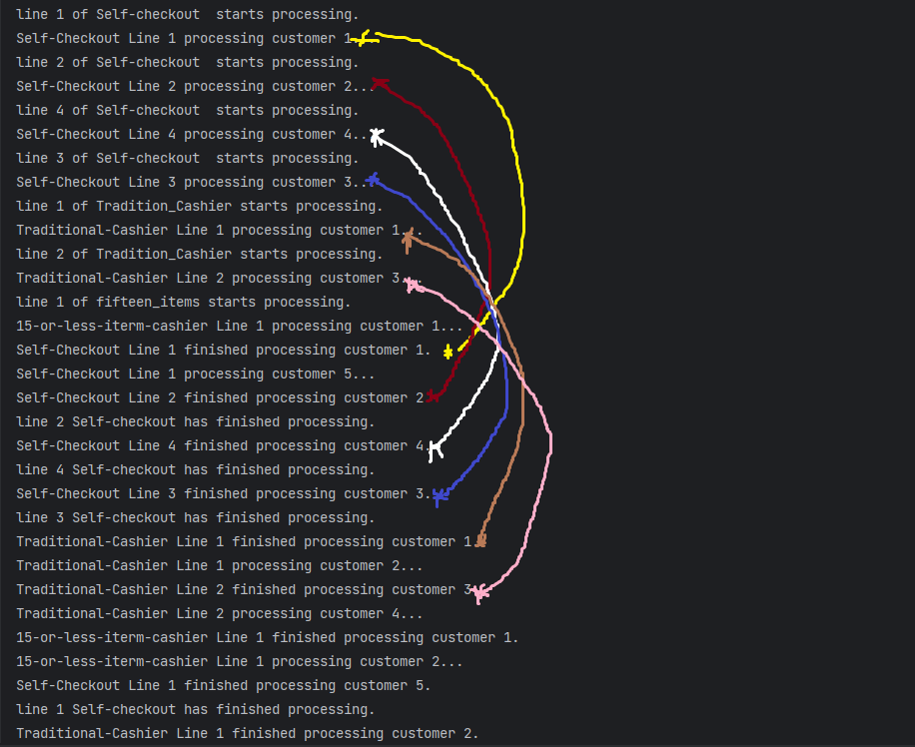
Parallel Computing
Execution

Slide 12
Serial Computing As Bases Of Compare
Checkout Lane Functions
Customer Processing Functions
Sequential Execution
In the main part of the code, the checkout lane functions are called sequentially, one after another, passing the corresponding customer lists as arguments.
The serial version uses the same three functions to simulate the processing of customers in each checkout lane: self_checkout_cashier(), traditional_cashier(), and fifteen_item_cashier().
The same three functions are used to simulate the actual processing of individual customers in each lane: left_processing_customer(), central_processing_customer(), and right_processing_customer().

Slide 13
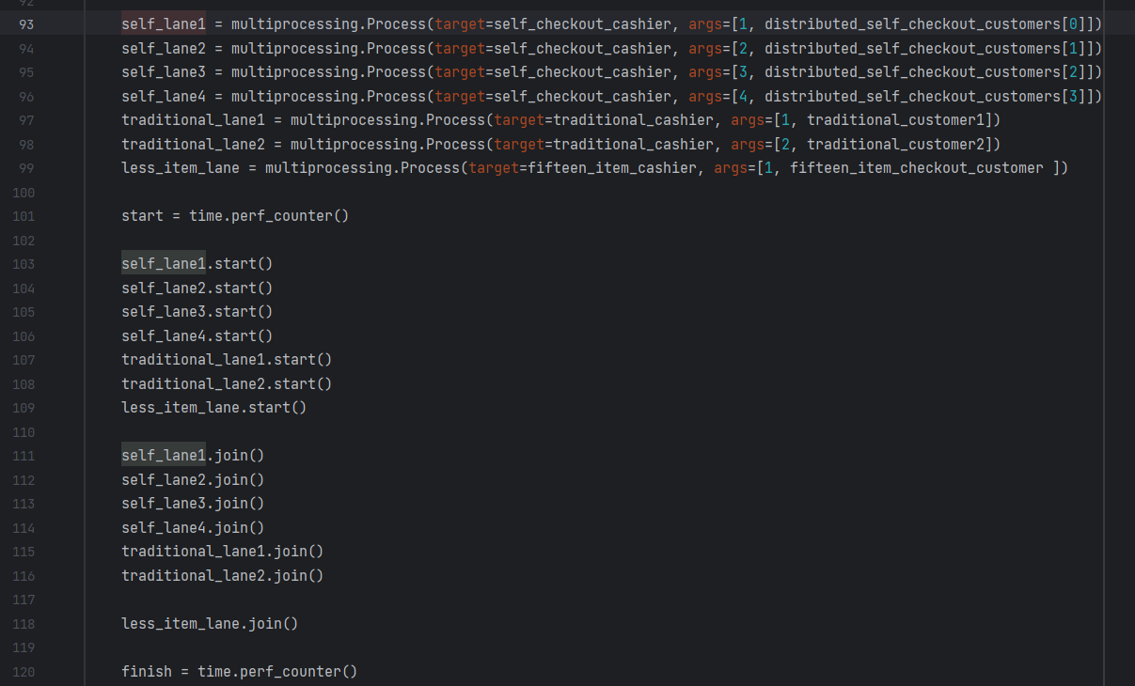
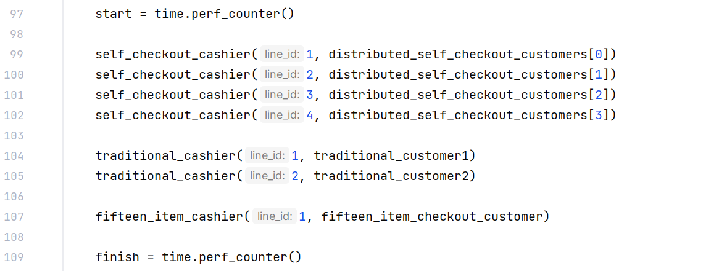
Parallel Execution
Serial Execution

Slide 14
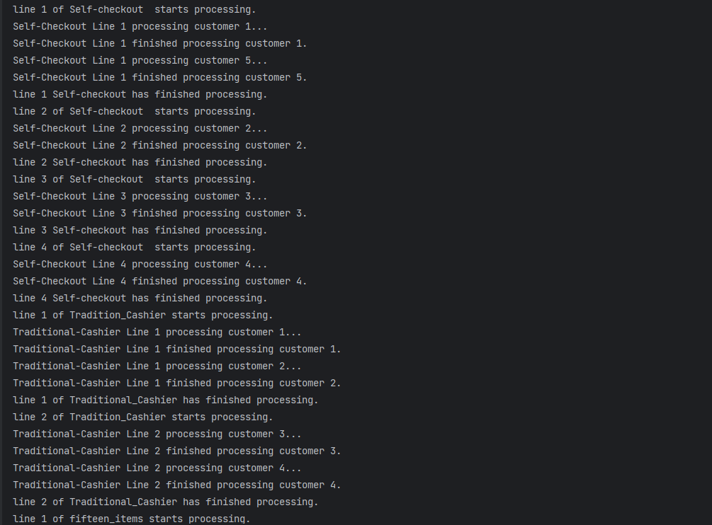
Serial Computing Output
Execution

Slide 15
Performance Comparison
1
Parallel Advantages
2
Factors to Consider
3
Theoretical Comparison
The parallel version leverages multiple processes running concurrently, potentially leading to faster execution times, especially on systems with multiple CPU cores or processors.
The performance gain from parallelization may be affected by the number of available CPU cores, the workload distribution among processes, and the overhead associated with process creation and communication.
Assuming it takes five seconds to process a customer, the parallel processing of fifteen customers would be substantially faster than the serial approach.

Slide 16
Runtime Measurement
Parallel Processing Time
Substantially Reduced To 4 Seconds
Serial Processing Time
Approximately 15 Seconds
Performance Improvement
Significant

Slide 17

Conclusion
1
Parallel Simulation
2
Performance Comparison
3
Future Improvements
The parallel checkout simulation demonstrates the use of Python's multiprocessing module to achieve concurrent execution of tasks, simulating multiple checkout lanes in a store.
By comparing the performance of the parallel and serial versions, the potential benefits of parallelization for this use case can be observed, such as reduced processing time.
Future work could include exploring different workload distributions, optimizing the process creation and communication overhead, and investigating the scalability of the parallel approach with varying numbers of checkout lanes and customers.

