Slide 1
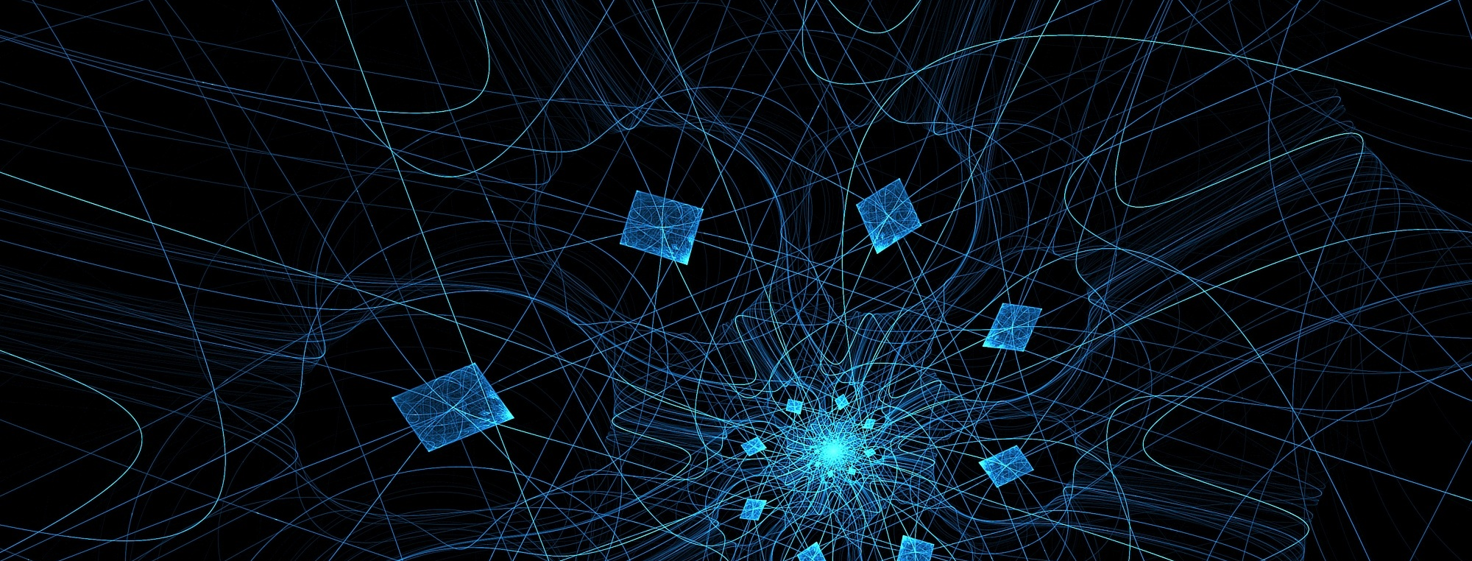
5G EVOLUTION / 6G PROJECT PROJECT TOPIC
Author, 8. August 2022

Slide 2
AGENDA
Introduction
Issue
Related work
Project goals
Own Approach
Progress
Demo
Milestones
Next Steps
Conclusion

Slide 3
INTRODUCTION
Wireguard
Modern VPN protocol
Very fast
Smaller codebase compared to IPsec and OpenVPN
Easier to maintain, upgrade, extend
Cross-platform
Part of the Linux kernel

Slide 4
ISSUE
Wireguard lacks multipath support
Wireguard doesn’t provide tunnel monitoring
Wireguard is integrated into the Linux kernel
Extensions build for Wireguard are harder to develop and test

Slide 5
RELATED WORK
Wireguard extensions, developed by Fraunhofer Fokus
Provide multipath support
Introduced additional custom headers (Path ID, Transmission Time, etc.)
Provide multiple load balancing algorithms

Slide 6
PROJECT GOALS
Establish the transfer of a large file using UDP
Introduce a set of custom headers, related to the file-transfer process
Using the header data calculate the following characteristics of the tunnel:
Capacity
Packet loss
Delay
Jitter
Output the characteristics

Slide 7

SENDING SIDE TRANSMISSION
Create the headers on the sending side
Put the headers in the UDP message and send it
Extracting the headers on the receiver side

Slide 8
RECEIVING SIDE TRANSMISSION
Receive the UDP packet
Extract the headers
Extract the message
Extracting the headers on the receiver side

Slide 9
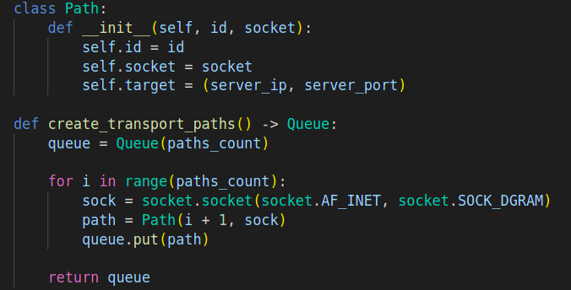
MULTIPLE PATHS

Slide 10
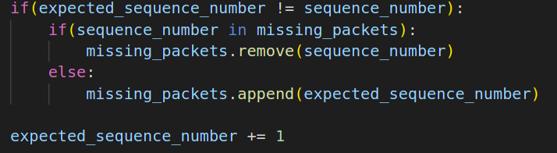
CALCULATION OF PACKET LOSS

Slide 11
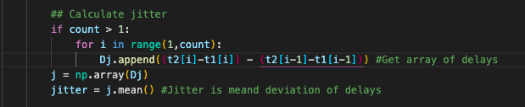
JITTER CALCULATION

Slide 12
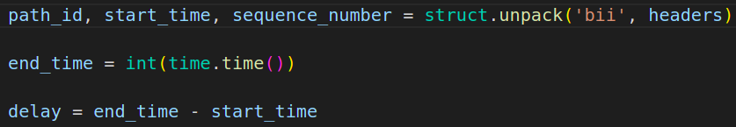
DELAY CALCULATION

Slide 13
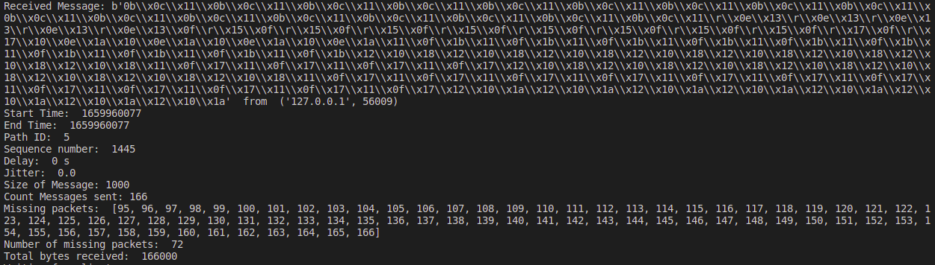
RESULTS

Slide 14
MILESTONES
Build the file transfer functionality
Properly send and receive data and reconstruct the initial file
Attach custom headers to be able to calculate the different characteristics
Develop a multipath communication between the client and server
Output the calculated data

Slide 15
CONCLUSION
Backhaul Characteristics of the tunnel transmission could be calculated and presented on Console.

Slide 16
REFERENCES
https://wiki.python.org/moin/UdpCommunication
https://www.keil.com/pack/doc/mw/Network/html/group__net_u_d_p___func.html#:~:text=Description-,UDP%20socket%20routines%20enable%20simple%20IP%20communication%20using%20the%20user,features%20at%20the%20transport%20layer.

Slide 17
THANK YOU FOR YOUR ATTENTION
Questions?

