Slide 1
Smart Home System

Slide 2
Presented By
Md. Arman Habib 2017100000045
Md. Motasim Billah 2017100000040
G. M Mostafizur Rahman
2017000000213

Slide 3
Objective
Door Opening
Lights ON
AC/Fan ON depending on Temperature
Fire Alarm

Slide 4
Components
Microcontrollers
Arduino Uno
Input Components
Ultrasonic Sonar Sensor
Temperature Sensor
Flame Sensor
Output Components
Servo Motor
LED
DC Motor
Buzzer

Slide 5
Process
Obstacle checking – Ultrasonic Distance Sensor
Door opening – Servo Motor
Light ON – LED
Room Temperature Detect – Temperature Sensor
AC ON – LED
Fan ON – DC Motor
Fire detect – Flame Sensor
Fire Alarm - Buzzer

Slide 6
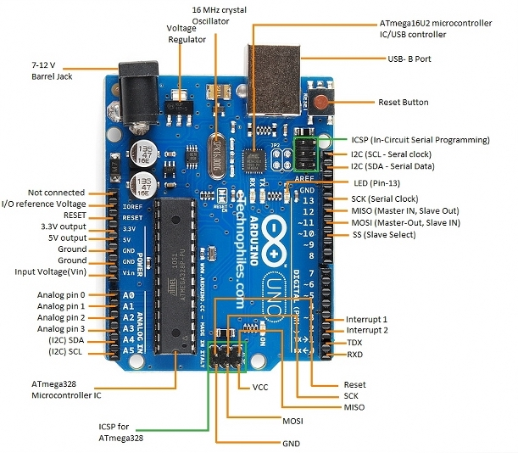
Arduino UNO
Open Source Microcontroller
Based on ATmega328P
Developed by Arduino
Consists of digital and analog i/o pins
Has interface for expansion boards

Slide 7
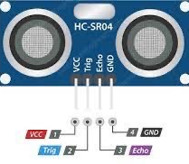
Ultrasonic Sonar Sensor
Used for measuring Distance
Trigger Pin Throws Ultrasonic Wave
Echo Pin receives the wave
Distance measured from wave’s throwing and receiving time duration

Slide 8
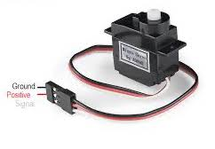
Servo Motor
Rotary actuator
Consists of GND, VCC and Control pin
It has control for angular position, velocity and acceleration
Consists of a motor and a sensor to give the desired position

Slide 9
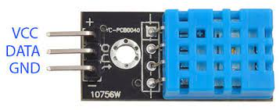
Temperature Sensor
Environmental Sensor
It consists of VCC, GND and DATA pin
It determines temperature and humidity of a place

Slide 10
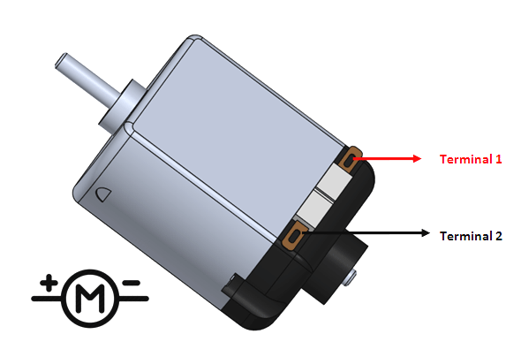
DC Motor
Rotatory Device
Used in fans, wheels etc.
It does not have precise control of its rotation
It rotates in a fixed RPM
It has two terminals to be connected to positive and negative point

Slide 11
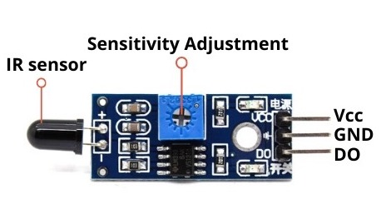
Flame Sensor
Detects the presence of gases
Used as a part of safety system
Consists of Analog out, Digital out, VCC and GND pin

Slide 12
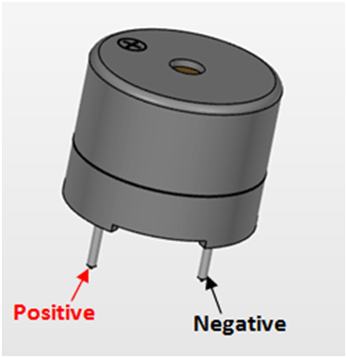
Buzzer
Audio Signaling device
Types: mechanical, electrical or piezoelectric
Consists GND, VCC and I/O pin
Use: alarm device, timers, training, confirmation of input (keystroke, mouse click etc.)

Slide 13
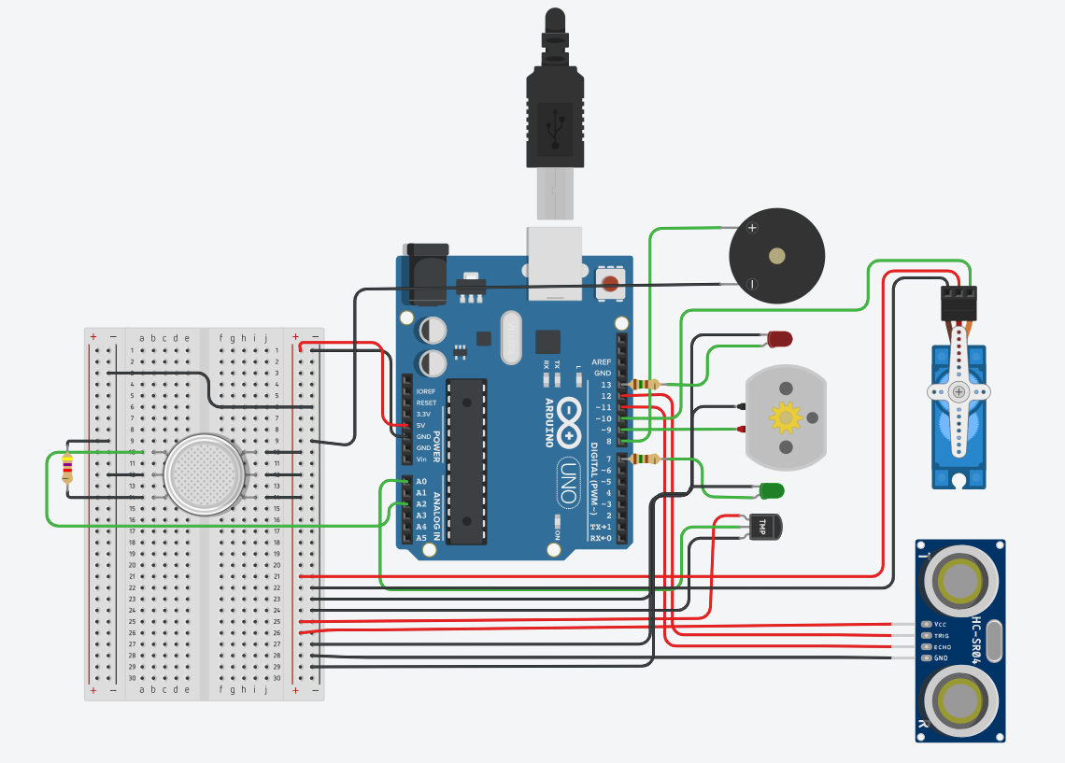
Circuit Diagram

Slide 14
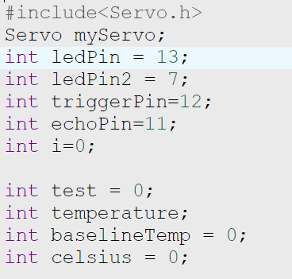
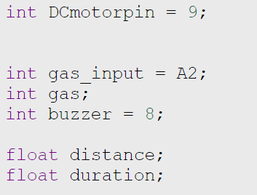
Code
Declaring Pins and Variables

Slide 15
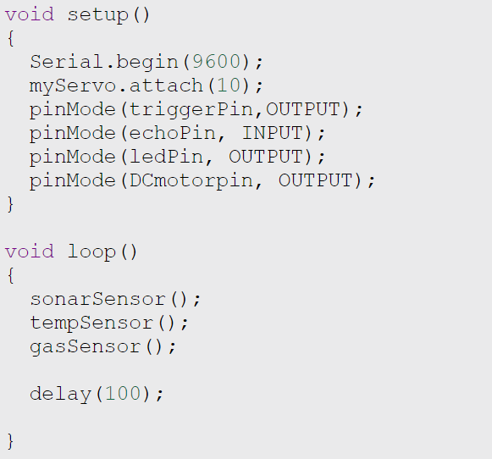
Code
Setup and Loop Method

Slide 16
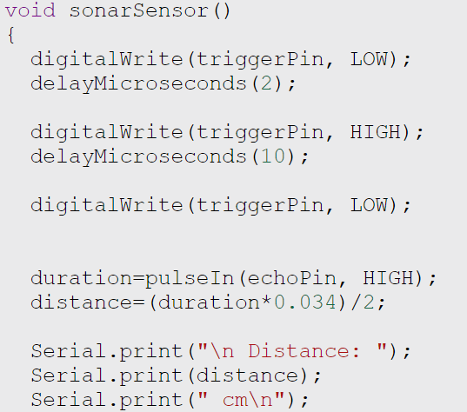
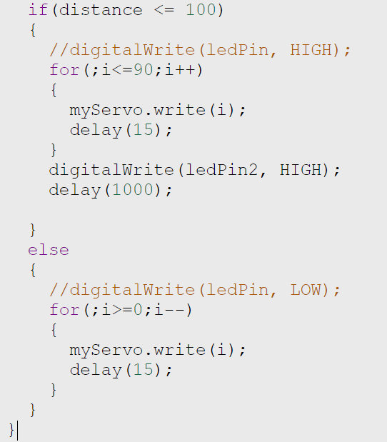
Code
Ultrasonic Sensor and Servo Motor

Slide 17
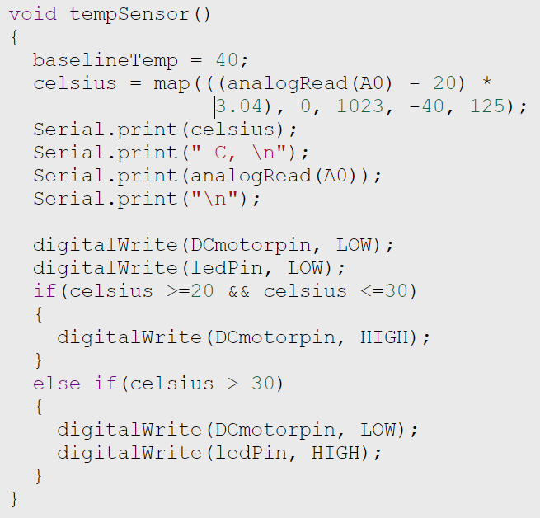
Code
Temperature Sensor and DC Motor

Slide 18
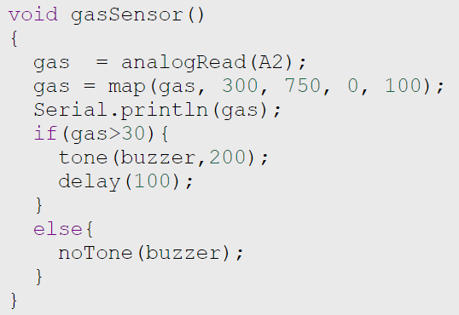
Code
Flame Sensor and Buzzer

Slide 19
Thank You.

