Slide 1

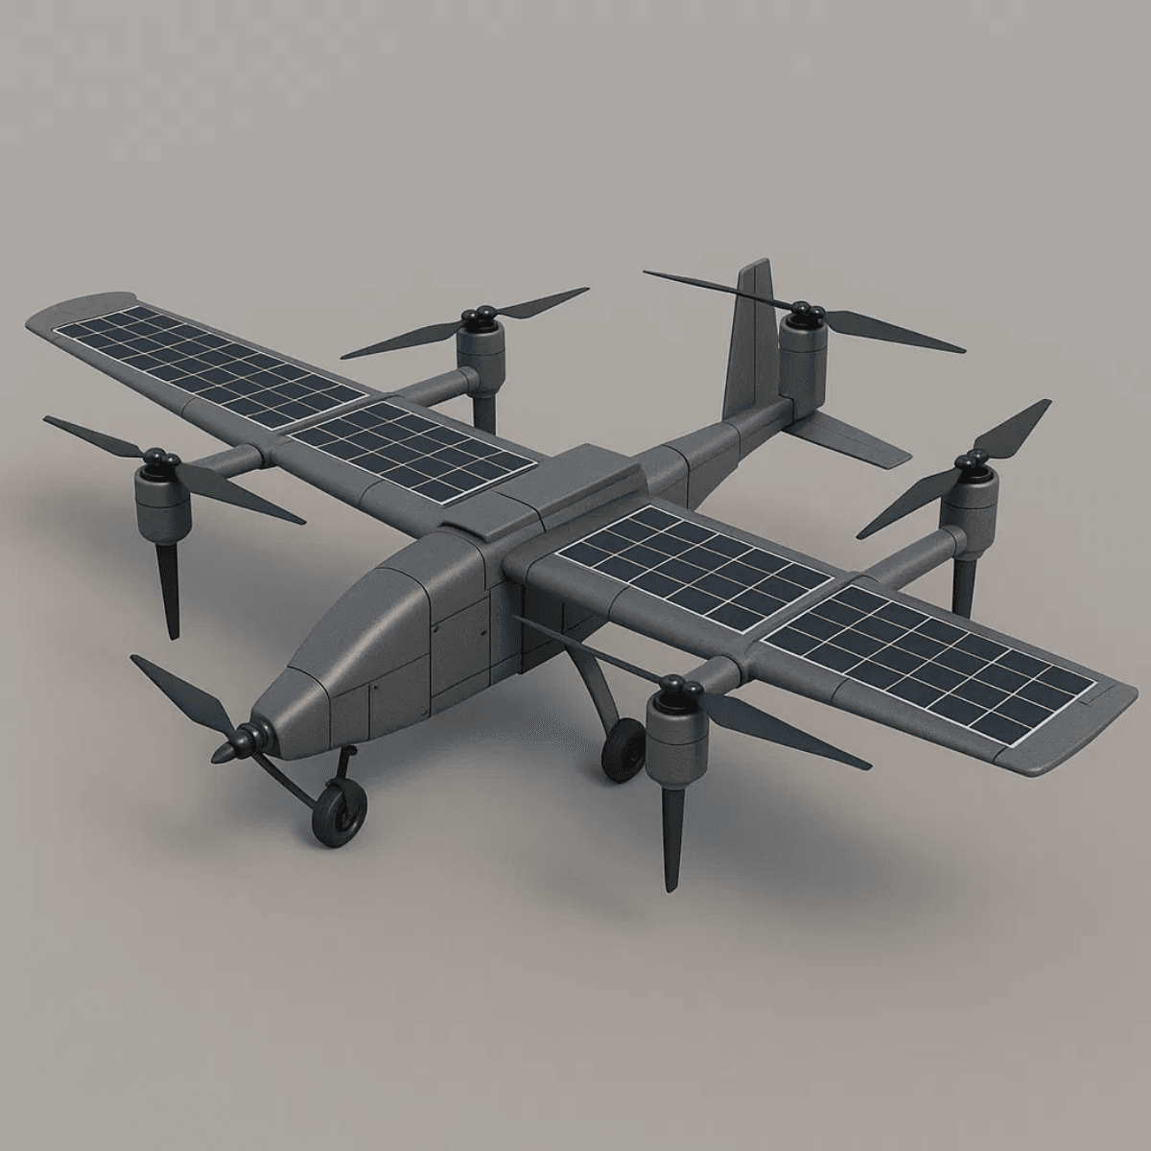

GreenLift AI: Intelligent VTOL Drone Delivery Ecosystem for SMEs
Transforming Last-Mile Logistics and Business Intelligence for 10 Million SMEs in Bangladesh
TEAM PHANTOM
CONTACT:
armanislam527@gmail.com
PHONE:
+8801521751005
PROJECT PORTFOLIO:
https://armanislam527.github.io/IntelligentVTOLDroneDeliveryEcosystemForSMEs/

Slide 2


The Team: Focused on Execution
A dedicated technical specialist driving the future of intelligent logistics
Arman Islam
Founder
Technical & Idea Supporter
Core Expertise:
▪
WRO 2025 Participant (Invited To National)
▪
Autonomous Systems Specialist
▪
Embedded Systems & Robotics
▪
Flight Control & Navigation
▪
IoT & Sensor Integration
PORTFOLIO: https://cv-of-arman.netlify.app
GITHUB: github.com/Armanislam527

Slide 3

The Logistics Barrier
Costly, Unreliable, and Data-Blind Operations Limiting SME Growth
01
02
Last-Mile Inefficiency
Monsoon Vulnerability
SMEs struggle with costly, unreliable final-delivery logistics that drain operational budgets.
Severe delivery delays during rainy seasons create supply chain chaos and customer dissatisfaction.
89% AFFECTED
91% REPORT DELAYS
03
04
Cost Burden
Data Blindness
Logistics consume a significant portion of SME budgets, limiting resources for growth and innovation.
Lack of business intelligence tools prevents critical insights on demand patterns and inventory.
18-25% OF BUDGET
73% LACK TOOLS

Slide 4
Market Opportunity
The $10 Billion Untapped Potential in Bangladesh's SME Sector
10.4M
78%
$10B+
SMEs in Bangladesh
Underserved in Poor Logistics Areas
Market Opportunity
Target Market Segments:
E-commerce & Online Retailers
▪
Agricultural Suppliers
▪
Local Pharmacies
▪
Cold-Chain Businesses
▪
Food & Beverage Distributors
▪
Retail Chains
▪
Starting Prototyping Area:
PABNA DISTRICT

Slide 5
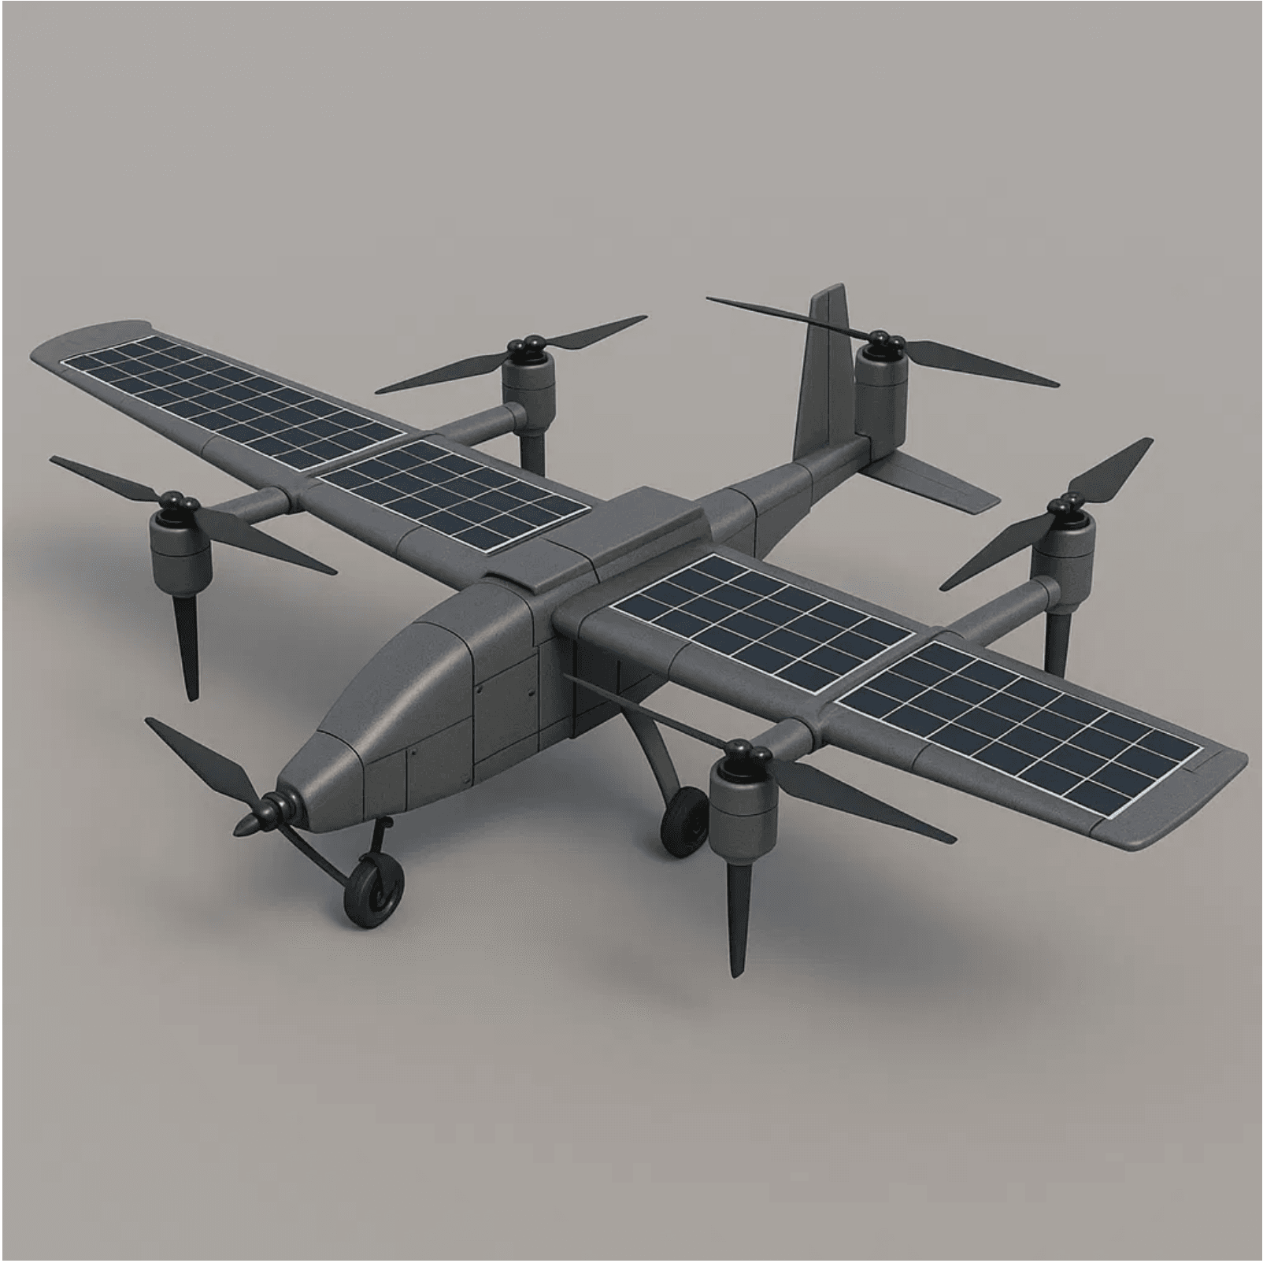
GreenLift AI: The Integrated Solution
Comprehensive ecosystem combining autonomous delivery with real-time business intelligence
01
Green-Fuel VTOL Drones
Autonomous, energy-efficient delivery for fast, reliable service in urban and rural areas
02
AI-Powered SME Dashboard
Converts raw business data into actionable insights for demand, inventory, and cash flow
03
Seamless Integration
Closed-loop intelligence system where every delivery improves predictive analytics
04
Localized & Affordable
Bangla interface, mobile-first design, pay-per-use model for easy SME adoption

Slide 6

Technical Deep Dive
Precision, Reliability, and Low-Cost Connectivity
LoRa Network
Smart Tension Sensor
Purpose
Mechanism
Low-power, long-range communication for telemetry and command signals in areas with poor cellular coverage.
Integrated into the string-down delivery system for secure, precise, and damage-free package release.
Benefits
Function
Ensures reliable control and data transmission, reducing operational costs compared to 4G/5G for non-payload data.
Detects pre-set threshold tension value when package lands. Upon reaching threshold, system automatically releases package and retracts string.
Range & Coverage
Extended range (5-15 km) with low power consumption, ideal for rural and semi-urban deployment.
Advantage
No landing required. Autonomous release ensures delivery without human intervention or landing damage.
COMMUNICATION PROTOCOL: MQTT/LoRaWAN
AUTO-RELEASE: THRESHOLD-BASED ACTIVATION
VTOL DRONE SPECIFICATIONS
PAYLOAD: 1-20 kg
RANGE: 10-20 km
PROPULSION: Hydrogen-Electric Hybrid
EMISSIONS: Zero-Carbon Delivery

Slide 7
AI Integration: Transforming Data into Profit
Machine learning powers intelligent decision-making across the entire delivery ecosystem
01
Demand Forecasting
Predictive analytics anticipate customer needs and optimize inventory levels proactively, reducing stockouts and overstock.
02
Route Optimization
AI calculates fastest, most energy-efficient delivery paths, reducing time and fuel consumption while maximizing daily capacity.
03
Autonomous Operations
Automated decision-making reduces manual oversight while maintaining safety and compliance standards across all deliveries.
04
Smart Inventory
Real-time inventory synchronization prevents stockouts and reduces wasteful overstock scenarios, improving cash flow.
05
Customer Behavior Analysis
Targeted marketing and personalized services built on customer insights that build loyalty and competitive differentiation.

Slide 8
Unique Value Proposition
Efficiency Meets Sustainability: First-of-its-kind Integration
⚡
💰
Zero-Carbon Operations
No Wage Burden
Hydrogen-electric fleet eliminates fuel costs and carbon emissions, aligning with global sustainability goals while boosting brand value.
One-time equipment investment replaces ongoing driver salaries. Autonomous operations reduce labor dependency and significantly improve margins.
🧠
🌦️
Integrated AI Analytics
Weather Resilience
Predictive insights optimize delivery routes, weather planning, and demand forecasting in ways traditional logistics cannot match.
Advanced sensors and AI modeling enable safe operations in challenging conditions where traditional methods struggle.
THE RESULT: Faster deliveries, lower costs, competitive advantage—all without environmental compromise.

Slide 9
Business Model: Predictable Revenue, Scalable Growth
Multiple revenue streams creating predictable income while remaining flexible to SME budgets
Pay-Per-Delivery
AI Dashboard Subscription
15-30 BDT
500-2,000 BDT/month
Variable revenue scales with transaction volume, aligned with customer success. Incentivizes efficient operations.
Recurring revenue for analytics, scheduling, and premium features. Tiered pricing for different SME sizes.
Strategic Partnerships
Fleet Leasing
Revenue Sharing
Equipment-as-a-Service
Co-branded solutions with e-commerce platforms and logistics companies expand reach and market credibility.
Maintenance and support included. Lowers customer capital requirements and ensures recurring revenue.
FLEXIBLE MODEL: Combines variable (pay-per-delivery) and recurring (subscriptions) revenue, ensuring sustainable growth while maintaining affordability for SMEs.

Slide 10

Costing: Strategic Investment for Market Entry
Breakdown of 10M BDT to complete pilot and hit Year 2 revenue
COMPONENT
ESTIMATED COST (BDT)
JUSTIFICATION
R&D and Prototyping
3,000,000
Finalize design, sensors, LoRa, and AI
Initial Fleet Acquisition
4,000,000
Buy 8–10 VTOL drones incl. components
Micro-Hub Setup
1,000,000
Pabna hub: solar, storage, dispatch, security
Software Development
1,500,000
AI dashboard, routing, API, mobile app
Regulatory & Legal
500,000
BVLOS, permits, compliance, legal setup
TOTAL INITIAL ASK
10,000,000
Funds pilot and market entry by Q4 2026
Capital Required for Pilot Completion & Market Entry
10,000,000 BDT
Funds prototype, approvals, and Pabna pilot with 50 SMEs

Slide 11
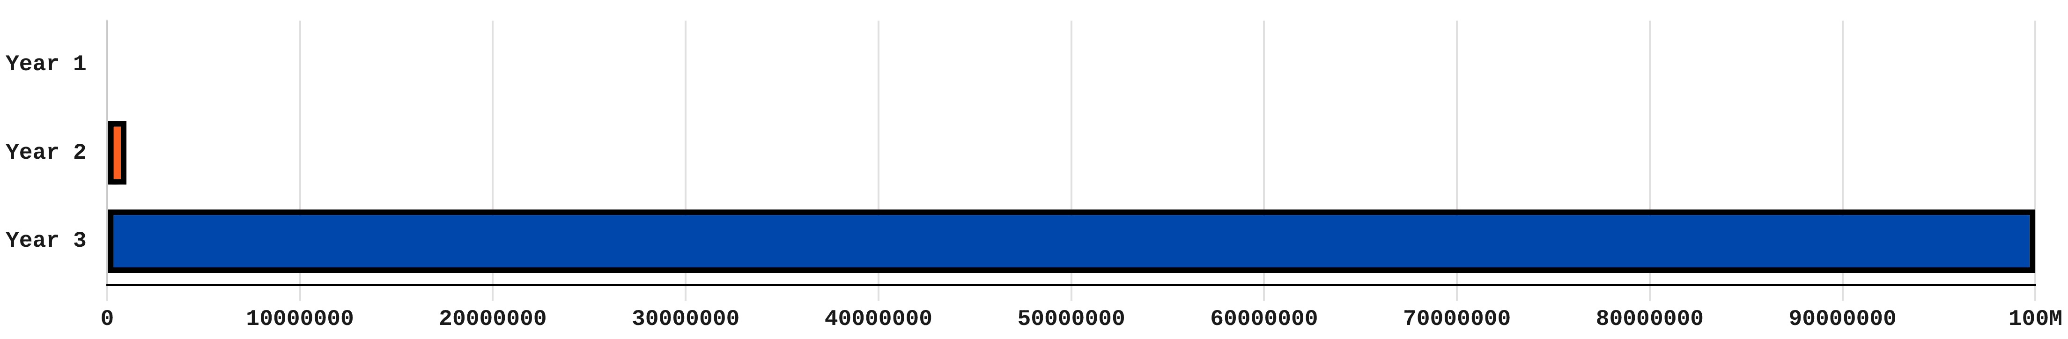
Financial Projections
Clear Path to 100 Million BDT Revenue and Market Leadership
YEAR
FOCUS AREA
REVENUE TARGET (BDT)
Year 1
R&D, Pilot, Regulatory
0 BDT
Year 2
Commercialization, 50 SME Contracts
1,000,000 BDT
Year 3
Scale-up, Multi-District Expansion
100,000,000 BDT
Return on Investment
Profit Phase Entry
Initial Investment
2.5 YRS
Q4 YR 2
10M BDT
Projected ROI based on initial investment and revenue growth
When recurring revenue exceeds operational costs
Capital required for pilot and market entry

Slide 12
Go-to-Market Strategy: Phased Rollout
Strategic approach targeting high-density SME clusters with proof-of-concept and scalable growth
01
02
Pilot Launch
Strategic Partnerships
Deploy 8-10 drones across 50 SME partners in Pabna district. Validate operations, gather data, and build proof-of-concept.
Align with e-commerce platforms, local retailers, and business associations for distribution, credibility, and co-branded solutions.
50 SME PARTNERS | PABNA DISTRICT
PARTNERSHIPS WITH KEY STAKEHOLDERS
03
04
Digital Marketing
Referral Program
Targeted campaigns, case studies, and influencer partnerships within SME networks. Build brand awareness and trust through social proof.
Incentivize early adopters to drive organic growth and peer adoption. Create network effects and sustainable customer acquisition.
CASE STUDIES & SOCIAL PROOF
INCENTIVIZED ORGANIC GROWTH
TIMELINE: Pilot Launch (Q3 2026) → Strategic Partnerships (Q4 2026) → Digital Marketing (Q1 2027) → Referral Program (Ongoing)

Slide 13
Competitive Moat: Data-Driven Advantage
Self-learning data loop creates a defensible market position
🔗
🌱
Integrated Platform
Sustainability-First
Unlike traditional couriers or standalone analytics platforms, GreenLift AI combines delivery logistics and AI business intelligence in one unified ecosystem.
Green-fuel VTOL drones differentiate us in an increasingly eco-conscious market. Appeals to SMEs seeking carbon-neutral operations and brand enhancement.
🌍
🧠
Local & Inclusive Design
Proprietary AI Algorithms
Designed specifically for Bangladesh's SME ecosystem. Bangla interface, low-tech literacy support, and rural infrastructure compatibility create barriers for global competitors.
Early regulatory alignment and proprietary machine learning models create high barriers to entry. Data improves with every delivery, strengthening competitive advantage.
DEFENSIBLE POSITION: Every delivery generates data that improves our AI models. Early market entry, regulatory relationships, and local expertise create a self-reinforcing competitive moat that competitors cannot easily replicate.

Slide 14
Next Steps: Accelerating to Market Leadership
Clear roadmap for the next 12 months to secure BVLOS clearance and full pilot deployment
Q1 2026
Q2 2026
Q3 2026
Q4 2026
Prototype Completion
Field Testing & Validation
Pilot Launch
Revenue & Expansion
Hardware/software finalization, integration testing, and pre-flight validation.
Real-world performance testing with regulatory bodies and select partners.
Full deployment in Pabna district with 50 SME partners and initial revenue generation.
Initial revenue generation and planning for multi-district expansion in Year 2.
Our Ask
10,000,000 BDT
Capital required to accelerate prototype completion, regulatory approval, and pilot execution. This investment directly funds our path to market leadership across Bangladesh.
INVESTMENT ALLOCATION: R&D (3M) | Fleet Acquisition (4M) | Micro-Hub Setup (1M) | Software Development (1.5M) | Regulatory & Legal (500K)

Slide 15
Business Model Canvas
Comprehensive strategic overview of GreenLift AI's sustainable ecosystem
Key Partners
Value Propositions
Channels
• SME Associations
✓ Zero-Carbon Delivery
• Direct Sales Team
• E-commerce Platforms
✓ Real-Time AI Insights
• Strategic Partnerships
• Local Retailers
✓ Cost Reduction (No Wage Burden)
• Online Platform
• Regulatory Bodies
✓ Weather Resilience
• Referral Program
Key Activities
✓ Integrated Platform
Revenue Streams
• Drone Operations
Customer Relationships
• Pay-Per-Delivery (15-30 BDT)
• AI Model Training
• Dedicated Account Management
• Dashboard Subscription (500-2,000 BDT/month)
• Software Development
• Automated Support
• Strategic Partnerships
• Regulatory Compliance
• Community Building
• Fleet Leasing
Key Resources
• Training & Onboarding
Cost Structure
• VTOL Drone Fleet
Customer Segments
• R&D & Development
• AI Analytics Engine
Small and Medium Enterprises (SMEs) in Bangladesh including e-commerce retailers, agricultural suppliers, pharmacies, and food distributors
• Fleet Maintenance
• LoRa Network
• Software Licensing
• Technical Team
• Hub Operations
• Regulatory Fees

Slide 16


Thank You
Let's Transform SME Logistics Together
Get in Touch
Scan to Learn More
Email
armanislam527@gmail.com
Phone
+8801521751005
Portfolio
cv-of-arman.netlify.app
GitHub
Connect with us for partnership and investment opportunities in intelligent drone logistics
github.com/Armanislam527
TEAM PHANTOM | PABNA UNIVERSITY OF SCIENCE AND TECHNOLOGY | GREENLIFT AI

