Slide 1

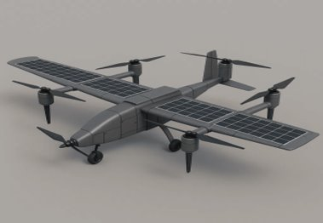


GreenLift AI: Intelligent VTOL Drone Delivery Ecosystem for SMEs
Transforming Last-Mile Logistics and Business Intelligence for 10 Million SMEs in Bangladesh
TEAM PHANTOM
CONTACT:
armanislam527@gmail.com
LinkedIn:
linkedin.com/in/armanislam527/
PHONE:
+8801521751005
PROJECT PORTFOLIO:
https://armanislam527.github.io/IntelligentVTOLDroneDeliveryEcosystemForSMEs/

Slide 2


The Team: Focused on Execution
A dedicated technical specialist driving the future of intelligent logistics
Arman
💡Technical & Idea Supporter
Core Expertise:
▪
WRO 2025 Participant (Invited To National)
▪
Autonomous Systems Specialist
▪
Embedded Systems & Robotics
▪
Flight Control & Navigation
▪
IoT & Sensor Integration
PORTFOLIO: cv-of-arman.netlify.app
LinkedIn:​ linkedin.com/in/armanislam527/​
GITHUB: github.com/Armanislam527

Slide 3

The Logistics Barrier
Costly, Unreliable, and Data-Blind Operations Limiting SME Growth
01
02
Monsoon Vulnerability
Last-Mile Inefficiency
Delays during rainy seasons
Create supply chain chaos
Customer dissatisfaction
Costly
unreliable final delivery
drains operational budgets.
89% AFFECTED
91% REPORT DELAYS
03
04
Data Blindness
Cost Burden
Consume a significant SME budgets
limiting resources for growth and innovation.
Lack of business intelligence
18-25% OF BUDGET
73% LACK TOOLS

Slide 4
Market Opportunity
The $10 Billion Untapped Potential in Bangladesh's SME Sector
7.9M
78%
$31B+
SMEs in Bangladesh
Underserved in Poor Logistics Areas
Market Opportunity
Target Market Segments:
E-commerce & Online Retailers
▪
Agricultural Suppliers
▪
Local Pharmacies
▪
Cold-Chain Businesses
▪
Food & Beverage Distributors
▪
Retail Chains
▪
Starting Prototyping Area:
Pabna District

Slide 5
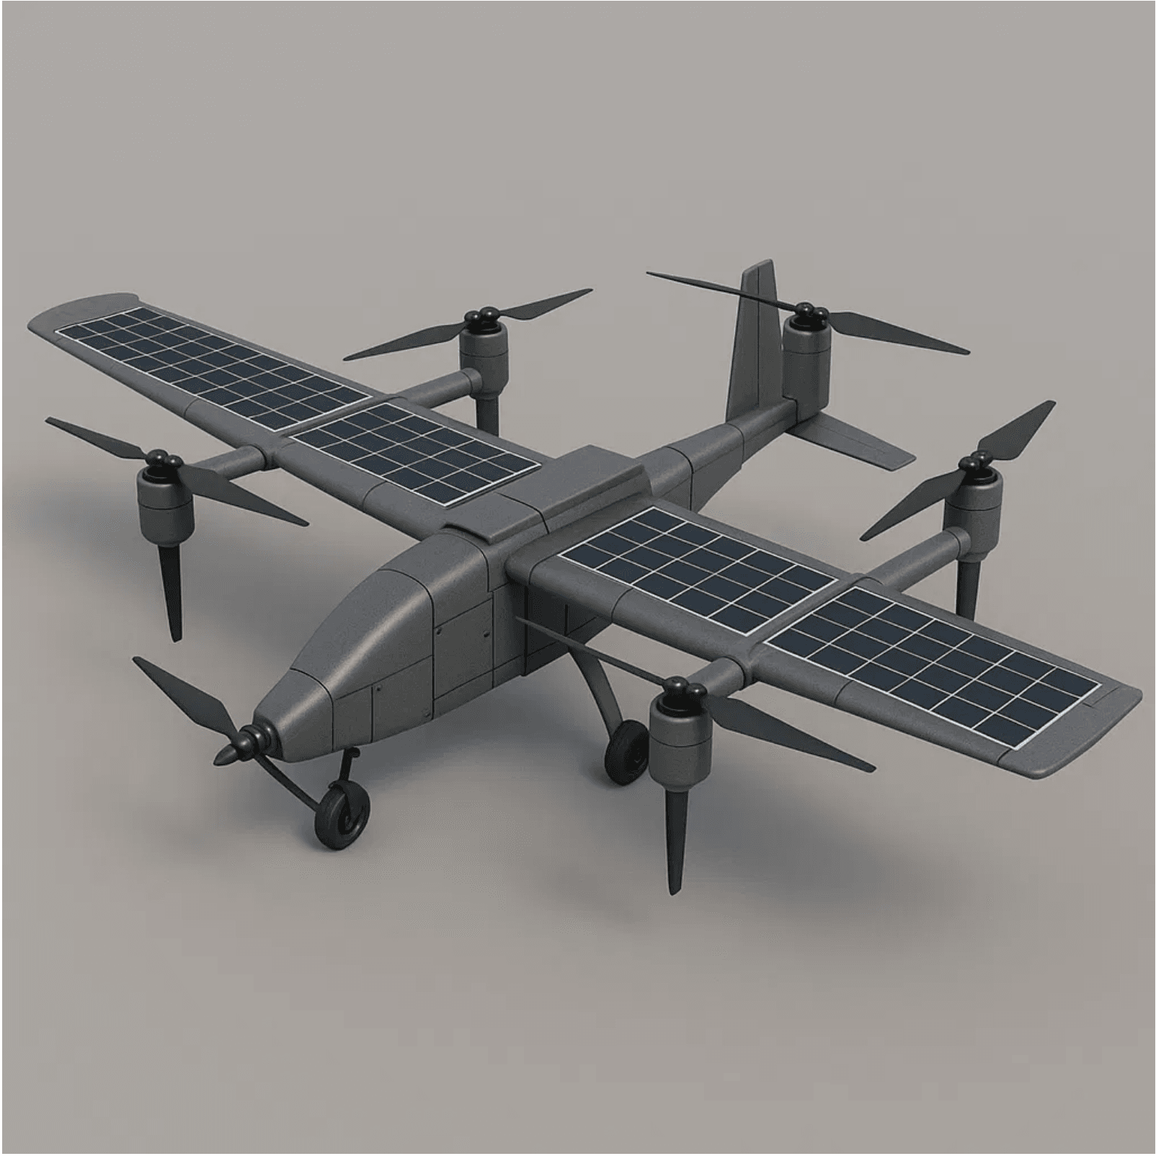
GreenLift AI: The Integrated Solution
Comprehensive ecosystem combining autonomous delivery with real-time business intelligence
Green-Fuel VTOL Drones
AI-Powered SME Dashboard
Autonomous
Green-energy
delivery for Fast reliable service in urban and rural areas
Converts raw business data into actionable insights for demand, inventory, and cash flow
Seamless Integration
Localized & Affordable
Closed-loop intelligence system where every delivery improves predictive analytics
Bangla interface, mobile-first design, pay-per-use model for easy SME adoption

Slide 6

Technical Deep Dive
Precision, Reliability, and Low-Cost Connectivity
LoRa Network
Smart Tension Sensor
Purpose
Mechanism
Integrated into the string-down delivery system for secure, precise, and damage-free package release.
Low-power, long-range communication
Benefits
Function
Ensures reliable control and data transmission, reducing operational costs
Detects pre-set threshold tension value for automatically releasing packages
Range & Coverage
Advantage
Extended range (5-15 km) with low power consumption
No landing required. Autonomous release ensures delivery without human
COMMUNICATION PROTOCOL: MQTT/LoRaWAN
AUTO-RELEASE: THRESHOLD-BASED ACTIVATION
VTOL DRONE SPECIFICATIONS
PAYLOAD: 1-20 kg
RANGE: 10-20 km
PROPULSION: Hydrogen-Electric Hybrid
EMISSIONS: Zero-Carbon Delivery

Slide 7

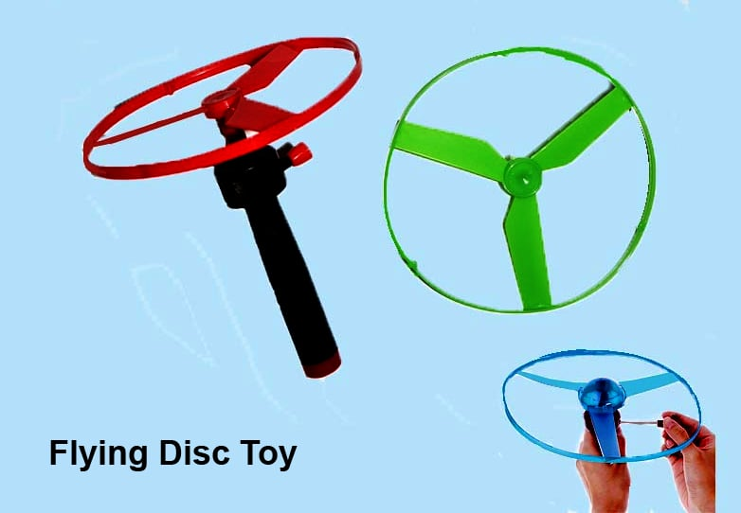
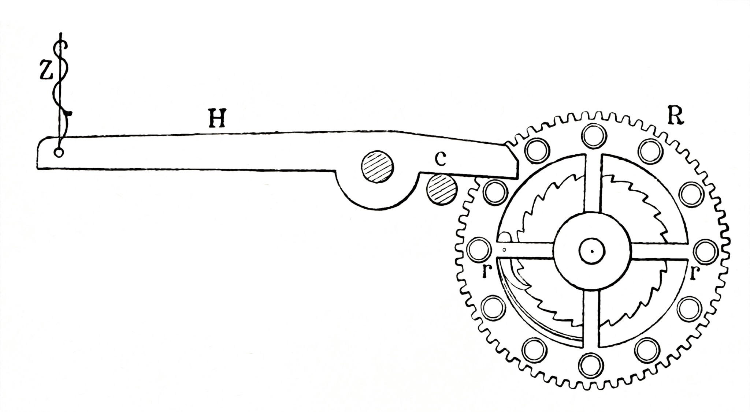

Weight Lift Mechanism
All Possible Approach
The Drone will never take down, so the delivery will be seamless

Slide 8
Unique Value Proposition
Efficiency Meets Sustainability: First-of-its-kind Integration
⚡
Zero-Carbon Operations
No Wage Burden
💰
Aligning with global sustainability goals while boosting brand value.
Replaces ongoing driver salaries
Autonomous operations reduce labor dependency
significantly improve margins.
🧠
Integrated AI Analytics
Weather Resilience
🌦️
optimize delivery routes
weather planning
demand forecasting
Advanced sensors and AI modeling enable safe operations in challenging conditions
THE RESULT: Faster deliveries, lower costs, competitive advantage—all without environmental compromise.

Slide 9
Business Model: Predictable Revenue, Scalable Growth
Multiple revenue streams creating predictable income while remaining flexible to SME budgets
Pay-Per-Delivery
AI Dashboard Subscription
15-30 BDT
500-2,000 BDT/month
Variable revenue scales with transaction volume.
Recurring revenue for analytics.
Strategic Partnerships
Fleet Leasing
Revenue Sharing
Equipment-as-a-Service
Co-branded solutions with e-commerce platforms and logistics companies.
Maintenance and support included. Lowers customer capital requirements and ensures recurring revenue.
FLEXIBLE MODEL: Combines variable (pay-per-delivery) and recurring (subscriptions) revenue, ensuring sustainable growth while maintaining affordability for SMEs.

Slide 10
AI Integration: Transforming Data into Profit
Machine learning powers intelligent decision-making across the entire delivery ecosystem
Demand Forecasting
01
Reducing stockouts and overstock.
Route Optimization
02
Reducing time while maximizing daily capacity.
Autonomous Operations
03
Maintaining safety and compliance standards across all deliveries.
Smart Inventory
04
Prevents stockouts and overstock scenarios which improving cash flow.
Customer Behavior Analysis
05
Build loyalty and competitive differentiation.

Slide 11

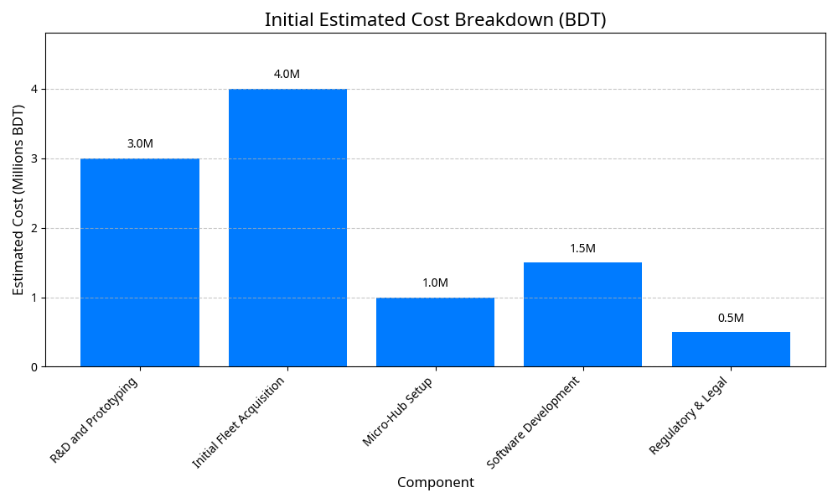
Costing: Strategic Investment for Market Entry
Breakdown of 10M BDT to complete pilot and hit Year 2 revenue
Build 8–10 VTOL drones including components
Pabna hub:
Solar
Storage
Dispatch
security
COMPONENT
ESTIMATED COST (BDT)
JUSTIFICATION
BVLOS
Permits
Compliance
legal setup
R&D and Prototyping
3,000,000
Finalize design, sensors, LoRa, and AI
Finalize design
sensors
LoRa
and AI
Initial Fleet Acquisition
4,000,000
Build 8–10 VTOL drones incl. components
Micro-Hub Setup
1,000,000
Pabna hub: solar, storage, dispatch, security
AI dashboard
Routing
API
mobile app
Software Development
1,500,000
AI dashboard, routing, API, mobile app
Regulatory & Legal
BVLOS, permits, compliance, legal setup
500,000
TOTAL INITIAL ASK
10,000,000
Funds pilot and market entry by Q4 2026
Capital Required for Pilot Completion & Market Entry
10,000,000 BDT
Funds prototype, approvals, and Pabna pilot with 50 SMEs

Slide 12
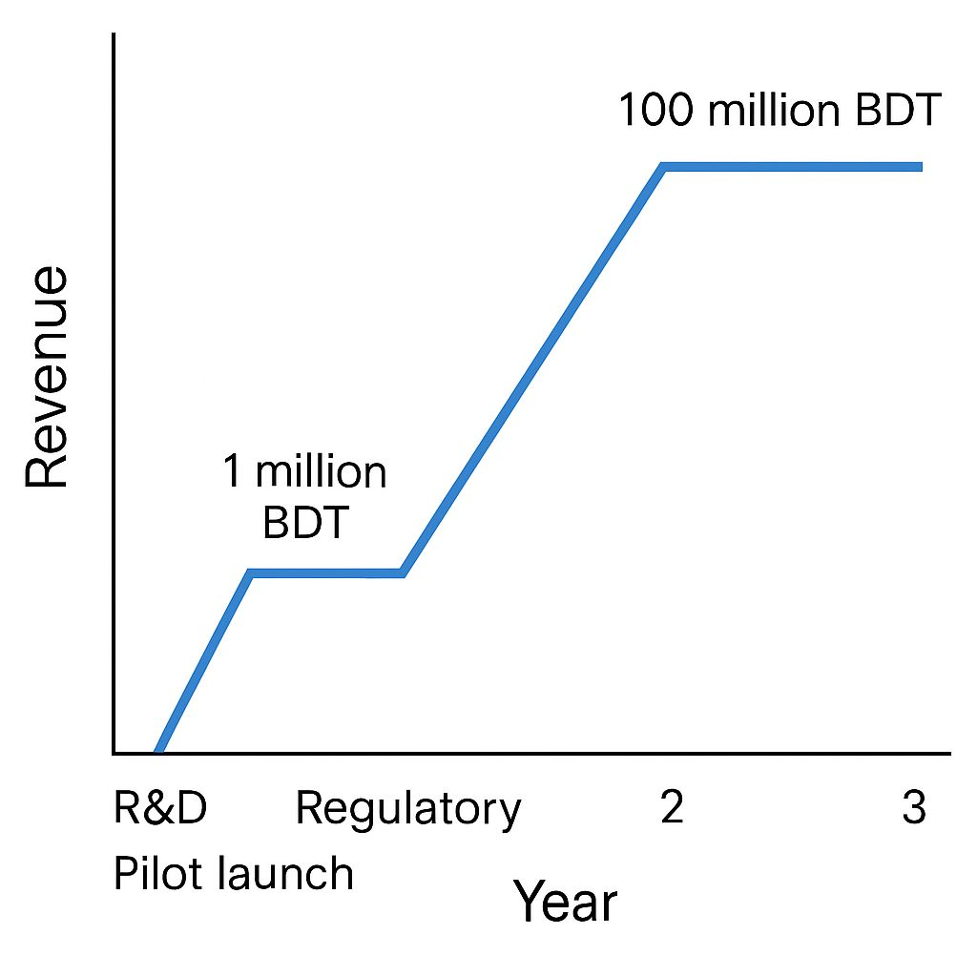
Financial Projections
Clear Path to 100 Million BDT Revenue and Market Leadership
YEAR Focus Area Revenue Target
Year 1 R&D,Pilot,Permissions 0 BDT
Year 2 Commercialization, 50 SME Contracts 1Million BDT
Year 3 Scale-up, Multi-District Expansion 100Million BDT
Return on Investment
Profit Phase Entry
Initial Investment
2.5 YRS
Q4 YR 2
10M BDT
Projected ROI based on initial investment and revenue growth
Revenue exceeds operational costs
Capital required for pilot and market entry

Slide 13
Go-to-Market Strategy: Phased Rollout
Strategic approach targeting high-density SME clusters with proof-of-concept and scalable growth
Pilot Launch
Strategic Partnerships
Align with e-commerce platforms, local retailers, and business associations for distribution, credibility, and co-branded solutions.
Deploy 8-10 drones across 50 SME partners in Pabna district. Validate operations, gather data, and build proof-of-concept.
50 SME PARTNERS | PABNA DISTRICT
PARTNERSHIPS WITH KEY STAKEHOLDERS
Digital Marketing
Referral Program
Targeted campaigns, case studies, and influencer partnerships within SME networks. Build brand awareness and trust through social proof.
Incentivize early adopters to drive organic growth and peer adoption. Create network effects and sustainable customer acquisition.
CASE STUDIES & SOCIAL PROOF
INCENTIVIZED ORGANIC GROWTH
TIMELINE: Pilot Launch (Q3 2026) → Strategic Partnerships (Q4 2026) → Digital Marketing (Q1 2027) → Referral Program (Ongoing)

Slide 14
Competitive Moat: Data-Driven Advantage
Self-learning data loop creates a defensible market position
🔗
Integrated Platform
Unlike traditional couriers or standalone analytics platforms, GreenLift AI combines delivery logistics and AI business intelligence in one unified ecosystem.
🌱
Sustainability-First
Green-fuel VTOL drones differentiate us in an increasingly eco-conscious market. Appeals to SMEs seeking carbon-neutral operations and brand enhancement.
🌍
Local & Inclusive Design
Designed specifically for Bangladesh's SME ecosystem. Bangla interface, low-tech literacy support, and rural infrastructure compatibility create barriers for global competitors.
🧠
Proprietary AI Algorithms
Early regulatory alignment and proprietary machine learning models create high barriers to entry. Data improves with every delivery, strengthening competitive advantage.
DEFENSIBLE POSITION: Every delivery generates data that improves our AI models. Early market entry, regulatory relationships, and local expertise create a self-reinforcing competitive moat that competitors cannot easily replicate.

Slide 15
Next Steps: Accelerating to Market Leadership
Clear roadmap for the next 12 months to secure BVLOS clearance and full pilot deployment
Q1 2026
Q2 2026
Q3 2026
Q4 2026
Prototype Completion
Field Testing & Validation
Pilot Launch
Revenue & Expansion
Hardware/software finalization, integration testing, and pre-flight validation.
Full deployment in Pabna district with 50 SME partners and initial revenue generation.
Initial revenue generation and planning for multi-district expansion in Year 2.
Real-world performance testing with regulatory bodies and select partners.
Our Ask
10,000,000 BDT
Capital required to accelerate prototype completion, regulatory approval, and pilot execution. This investment directly funds our path to market leadership across Bangladesh.
INVESTMENT ALLOCATION: R&D (3M) | Fleet Acquisition (4M) | Micro-Hub Setup (1M) | Software Development (1.5M) | Regulatory & Legal (500K)

Slide 16
Business Model Canvas
Comprehensive strategic overview of GreenLift AI's sustainable ecosystem
Key Partners
Value Propositions
Channels
• SME Associations
✓ Zero-Carbon Delivery
• Direct Sales Team
• E-commerce Platforms
✓ Real-Time AI Insights
• Strategic Partnerships
• Local Retailers
✓ Cost Reduction (No Wage Burden)
• Online Platform
• Regulatory Bodies
✓ Weather Resilience
• Referral Program
Key Activities
✓ Integrated Platform
Revenue Streams
• Drone Operations
Customer Relationships
• Pay-Per-Delivery (15-30 BDT)
• AI Model Training
• Dedicated Account Management
• Dashboard Subscription (500-2,000 BDT/month)
• Software Development
• Automated Support
• Strategic Partnerships
• Regulatory Compliance
• Community Building
• Fleet Leasing
Key Resources
• Training & Onboarding
Cost Structure
• VTOL Drone Fleet
Customer Segments
• R&D & Development
• AI Analytics Engine
SMEs in Bangladesh
e-commerce retailers
agricultural suppliers
Pharmacies
and food distributors
• Fleet Maintenance
• LoRa Network
• Software Licensing
• Technical Team
• Hub Operations
• Regulatory Fees

Slide 17


Thank You
Deliver smarter Grow cleaner
Scan to Learn More
Get in Touch
Email
armanislam527@gmail.com
Phone & Whatsapp
+8801521751005
Portfolio
cv-of-arman.netlify.app
Relevant Work>
GitHub
Project Portfolio
Armanislam527
LinkedIn:
armanislam527
TEAM PHANTOM | PABNA UNIVERSITY OF SCIENCE AND TECHNOLOGY | GREENLIFT AI

