Slide 1




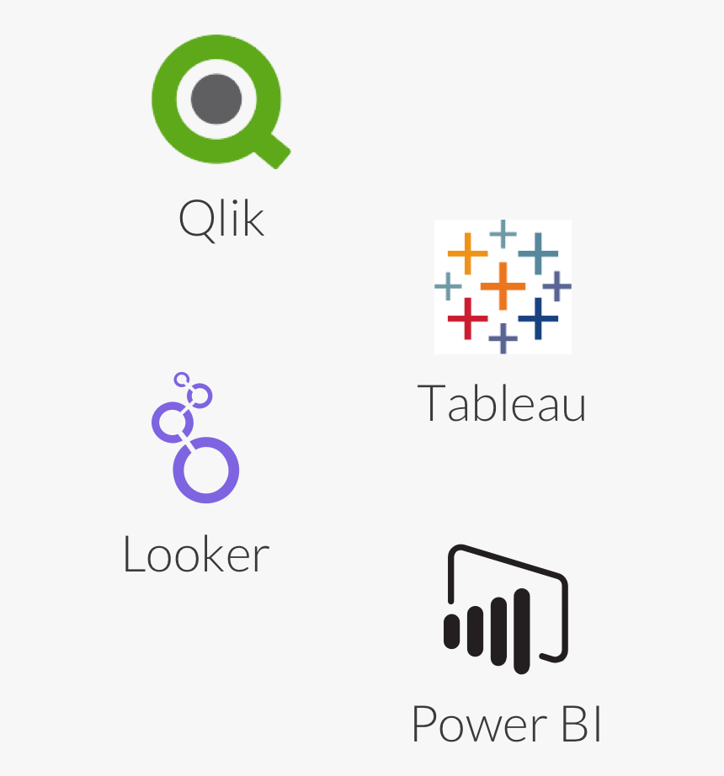






DWH schema creation
Realtor static tables
Static tables to RDS
Static-denormalization-parquet
Static Staging Area
Static-
Parquet-
To - Redshit
Realtor transaction tables
Realtor transaction tables
Realtor transaction tables
Transaction tables to RDS
AWS RDS
AWS CloudWatch
Transaction-denormalization-parquet
Transaction Staging Area
Static-
Parquet-
To - Redshit
AWS RDS
AWS RDS
Transaction-denormalization-parquet
AWS Redshift
AWS Redshift
AWS Redshift
External source
AWS CloudWatch
AWS CloudWatch
Metadata to upsert into Redshift
Metadata to upsert into Redshift
Estate-Broker relationship
Selling estates
Batch processing
Stream processing

Slide 2
DWH schema creation
Realtor static tables
Static tables to RDS
Static-denormalization-parquet
Static Staging Area
Static-
Parquet-
To - Redshit
Realtor transaction tables
Realtor transaction tables
Realtor transaction tables
Transaction tables to RDS
AWS RDS
AWS CloudWatch
Transaction-denormalization-parquet
Transaction Staging Area
Static-
Parquet-
To - Redshit
AWS RDS
AWS RDS
Transaction-denormalization-parquet
AWS Redshift
AWS Redshift
AWS Redshift
External source
AWS CloudWatch
AWS CloudWatch
Metadata to upsert into Redshift
Metadata to upsert into Redshift
Estate-Broker relationship
Selling estates

