Slide 1

Fingerprint Based Biometric Attendance System

Slide 2
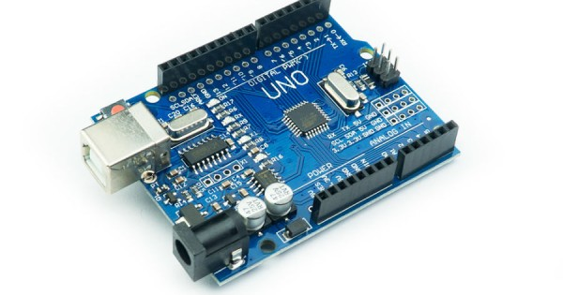
What is Arduino?
-

Slide 3
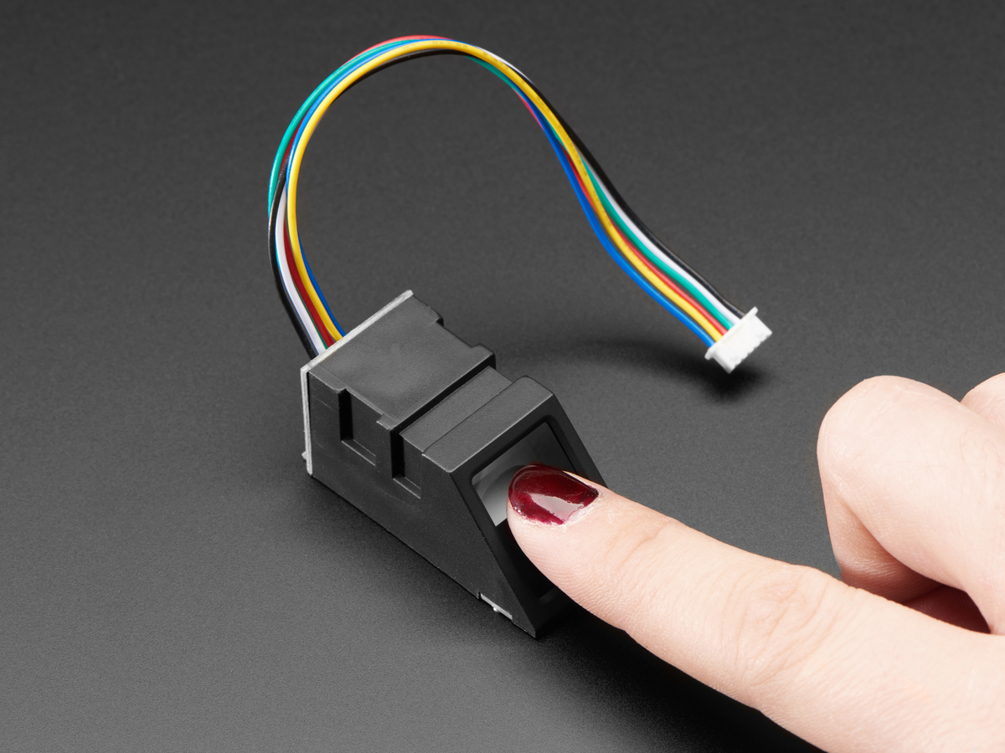
What is Finger Print Sensor?

Slide 4
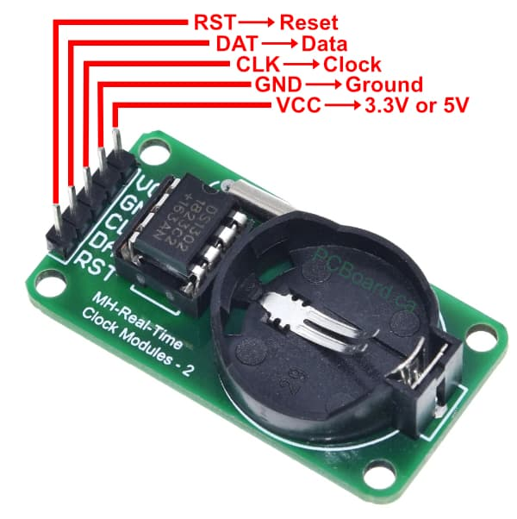
What is real time module?

Slide 5




Slide 6




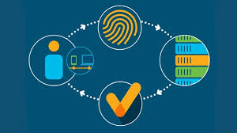

Slide 7
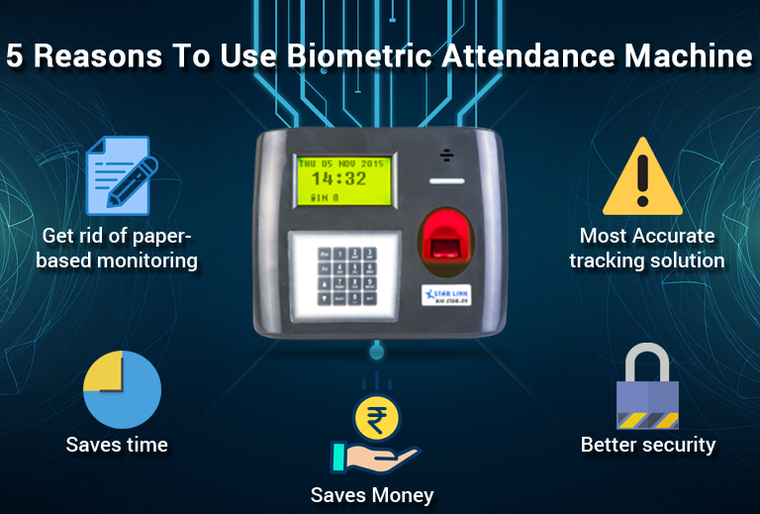

Slide 8

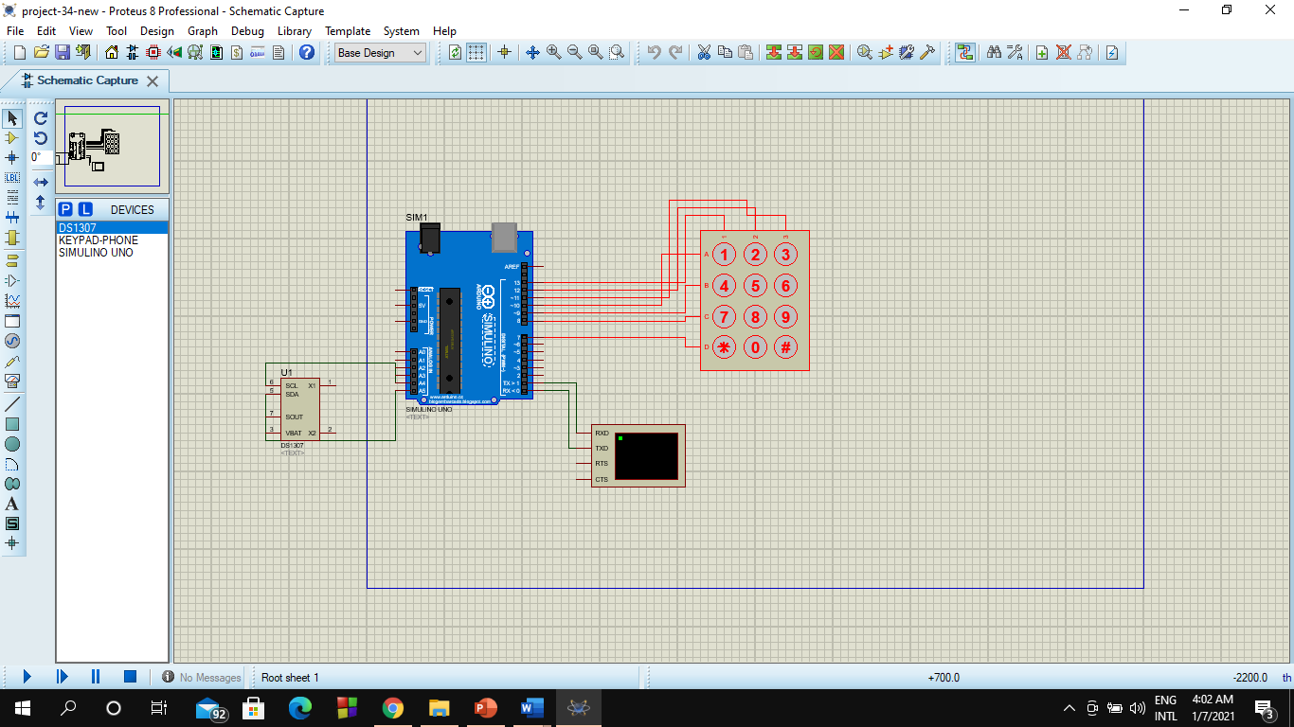
1. Arduino Board Uno
2. Keypad
3. Virtual Terminal (proteus)
4. Connecting Wires
5. Bread Board
6. DS1307 RTC module

Slide 9
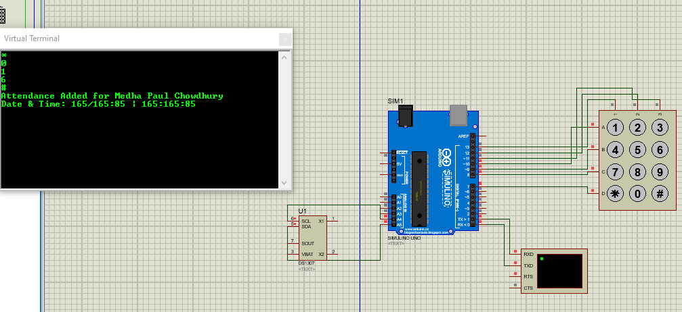
Fig: Diagram

