Slide 1
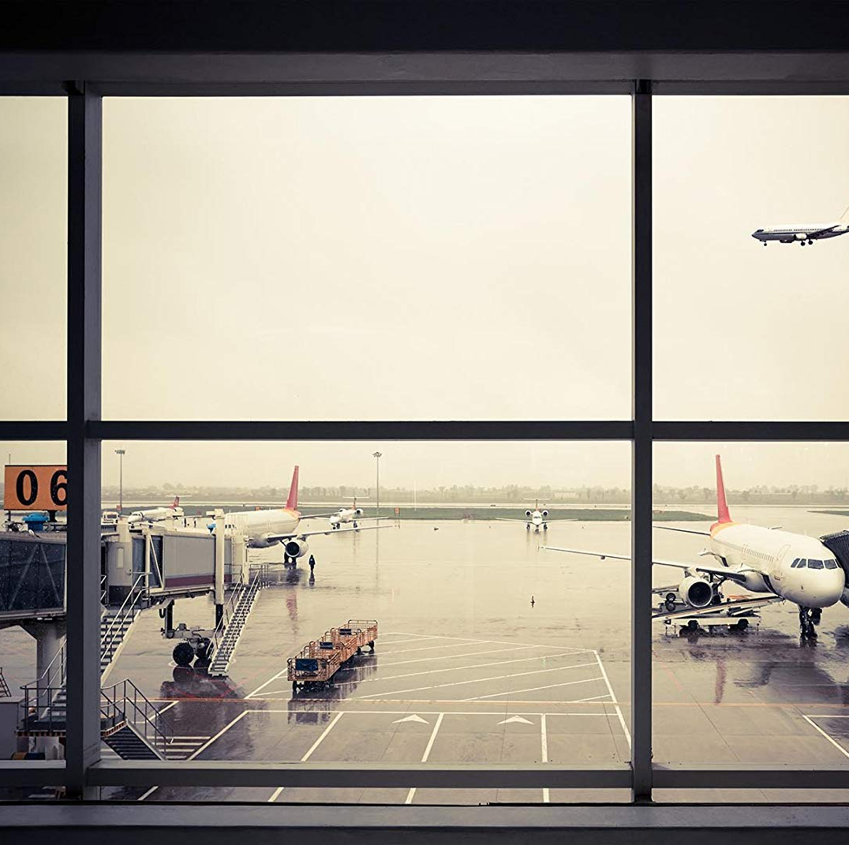
Analysis of Airline Sentiment through Twitter Data
Arman Siddiqui
Notes:
Title Slide

Slide 2



Troublesome Airline History
Inclement weather often causes flight issues such as delays, reroutes, or entire cancellations.
Airlines often offer compensation however passengers rarely make use of them
Cancelled flights just from 2021 to 2022 have already doubled
From FlightAware, cancelled US flights reached 121,552 in all of 2021 and have already reached 121,918 at the end of June 2022
Since 1995 unruly passenger reports have increased from 146 to 1,944 in 2022 according to the Federal Aviation Administration
Unruly passengers feed into the overall dissatisfaction of those flying

Slide 3

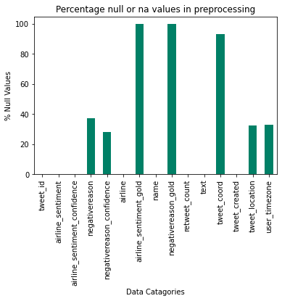
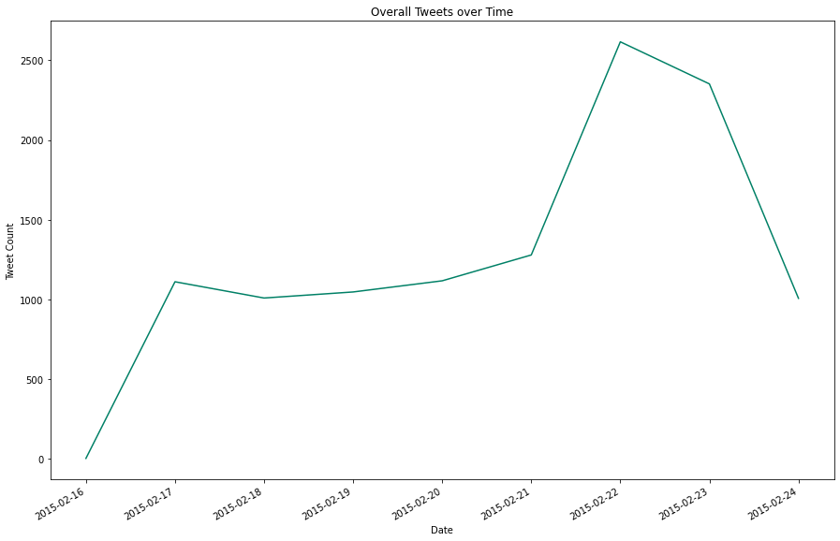
Turbulent Data
The data was collected between February 16th and the 24th which is a very short period of time
In addition, 3 categories from our dataset were dropped as a result of over 95% null values
The data types posed challenging for modeling due to its highly categorical nature

Slide 4
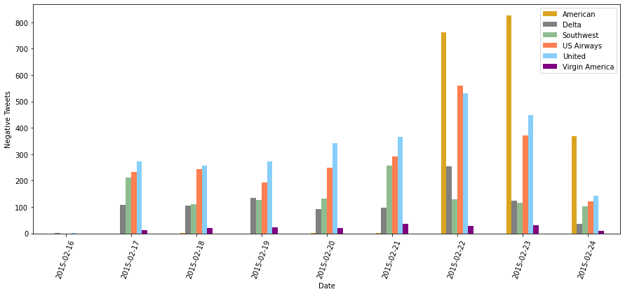

The Significance of Details in Time Series Data
The peak distributions of negative tweets on the 22nd and 23rd most likely skew our overall data
Note that the high count of negative tweets from America do not occur until the last 3 days
This probably skews our already limited data
Could possibly be explained by weather trends or delayed passenger feedback

Slide 5
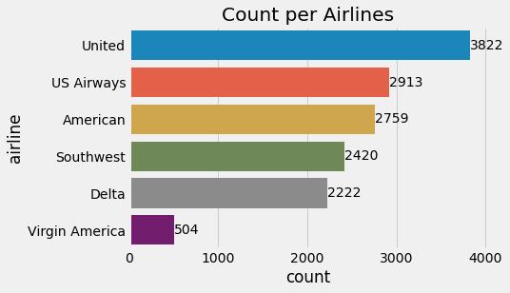

Tweeting @Airlines
United Airlines had the greatest number of overall tweets with Virgin Airlines having the lowest
The large range in tweet distribution is probably a result of the short data collection period

Slide 6
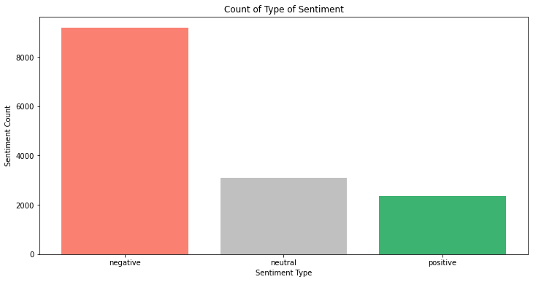

Overall Airline Sentiment
Negative sentiment was highest across all airlines
Discuss issues with the data and sentiment “scoring”

Slide 7
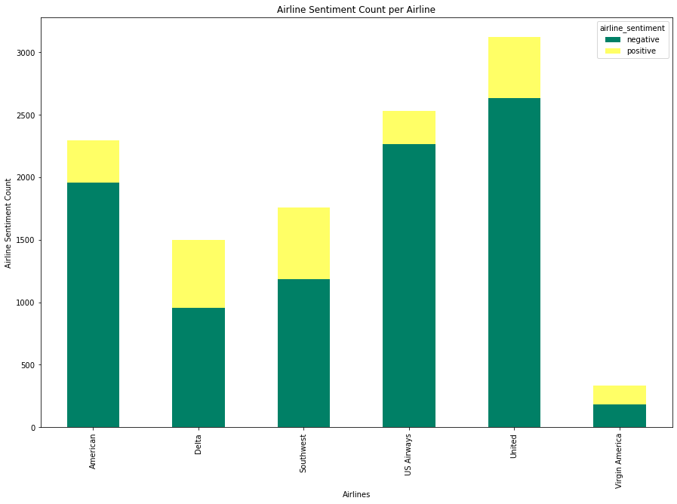
Airline Specific Sentiment
All airlines had a strong negative sentiment
United led the group on count with Virgin America having the least number of tweets as a whole

Slide 8

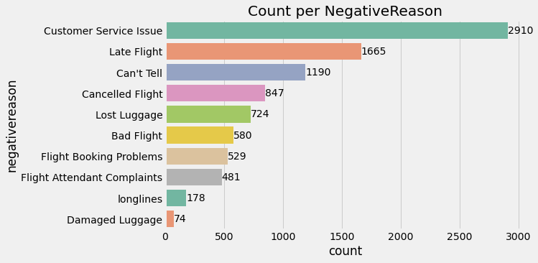
Leading Reasons for Dissatisfaction
Customer Service Issues were cited as the leading reason for airline dissatisfaction

Slide 9
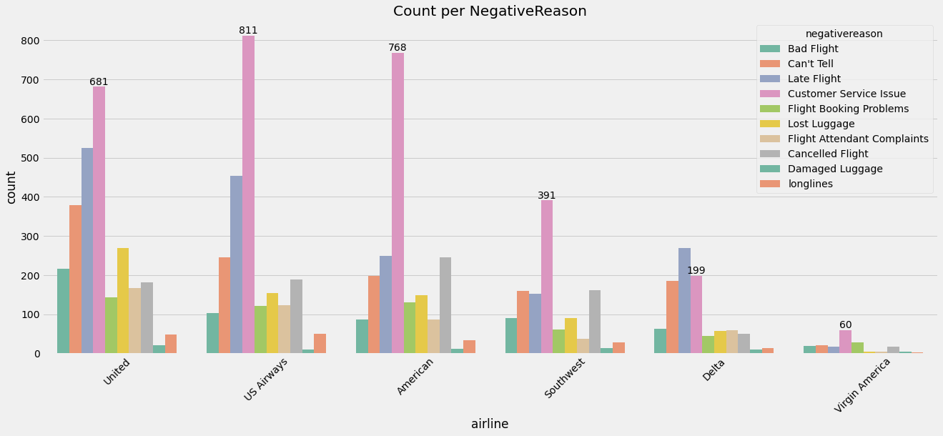
Airline Specific Reasons for Dissatisfaction
Customer Service was cited as the leading cause for dissatisfaction amongst all airlines except Delta
Late Flights were the 2nd leading cause for dissatisfaction for all airlines except Delta where it was the leading cause

Slide 10
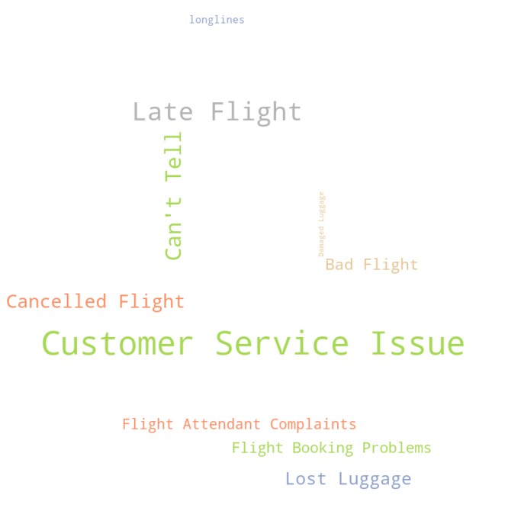


Taking a Step Back
Customer Service was the leading cause for dissatisfaction amongst fliers
There was an overall strong negative sentiment across all airlines
The data used was incredibly limited in nature due to its short length and skewed data

Slide 11

Actionable Items
Airlines should focus on ensuring customer satisfaction and prompt customer service whilst also being aware that individuals voicing concerns online may not reflect the views off all customers
There should be an emphasis on leaving customers wanting to fly again to create a continuous repetitive stream of income per customer
Airlines may want to look into collecting their own data via follow up emails requesting how satisfied a flier was after their trip

Slide 12

Future Analysis
For future data collection, it should be noted that a much larger time period is preferred as opposed to a short one
Efforts by airlines to not only collect Twitter data but data outside of Twitter should be increased
Paying attention to the types of data collected will allow for future analysis to create effective and robust predictive models

