Slide 1


TECHNICAL EVALUATION · DEEP LEARNING STUDY
Evaluation & Fine-Tuning of
EfficientLoFTR
Semi-dense local feature matching for thermal–optical (IR ↔ RGB) image pairs
Thermal / IR
Optical / RGB
Presented by Arman Sajjadi
For Prof. Hasan F. Ates · Özyeğin University — Faculty of Engineering
Notes:
Title. Introduce the goal: evaluate EfficientLoFTR for thermal–optical matching, fine-tune it, and compare against a classical ORB+RANSAC pipeline. Thermal=amber, optical=cyan motif carried through the deck.

Slide 2






ROADMAP
What this study covers
The problem
01
EfficientLoFTR
02
Why cross-modal matching breaks classical features
A detector-free, semi-dense transformer matcher
Methods compared
03
Experimental setup
04
Classical ORB vs. pre-trained vs. fine-tuned ELoFTR
RoadScene dataset & a two-stage fine-tuning recipe
Results
05
Conclusions
06
Qualitative matches & quantitative head-to-head
Key takeaways and directions for future work
2
Notes:
Agenda. Six beats: problem, model, methods, setup, results, conclusions. Keep it to ~20 seconds.

Slide 3
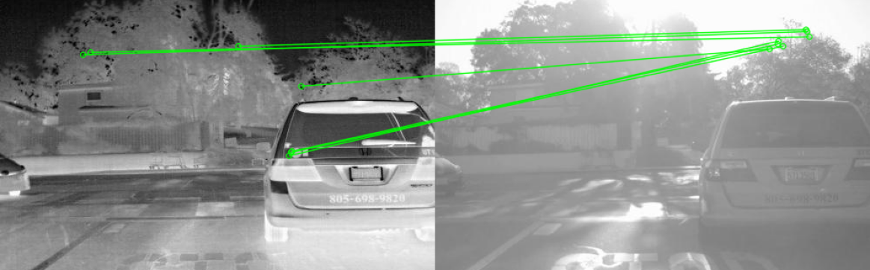



THE PROBLEM
Matching across modalities breaks classical features
Thermal and optical sensors see the same scene through different physics — edges, textures and even intensity ordering can invert between them.
CLASSICAL ORB · ONE THERMAL–OPTICAL PAIR
Appearance gap
Hand-crafted descriptors (SIFT/SURF/ORB) assume photometric consistency that does not hold IR ↔ RGB.
Texture-poor regions
Roads, sky and walls give few repeatable keypoints to detect and describe.
7 of 287 matches survive RANSAC
A 2.4% inlier ratio — effectively unusable for pose or reconstruction.
RANSAC can't save it
With mostly wrong putatives, geometric verification keeps only a handful of inliers.
So the question: can a modern detector-free matcher close this gap — and how much does domain fine-tuning add?
3
Notes:
Motivation. Thermal and optical sensors differ physically, so hand-crafted descriptors that assume photometric consistency fail. The ORB teaser (7/287 inliers) frames the central question.

Slide 4


THE MODEL
EfficientLoFTR in a nutshell
Detector-free and semi-dense: instead of detecting keypoints, a transformer directly establishes correspondences across the whole image — robust to viewpoint change and texture-poor scenes, at ~2.5× the speed of LoFTR.
Aggregated attention
Two-stage refinement
Built for speed
Neighbouring & salient tokens are pooled before attention, so vanilla attention runs on far fewer tokens — fast and expressive.
Mutual-nearest-neighbour gives a pixel match, then a tiny 3×3 correlation window yields a sub-pixel result with minimal variance.
A reparameterized RepVGG backbone, plus an optional drop of dual-softmax at inference, push it to sparse-like latency.
~2.5× faster than LoFTR
semi-dense matches, no detector
≈ SP+LightGlue speed, higher accuracy
4
Notes:
What ELoFTR is: detector-free, semi-dense, transformer-based, ~2.5x faster than LoFTR. Three innovations: aggregated attention, two-stage refinement, RepVGG + optional dual-softmax drop.

Slide 5



ARCHITECTURE
A coarse-to-fine matching pipeline
1
2
3
4
Feature extraction
Coarse transform
Coarse matching
Fine matching
RepVGG backbone produces 1/8 coarse maps plus 1/4 & 1/2 fine features.
Aggregated self- & cross-attention ×N with rotary position encoding.
Score matrix → dual-softmax → mutual-nearest-neighbour coarse matches.
Two-stage refine: MNN pixel match, then 3×3 sub-pixel expectation.
Why it's efficient: attention is the bottleneck in LoFTR — aggregating tokens first means the transformer touches a fraction of them, while the two-stage refinement removes the spatial variance of LoFTR's expectation-only fine step.
5
Notes:
Pipeline: extract → coarse transform (aggregated attention xN, RoPE) → coarse match (dual-softmax + MNN) → two-stage fine match (MNN then 3x3 subpixel).

Slide 6
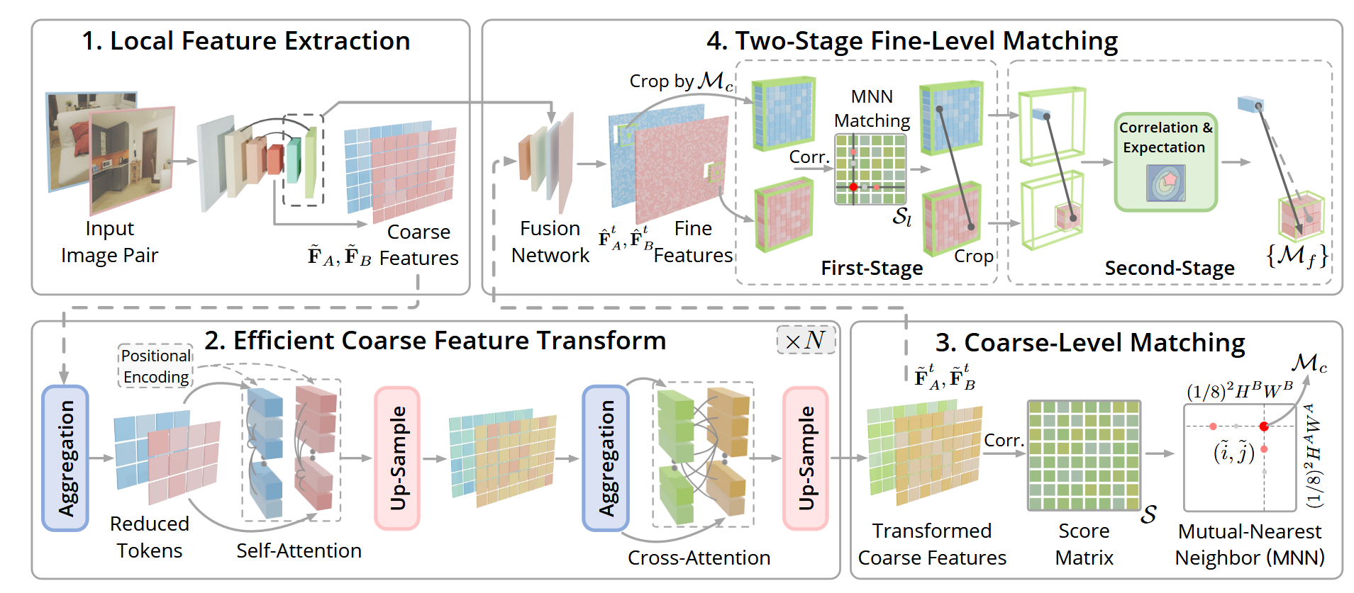
ARCHITECTURE · FROM THE PAPER
The four-stage matching pipeline
WANG ET AL., EFFICIENTLOFTR — FIGURE 2
Four stages, one pass: extract → transform → coarse match → fine match — each block above maps directly onto the step cards on the previous page.
6

Slide 7


EXPERIMENT DESIGN
Three matchers, one benchmark
CLASSICAL
ZERO-SHOT
ADAPTED
ORB + RANSAC
Pre-trained ELoFTR
Fine-tuned ELoFTR
ORB detector/descriptor (2000 features)
Brute-force Hamming matcher, cross-check
RANSAC homography (3 px) verification
Official outdoor weights (MegaDepth)
Run directly on thermal–optical pairs
No adaptation — tests raw generalization
Same network, adapted to RoadScene
Our two-stage fine-tuning recipe
Coarse homography self-supervision
SURF is patented/non-free in OpenCV, so ORB is used as the standard hand-crafted representative.
Measures how far an off-the-shelf modern matcher already transfers across modalities.
Tests how much a modest amount of in-domain training buys on this task.
Shared evaluation: every method is scored the same way — RANSAC homography at 3 px → inlier count, inlier ratio, matching accuracy (MMA@3px) and runtime (FPS) on the held-out RoadScene test set.
7
Notes:
Three methods on one benchmark: classical ORB; pre-trained ELoFTR (zero-shot); fine-tuned ELoFTR. Note SURF is patented so ORB is the classical representative. All scored identically with RANSAC@3px.

Slide 8

SETUP
Dataset & fine-tuning recipe
RoadScene dataset
1
STAGE 1
Warm-up the backbone
Aligned infrared ↔ visible road scenes
Load outdoor weights, freeze the transformer, train only the RepVGG CNN backbone to absorb the new modality.
176
22
23
TRAIN
VAL
TEST
2
STAGE 2
221 paired images · total, split 80 / 10 / 10
End-to-end adaptation
Pre-processing & augmentation
Grayscale, resized to 640 × 480
Random homography warp (≤ 5% corner shift)
Brightness / contrast + Gaussian noise
Load best Stage-1 weights, unfreeze the whole network and train the transformer too for cross-modal matching.
Adam · lr 1e-5 · 25 epochs/stage · mixed precision · grad-clip · coarse homography supervision (fine head off) · best-val checkpointing
8
Notes:
Setup: RoadScene, 221 aligned IR/RGB pairs, 176/22/23 split, 640x480, homography+photometric augmentation. Two-stage fine-tuning: warm up backbone (transformer frozen), then end-to-end. Adam 1e-5, AMP, 25 epochs/stage.

Slide 9
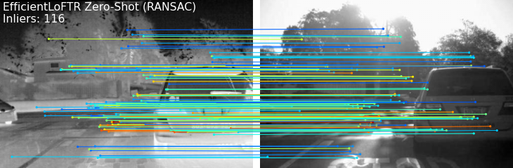
QUALITATIVE · SAME PAIR (FLIR_00006)
Classical ORB vs. zero-shot ELoFTR
ORB + RANSAC
Hand-crafted features · no learning
7 inliers
2.4% inlier ratio
Pre-trained ELoFTR
Off-the-shelf weights · no fine-tuning
116 inliers
27.6% inlier ratio
Same image pair, same RANSAC. Even with no fine-tuning, ELoFTR finds 16× more verified correspondences than ORB.
9
Notes:
Qualitative, same pair FLIR_00006: ORB keeps 7 inliers (2.4%); zero-shot ELoFTR keeps 116 (27.6%) — 16x more, with no training.

Slide 10
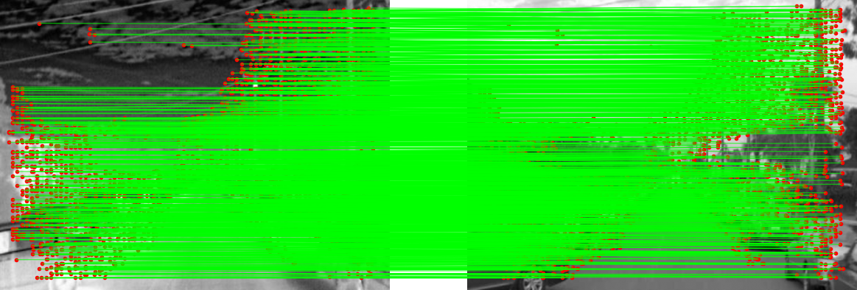

QUALITATIVE · FINE-TUNED
Dense, clean cross-modal correspondences
Fine-tuned ELoFTR on an unseen RoadScene test pair — infrared (left) ↔ visible (right). Green lines are confident matches.
Hundreds to thousands
Spans hard regions
Geometrically coherent
1,000–2,200 confident matches per pair — orders of magnitude beyond ORB.
Correspondences cover road, sky and low-texture areas, not just strong corners.
Match lines are near-parallel and consistent with the scene's registration.
10
Notes:
Qualitative, fine-tuned: ~1000–2200 confident matches per unseen pair, spread across textureless regions, geometrically coherent.

Slide 11
QUANTITATIVE · ROADSCENE TEST (23 PAIRS)
Head-to-head results
Method
Avg matches
RANSAC inliers
Inlier ratio
MMA @ 3px
Speed
Classical (ORB)
411.4
7.7
2.2%
5.6%
11.4 fps
Pre-trained ELoFTR
847.5
323.6
32.0%
71.8%
6.2 fps
Fine-tuned ELoFTR
1600.6
701.2
44.8%
76.4%
9.1 fps
91×
+12.8 pts
76.4%
more RANSAC inliers than ORB
inlier ratio from fine-tuning
matching accuracy (MMA@3px)
MMA@3px = share of matches consistent with the pairs' known IR↔RGB registration.
11
Notes:
Quantitative table. Walk top to bottom; highlight the fine-tuned row. 91x more inliers than ORB; fine-tuning adds +12.8 pts inlier ratio and lifts MMA to 76.4%. Note MMA is measured against the pairs' known registration.

Slide 12
QUANTITATIVE · VISUAL
Where the gains show up
Match quality (%)
Speed (frames / second)
Takeaway: ELoFTR's accuracy lead is enormous, and fine-tuning lifts it further. ORB wins raw FPS but its matches are unusable; both ELoFTR variants share one architecture, so their speeds are effectively equal (~6–9 fps) and stay real-time.
12
Notes:
Charts. Accuracy gap is huge and fine-tuning widens it. ORB has higher raw FPS but useless matches; both ELoFTR variants share one architecture so speed is effectively equal and real-time.

Slide 13

ANALYSIS
Strengths & trade-offs
Classical · ORB + RANSAC
EfficientLoFTR
STRENGTHS
STRENGTHS
Extremely fast, tiny footprint
Robust semi-dense cross-modal matches
No GPU and no training required
High accuracy (MMA 72–76%)
Trivial to deploy anywhere
Fine-tuning adds a clear margin
LIMITATIONS
Stays real-time (~9 fps)
Collapses across the modality gap
LIMITATIONS
Only ~8 inliers survive RANSAC
Needs a GPU; slower than ORB
MMA ~6% — unusable for geometry
Best results want in-domain fine-tuning
Can struggle on strong repetitive structure
13
Notes:
Strengths/trade-offs. ORB: fast, no GPU, but breaks across modality. ELoFTR: robust, accurate, fine-tuning helps, real-time, but needs a GPU and benefits from in-domain training.

Slide 14


TAKEAWAYS
Conclusions & next steps
WHAT WE FOUND
ELoFTR decisively beats ORB on thermal–optical matching — MMA 76% vs. 6%, and 91× more verified inliers.
Future work
Score against the dataset's ROMA ground-truth homographies → pose / reprojection-error AUC.
Scale to a larger multimodal corpus (LasHeR, VEDAI) and re-enable the fine-level refinement head.
Add LO-RANSAC and a licensed SURF baseline for a fuller classical comparison.
Inject global/semantic context to fix the repetitive-structure failure noted in the paper.
Fine-tuning on RoadScene adds a real margin: inlier ratio 32% → 45%, inliers roughly 2.2×.
The adapted model stays real-time (~9 fps), keeping it practical for SLAM / localization use.
14
Notes:
Conclusions: ELoFTR decisively wins; fine-tuning adds a real margin; stays real-time. Future: ROMA GT homographies + pose AUC, larger datasets, LO-RANSAC/SURF, global context for repetitive structures.

Slide 15
QUESTIONS & DISCUSSION
Thank you
Happy to walk through the code, the training details, or any of the results in our meeting.
Thermal / IR
Optical / RGB
Arman Sajjadi
Evaluation & Fine-Tuning of EfficientLoFTR · Thermal–Optical Image Matching
Notes:
Thank you. Invite questions; offer to walk through code, training, or results in the meeting.

