Slide 1
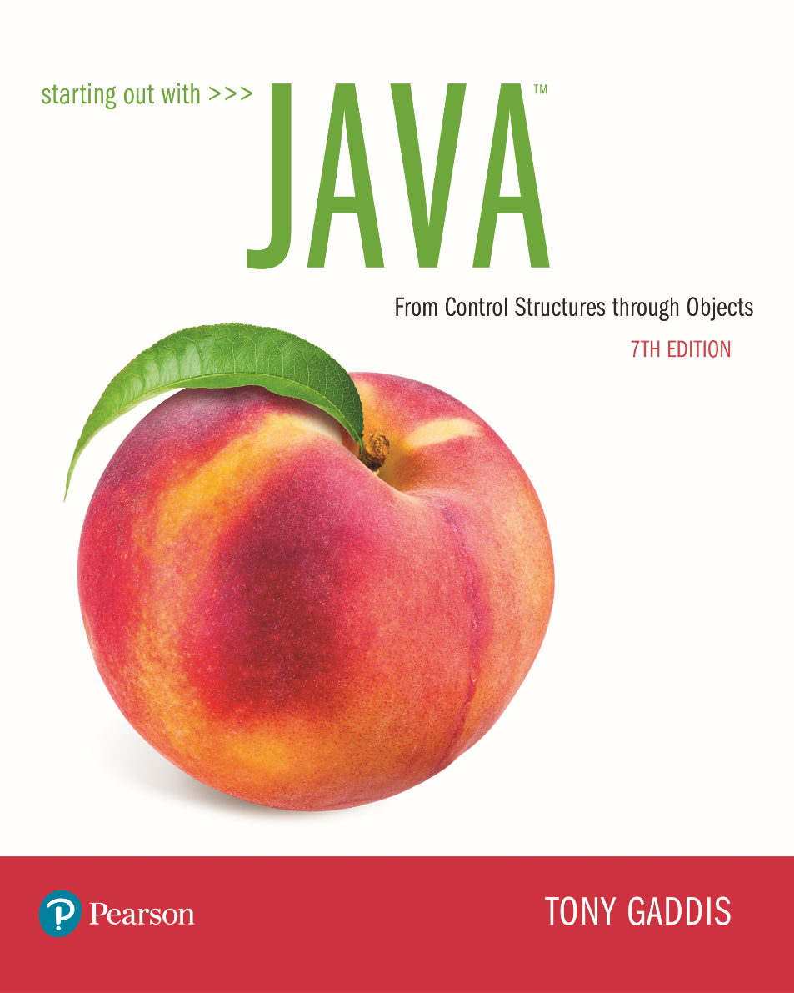
STARTING OUT WITH JAVATM
7th Edition
Chapter 15
Recursion

Slide 2
Chapter Topics
Chapter 15 discusses the following main topics:
  Introduction to Recursion
  Solving Problems with Recursion
  Examples of Recursive Methods
  A Recursive Binary Search Method
  The Towers of Hanoi

Slide 3
Introduction to Recursion (1 of 3)
We have been calling other methods from a method.
It’s also possible for a method to call itself.
A method that calls itself is a recursive method.
Example: EndlessRecursion.java

Slide 4
Introduction to Recursion (2 of 3)
This method in the example displays the string “This is a recursive method.”, and then calls itself.
Each time it calls itself, the cycle is repeated endlessly.
Like a loop, a recursive method must have some way to control the number of times it repeats.
Example: Recursive.java, RecursionDemo.java

Slide 5
Introduction to Recursion (3 of 3)
The method is first called from the main method of the RecursionDemo class.
First call of the method
n = 5
Second call of the method
n = 4
The second through sixth calls are recursive.
Third call of the method
n = 3
Fourth call of the method
n = 2
Fifth call of the method
n = 1
Sixth call of the method
n = 0

Slide 6
Solving Problems With Recursion (1 of 7)
Recursion can be a powerful tool for solving repetitive problems.
Recursion is never absolutely required to solve a problem.
Any problem that can be solved recursively can also be solved iteratively, with a loop.
In many cases, recursive algorithms are less efficient than iterative algorithms.

Slide 7
Solving Problems With Recursion (2 of 7)
Recursive solutions repetitively:
    allocate memory for parameters and local variables, and
    store the address of where control returns after the method terminates.
These actions are called overhead and take place with each method call.
This overhead does not occur with a loop.
Some repetitive problems are more easily solved with recursion than with iteration.
  Iterative algorithms might execute faster; however,
  a recursive algorithm might be designed faster.

Slide 8
Solving Problems With Recursion (3 of 7)
Recursion works like this:
  A base case is established.
    If matched, the method solves it and returns.
  If the base case cannot be solved now:
    the method reduces it to a smaller problem (recursive case) and calls itself to solve the smaller problem.
By reducing the problem with each recursive call, the base case will eventually be reached and the recursion will stop.
In mathematics, the notation n! represents the factorial of the number n.

Slide 9
Solving Problems With Recursion (4 of 7)
The factorial of a nonnegative number can be defined by the following rules:
  If n = 0 then n! = 1
  If n > 0 then n! = 1 × 2 × 3 × ... × n
Let’s replace the notation n! with factorial(n), which looks a bit more like computer code, and rewrite these rules as:
  If n = 0 then factorial(n) = 1
  If n > 0 then factorial(n) = 1 × 2 × 3 × ... × n

Slide 10
Solving Problems With Recursion (5 of 7)
These rules state that:
  when n is 0, its factorial is 1, and
  when n greater than 0, its factorial is the product of all the positive integers from 1 up to n.
Factorial(6) is calculated as
  1 × 2 × 3 × 4 × 5 × 6.
The base case is where n is equal to 0:
  if n = 0 then factorial(n) = 1
The recursive case, or the part of the problem that we use recursion to solve is:
  if n > 0 then factorial(n) = n × factorial(n – 1)

Slide 11
Solving Problems With Recursion (6 of 7)
The recursive call works on a reduced version of the problem, n – 1.
The recursive rule for calculating the factorial:
  If n = 0 then factorial(n) = 1
  If n > 0 then factorial(n) = n × factorial(n – 1)
A Java based solution:
  private static int factorial(int n)
  {
  if (n == 0) return 1; // Base case
  else return n * factorial(n - 1);
  }
Example: FactorialDemo.java

Slide 12
Solving Problems With Recursion (7 of 7)
The method is first called from the main method of the FactorialDemo class.
First call of the method
n = 4
Return value: 24
Second call of the method
n = 3
Return value: 6
Third call of the method
n = 2
Return value: 2
Fourth call of the method
n = 1
Return value: 1
Fifth call of the method
n = 0
Return value: 1

Slide 13
Direct and Indirect Recursion
When recursive methods directly call themselves it is known as direct recursion.
Indirect recursion is when method A calls method B, which in turn calls method A.
There can even be several methods involved in the recursion.
Example, method A could call method B, which could call method C, which calls method A.
Care must be used in indirect recursion to ensure that the proper base cases and return values are handled.

Slide 14
Summing a Range of Array Elements
(1 of 2)
Recursion can be used to sum a range of array elements.
A method, rangeSum takes following arguments:
  an int array,
  an int specifying the starting element of the range, and
  an int specifying the ending element of the range.
  How it might be called:
    int[] numbers = {1, 2, 3, 4, 5, 6, 7, 8, 9};
    int sum;
    sum = rangeSum(numbers, 3, 7);

Slide 15
Summing a Range of Array Elements
(2 of 2)
The definition of the rangeSum method:
  public static int rangeSum(int[] array,
  int start, int end)
  {
  if (start > end)
  return 0;
  else
  return array[start]
  + rangeSum(array, start + 1, end);
  }
Example: RangeSum.java

Slide 16
Drawing Concentric Circles
The definition of the drawCircles method:
  private void drawCircles(Graphics g, int n, int
  topXY, intƒsize)
  {
  if (n > 0)
  {
  g.drawOval(topXY, topXY, size, size);
  drawCircles(g, n - 1, topXY + 15, size - 30);
  }
  }
Example: Circles.java

Slide 17
The Fibonacci Series (1 of 2)
Some mathematical problems are designed to be solved recursively.
One well known example is the calculation of Fibonacci numbers.:
  0, 1, 1, 2, 3, 5, 8, 13, 21, 34, 55, 89, 144, 233,…
After the second number, each number in the series is the sum of the two previous numbers.
The Fibonacci series can be defined as:
  F0 = 0
  F1 = 1
  FN = FN–1 + FN–2 for N ≥ 2.

Slide 18
The Fibonacci Series (2 of 2)
  public static int fib(int n)
  {
  if (n == 0)
  return 0;
  else if (n == 1)
  return 1;
  else
  return fib(n - 1) + fib(n - 2);
  }
This method has two base cases:
  when n is equal to 0, and
  when n is equal to 1.
Example: FibNumbers.java

Slide 19
Greatest Common Divisor (GCD)
The definition of the gcd method:
  public static int gcd(int x, int y)
  {
  if (x % y == 0)
  return y;
  else
  return gcd(y, x % y);
  }
Example: GCDdemo.java

Slide 20
Recursive Binary Search
The binary search algorithm can be implemented recursively.
The procedure can be expressed as:
  If array[middle] equals the search value, then the value is found.
  Else
  if array[middle] is less than the search value, do a binary search on the upper half of the array.
  Else
  if array[middle] is greater than the search value, perform a binary search on the lower half of the array.
Example: RecursiveBinarySearch.java

Slide 21
The Towers of Hanoi (1 of 2)
The Towers of Hanoi is a mathematical game that uses:
  three pegs and
  a set of discs with holes through their centers.
The discs are stacked on the leftmost peg, in order of size with the largest disc at the bottom.
The object of the game is to move the pegs from the left peg to the right peg by these rules:
  Only one disk may be moved at a time.
  A disk cannot be placed on top of a smaller disc.
  All discs must be stored on a peg except while being moved.

Slide 22
The Towers of Hanoi (2 of 2)
The overall solution to the problem is to move n discs from peg 1 to peg 3 using peg 2 as a temporary peg.
This algorithm solves the game.
  If n > 0 Then
    Move n – 1 discs from peg A to peg B,
    using peg C as a temporary peg.
    Move the remaining disc from the peg A to peg C.
    Move n – 1 discs from peg B to peg C,
    using peg A as a temporary peg.
  End If
The base case for the algorithm is reached when there are no more discs to move.
Example: Hanoi.java, HanoiDemo.java

Slide 23
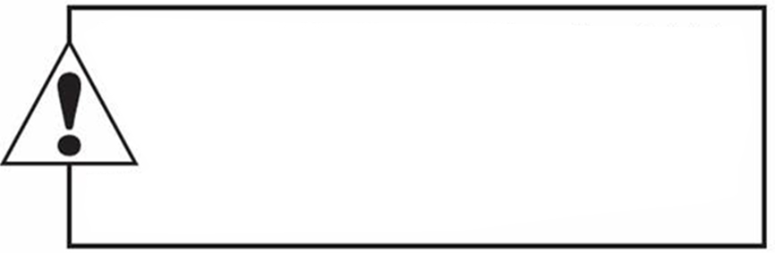
Copyright
This work is protected by United States copyright laws and is provided solely
for the use of instructions in teaching their courses and assessing student
learning. dissemination or sale of any part of this work (including on the
World Wide Web) will destroy the integrity of the work and is not permit-
ted. The work and materials from it should never be made available to
students except by instructors using the accompanying text in their
classes. All recipients of this work are expected to abide by these
restrictions and to honor the intended pedagogical purposes and the needs of
other instructors who rely on these materials.

