Slide 1
OS SEMESTER PROJECT
Deadlock Detection
& Recovery System
Interactive RAG Visualizer · Banker's Algorithm · DFS Cycle Detection
Syed Rameez Hassan S24CSC045
Armeen Mubeen S24CSC009
Muntasha Samoo S24CSC011
Mahnoor Motiwala S24CSC027
Supervisor: Miss Mahjabeen Tahir | Salim Habib University | Spring 2026
Detection
Avoidance
Recovery
Visualization

Slide 2
INTRODUCTION
Problem & Objectives
The Problem
Our Objectives
▸ Deadlock: processes permanently blocked
waiting for resources held by each other
✓ Build an interactive web-based RAG visualizer
▸ Invisible to users — no error message,
processes simply freeze
✓ Implement DFS cycle detection for deadlock
✓ Implement Wait-for Graph reduction
▸ Can crash production systems, freeze
services, corrupt data
✓ Implement Banker's Algorithm for avoidance
▸ 4 Coffman conditions must ALL hold:
Mutual Exclusion · Hold & Wait ·
No Preemption · Circular Wait
✓ Provide 3 recovery strategies with live UI
✓ Make OS concepts tangible for education
3
4
2
100%
Algorithms
Test Scenarios
Recovery Modes
Browser-based

Slide 3
THEORY
Deadlock Concepts & Algorithms
C1
C2
C3
C4
Mutual Exclusion
Hold & Wait
No Preemption
Circular Wait
Only one process can hold a resource at a time. Others must wait.
A process holds resources while waiting to acquire additional ones.
Resources cannot be forcibly taken from a process holding them.
P1→P2→P3→P1: a closed chain of processes each waiting on the next.
01
02
03
Prevention
Detection & Recovery
Avoidance
Eliminate at least one Coffman condition by design. Safe but very restrictive — limits concurrency.
Allow deadlocks to occur, then detect cycles using DFS or Wait-for Graph, and recover via termination or preemption.
Before granting a request, use Banker's Algorithm to verify the system stays in a safe state.
Not our focus
Our approach ✓
Complementary

Slide 4
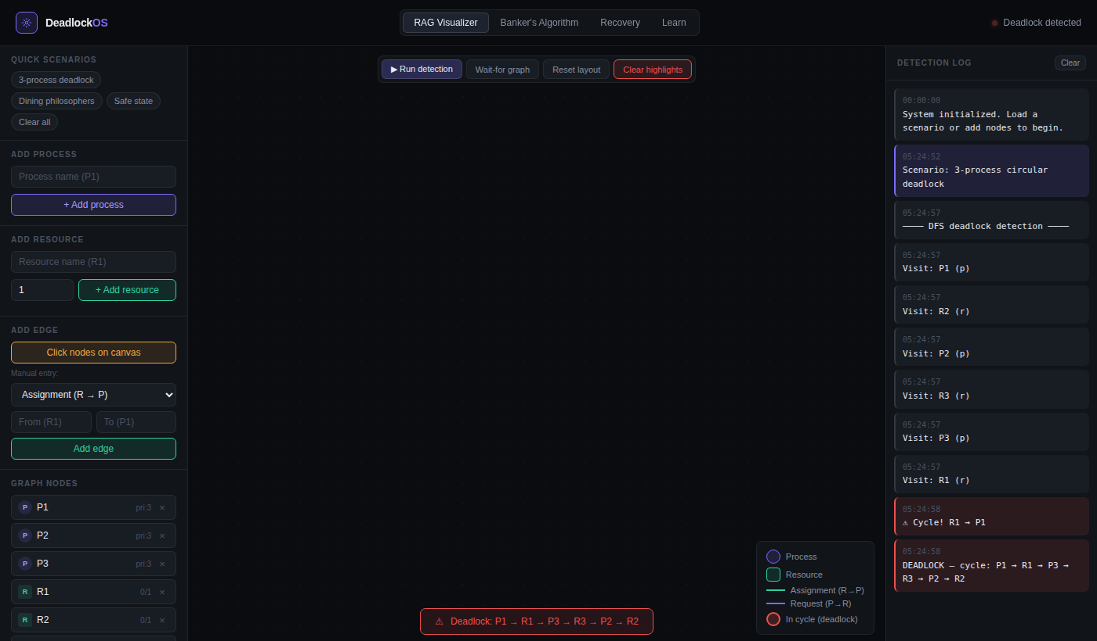
METHODOLOGY — UI
RAG Visualizer — Deadlock Detection UI
Quick Scenario Loader
Deadlock cycle banner
DFS traversal log
⚠ Deadlock detected: P1→R1→P3→R3→P2→R2 — visible in UI status bar and log panel

Slide 5
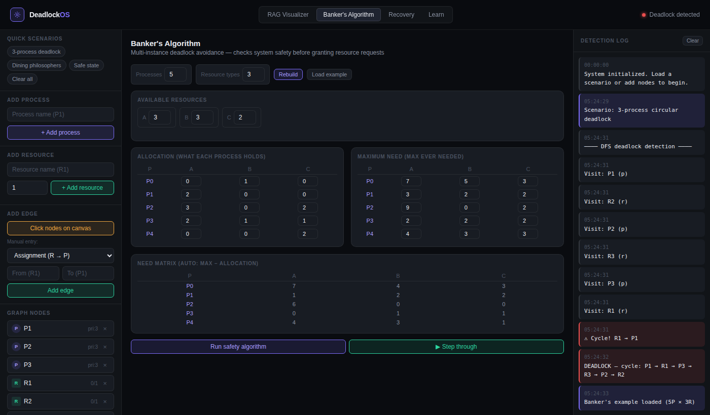
METHODOLOGY — BANKER'S
Banker's Algorithm — Safety Check UI
Inputs
1
Allocation, Max, and Available vectors set by user for 5 processes × 3 resource types
Need Matrix
2
Auto-computed: Need[i][j] = Max[i][j] − Allocation[i][j]. Shown in live table
Safety Check
3
Work ← Available. Find Pi where Need[i] ≤ Work, simulate finish, reclaim resources
Result
4
If all processes finish → SAFE with sequence P1→P3→P4→P0→P2. Else UNSAFE, deny request
Need[i][j] = Max[i][j] − Allocation[i][j]

Slide 6
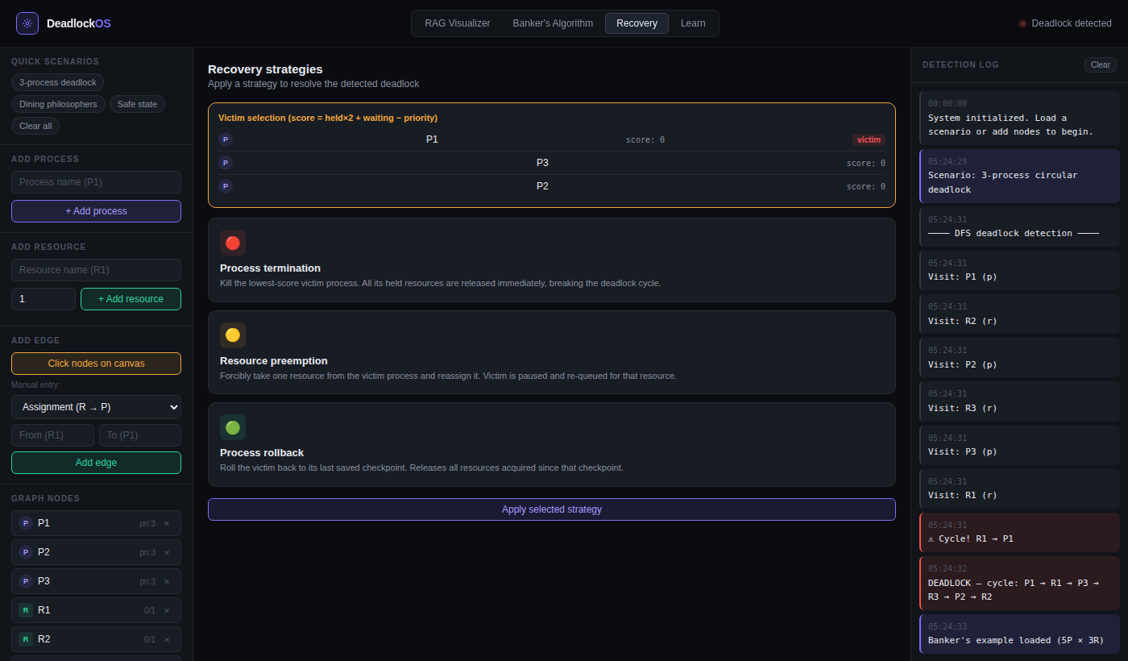
METHODOLOGY — RECOVERY
Recovery Strategies — Live UI
● Process Termination
Kill the lowest-cost victim (fewest resources + lowest priority). Release all held resources. Re-run detection until no cycle.
Cost: High — work lost
◐ Resource Preemption
Forcibly take ONE resource from victim. Victim re-queued for that resource. Minimal disruption to other processes.
Cost: Medium
◌ Process Rollback
Roll victim back to last checkpoint. All resources acquired since checkpoint released. Victim restarts from safe state.
Cost: Low — if checkpointed
Victim score = held×2 + wait_time − priority

Slide 7
ALGORITHMS
Algorithm Design — DFS Cycle Detection
DFS Cycle Detection (RAG)
Time Complexity
O(V + E)
detect_deadlock(graph):
visited = {}
V = nodes (processes+resources), E = edges
rec_stack = {}
for node in graph:
Space Complexity
if node not in visited:
O(V)
if dfs(node): return DEADLOCK
Visited set + recursion stack
dfs(node):
visited.add(node)
Data Structure
rec_stack.add(node)
Adj. List
for neighbour in graph[node]:
if neighbour not in visited:
Processes and resources as nodes, edges directed
if dfs(neighbour): return True
elif neighbour in rec_stack:
return True ← CYCLE FOUND
Wait-for Graph (WFG)
rec_stack.remove(node)
return False
A simplified RAG with resource nodes removed.
If P1→R1→P2 in RAG, then P1→P2 in WFG.
A cycle in WFG = deadlock. Faster to compute at runtime.

Slide 8
TESTING
Test Scenarios & Validation Results
Scenario | Processes | Deadlock Expected | DFS Result | Banker's | Recovery
3-process circular | P1,P2,P3 | YES | ✓ Detected | N/A | Terminate P1
Dining philosophers | P1–P5 | YES | ✓ Detected | N/A | Preempt R2
Safe state (textbook) | P0–P4 | NO | ✓ None | ✓ Safe seq | Not needed
Unsafe state | P0–P4 | NO (but unsafe) | No cycle | ✗ Unsafe | Deny request
No deadlock (normal) | P1,P2,P3 | NO | ✓ None | ✓ Safe | Not needed
Mixed multi-resource | P1–P4 | YES | ✓ Detected | N/A | Rollback P2
6/6
100%
<500ms
0
Scenarios Passed
Detection Accuracy
Response Time
Crashes / Errors

Slide 9
CONCLUSION
Conclusion & Future Enhancements
What We Achieved
Future Enhancements
✓ Interactive RAG visualizer with drag, click-to-connect, and color-coded states
→ Step-by-step animation of Banker's safety iterations
✓ DFS cycle detection with step-by-step traversal log showing each visited node
→ JSON export/import for saving and sharing scenarios
✓ Wait-for Graph reduction for multi-instance resources
→ Distributed deadlock: Chandy-Misra-Haas algorithm
✓ Banker's Safety Algorithm with live editable matrices and safe sequence output
→ Process arrival timeline — dynamic temporal simulation
✓ 3 recovery strategies: termination, preemption, rollback — with before/after view
→ Quiz mode: predict deadlock before algorithm reveals
✓ 6 test scenarios all validated against Silberschatz textbook expected outputs
→ Full keyboard navigation and screen-reader support
Key Takeaway
Visualization-driven tools bridge the gap between abstract OS theory and intuitive understanding.
This system is both a working implementation and an educational tool ready for live demonstration.
References: Silberschatz et al. (2018), Tanenbaum & Bos (2015), Coffman et al. (1971), Dijkstra (1968)

