Slide 1

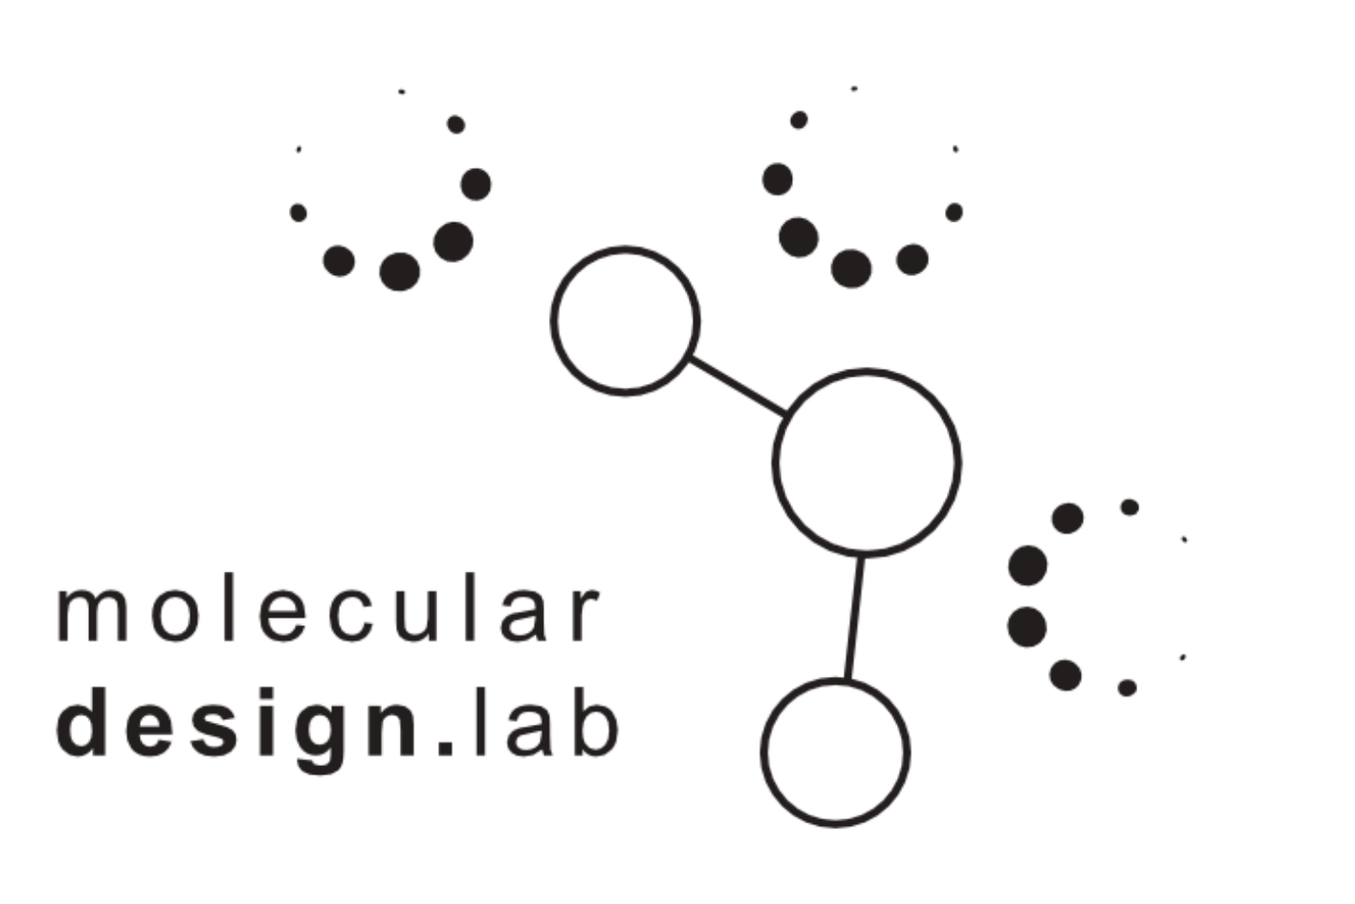
OpenMMDL System Preparation and MD Simulation
Notes:
Ligand endogenous current pronounce it right

Slide 2
How to use OpenMMDL
git clone /mdspace/valerij/OpenMMDL
Copies the OpenMMDL Folder in your current folder
conda create --name <env_name> --file requirements.txt
Creates an conda enviroment with all the necessary packages

Slide 3
Two Parts of a Workflow
OpenMMDL
OpenMMDL
Simulation
OpenMMDL
Setup
OpenMM
Setup
T019 · Molecular dynamics simulation
Peter
Eastman
Volkamer Lab
David Schaller

Slide 4
OpenMMDL Setup: Forcefields
FF/Water | Amber 14 | Amber 99SB | Amber 99SB-ILDB | Amber03 | Amber 10 | CHARMM 36
TIP3P | + | + | + | + | + | +/-
TIP3P-FB | + | + | + | + | + | +/-
SPC/E | + | + | + | + | + | +/-
TIP4P-Ew | + | + | + | + | + | +/-
TIP4P-FB | + | / | / | / | / | +/-
TIP5P | / | + | + | + | + | +/-
Solvent
Membrane
FF/Water | Amber 14 | Amber 99SB | Amber 99SB-ILDB | Amber03 | Amber 10 | CHARMM 36
TIP3P | + | + | + | + | + | +/-
TIP3P-FB | + | + | + | + | + | +/-
SPC/E | + | + | + | + | + | +/-
TIP4P-Ew | - | - | - | - | - | -
TIP4P-FB | - | - | - | - | - | -
TIP5P | - | - | - | - | - | -

Slide 5
OpenMMDL Setup: Protein Preparation
PdbFixer used for Preparation of protein for OpenMM Simulation
Mandatory:
Finds nonstandard residues and replaces them
Adds Heavyatoms
Optional:
Removing chains
Add missing residues
Add hydrogens
Add Solvent / Membrane

Slide 6
OpenMMDL Setup: Membrane/Solvent
Solvent/Membrane Options
Membrane:
Minnimum padding distance, ionic strength, positive/negative ions
Solvent:
Minnimum padding distance
Box Vectors
Ionic strength, positive/negative ions
All Options can be manually modified in the Simulation Options menu

Slide 7
OpenMMDL Setup: Simulation Options
System: Nonbonded methods, cutoff distance, constraints, ewald error tolerance, hydrogen mass, etc. (default OpenMM-Setup Settings)
Integrator: Step size (ps) , temperature (K) , pressure (atm)
Simulation: Simulation length (steps), Equilibration length (steps), Platform (CPU/GPU)
Manual:
Ligand, Ligand name (with .sdf), Ligand minimization
Manual setup → Enter solvent/water manually
Output:
Save dcd, Save log file, Data to write out in log file
Restart simulation from checkpoint, Starting step ( works only for solvent)
MDAnalysis postprocessing, MDTraj removal

Slide 8
From Setup to Simulation
Ligand → Ligand.sdf
OpenMMDL
Setup
OpenMMDL
Simulation
Python3 OpenMMDL_Simulation.py
Script → OpenMMDL_Simulation.py
PDB → OpenMMDL_Protein.pdb

Slide 9
OpenMMDL Simulation: Step by Step procedure
Selects required forcefield and water models
Creates forcefield (selected in OpenMMDL_Setup), for ligands GAFF
Transforms protein → openmm
Transforms ligand→ rdkit → openff (names atoms) → openmm
Combines protein and ligand
Adds Solvent/Membrane depending on settings
Minimization, equilibration and simulation
Post MD processing:
Centering of protein and ligand in water box center (MDTraj)
Moving of protein to starting coordinates (MDAnalysis)
Removal of water and membrane (MDAnalysis)
Cleanup process of all files in different folders

Slide 10
The road ahead
OpenMMDL
Setup
OpenMMDL
Simulation
?
Settings
SDF file selection
MDAnalysis
Checkpoint
Dynophores
FEP/Yank
Forcefields
Water Model
ML Application
Code Cleaning / Slurm Script
Cookiecutter / Github / Readme docs
Setup / Alias
Testing / Bug Fixing

