Slide 1
JAVA/Regular Expressions
www.instigate-training-center.am

Slide 2
Topics
Overview
Classes structure
Character Classes
Quantifiers
Matches and LookingAt
ReplaceFirst and ReplaceAll
Useful links

Slide 3
Overview
Regular expressions are a way to describe a set of strings based on common characteristics shared by each string in the set. They can be used to search, edit, or manipulate text and data
The regular expression syntax supported by the java.util.regex API

Slide 4
Classes structure
java.util.regex
Matcher
PatternSyntaxException
Pattern

Slide 5
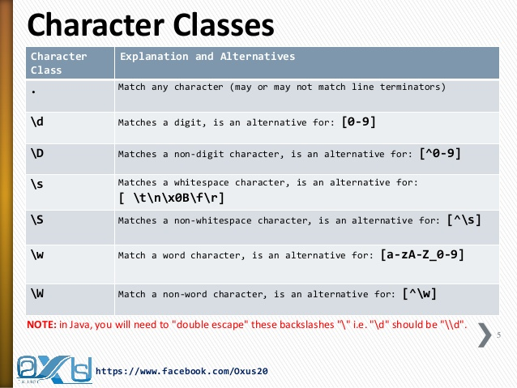

Slide 6
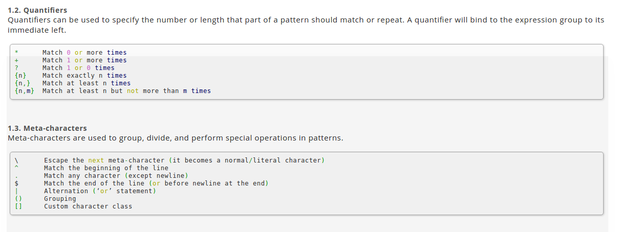
Quantifiers

Slide 7
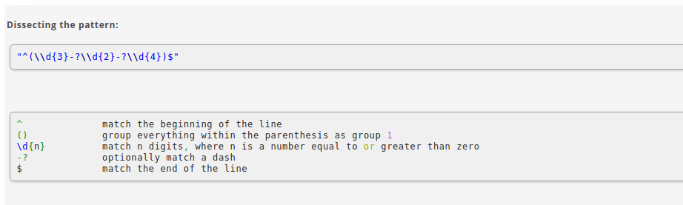

Slide 8
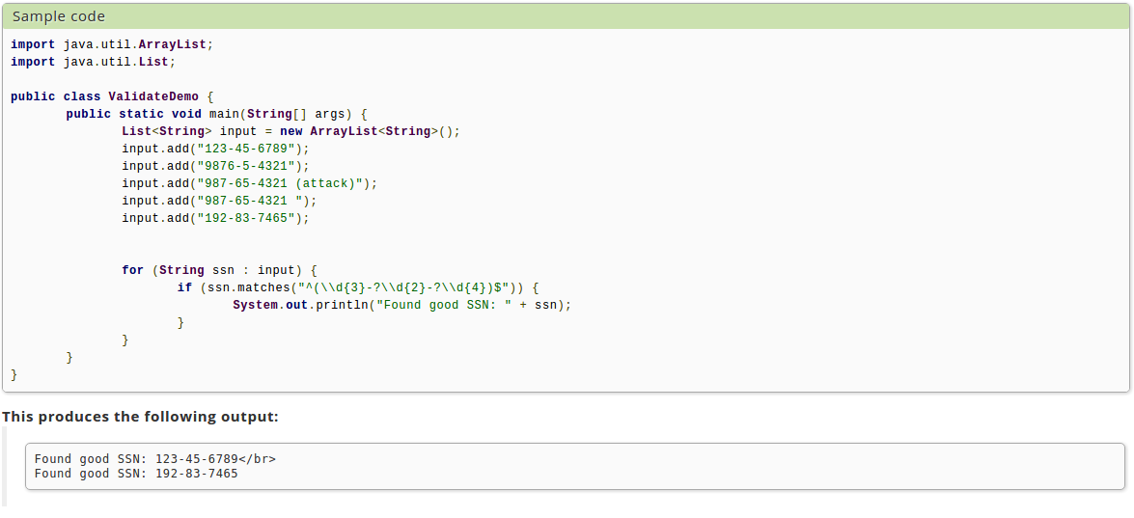

Slide 9
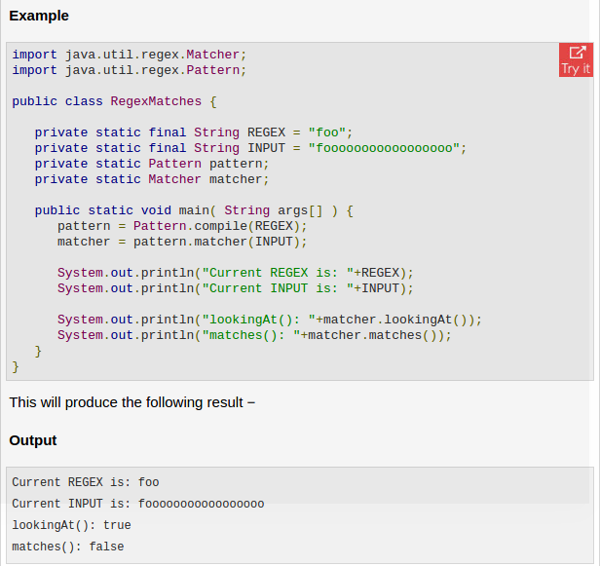
Matches and LookingAt

Slide 10
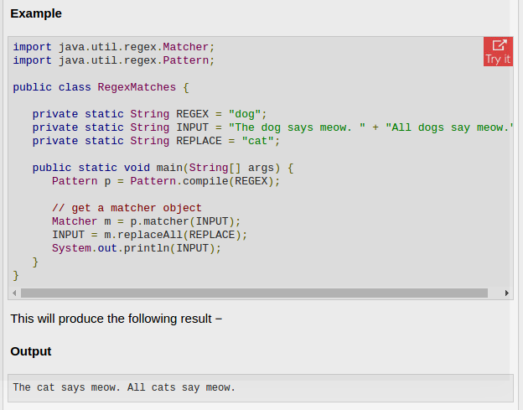
ReplaceFirst and ReplaceAll

Slide 11
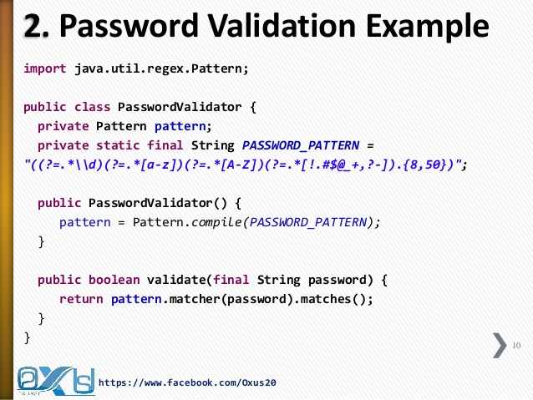

Slide 12
Useful links
https://www.tutorialspoint.com/java/java_regular_expressions.htm
https://docs.oracle.com/javase/tutorial/essential/regex/http://www.ocpsoft.org/opensource/guide-to-regular-expressions-in-java-part-1/

