Slide 1


Java / Part 2

Slide 2

Presentation Outline
Java primitive types and wrapper classes
The String Constant Pool
Difference between String, StringBuilder and StringBuffer classes
Object and Classes

Slide 3


Slide 4
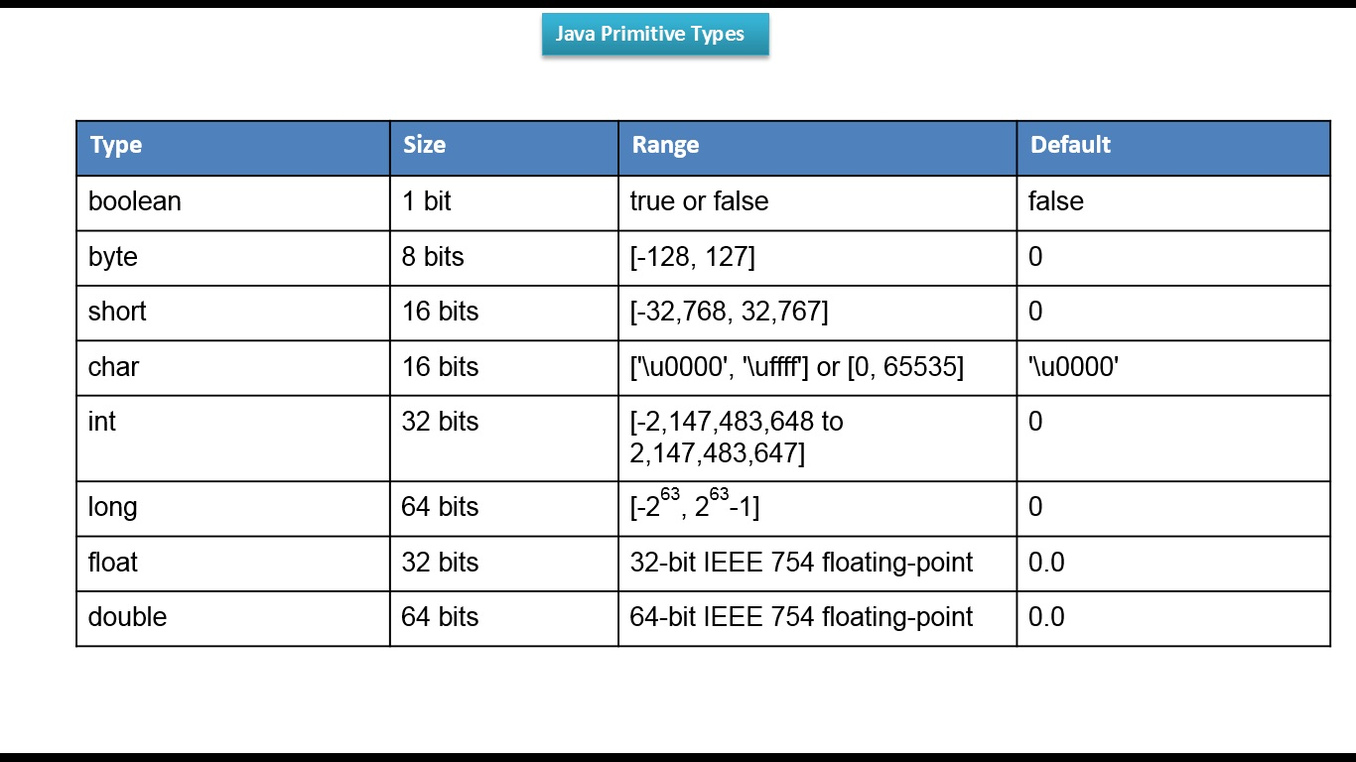
Primitive Types

Slide 5
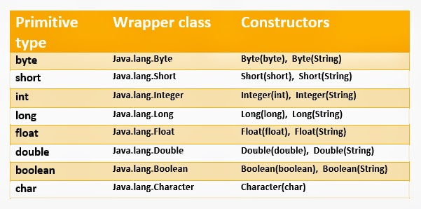
Wrapper Classes

Slide 6
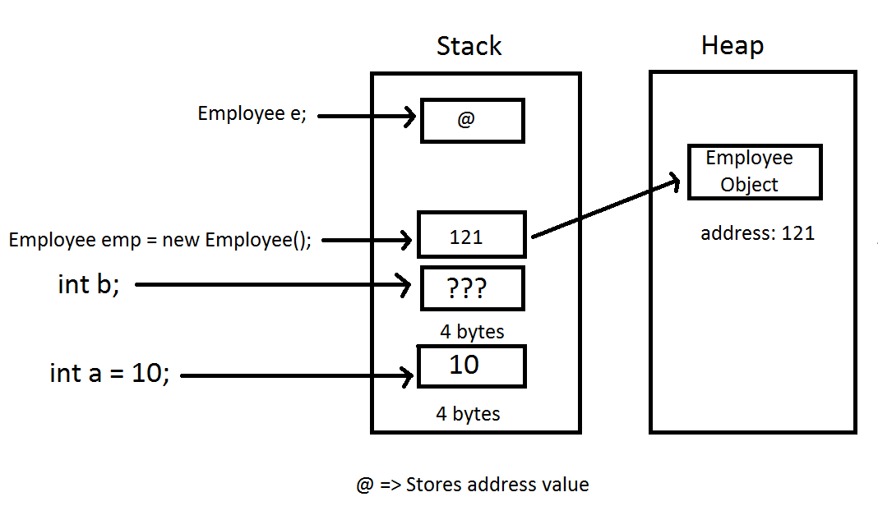
Difference between primitive and reference types in memory

Slide 7
Wrapper Classes

Slide 8

String Constructors
  String str1= new String() ; //empty object
  String str2= new String(“string”) ; //string input
  String str3= new String(char[]) ; //char array input
  String str4= new String(byte[]) ; //byte array input

Slide 9
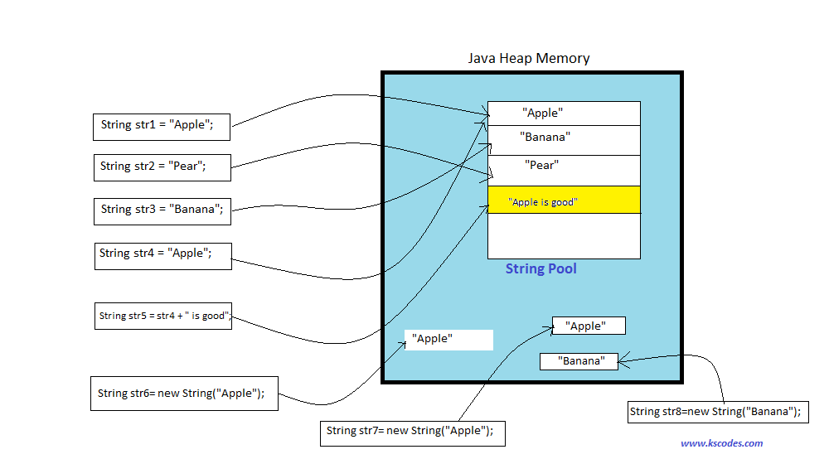
The String Constant Pool

Slide 10
Difference Between String , StringBuilder and StringBuffer
 | String | String Builder | String Buffer
Storage Area | Constant String Pool | Heap | Heap
Modifiable | No (immutable) | Yes (mutable) | Yes (mutable)
Thread safe | Yes | Yes | No
Performance | Fast | Very slow | Fast

Slide 11
What is Class?
A class, in the context of Java, are templates that are used to create objects, and to define object data types and methods. Core properties include the data types and methods that may be used by the object. All class objects should have the basic class properties. Classes are categories, and objects are items within each category.
Name used for classes, methods, interfaces and variables are called Identifier. Identifier must follow some rules. Here are the rules:
    All identifiers must start with either a letter( a to z or A to Z ) or currency character($) or an underscore.
    After the first character, an identifier can have any combination of characters.
    A Java keyword cannot be used as an identifier.
    Identifiers in Java are case sensitive, foo and Foo are two different identifiers.

Slide 12
Create Objects
Using new keyword Employee emp1 = new Employee(); | } → constructor gets called
Using newInstance() method of Class class Employee emp2 = (Employee) Class.forName("org.Employee").newInstance(); Employee emp2 = Employee.class.newInstance(); | } → constructor gets called
Using newInstance() method of Constructor class Constructor<Employee> constructor = Employee.class.getConstructor(); Employee emp3 = constructor.newInstance(); | } → constructor gets called
Using clone() method Employee emp4 = (Employee) emp3.clone(); | } → no constructor call
Using deserialization ObjectInputStream in = new ObjectInputStream(new FileInputStream("data.obj")); Employee emp5 = (Employee) in.readObject(); | } → no constructor call

Slide 13
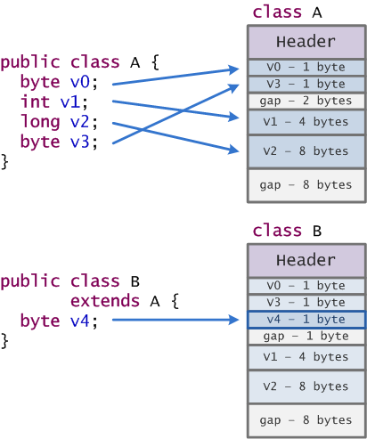
Objects size

Slide 14
https://dzone.com/articles/5-different-ways-to-create-objects-in-java-with-ex

Slide 15

Object and Classe

Slide 16

Apache Maven

Slide 17
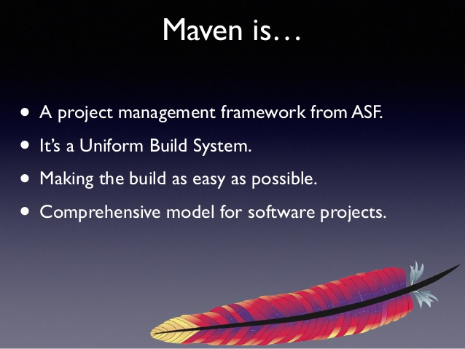

Slide 18
Maven, a Yiddish word meaning accumulator of knowledge, was originally started as an attempt to simplify the build processes in the Jakarta Turbine project. The result is a tool that can now be used for building and managing any Java-based project.

Slide 19
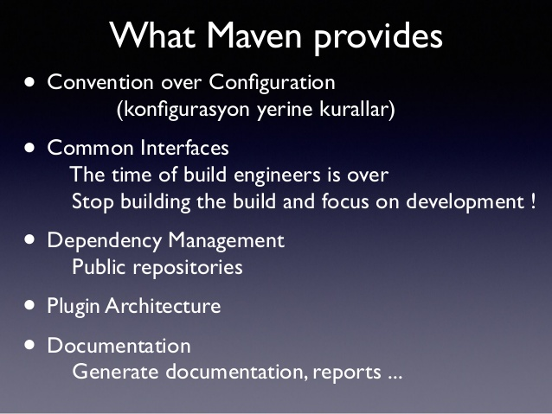

Slide 20
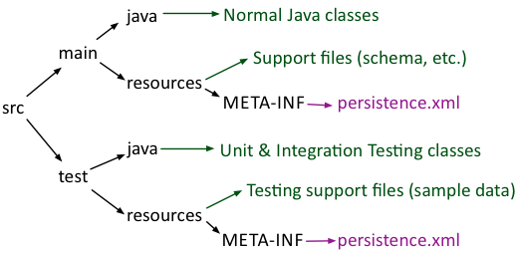

Slide 21

POM xml
POM stands for "Project Object Model".
It is an XML representation of a Maven project held in a file named pom.xml
It gathers:
Project configuration Project description
Project dependencies Project inheritance
Project aggregation

Slide 22
Key elements of initial pom xml:
1. project
2. modelVersion(version of the object model this POM is using)
3. groupId
4. artifactId( <artifactId>-<version>.<extension>)
5. packaging
6. version
7. name
8. url
9. description

Slide 23
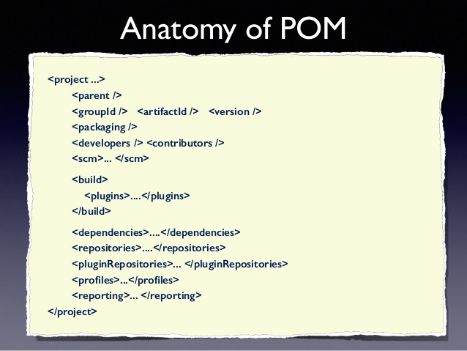

Slide 24
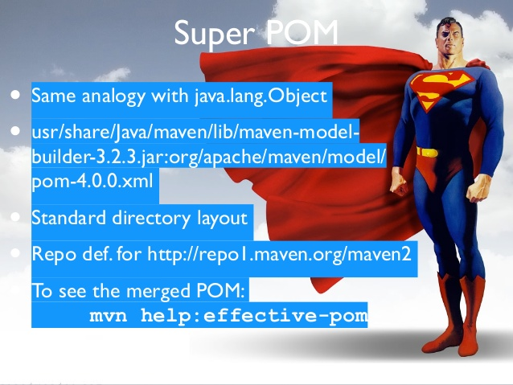

Slide 25
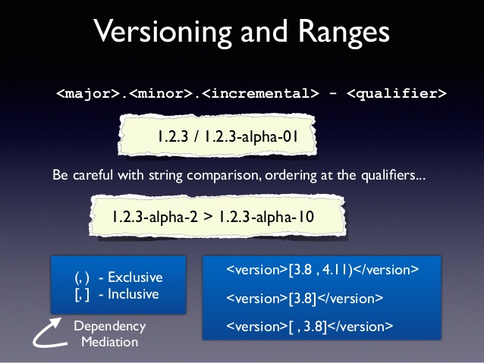

Slide 26
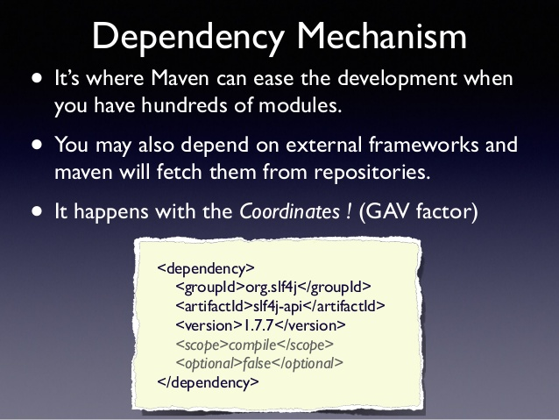

Slide 27
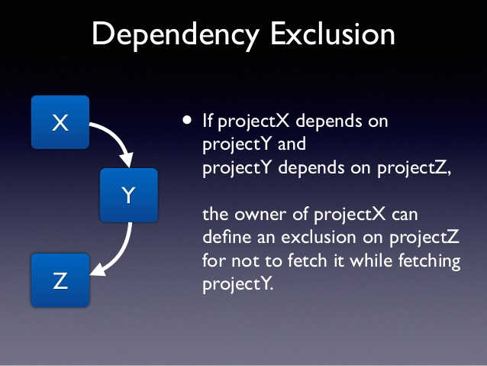

Slide 28
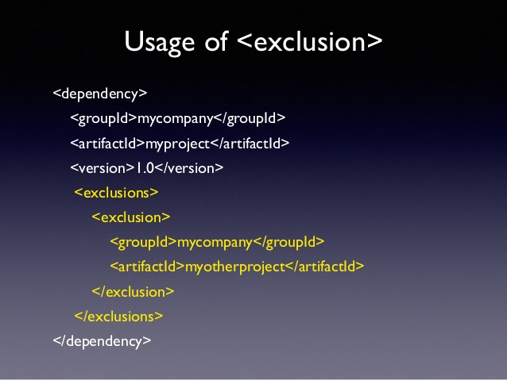

Slide 29
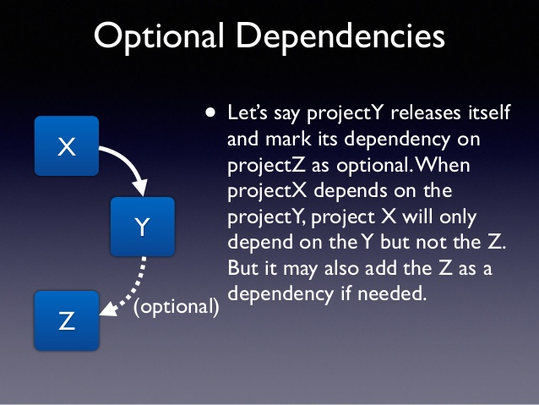

Slide 30
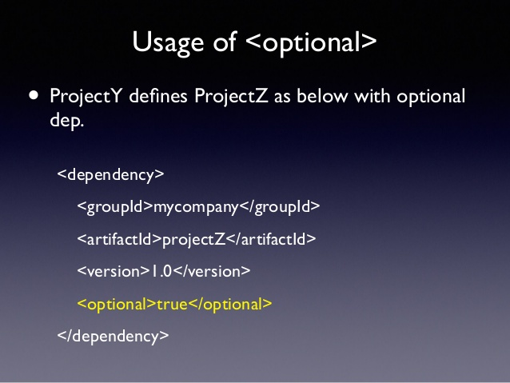

Slide 31
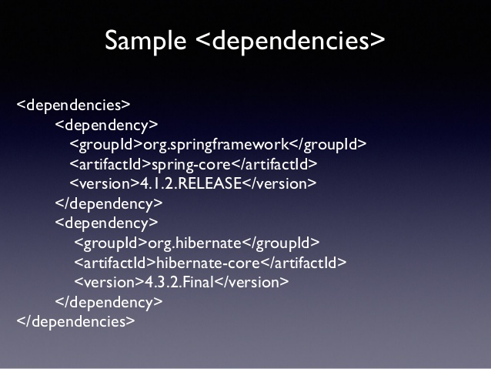

Slide 32
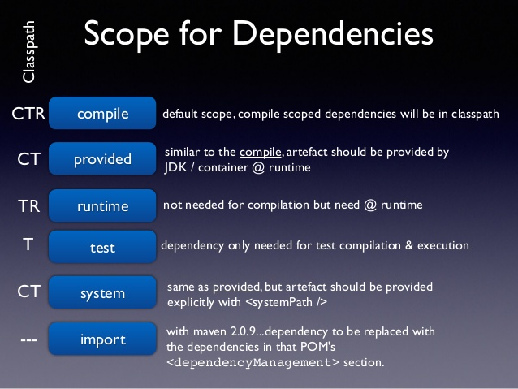

Slide 33
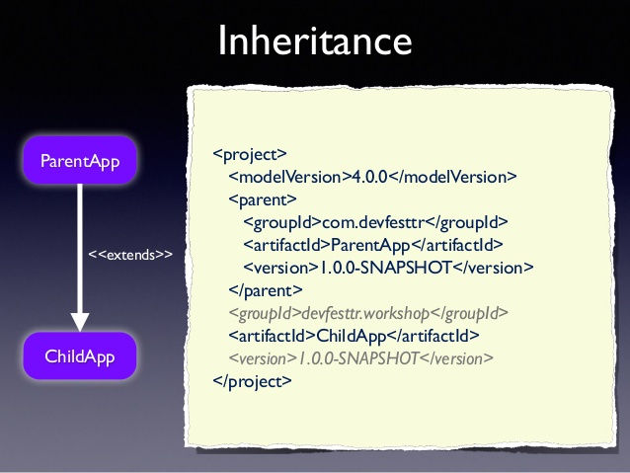

Slide 34
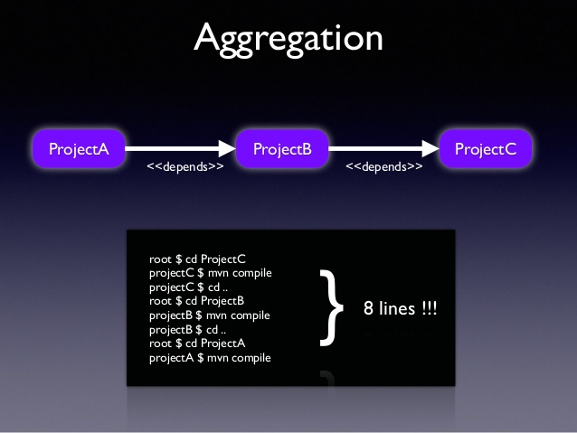

Slide 35
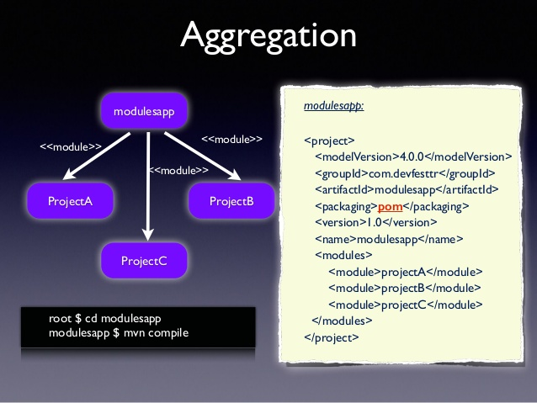

Slide 36
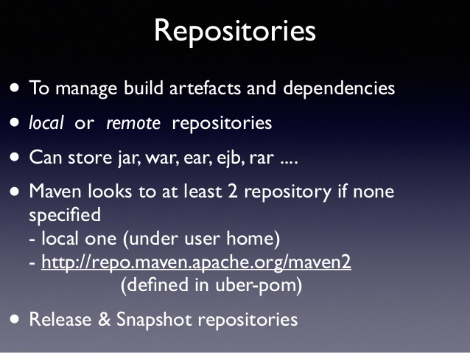

Slide 37
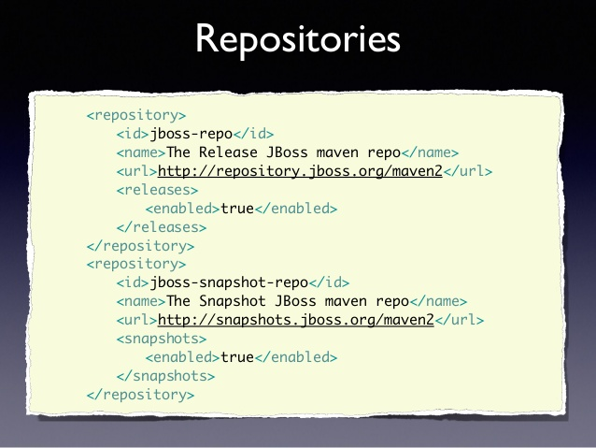

Slide 38
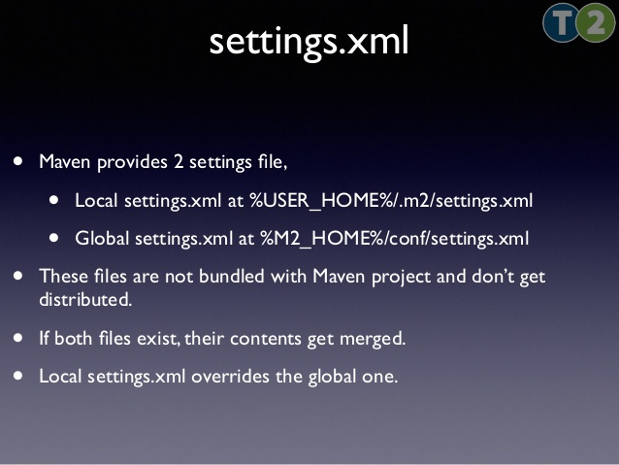

Slide 39
Properties
${X}, where X is the property.
env.X: ${env.PATH} contains the PATH environment variable.
project.x: ${project.version}.
Settings.x: ${settings.offline}.
${java.home}.
x: Set within a <properties /> element in the POM. ${someVar}.

Slide 40
Plugins
Configuration - to specify which of the project's config is important
Executions - to specify how will work that plugin(with goals and phases)
goals:. In this case, a list of plugin goals which are being specified by this execution block.
phase: This is the phase that the list of goals will execute in. This is a very powerful option, allowing one to bind any goal to any phase in the build lifecycle, altering the default behavior of Maven.

Slide 41
clean Clean up after the build
compiler Compiles Java sources
deploy Deploy the built artifact to the remote repository.
failsafe Run the JUnit integration tests in an isolated classloader.
install Install the built artifact into the local repository.
resources Copy the resources to the output directory for including in the JAR.
site Generate a site for the current project.
surefire Run the JUnit unit tests in an isolated classloader.
verifier Useful for integration tests - verifies the existence of certain conditions.

Slide 42
It is strongly recommended to use the latest release version of Apache Maven to take advantage of newest features and bug fixes.
Maven 3.5.0
Why not Maven 3.4.0?
After Maven 3.3.9 was released, the Eclipse Aether project was retired and the code base was migrated to the Apache Maven project.
The decision was taken to forever burn the 3.4.x release line.

Slide 43
Overview about the changes
console output colors
The JAVA_HOME - check if JAVA_HOME is set or not then trying to discover via which java,
M2_HOME is removed
mvn script is updated
Corrected memory management related to big amount of modules
Replaced Eclipse Aether with Maven (lib to work with artifacts and repos)
.mvn/maven.config file can be overwritten via command line

Slide 44


