Slide 2
What is Java Collections?
A collection is an object that contains a group of objects.
Each object in a collection is called an element. Every collection contains a group of objects.
Each different type of collection manages their elements in its own way.

Slide 3
Architecture of the Collection Framework
It is a unified architecture for representing and manipulating collections. All collections frameworks contain the following:
  Interfaces
  Interface Implementer Classes
  Algorithms
Java Collections are designed to work only with objects.
All collection classes in Java are declared generic.

Slide 4
What is an Interfaces?
In collections, interfaces provide an abstract data type for representing the collection java.util.Collection - the root interface of the framework. It is at the top of the Collection hierarchy.
It contains the most important methods: size (), iterator (), add (), remove (), clear (). Each collection must implement these methods.
Also there are other important interfaces java.util.List, java.util.Set, java.util.Queue and java.util.Map. Map is the only interface that does not inherit the Collection interface, but is an integral part of the collections.
All interfaces of the framework are in the package java.util.

Slide 5
What are Interface Implementer Classes?
Java provides ready-made classes with the implementation of the collections. We can use them to create new types of collections in our program. Using the ArrayList, LinkedList, HashMap, TreeMap, HashSet, TreeSet classes, we can solve a huge number of tasks, but if we need a special implementation of a collection, we can inherit it and work with its implementation.
In Java 1.5, thread-safe collections were invented that allowed us to modify the contents of the collection by iterating through the elements.
The most popular are: CopyOnWriteArrayList, ConcurrentHashMap, CopyOnWriteArraySet. These classes are in the java.util.concurrent package.
All collection classes are in the java.util and java.util.concurrent packages.

Slide 6
What are Algorithms?
Algorithms are useful methods that solve trivial problems for the elements of a collection, for example:
  Searching
  Sorting
  Shuffling

Slide 7
Iterator Interface in Java
It is one of the predefined interface present in java.util.* package.
The purpose of this interface is that to extract or retrieve the elements of collection variable only in forward direction but not in backward direction.
By default an object of iterator is pointing just before the first element of any collection framework variable.

Slide 8
Points to Remember
Iterator allows to remove the elements from collection object.
Iterator is not Synchronized.
Using Iterator elements of collection can be access only in forward direction.
Iterator can be available to all the collection classes.
Every collection class contains Iterator() and that returns Iterator object, using this object reference elements can be retrieved from collection.

Slide 9
Methods of Iterator Interface
public boolean hasNext()
  This method returns true provided by Iterator interface object is having next element otherwise it returns false.
public object next()
  This method is used for retrieving next element of any collection framework variable provided public boolean hasNext(). If next elements are available then this method returns true otherwise it returns false.
remove()
  Remove from collection the last element returned by Iterator.

Slide 10
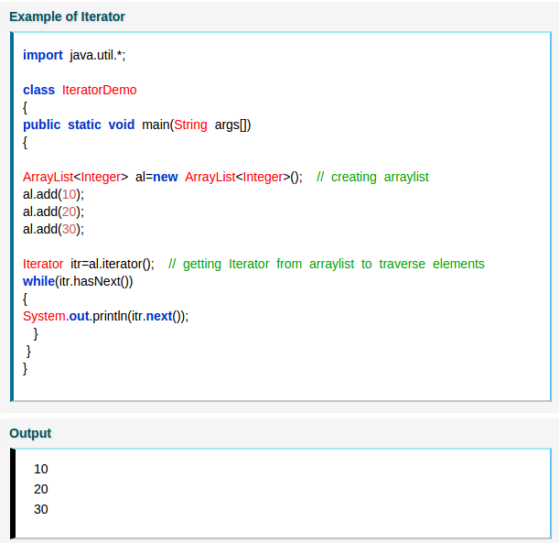

Slide 11
Lamda expressions
Introduction
Lambda expressions are a new and important feature included in Java SE 8. They provide a clear and concise way to represent one method interface using an expression. Lambda expressions also improve the Collection libraries making it easier to iterate through, filter, and extract data from a Collection.
Java lambda expressions are Java's first step into functional programming. A Java lambda expression is thus a function which can be created without belonging to any class. A lambda expression can be passed around as if it was an object and executed on demand.

Slide 12
Lamda expressions syntax
Lambda expressions in Java is usual written using the following syntax:
(argument) -> (body)
For example:
(arg1, arg2...) -> { body }
(type1 arg1, type2 arg2...) -> { body }

Slide 13
Following are some examples of Lambda expressions.
(int a, int b) -> { return a + b; }
() -> System.out.println("Hello World");
(String s) -> { System.out.println(s); }
() -> 42
() -> { return 3.1415 };

Slide 14
Structure of Lambda Expressions
Let’s check the structure of lambda expressions.
A lambda expression can have zero, one or more parameters.
The type of the parameters can be explicitly declared or it can be inferred from the context. e.g. (int a) is same as just (a)
Parameters are enclosed in parentheses and separated by commas. e.g. (a, b) or (int a, int b) or (String a, int b, float c)
Empty parentheses are used to represent an empty set of parameters. e.g. () -> 42
When there is a single parameter, if its type is inferred, it is not mandatory to use parentheses. e.g. a -> return a*a
The body of the lambda expressions can contain zero, one or more statements.
If body of lambda expression has single statement curly brackets are not mandatory and the return type of the anonymous function is the same as that of the body expression.
When there is more than one statement in body than these must be enclosed in curly brackets (a code block) and the return type of the anonymous function is the same as the type of the value returned within the code block, or void if nothing is returned.

Slide 15
Examples of Lambda Expression
public class RunnableTest {
public static void main(String[] args) {
System.out.println("=== RunnableTest ===");
// Anonymous Runnable
Runnable r1 = new Runnable(){
@Override
public void run(){
System.out.println("Hello world one!");
}
};
// Lambda Runnable
Runnable r2 = () -> System.out.println("Hello world two!");
// Run em!
r1.run();
r2.run();
}
}

Slide 16
Given a list, sum the square of each element from this list. See how Lambda expression can be used to achieve this in a single statement. This is also a starters example on MapReduce. We used map() to square each element and then reduce() to reduce all elements into single number.
//Old way:
List<Integer> list = Arrays.asList(1,2,3,4,5,6,7);
int sum = 0;
for(Integer n : list) {
int x = n * n;
sum = sum + x;
}
System.out.println(sum);
//New way:
List<Integer> list = Arrays.asList(1,2,3,4,5,6,7);
int sum = list.stream().map(x -> x*x).reduce((x,y) -> x + y).get();
System.out.println(sum);

