Slide 1

Performance testing

Slide 2
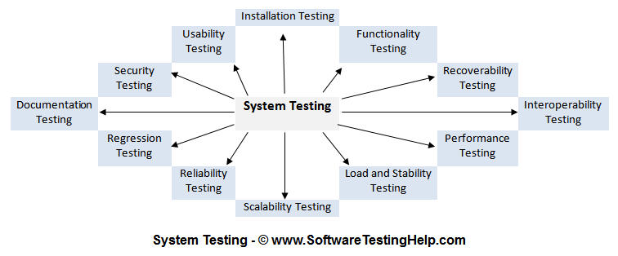
System testing

Slide 3
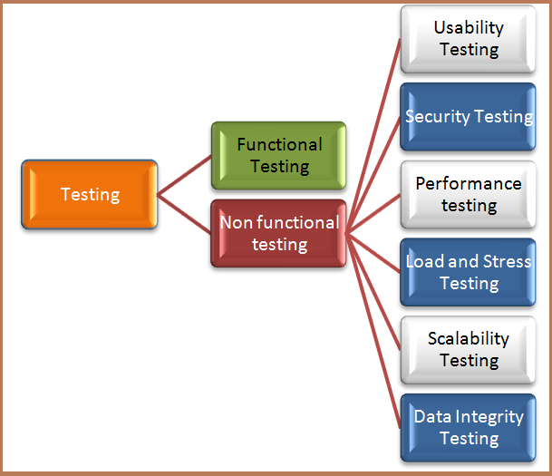
Non functional testing

Slide 4
Performance test types
Load Testing
Stress Testing
Capacity testing
Volume testing
Endurance testing
Spike testing
Scalability testing
Reliability testing

Slide 5
  List out what are the common performance problem does user face?
Longer loading time
Poor response time
Poor Scalability
Bottlenecking (coding errors or hardware issues)

Slide 6
List out some common performance bottlenecks?
Memory Utilization
Networking Utilization
CPU Utilization
Disk Usage

Slide 7
Load testing
Load testing is the process of putting demand on a software system or computing device and measuring its response. Load testing is performed to determine a system's behavior under both normal and anticipated peak load conditions.

Slide 8
benchmark testing and baseline testing
Benchmark Testing: It is the method of comparing performance of your system performance against an industry standard that is set by other organization
Baseline Testing: It is the procedure of running a set of tests to capture performance information. When future change is made in the application, this information is used as a reference

Slide 9
Stress Testing
It allows the test team to monitor system performance during failures.
To verify if the system has saved the data before crashing or NOT.
To verify if the system prints meaning error messages while crashing or did it print some random exceptions.
To verify if unexpected failures do not cause security issues.

Slide 10
Duration
Endurance Testing: It is one type of performance testing where the testing is conducted to evaluate the behavior of the system when a significant workload is given continuously
Spike Testing: It is also a type of performance testing that is performed to analyze the behavior of the system when the load is increased substantially.

Slide 11
Volume testing
Volume testing refers to testing a software application with a certain amount of data. This amount can, in generic terms, be the database size or it could also be the size of an interface file that is the subject of volume testing.

Slide 12
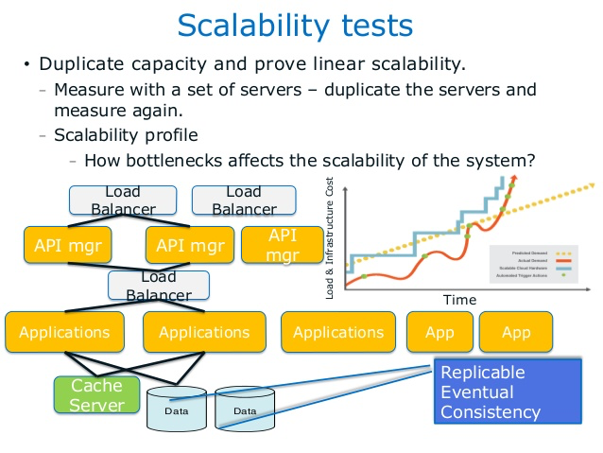
Scalability testing

Slide 13
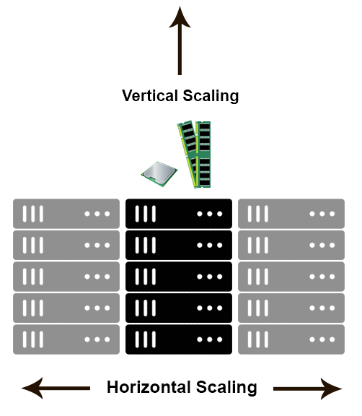
Scalability testing
Horizontal scaling means that you scale by adding more machines into your pool of resources whereas Vertical scaling means that you scale by adding more power (CPU, RAM) to an existing machine.

Slide 14
Reliability testing
The probability of failure-free software operation for a specified period of time in a specified environment. Software Reliability is not a direct function of time. Electronic and mechanical parts may become “old” and wear out with time and usage, but software will not rust or wear-out during its life cycle. Software will not change over time unless intentionally changed or upgraded.

Slide 15
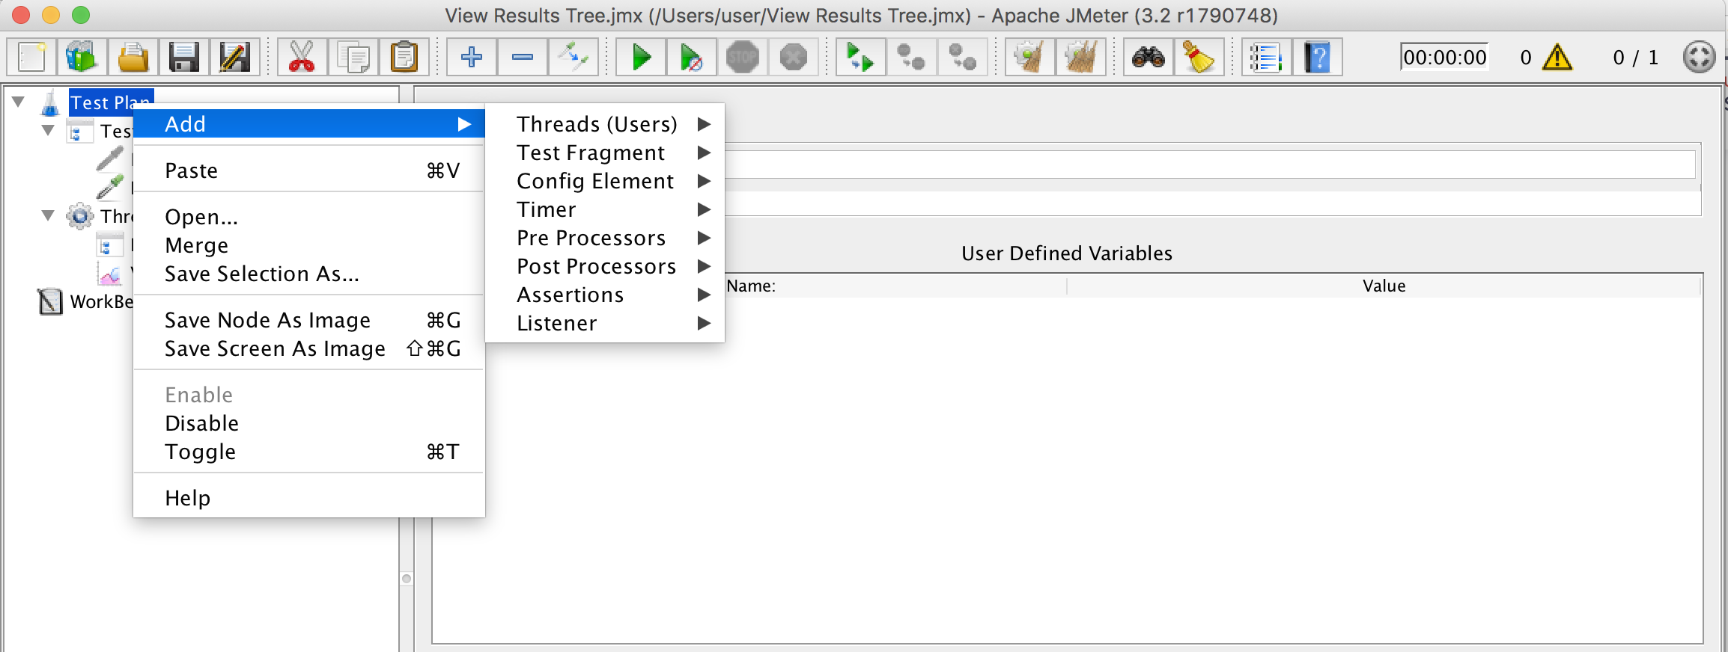
JMeter

Slide 16
BlazeMeter
https://www.blazemeter.com/usecases

Slide 17
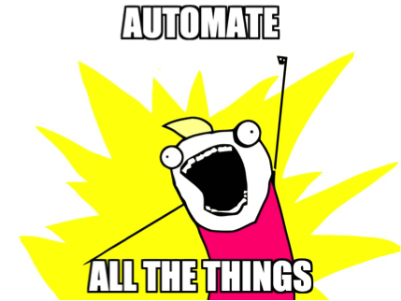
THANKS

