Slide 1
Few-Shot Segmentation
Till August 14

Slide 2
Table of Contents
Review
Completed Tasks
Questions & Problems
Practical Challenges
Ideas and future works

Slide 3
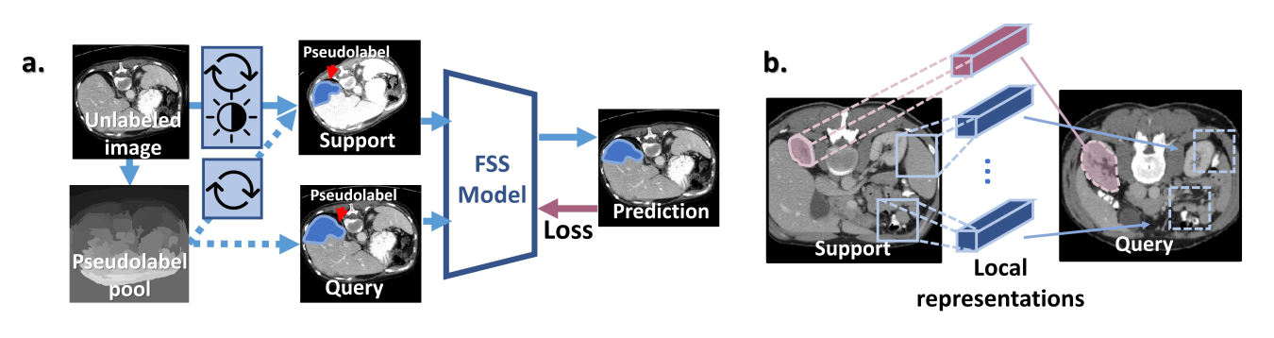
Review
Paper: SSL_ALPNet

Slide 4
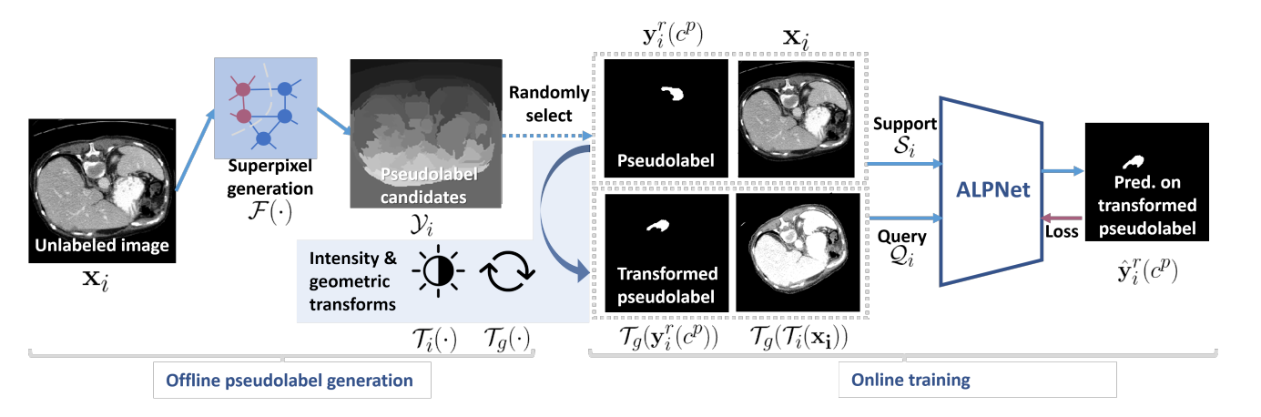
Review
Superpixel-based Self-supervised Learning:

Slide 5
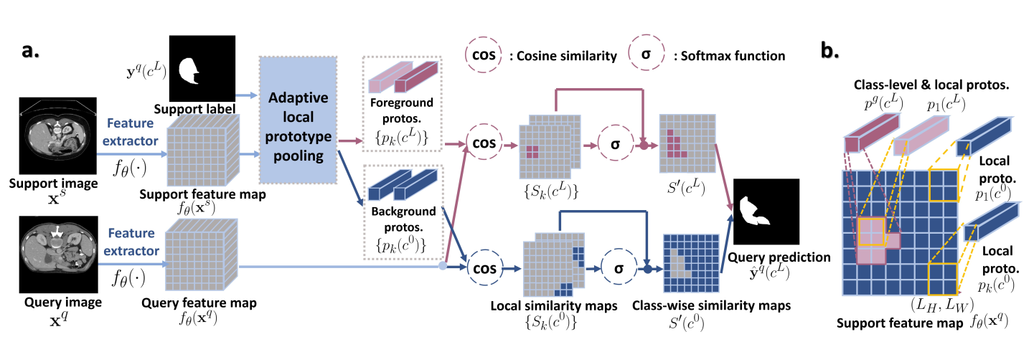
Review
ALPNet:

Slide 6
Completed Tasks
Exploring and Understanding Data
Implementing Voxelmorph
Superpixel Matching
Read and Refactor Source-Code
Setup Server Account
Training with New Data Augmentation

Slide 7
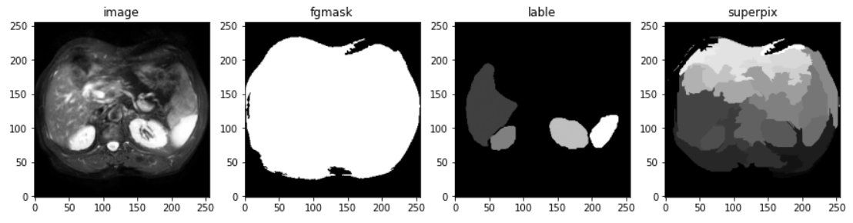
Exploring and Understanding Data
20 patients, each have data of dim (n, 256, 256) n: number of slices, varies from 31 to 46. each slice is 256*256 pixels. each slice has about 20 superpixels.

Slide 8
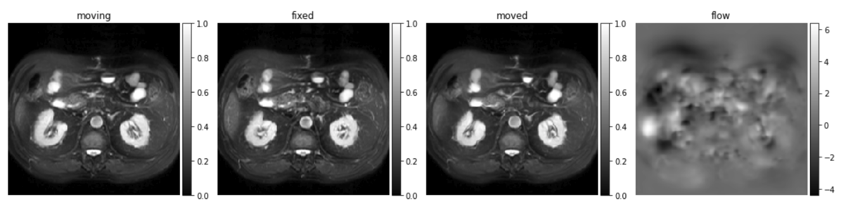
Implementing Voxelmorph
Implemented voxelmorph registration for our data. (both tensorflow and torch)
Currently the registration is between two consecutive slice.

Slide 9
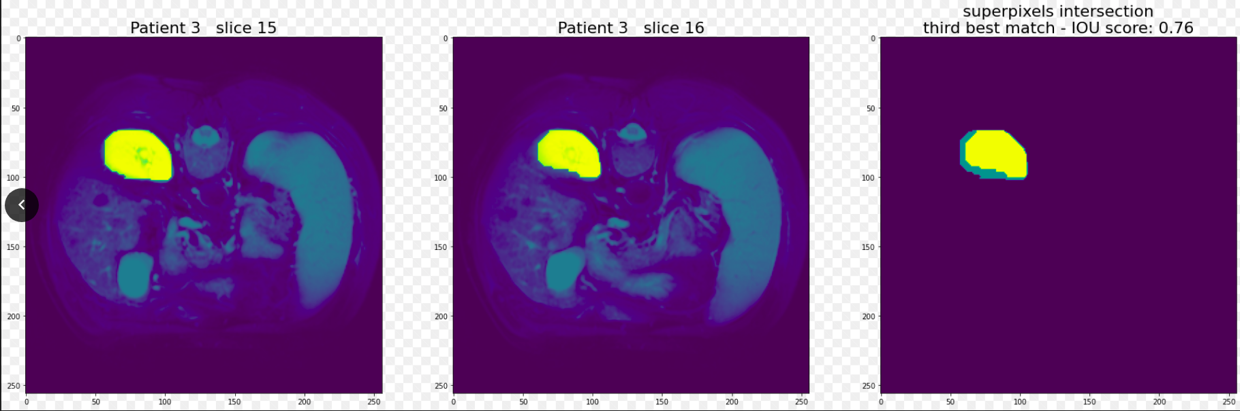
Superpixel Matching
Using IoU as similarity score.
For supix_a from slice_a, given slice_b: find supix_b from slice_b that matches supix_a better than other supixs in slice_b.

Slide 10
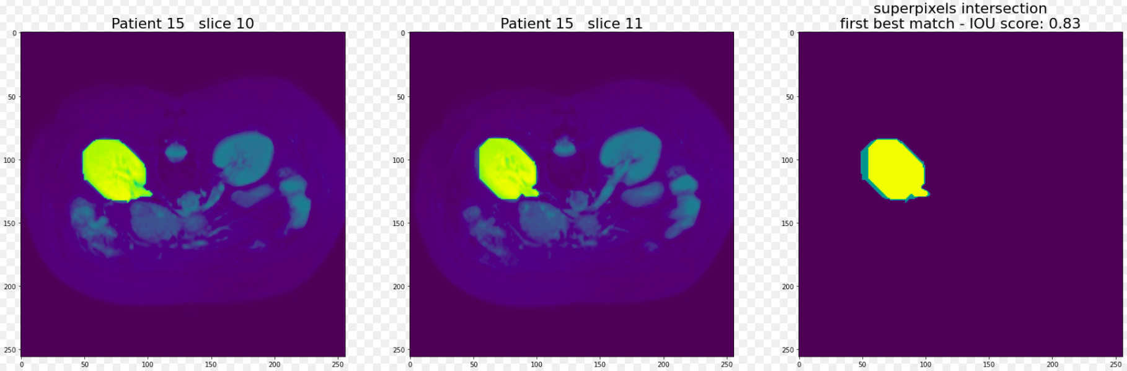
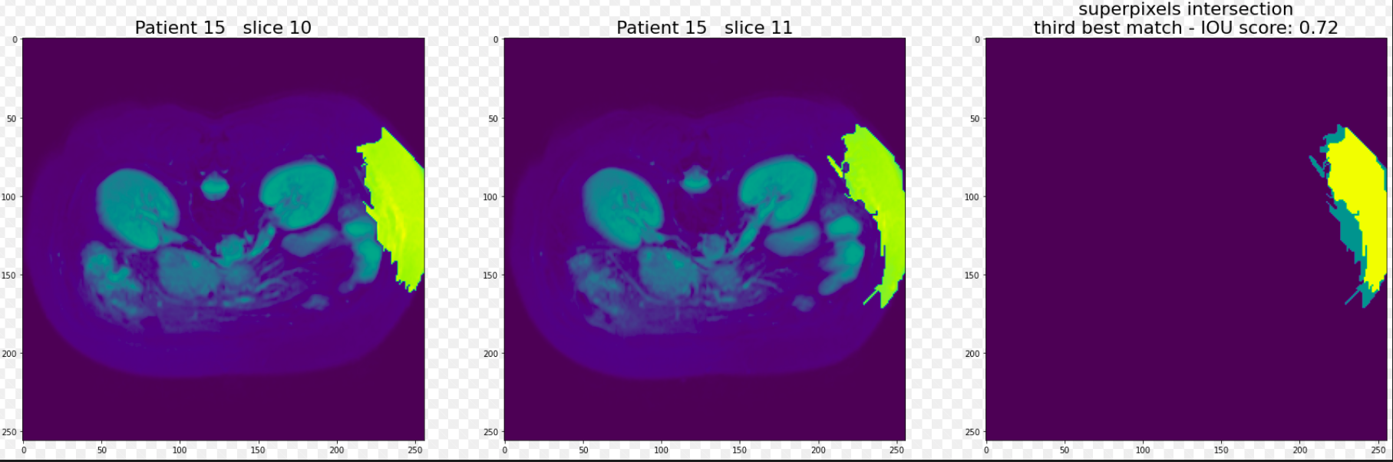

Slide 11
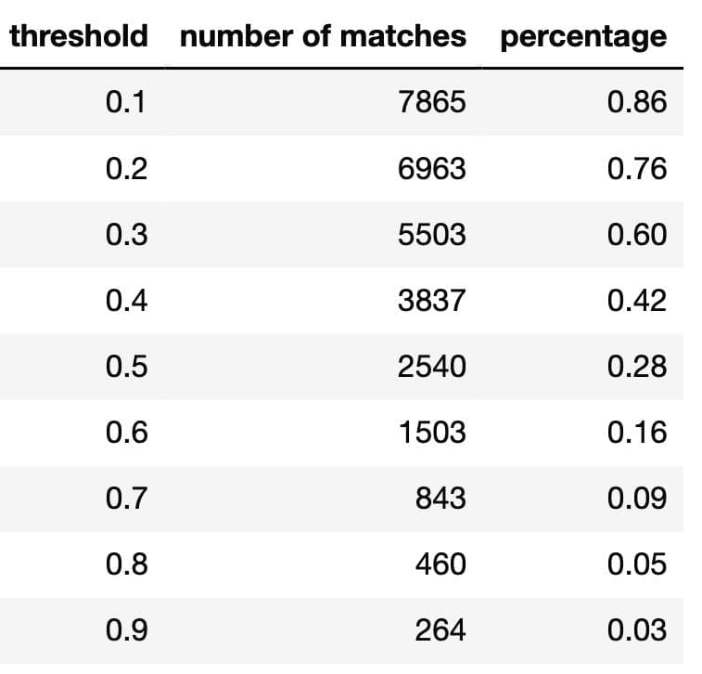
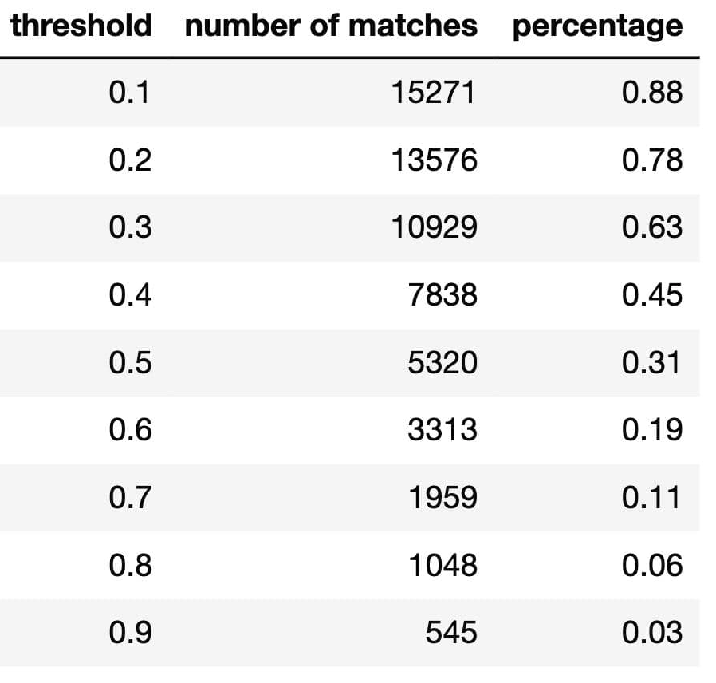
Superpixel Matching
all_matches: 9166 (excluding LK and RK)
all_matches: 17358 (including LK and RK)

Slide 12
Read and Refactor Source-Code
We only focused on SSL part add new augmentation methods.
Original augmentation: slice_a = random_slice() support = transform_intensity_geo(slice_a) query = transform_intensity_geo(slice_a)
New augmentation: slice_a = random_slice() slice_b = next_slice(slice_a) support = transform_intensity_geo(slice_a) query = transform_intensity_geo(slice_b) randomly swap [support, query]
Almost no extra cost (creating all supix_matches in a preprocess)

Slide 13
Training with New Data-Augmentation
Quantitative results: SSL_ALPNet_Results

Slide 14
Questions and Problems
Why do results from server and colab have significant differences?
Original method ran on colab gives better results than paper report!
There is inadequate up-and-down in training loss. maybe lr is not small enough → use smaller decay. maybe there exists some inconsistent data → remove early or late slices.
In a lot of cases, training with less epochs gives better results.
How can batch-size affect the results? If it doesn’t have any bad effect, it can improve training time.

Slide 15
Practical Challenges
We encountered several inconsistency in server.
In Colab, each run takes about 7 hours to complete.
There is both memory and GPU limit.
We were forced to create more than 20 google accounts.
→ Each run takes a lot of time and managing all runs together is difficult. → It is hard to run in large space. We have to be more selective.

Slide 16
Ideas and Future Works
Use vxm-registration in data-augmentation as well.
Find matched-supix from more distant slices.
Use dice-score as our loss function instead of Cross-Entropy-Loss.
→ I think we have to tackle the problem that each epoch, result varies greatly.

Slide 17
End of Report

