Slide 1
Web Scraper
Armin Felahatpisheh

Slide 2
Main Idea
Given a set of domains, find the number of distinct words from them such that:
We run on different threads to speed up
We avoid race conditions
Each page is scraped once only
Efficient retrieval from the queue
We scrape all the contents of the page
We extract as many pages (links) as possible from the scraped page
We find the number of unique words based on Flajolet-Martin algorithm for each page
We store all the pages and their corresponding words count

Slide 3
Requirements
Python11
Beautifulsoup4
Playwright
Validators
PrettyTable
Concurrent.Futures

Slide 4
How does it work?
Playwright Scrapers Job
E2E testing like (selenium)
Headless show can help us see the result.

Slide 5
1. We run on different threads to speed up
On average each page takes like 2 seconds to be fully scraped
What is a thread?
How multithreading can help?
Can asyncio help us too?
Can multiprocessing help us too?

Slide 6
2. We avoid race conditions
What is a race condition?
How I avoided that?
Rlock

Slide 7
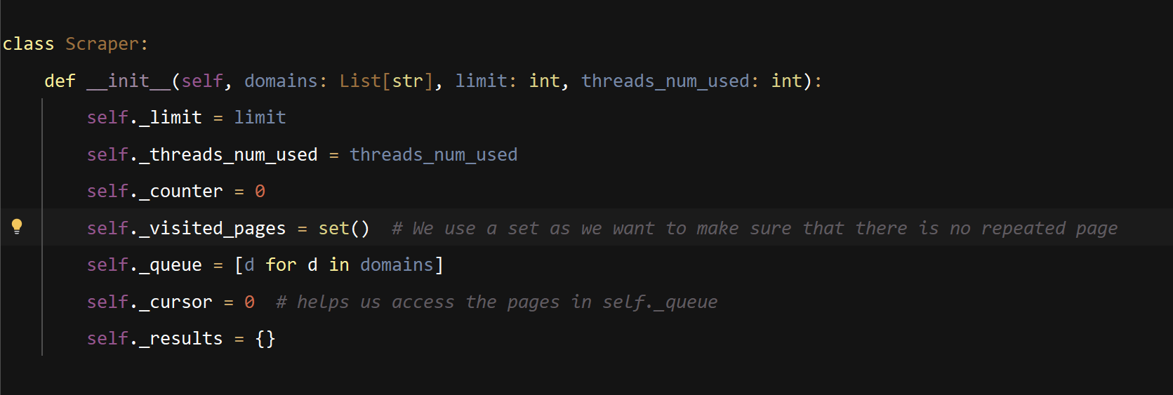
3. Each page is scraped once only

Slide 8
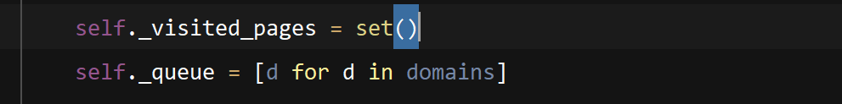
4. Efficient retrieval from the queue
Queue and cursor
_visited_pages

Slide 9
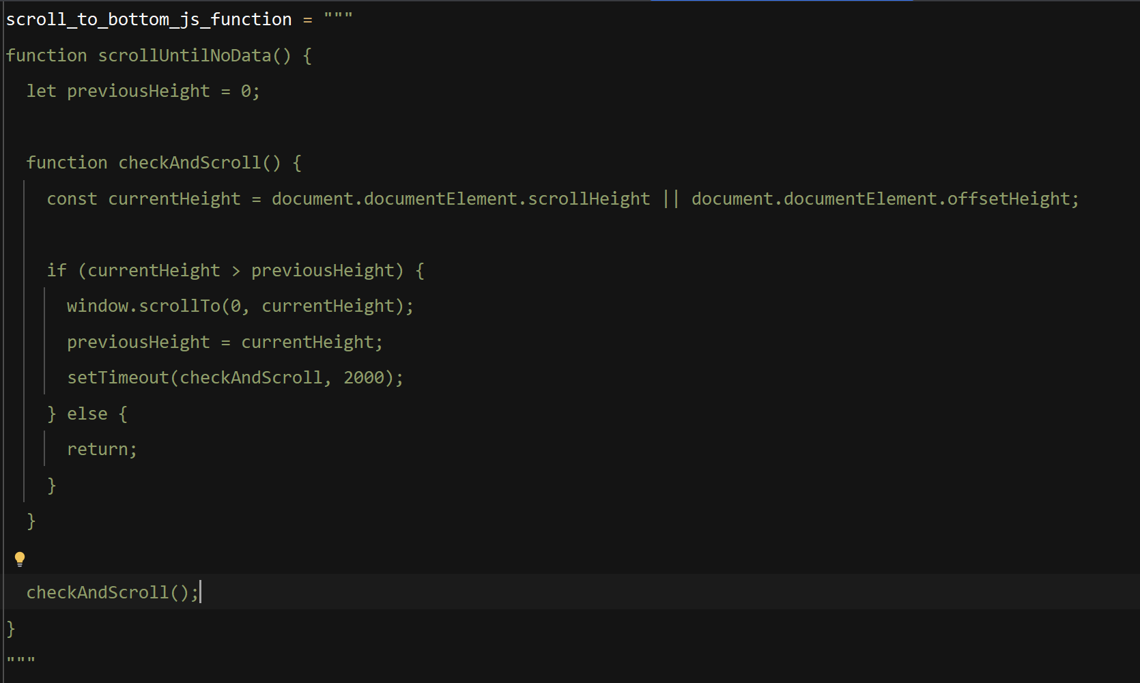
5. We scrape all the contents of the page

Slide 10
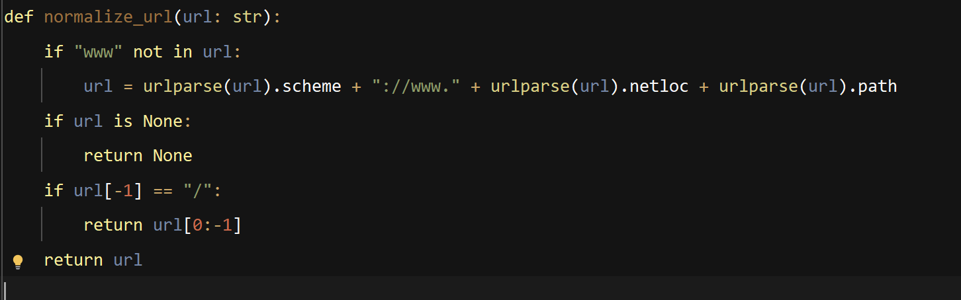
6. We extract as many pages (links) as possible from the scraped page
Normalizing the pages.

Slide 11
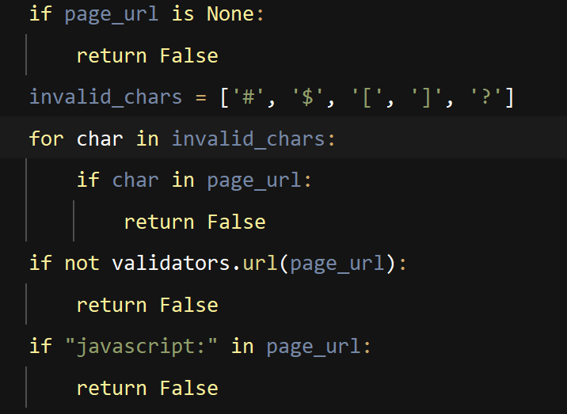
6. We extract as many pages (links) as possible from the scraped page
Valid Pages are only extracted.

Slide 12
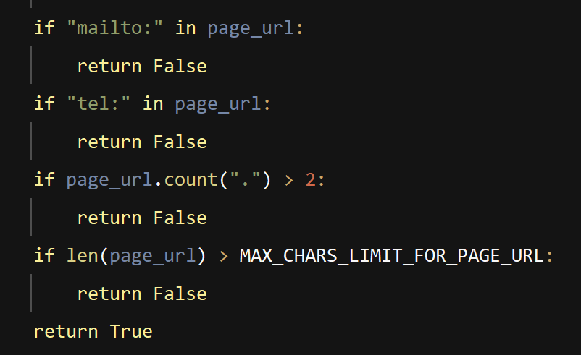
6. We extract as many pages (links) as possible from the scraped page
Valid Pages are only extracted.

Slide 13
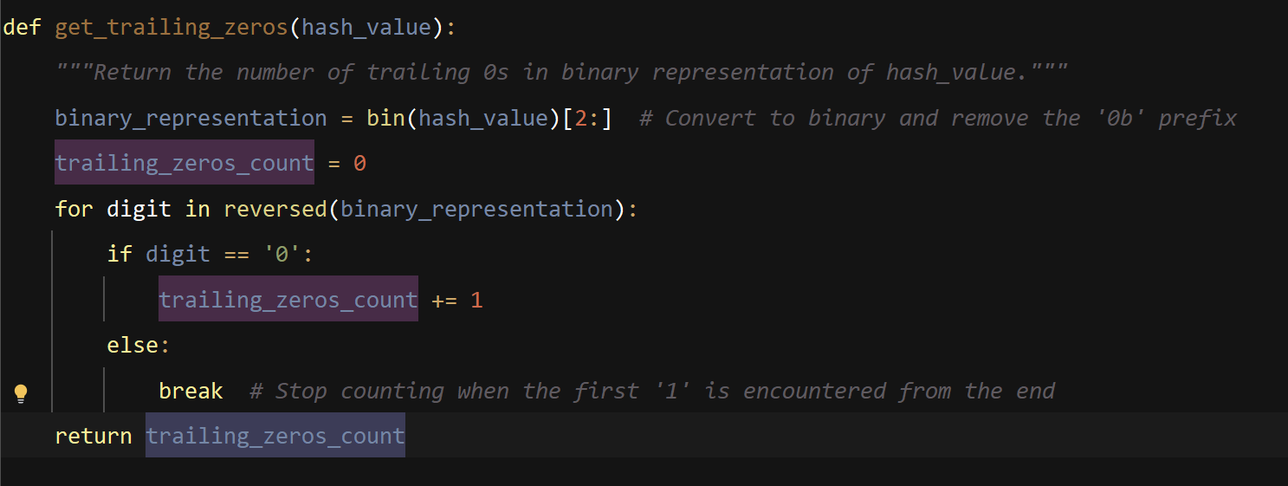
7. We find the number of unique words based on Flajolet-Martin algorithm for each page
We run on different threads to speed up
We avoid race conditions
Each page is scraped once on

Slide 14
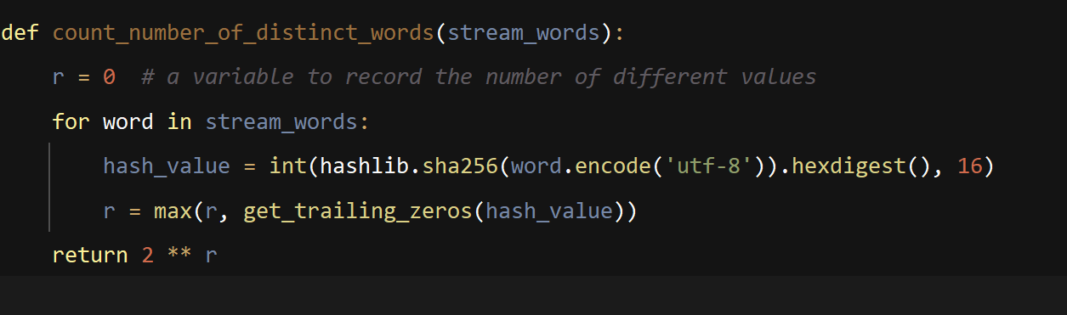
7. We find the number of unique words based on Flajolet-Martin algorithm for each page

Slide 15
8. We store all the pages and their corresponding words count
We sort the results and show them in descending order
PrettyTable usage
How to avoid corrupted files
Why we need this information?

Slide 16
Summary
Given a set of domains, find the number of distinct words from them such that:
We run on different threads to speed up
We avoid race conditions
Each page is scraped once only
Efficient retrieval from the queue
We scrape all the contents of the page
We extract as many pages (links) as possible from the scraped page
We find the number of unique words based on Flajolet-Martin algorithm for each page
We store all the pages and their corresponding words count

Slide 17
Thank You

