Slide 1
Python Basics
for Data Analysis
By Armin Khayati

Slide 2
Python Basics :
Everything is an Object
Everything is an object (number, string, data structure, function, class, module) which is referred to as a Python object
Each object has an associated type and internal data.

Slide 3
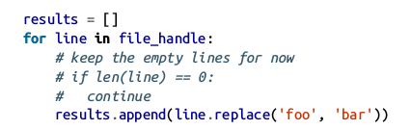
Python Basics :
Comments
Any text preceded by the hash mark (pound sign) # is ignored by the Python interpreter.

Slide 4


Python Basics :
Function and object method calls
You call functions using parentheses and passing zero or more arguments, optionally assigning the returned value to a variable
Almost every object in Python has attached functions, known as methods
Functions can take both positional and keyword arguments

Slide 5

Python Basics :
Variables and argument passing
When assigning a variable (or name) in Python, you are creating a reference to the object on the right-hand side of the equals sign.
In Python, a and b actually now refer to the same object, the original list [1, 2, 3]

Slide 6


Python Basics :
Variables and argument passing
You can prove this to yourself by appending an element to a and then examining b

Slide 7

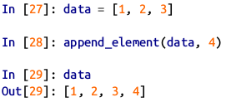
Python Basics :
Variables and argument passing
When you pass objects as arguments to a function, new local variables are created referencing the original objects without any copying.
If you bind a new object to a variable inside a function, that change will not be reflected in the parent scope.

Slide 8
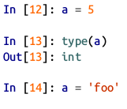

Python Basics :
Dynamic references, strong types
In contrast with many compiled languages, such as Java and C++, object references in Python have no type associated with them.

Slide 9
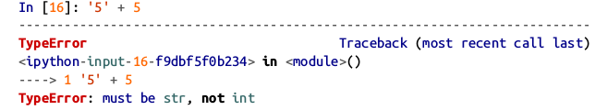
Python Basics :
Dynamic references, strong types
Variables are names for objects within a particular name-space; the type information is stored in the object itself
Python is a “typed language” ; consider this example
Python is considered a strongly typed language

Slide 10
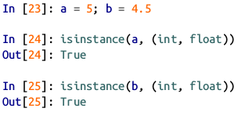

Python Basics :
Dynamic references, strong types
You can check that an object is an instance of a particular type using the isinstance function
isinstance can accept a tuple of types if you want to check that an object’s type is among those present in the tuple

Slide 11
Python Basics :
Attributes and methods
Objects in Python have attributes (other Python objects stored “inside”the object)
Objects in Python methods (functions associated with an object that can have access to the object’s internal data)

Slide 12
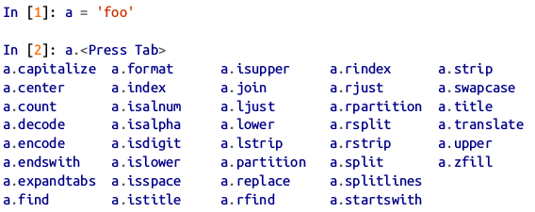
Python Basics :
Attributes and methods
Both of them are accessed via the syntax obj.attribute_name

Slide 13

Python Basics :
Attributes and methods
Attributes and methods can also be accessed by name via the getattr function

Slide 14
Python Basics :
Duck typing
Often you may not care about the type of an object but rather only whether it has certain methods or behavior.
This is sometimes called “duck typing,” after the saying “If it walks like a duck and quacks like a duck, then it’s a duck.”

Slide 15
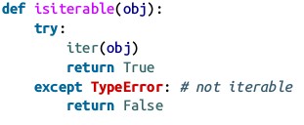


Python Basics :
Duck typing
For example, you can verify that an object is iterable if it implemented the iterator protocol. For many objects, this means it has a __iter__ “magic method” .

Slide 16

Python Basics :
Duck typing
Write functions that can accept multiple kinds of input.
A function that can accept any kind of sequence (list, tuple, ndarray) or even an iterator. You can first check if the object is a list (or a NumPy array) and, if it is not, convert it to be one.

Slide 17
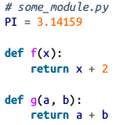


Python Basics :
Imports
In Python a module is simply a file with the .py extension containing Python code. Suppose that we had the following module:
If we wanted to access the
variables and functions
defined in some_module.py,
from another file in the same directory we could do
OR

Slide 18
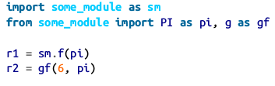
Python Basics :
Imports
By using the as keyword you can give imports different variable names.

Slide 19
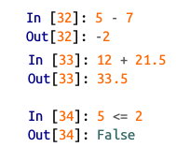
Python Basics :
Binary operators and comparisons
Most of the binary math operations and comparisons are as you might expect

Slide 20
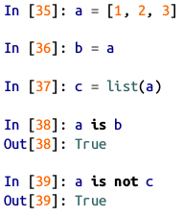

Python Basics :
Binary operators and comparisons
To check if two references refer to the same object, use the is keyword.
is not is also perfectly valid if you want to check that two objects are not the same.

Slide 21

Python Basics :
Binary operators and comparisons
list always creates a new Python list (i.e., a copy), we can be sure that c is distinct from a .
Comparing with ‘is’ is not the same as the == operator.

Slide 22
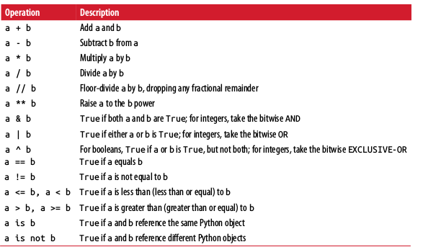
Python Basics :
Binary operators and comparisons

Slide 23
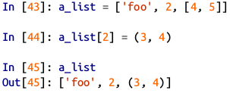
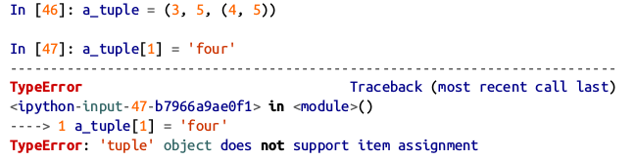
Python Basics :
Mutable and immutable objects
Most objects in Python, such as lists, dicts, NumPy arrays, and most user-defined types (classes), are mutable.
Others, like strings and tuples, are immutable.

Slide 24
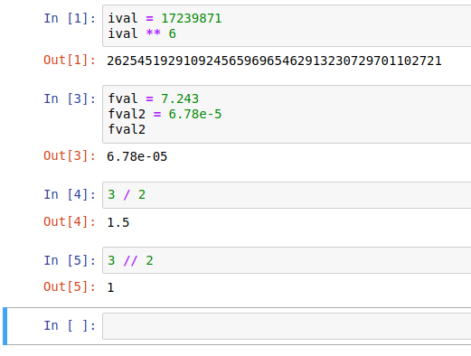
Python Basics :
Numeric Types

Slide 25
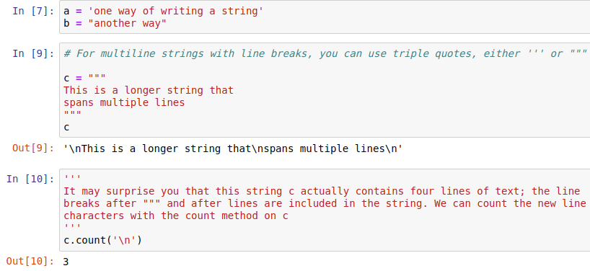
Python Basics :
Strings

Slide 26
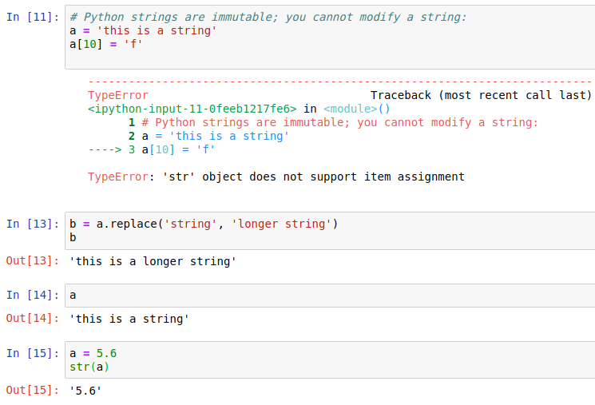
Python Basics :
Strings

Slide 27
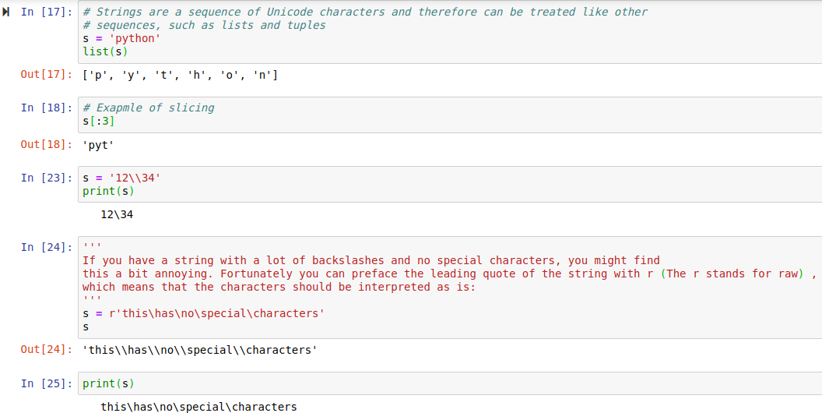
Python Basics :
Strings

Slide 28
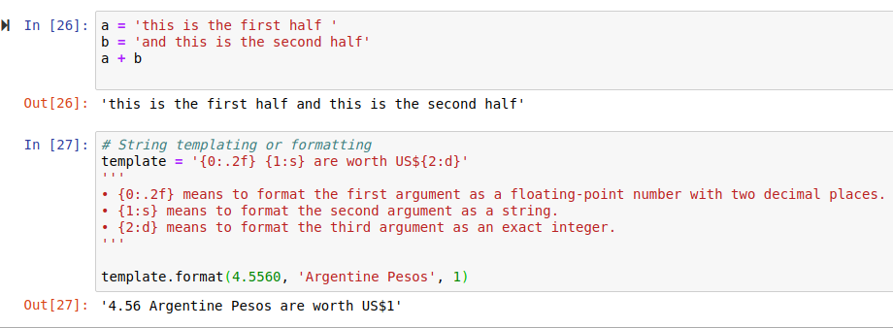
Python Basics :
Strings

Slide 29
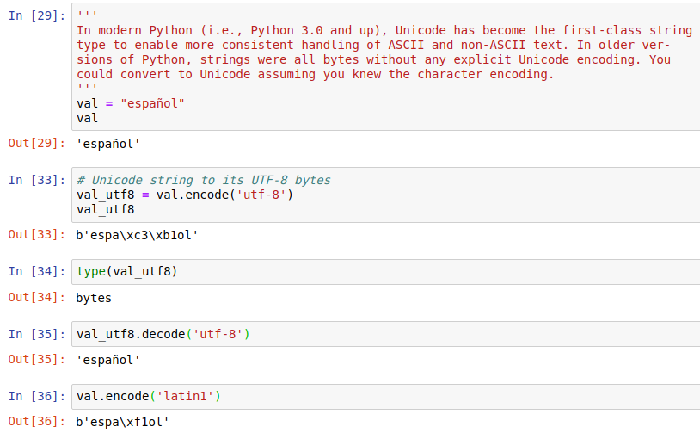
Python Basics :
Bytes and Unicode

Slide 30
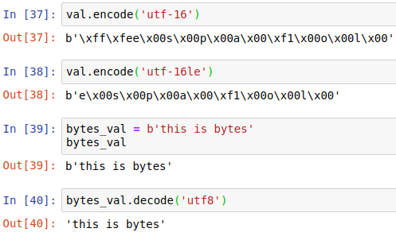
Python Basics :
Bytes and Unicode

Slide 31
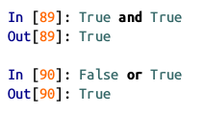
Python Basics :
Booleans

Slide 32
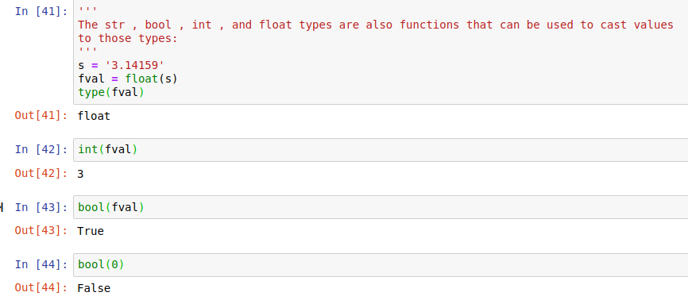
Python Basics :
Type casting

Slide 33
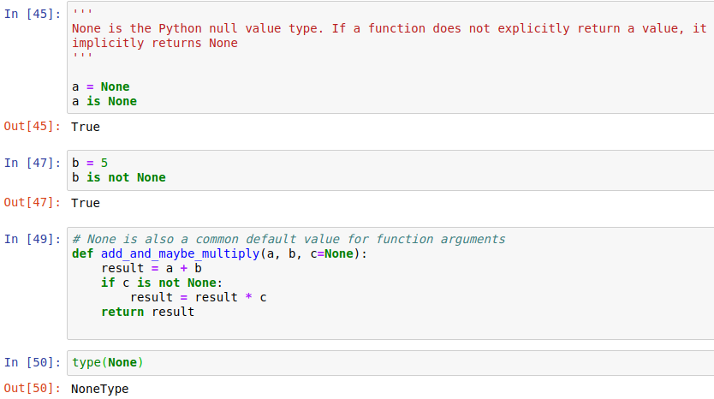
Python Basics :
None

Slide 34
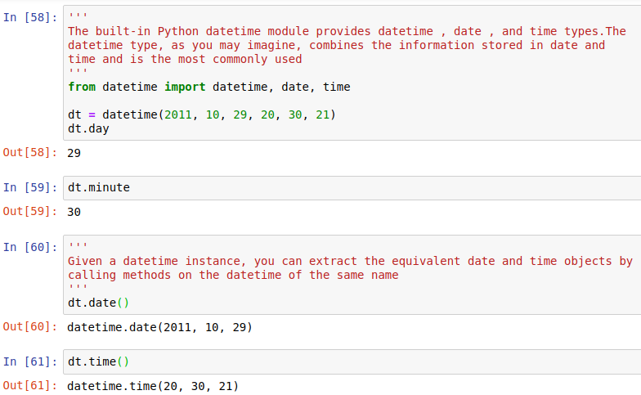
Python Basics :
Dates and times

Slide 35
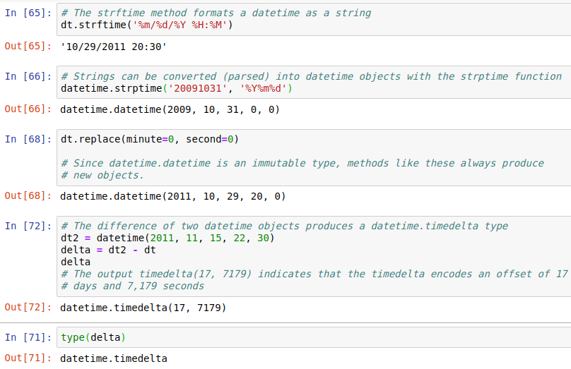
Python Basics :
Dates and times

Slide 36
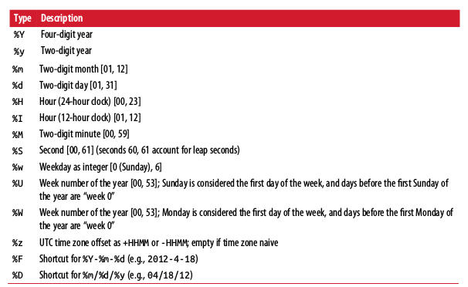
Python Basics :
Datetime format specification (ISO C89 compatible)

Slide 37
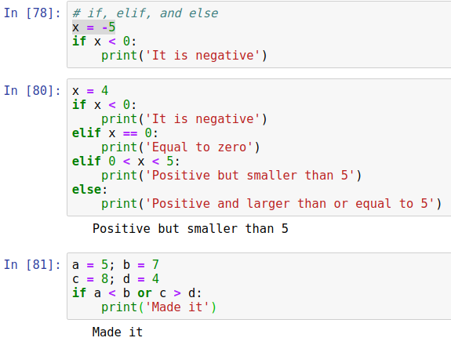
Python Basics :
Control Flow

Slide 38
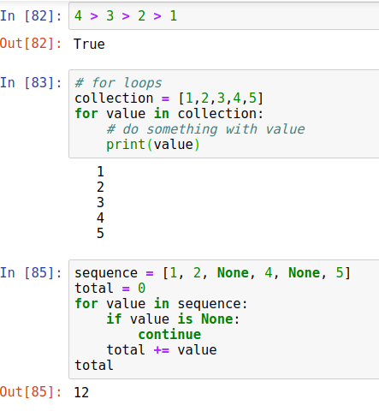
Python Basics :
Control Flow

Slide 39
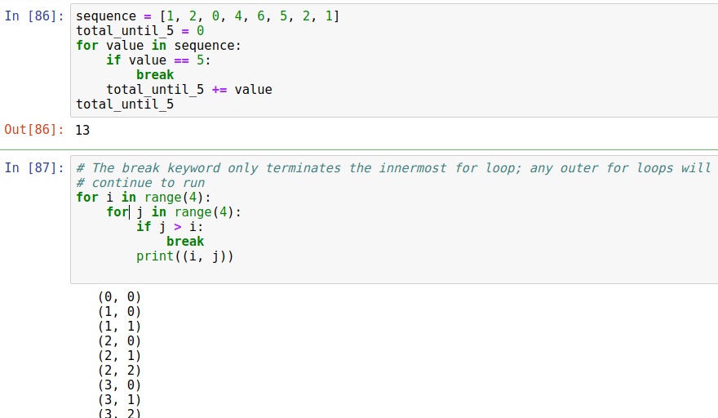
Python Basics :
Control Flow

Slide 40
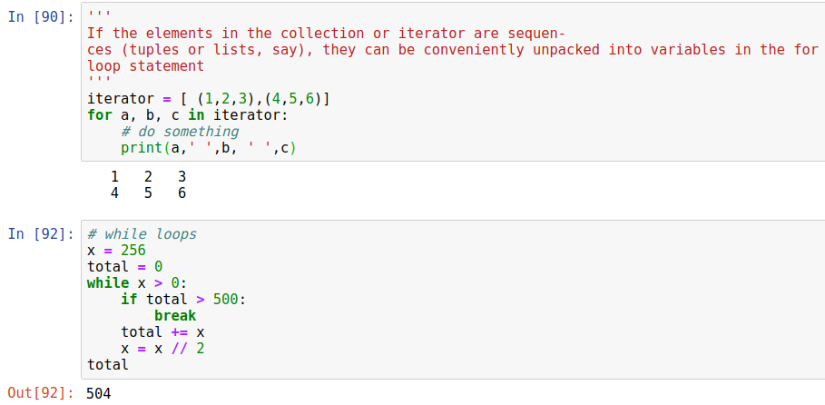
Python Basics :
Control Flow

Slide 41
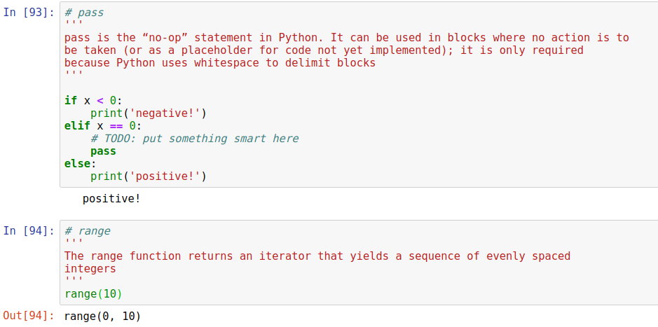
Python Basics :
Control Flow

Slide 42
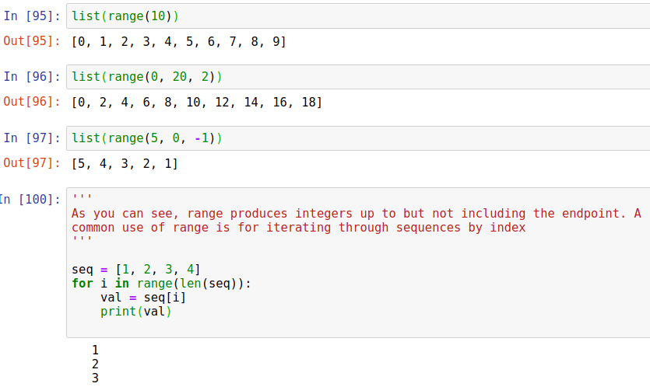
Python Basics :
Control Flow

Slide 43
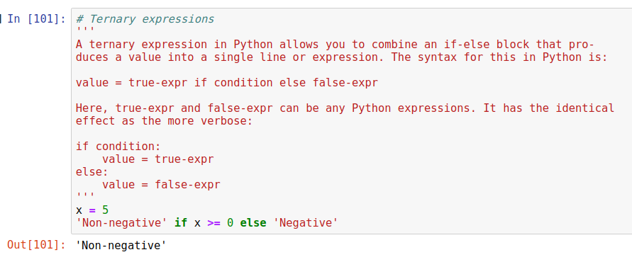
Python Basics :
Control Flow

