Slide 1
Python Basics
for Data Analysis
By Armin Khayati

Slide 2
Python Basics :
Built-in Data Structures, Functions,
and Files
Python’s workhorse data structures are : tuples, lists, dicts, and sets.
Python’s data structures are simple but powerful. Mastering their use is a critical part of becoming a proficient Python programmer.

Slide 3
Python Basics :
Tuple
Python’s workhorse data structures are : tuples, lists, dicts, and sets.
Python’s data structures are simple but powerful. Mastering their use is a critical part of becoming a proficient Python programmer.

Slide 4


Python Basics :
Tuple
A tuple is a fixed-length, immutable sequence of Python objects. The easiest way to create one is with a comma-separated sequence of values.
When you’re defining tuples in more complicated expressions, it’s often necessary to enclose the values in parentheses, as in this example of creating a tuple of tuples

Slide 5
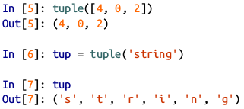

Python Basics :
Tuple
You can convert any sequence or iterator to a tuple by invoking tuple.
Elements can be accessed with square brackets [values] as with most other sequence types.

Slide 6
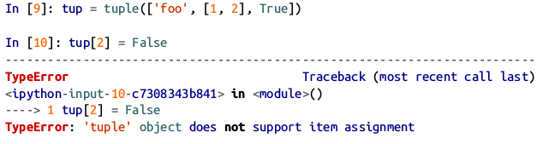
Python Basics :
Tuple
While the objects stored in a tuple may be mutable themselves, once the tuple is created it’s not possible to modify which object is stored in each slot.

Slide 7


Python Basics :
Tuple
If an object inside a tuple is mutable, such as a list, you can modify it in-place.
You can concatenate tuples using the + operator to produce longer tuples.

Slide 8
Python Basics :
Tuple
Multiplying a tuple by an integer, as with lists, has the effect of concatenating together that many copies of the tuple.

Slide 9
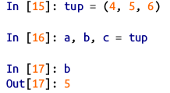
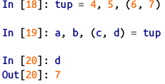
Python Basics :
Unpacking tuples
If you try to assign to a tuple-like expression of variables, Python will attempt to unpack the value on the right-hand side of the equals sign.
Even sequences with nested tuples can be unpacked:

Slide 10



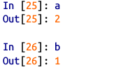
Python Basics :
Unpacking tuples
Using this functionality you can easily swap variable names, a task which in many languages might look like
But, in Python, the swap can be done like this

Slide 11
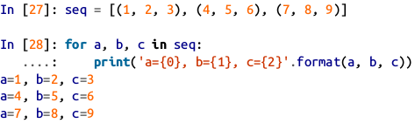
Python Basics :
Unpacking tuples
A common use of variable unpacking is iterating over sequences of tuples or lists.
Another common use is returning multiple values from a function.

Slide 12
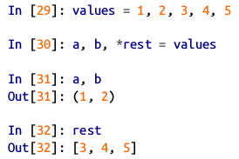
Python Basics :
Unpacking tuples
Another application of tuple unpacking is “pluking” few elements from the beginning of a tuple.
This uses the special syntax *rest
It is also used in function signatures to capture an arbitrarily long list of positional arguments
.

Slide 13

Python Basics :
Tuple Methods
As a matter of convention, many Python programmers will use the underscore ( _ ) for unwanted variables.
Since the size and contents of a tuple cannot be modified, it is very light on instance methods.
A particularly useful one (also available on lists) is count , which counts the number of occurrences of a value.

Slide 14
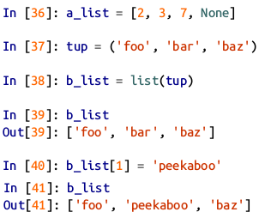
Python Basics :
List
In contrast with tuples, lists are variable-length and their contents can be modified in-place.
You can define them using square brackets [ ] or using the list type function

Slide 15
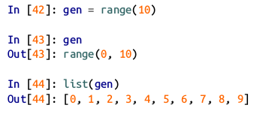
Python Basics :
List
Lists and tuples are semantically similar (though tuples cannot be modified) and can be used interchangeably in many functions.
The list function is frequently used in data processing as a way to materialize an iterator or generator expression

Slide 16
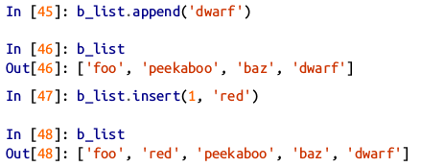
Python Basics :
Adding and removing elements
Elements can be appended to the end of the list with the append method.
Using insert you can insert an element at a specific location in the list.
The insertion index must be between 0 and the length of the list, inclusive.

Slide 17
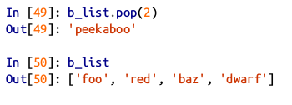
Python Basics :
Adding and removing elements
The inverse operation to insert is pop , which removes and returns an element at a particular index.

Slide 18
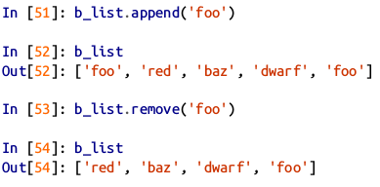
Python Basics :
Adding and removing elements
Elements can be removed by value with remove , which locates the first such value and removes it from the last.

Slide 19


Python Basics :
Adding and removing elements
If performance is not a concern, by using append and remove , you can use a Python list as a perfectly suitable “multiset” data structure.
To check if a list contains a value using the in keyword.
The keyword not can be used to negate in

Slide 20
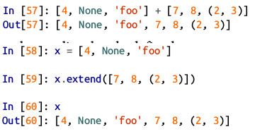
Python Basics :
Concatenating and combining lists
Similar to tuples, adding two lists together with ‘+’ concatenates them.
If you have a list already defined, you can append multiple elements to it using the extend method.

Slide 21









Python Basics :
Concatenating and combining lists
Note that list concatenation by addition is a comparatively expensive operation since a new list must be created and the objects copied over.
Using extend to append elements to an existing list, especially if you are building up a large list, is usually preferable.

Slide 22
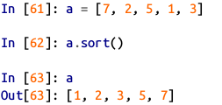
Python Basics :
Sorting
You can sort a list in-place (without creating a new object) by calling its sort function.

Slide 23
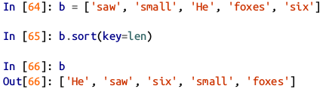
Python Basics :
Sorting
sort has a few good options such as the ability to pass a secondary sort key—that is, a function that produces a value to use to sort the objects.

Slide 24
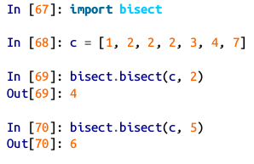
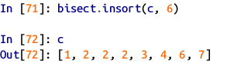
Python Basics :
Binary search and maintaining a sorted list
The built-in bisect module implements binary search and insertion into a sorted list.
bisect.bisect finds the location where an element should be inserted to keep it sorted.
bisect.insort actually inserts the element into that location

Slide 25

Python Basics :
Slicing
You can select sections of most sequence types by using slice notation, which in its basic form consists of start:stop passed to the indexing operator [ ]

Slide 26

Python Basics :
Slicing
Slices can also be assigned to with a sequence
While the element at the start index is included, the stop index is not included, so that the number of elements in the result is
stop - start .

Slide 27
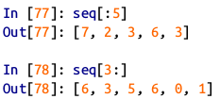
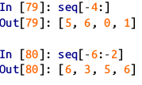
Python Basics :
Slicing
Either the start or stop can be omitted, in which case they default to the start of the sequence and the end of the sequence.
Negative indices slice the sequence relative to the end.

Slide 28


Python Basics :
Slicing
A step can also be used after a second colon to, say, take every other element.
A clever use of this is to pass -1 , which has the useful effect of reversing a list or tuple.

Slide 29
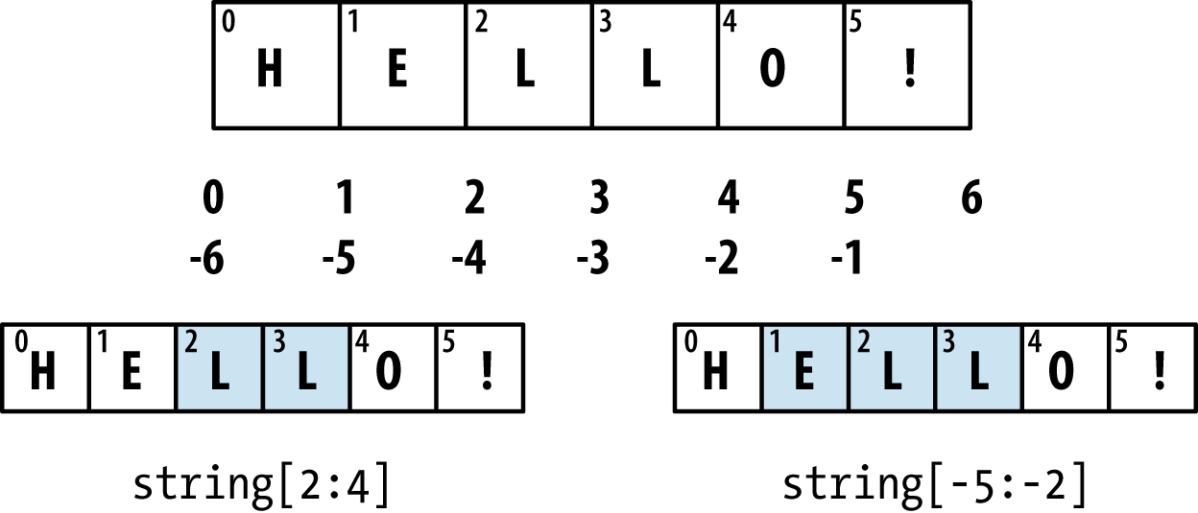
Python Basics :
Slicing

Slide 30
Python Basics :
Built-in Sequence Functions
Python has a handful of useful sequence functions that you should familiarize yourself with and use at any opportunity

Slide 31


Python Basics : enumerate
It’s common when iterating over a sequence to want to keep track of the index of the current item.
A do-it-yourself approach would look like.
Python has a built-in function, enumerate , which returns a sequence of (i, value) tuples

Slide 32
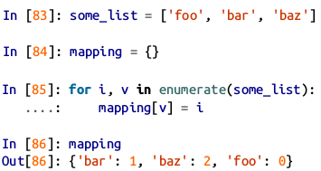
Python Basics : enumerate
When you are indexing data, a helpful pattern that uses enumerate is computing a dict mapping the values of a sequence (which are assumed to be unique) to their locations in the sequence.

Slide 33
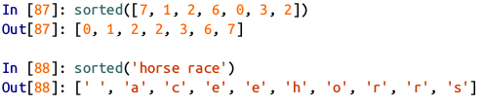
Python Basics : sorted
The sorted function returns a new sorted list from the elements of any sequence.
The sorted function accepts the same arguments as the sort method on lists.

Slide 34
Python Basics : zip
zip “pairs” up the elements of a number of lists, tuples, or other sequences to create a list of tuples.
zip can take an arbitrary number of sequences, and the number of elements it produces is determined by the shortest sequence.
A very common use of zip is simultaneously iterating over multiple sequences, possibly also combined with enumerate.

Slide 35
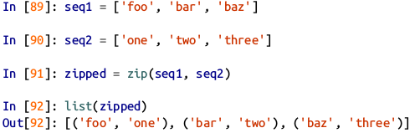

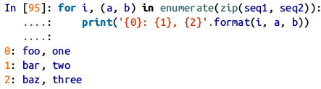
Python Basics : zip

Slide 36
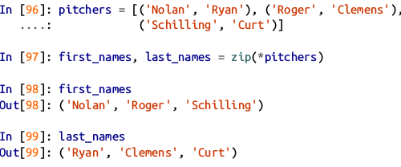
Python Basics : zip
Given a “zipped” sequence, zip can be applied in a clever way to “unzip” the sequence.
Another way to think about this is converting a list of rows into a list of columns.
The syntax, which looks a bit magical, is

Slide 37

Python Basics : reversed
reversed iterates over the elements of a sequence in reverse order.
Keep in mind that reversed is a generator, so it does not create the reversed sequence until materialized (e.g., with list or a for loop).

Slide 38
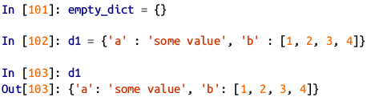
Python Basics : dict
A more common name for it is hash map or associative array.
One approach for creating one is to use curly braces { } and colons to separate keys and values.
key and value are Python objects.

Slide 39
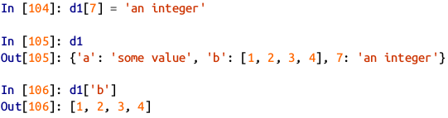
Python Basics : dict
You can access, insert, or set elements using the same syntax as for accessing elements of a list or tuple.

Slide 40

Python Basics : dict
You can check if a dict contains a key using the same syntax used for checking whether a list or tuple contains a value.
You can delete values either using the del keyword or the pop method

Slide 41
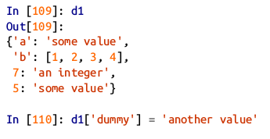
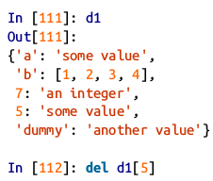

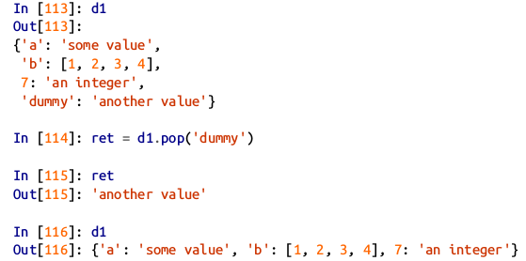

Python Basics : dict

Slide 42

Python Basics : dict
The keys and values method give you iterators of the dict’s keys and values.
These functions output the keys and values in the same order.

Slide 43

Python Basics : dict
You can merge one dict into another using the update method.
The update method changes dicts in-place, so any existing keys in the data passed to update will have their old values discarded.

Slide 44


Python Basics :
Creating dicts from sequences
It’s common to occasionally end up with two sequences that you want to pair up element-wise in a dict.
As a firs/t cut, you might write code like this.
Since a dict is essentially a collection of 2-tuples, the dict function accepts a list of 2-tuples

Slide 45

Python Basics :
Default values
It’s very common to have logic like this.
Thus, the dict methods get and pop can take a default value to be returned.
get by default will return None if the key is not present, while pop will raise an exception.
With setting values, a common case is for the values in a dict to be other collections, like lists.

Slide 46
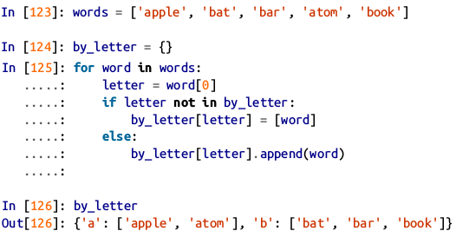
Python Basics :
Default values
Imagine categorizing a list of words by their first letters as a dict of lists.

Slide 47


Python Basics :
Default values
The setdefault dict method is for precisely this purpose. The preceding for loop can be rewritten as
The built-in collections module has a useful class, defaultdict , which makes this even easier.
To create one, you pass a type or function for generating the default value for each slot in the dict.

Slide 48
Python Basics :
Valid dict key types
While the values of a dict can be any Python object, the keys generally have to be immutable objects like scalar types (int, float, string) or tuples (all the objects in the tuple need to be immutable, too)
The technical term here is hashability.
You can check whether an object is hashable (can be used as a key in a dict) with the hash function
To use a list as a key, one option is to convert it to a tuple, which can be hashed as long as its elements also can

Slide 49
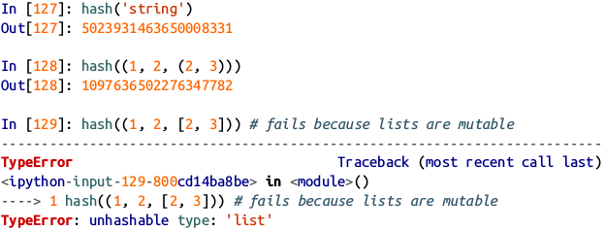
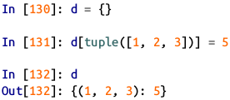
Python Basics :
Valid dict key types

Slide 50
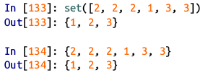
Python Basics :
Set
A set is an unordered collection of unique elements.
You can think of them like dicts,but keys only, no values.
A set can be created in two ways: via the set function or via a set literal with curly braces { }

Slide 51
Python Basics :
Set
Sets support mathematical set operations like union, intersection, difference, and symmetric difference.
The union of two sets can be computed with either the union method or the | binary operator.
The intersection of two sets can be computed with either the & operator or the intersection method.

Slide 52


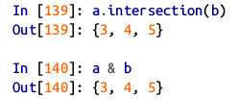
Python Basics :
Set

Slide 53
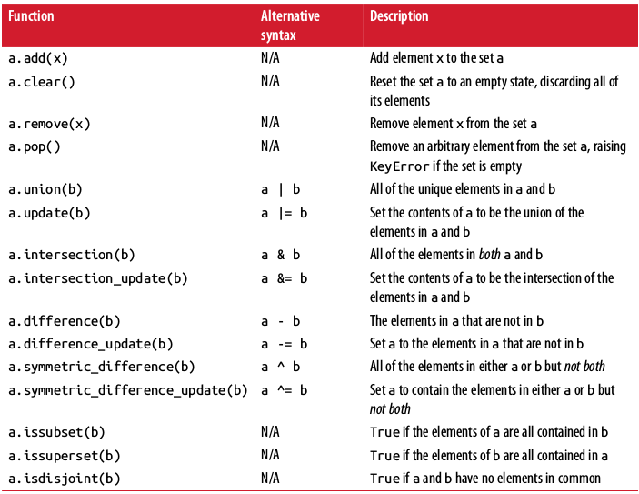
Python Basics :
Python common set operations

Slide 54
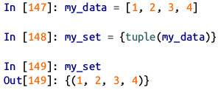
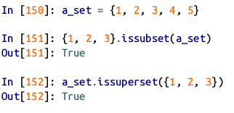

Python Basics :
Set
Like dicts, set elements generally must be immutable.
You can also check if a set is a subset of (is contained in) or a superset of (contains all elements of) another set
Sets are equal if and only if their contents are equal.

Slide 55
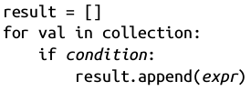
Python Basics :
List, Set, and Dict Comprehensions
List comprehensions are one of the most-loved Python language features.
They allow you to concisely form a new list by filtering the elements of a collection, transforming the elements passing the filter in one concise expression.
They take the basic form:
This is equivalent to the following for loop

Slide 56

Python Basics :
List, Set, and Dict Comprehensions
Example of List Comprehensions

Slide 57
Python Basics :
List, Set, and Dict Comprehensions
A dict comprehension basic form
A set comprehension basic form

Slide 58


Python Basics :
List, Set, and Dict Comprehensions
A set comprehension example
We could also express this more functionally using the map function

Slide 59

Python Basics :
List, Set, and Dict Comprehensions
A dict comprehension example

Slide 60

Python Basics :
Nested list comprehensions
Suppose we have a list of lists containing some English and Spanish names.
suppose we wanted to get a single list containing all names with two or more e ’s in them.
for loop implementation:

Slide 61
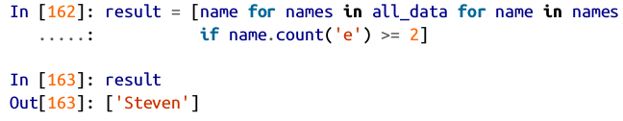
Python Basics :
Nested list comprehensions
We can wrap this whole operation up in a single nested list comprehension.

Slide 62
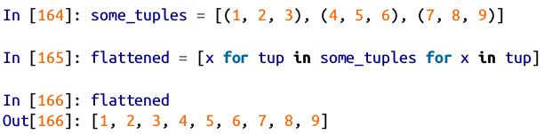
Python Basics :
Nested list comprehensions
Another example where we “flatten” a list of tuples of integers into a simple list of integers.
Keep in mind that the order of the for expressions would be the same if you wrote a nested for loop instead of a list comprehension

Slide 63

Python Basics :
Nested list comprehensions
Produce a list of lists.

