Slide 1
Python Basics
for Data Analysis
By Armin Khayati

Slide 2
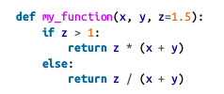
Python Basics :
Functions
Functions are the primary and most important method of code organization and reuse in Python.
Functions are declared with the def keyword and returned from with the return keyword.

Slide 3

Python Basics :
Functions
There is no issue with having multiple return statements.
If Python reaches the end of a function without encountering a return statement, None is returned automatically.
Each function can have positional arguments and keyword arguments.

Slide 4
Python Basics :
Namespaces, Scope, and Local Functions
Functions can access variables in two different scopes: global and local.
An alternative and more descriptive name describing a variable scope in Python is a namespace.
Any variables that are assigned within a function by default are assigned to the local namespace.
The local namespace is created when the function is called and immediately populated by the function’s arguments. After the function is finished, the local namespace is destroyed.

Slide 5


Python Basics :
Namespaces, Scope, and Local Functions
Difference???

Slide 6
Python Basics :
Namespaces, Scope, and Local Functions
First one : When func() is called, the empty list a is created, five elements are appended, and then a is destroyed when the function exits.
Second one : When func() is called, five elements are appended, and the list a still exists when the function exits.

Slide 7
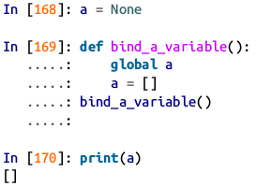
Python Basics :
Namespaces, Scope, and Local Functions
Assigning variables outside of the function’s scope is possible, but those variables must be declared as global via the global keyword.

Slide 8
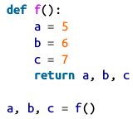
Python Basics :
Returning Multiple Values
Here’s an example:
What’s happening here is
that the function is actually
just returning one object, namely a tuple, which is then being unpacked into the result variables.
We could have done this instead

Slide 9
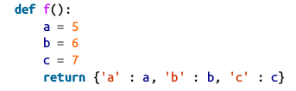
Python Basics :
Returning Multiple Values
A potentially attractive alternative to returning multiple values like before might be to return a dict instead.

Slide 10
Python Basics :
Functions Are Objects
Since Python functions are objects, many constructs can be easily expressed that are difficult to do in other languages.
Suppose we were doing some data cleaning and needed to apply a bunch of transformations to the following list of strings.
Lots of things need to happen to make this list of strings uniform and ready for analysis: stripping whitespace, removing punctuation symbols, and standardizing on proper capitalization.

Slide 11
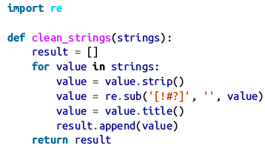
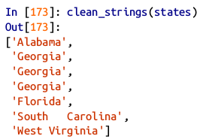
Python Basics :
Functions Are Objects
One way to do this is to use built-in string methods along with the re standard library module for regular expressions.
The result looks like this:

Slide 12
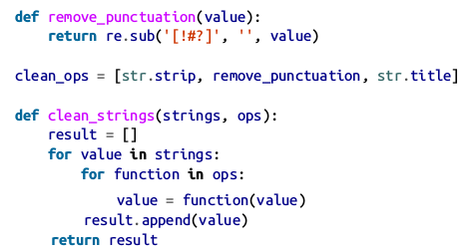
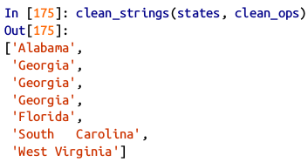
Python Basics :
Functions Are Objects
An alternative approach that you may find useful is to make a list of the operations you want to apply to a particular set of strings.
Then we have the following:

Slide 13
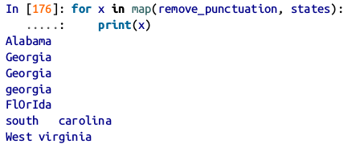
Python Basics :
Functions Are Objects
A more functional pattern like this enables you to easily modify how the strings are transformed at a very high level. The clean_strings function is also now more reusable and generic.
You can use functions as arguments to other functions like the built-in map function, which applies a function to a sequence of some kind:
.

Slide 14

Python Basics :
Anonymous (Lambda) Functions
Python has support for so-called anonymous or lambda functions, which are a way of writing functions consisting of a single statement, the result of which is the return value.
They are defined with the lambda keyword, which has no meaning other than “we are declaring an anonymous function”.

Slide 15
Python Basics :
Anonymous (Lambda) Functions
They are especially convenient in data analysis because, as you’ll see, there are many cases where data transformation functions will take functions as arguments.
It’s often less typing (and clearer) to pass a lambda function as opposed to writing a full-out function declaration or even assigning the lambda function to a local variable.

Slide 16
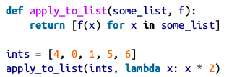
Python Basics :
Anonymous (Lambda) Functions
For example, consider this silly example:
You could also have written
[x * 2 for x in ints] , but here we were able to succinctly pass a custom operator to the apply_to_list function.

Slide 17
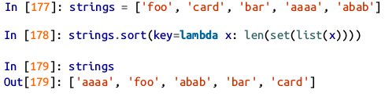
Python Basics :
Anonymous (Lambda) Functions
As another example, suppose you wanted to sort a collection of strings by the number of distinct letters in each string:

Slide 18

Python Basics
Currying : Partial Argument Application
Currying is computer science jargon (named after the mathematician Haskell Curry) that means deriving new functions from existing ones by partial argument application.
For example, suppose we had a trivial function that adds two numbers together.

Slide 19

Python Basics
Currying : Partial Argument Application
Using this function, we could derive a new function of one variable, add_five , that adds 5 to its argument:
The second argument to add_numbers is said to be curried.
The built-in functools module can simplify this process using the partial function:

Slide 20
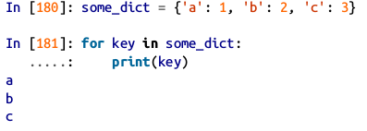
Python Basics :
Generators
When you write for key in some_dict , the Python interpreter first attempts to create an iterator out of some_dict

Slide 21

Python Basics :
Generators
An iterator is any object that will yield objects to the Python interpreter when used in a context like a for loop.

Slide 22
Python Basics :
Generators
A generator is a concise way to construct a new iterable object.
Normal functions execute and return a single result at a time.
Generators return a sequence of multiple results lazily, pausing after each one until the next one is requested.
To create a generator, use the yield keyword instead of return in a function.

Slide 23



Python Basics :
Generators
When you actually call the generator, no code is immediately executed.
It is not until you request elements from the generator that it begins executing its code

Slide 24


Python Basics :
Generator expresssions
Another even more concise way to make a generator is by using a generator expression.
This is completely equivalent to the following more verbose generator:

Slide 25
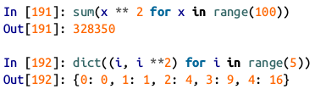
Python Basics :
Generator expresssions
Generator expressions can be used instead of list comprehensions as function arguments in many cases.

Slide 26
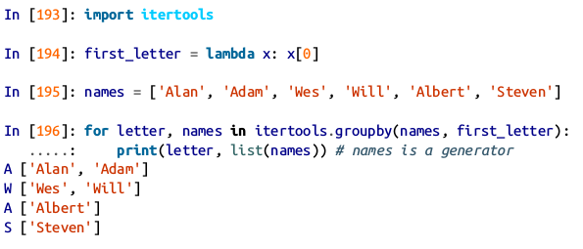
Python Basics :
Itertools module
The standard library itertools module has a collection of generators for many common data algorithms.
For example, groupby takes any sequence and a function, grouping consecutive elements in the sequence by return value of the function.
.

Slide 27
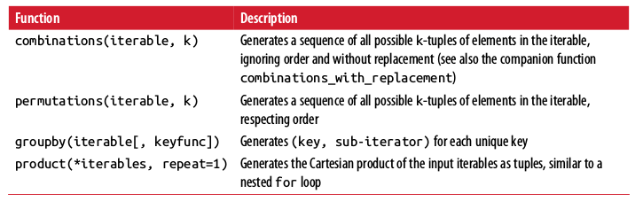
Python Basics :
Some useful itertools functions

Slide 28
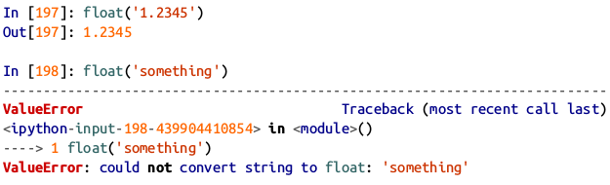
Python Basics :
Errors and Exception Handling
Handling Python errors or exceptions gracefully is an important part of building robust programs.
In data analysis applications, many functions only work on certain kinds of input.
As an example, Python’s float function is capable of casting a string to a floating-point number, but fails with ValueError on improper inputs
.

Slide 29
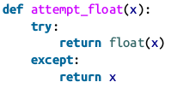
Python Basics :
Errors and Exception Handling
Suppose we wanted a version of float that fails gracefully, returning the input argument.
We can do this by writing a function that encloses the call to float in a try / except block

Slide 30

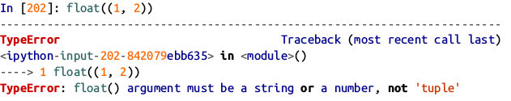
Python Basics :
Errors and Exception Handling
The code in the except part of the block will only be executed if float(x) raises an exception.
You might notice that float can raise exceptions other than ValueError

Slide 31
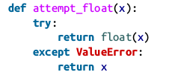
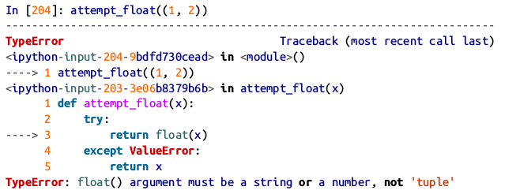
Python Basics :
Errors and Exception Handling
You might want to only suppress ValueError , since a TypeError might indicate a legitimate bug in your program.

Slide 32
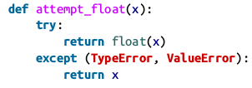
Python Basics :
Errors and Exception Handling
You can catch multiple exception types by writing a tuple of exception types.

Slide 33
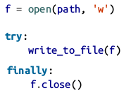
Python Basics :
Errors and Exception Handling
In some cases, you may not want to suppress an exception, but you want some code to be executed regardless of whether the code in the try block succeeds or not.

Slide 34
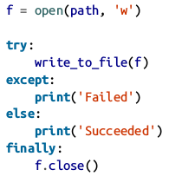
Python Basics :
Errors and Exception Handling
You can have code that executes only if the try: block succeeds using else

Slide 35
Python Basics :
Files and the Operating System
Usually we use high-level tools like pandas.read_csv to read data files from disk into Python data structures.
However, it’s important to understand the basics of how to work with files in Python.
Fortunately, it’s very simple, which is one reason why Python is so popular for text and file munging.

Slide 36


Python Basics :
Files and the Operating System
To open a file for reading or writing, use the built-in open function with a file path.
By default, the file is opened in read-only mode 'r' . We can then treat the file handle f like a list and iterate over the lines like so :

Slide 37
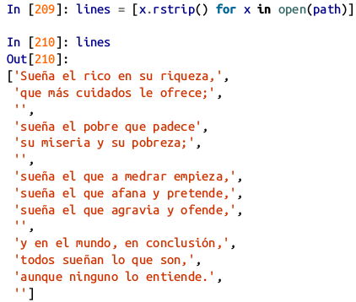
Python Basics :
Files and the Operating System
The lines come out of the file with the end-of-line (EOL) markers intact, so you’ll often see code to get an EOL-free list of lines in a file like

Slide 38


Python Basics :
Files and the Operating System
When you use open to create file objects, it is important to explicitly close the file when you are finished with it.
Closing the file releases its resources back to the operating system:
One of the ways to make it easier to clean up open files is to use the with statement:
This will automatically close the file f when exiting the with block.

Slide 39
Python Basics :
Files and the Operating System
If we had typed f = open(path, 'w') , a new file at examples/segismundo.txt would have been created (be careful!), overwriting any one in its place.
There is also the 'x' file mode, which creates a writable file but fails if the file path already exists.

Slide 40
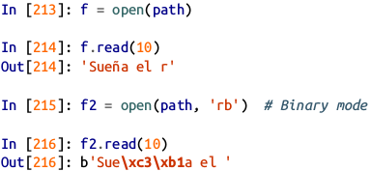
Python Basics :
Files and the Operating System
For readable files, some of the most commonly used methods are read , seek , and tell .
read returns a certain number of characters from the file.
What constitutes a “character” is determined by the file’s encoding (e.g., UTF-8) or simply raw bytes if the file is opened in binary mode.
.

Slide 41
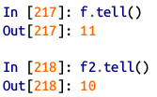
Python Basics :
Files and the Operating System
The read method advances the file handle’s position by the number of bytes read. tell gives you the current position:

Slide 42

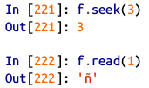
Python Basics :
Files and the Operating System
You can check the default encoding in the sys module:
seek changes the file position to the indicated byte in the file:

Slide 43
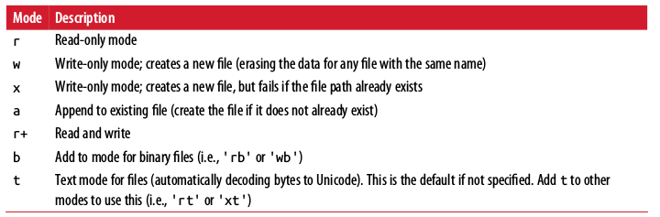
Python Basics :
Files and the Operating System
Python file modes table :

Slide 44
Python Basics :
Bytes and Unicode with Files
The default behavior for Python files (whether readable or writable) is text mode, which means that you intend to work with Python strings (i.e., Unicode). This contrasts with binary mode, which you can obtain by appending b onto the file mode.

Slide 45

Python Basics :
Bytes and Unicode with Files
Here we have a file which contains non-ASCII characters with UTF-8 encoding.

Slide 46
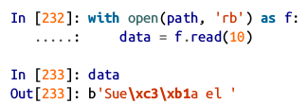
Python Basics :
Bytes and Unicode with Files
UTF-8 is a variable-length Unicode encoding, so when I requested some number of characters from the file, Python reads enough bytes (which could be as few as 10 or as many as 40 bytes) from the file to decode that many characters.
If I open the file in 'rb' mode instead, read requests exact numbers of bytes:

Slide 47
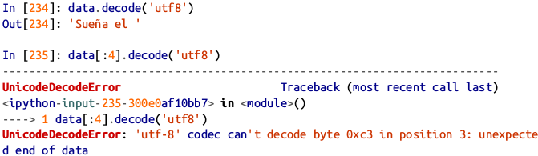
Python Basics :
Bytes and Unicode with Files
Depending on the text encoding, you may be able to decode the bytes to a str object yourself, but only if each of the encoded Unicode characters is fully formed:

Slide 48
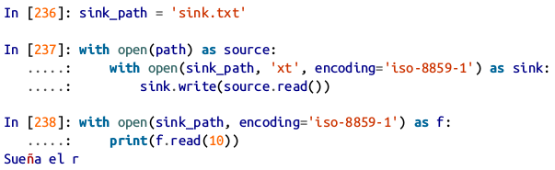
Python Basics :
Bytes and Unicode with Files
Text mode, combined with the encoding option of open , provides a convenient way to convert from one Unicode encoding to another:

Slide 49
Python Basics :
Bytes and Unicode with Files
Beware using seek when opening files in any mode other than binary. If the file position falls in the middle of the bytes defining a Unicode character, then subsequent reads will result in an error.
If you find yourself regularly doing data analysis on non-ASCII text data, mastering Python’s Unicode functionality will prove valuable.

Slide 50
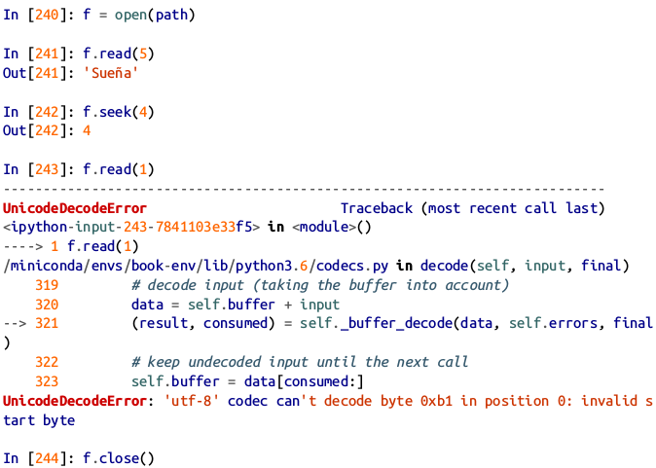
Python Basics :
Bytes and Unicode with Files

