Slide 1
Pandas Basics
for Data Analysis
By Armin Khayati

Slide 2
Pandas Basics
Pandas contains data structures and data manipulation tools designed to make data cleaning and analysis fast and easy in Python.
pandas is often used in tandem with numerical computing tools like NumPy and SciPy, analytical libraries like statsmodels and scikit-learn, and data visualization libraries like matplotlib.
While pandas adopts many coding idioms from NumPy, the biggest difference is that pandas is designed for working with tabular or heterogeneous data.
NumPy, by contrast, is best suited for working with homogeneous numerical array data.

Slide 3

Pandas Basics
Throughout the rest of the slides, we use the following import convention for pandas:
Thus, whenever you see pd. in code, it’s referring to pandas.
You may also find it easier to import Series and DataFrame into the local namespace since they are so frequently used

Slide 4
Pandas Basics
To get started with pandas, you will need to get comfortable with its two workhorse data structures: Series and DataFrame.
While they are not a universal solution for every problem, they provide a solid, easy-to-use basis for most applications.

Slide 5
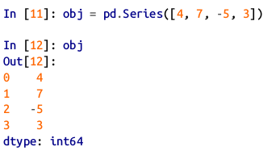
Series
A Series is a one-dimensional array-like object containing a sequence of values and an associated array of data labels, called its index.
The simplest Series is formed from only an array of data:

Slide 6
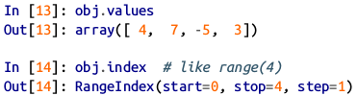
Series
The string representation of a Series displayed interactively shows the index on the left and the values on the right.
Since we did not specify an index for the data, a default one consisting of the integers 0 through N - 1 (where N is the length of the data) is created.

Slide 7
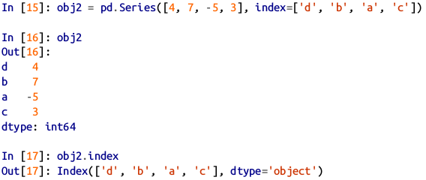
Series
Often it will be desirable to create a Series with an index identifying each data point with a label:

Slide 8
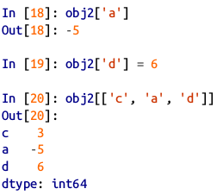
Series
Compared with NumPy arrays, you can use labels in the index when selecting single values or a set of values:
Here ['c', 'a', 'd'] is interpreted as a list of indices, even though it contains strings instead of integers.

Slide 9
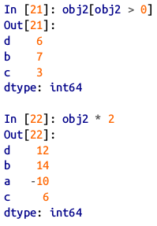
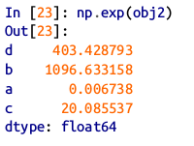
Series
Using NumPy functions or NumPy-like operations, such as filtering with a boolean array, scalar multiplication, or applying math functions, will preserve the index-value link:

Slide 10
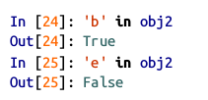
Series
Another way to think about a Series is as a fixed-length, ordered dict, as it is a mapping of index values to data values. It can be used in many contexts where you might use a dict:

Slide 11
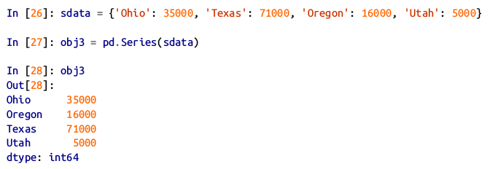
Series
You can create a Series from a Python dictionary by passing the dict:

Slide 12
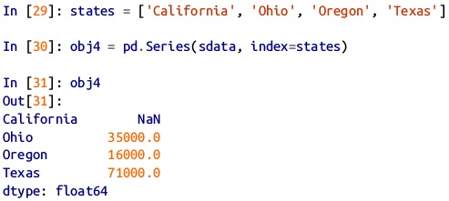
Series
When you are only passing a dict, the index in the resulting Series will have the dict’s keys in sorted order.
You can override this by passing the dict keys in the order you want them to appear in the resulting Series:

Slide 13
Series
Here, three values found in sdata were placed in the appropriate locations, but since no value for 'California' was found, it appears as NaN (not a number), which is considered in pandas to mark missing or NA values.
Since 'Utah' was not included in states , it is excluded from the resulting object.

Slide 14
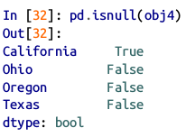
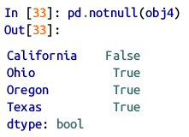
Series
The isnull and notnull functions in pandas should be used to detect missing data:

Slide 15
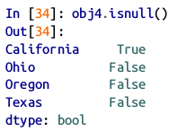
Series
Series also has these as instance methods:

Slide 16
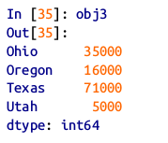
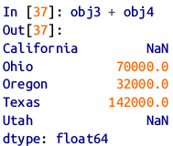
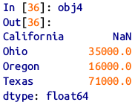
Series
A useful Series feature for many applications is that it automatically aligns by index label in arithmetic operations:

Slide 17
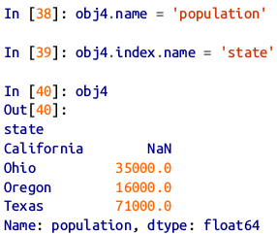
Series
If you have experience with databases, you can think about Data alignment as being similar to a join operation.
Both the Series object itself and its index have a name attribute, which integrates with other key areas of pandas functionality:
.

Slide 18
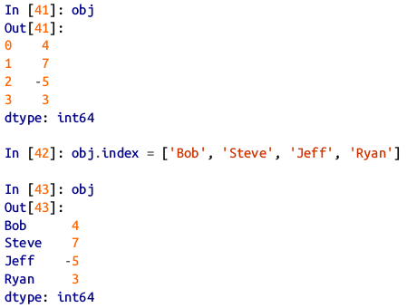
Series
A Series’s index can be altered in-place by assignment:

Slide 19
DataFrame
A DataFrame represents a rectangular table of data and contains an ordered collection of columns, each of which can be a different value type (numeric, string, boolean, etc.).
The DataFrame has both a row and column index; it can be thought of as a dict of Series all sharing the same index.
Under the hood, the data is stored as one or more two-dimensional blocks rather than a list, dict, or some other collection of one-dimensional arrays.

Slide 20

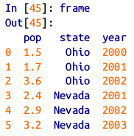
DataFrame
There are many ways to construct a DataFrame, though one of the most common is from a dict of equal-length lists or NumPy arrays:
The resulting DataFrame will have its index assigned automatically as with Series, and the columns are placed in sorted order:
.

Slide 21
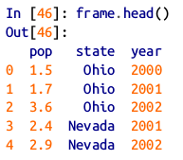
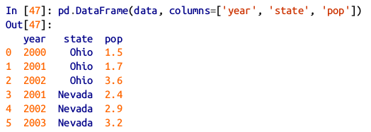
DataFrame
For large DataFrames, the head method selects only the first five rows:
If you specify a sequence of columns, the DataFrame’s columns will be arranged in that order:
.

Slide 22
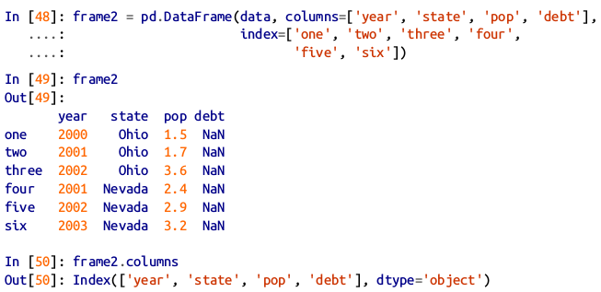
DataFrame
If you pass a column that isn’t contained in the dict, it will appear with missing values in the result:

Slide 23
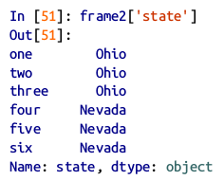
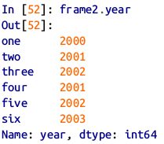
DataFrame
A column in a DataFrame can be retrieved as a Series either by dict-like notation or by attribute:

Slide 24
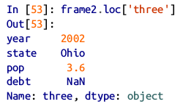
DataFrame
Note that the returned Series have the same index as the DataFrame, and their name attribute has been appropriately set.
Rows can also be retrieved by position or name with the special loc attribute (much more on this later):

Slide 25
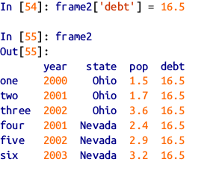
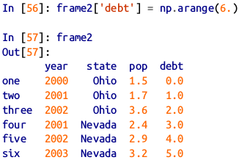
DataFrame
Columns can be modified by assignment. For example, the empty 'debt' column could be assigned a scalar value or an array of values:

Slide 26
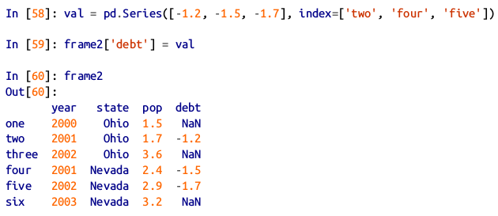
DataFrame
When you are assigning lists or arrays to a column, the value’s length must match the length of the DataFrame.
If you assign a Series, its labels will be realigned exactly to the DataFrame’s index, inserting missing values in any holes:
.

Slide 27
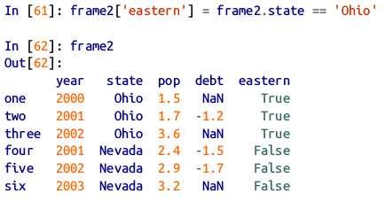
DataFrame
Assigning a column that doesn’t exist will create a new column.
The del keyword will delete columns as with a dict.
As an example of del , I first add a new column of boolean values where the state column equals 'Ohio' :
.

Slide 28

DataFrame
New columns cannot be created with the frame2.eastern syntax.
The del method can then be used to remove this column:

Slide 29

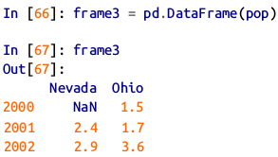
DataFrame
Another common form of data is a nested dict of dicts:
If the nested dict is passed to the DataFrame, pandas will interpret the outer dict keys as the columns and the inner keys as the row indices:
.

Slide 30
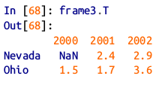
DataFrame
You can transpose the DataFrame (swap rows and columns) with similar syntax to a NumPy array:
The keys in the inner dicts are combined and sorted to form the index in the result.

Slide 31
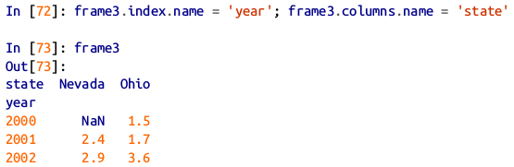
DataFrame
If a DataFrame’s index and columns have their name attributes set, these will also be displayed:

Slide 32
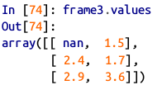
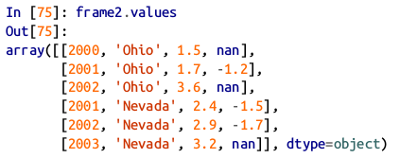
DataFrame
As with Series, the values attribute returns the data contained in the DataFrame as a two-dimensional ndarray:

Slide 33
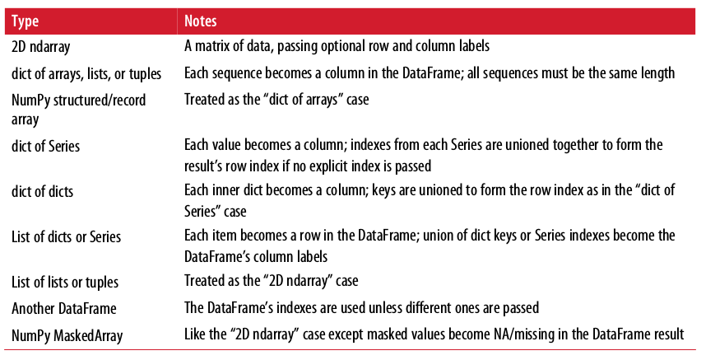
Possible data inputs to DataFrame constructor

Slide 34
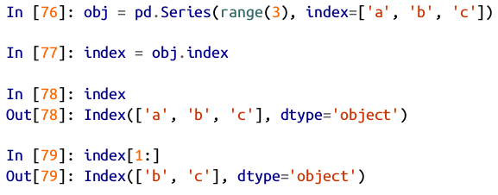
Index Objects
pandas’s Index objects are responsible for holding the axis labels and other metadata (like the axis name or names).
Any array or other sequence of labels you use when constructing a Series or DataFrame is internally converted to an Index:
.

Slide 35

Index Objects
Index objects are immutable and thus can’t be modified by the user:

Slide 36
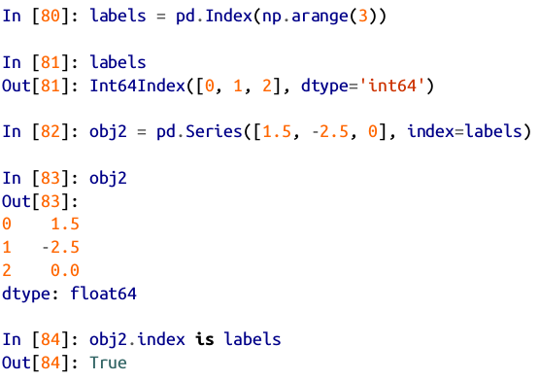
Index Objects
Immutability makes it safer to share Index objects among data structures:

Slide 37
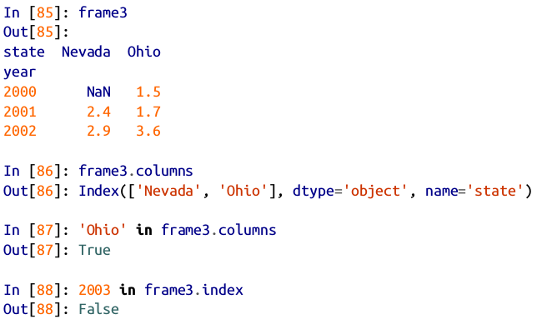
Index Objects
In addition to being array-like, an Index also behaves like a fixed-size set:

Slide 38
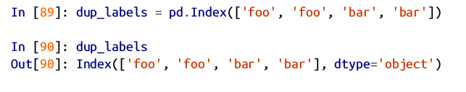
Index Objects
Unlike Python sets, a pandas Index can contain duplicate labels:

Slide 39
Index Objects
Selections with duplicate labels will select all occurrences of that label.
Each Index has a number of methods and properties for set logic, which answer other common questions about the data it contains.

Slide 40
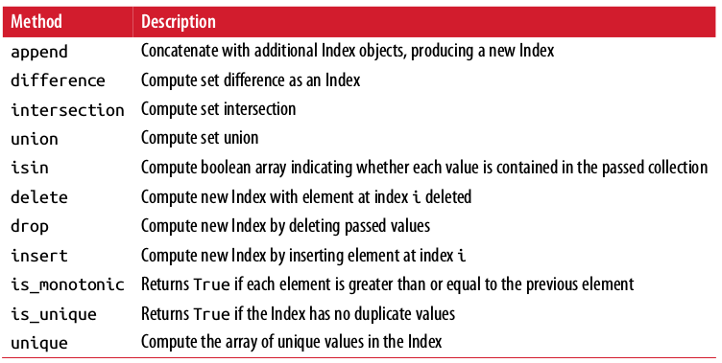
Some Index methods and properties

Slide 41
Essential Functionality
This section will walk you through the fundamental mechanics of interacting with the data contained in a Series or DataFrame.

Slide 42
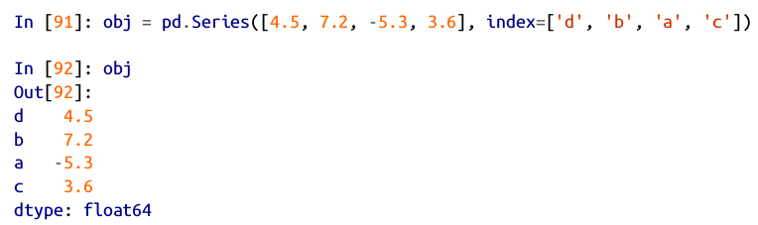
Reindexing
An important method on pandas objects is reindex , which means to create a new object with the data conformed to a new index.
Consider an example:

Slide 43
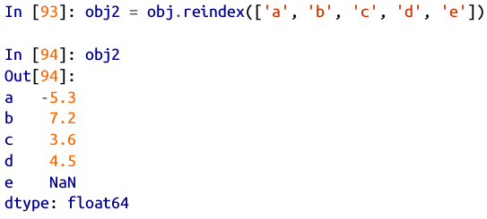
Reindexing
Calling reindex on this Series rearranges the data according to the new index, introducing missing values if any index values were not already present:

Slide 44
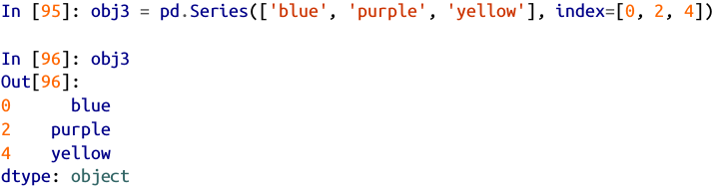
Reindexing
For ordered data like time series, it may be desirable to do some interpolation or filling of values when reindexing.

Slide 45
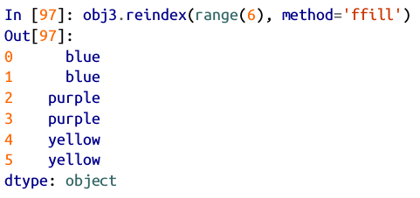
Reindexing
The method option allows us to do this, using a method such as ffill , which forward-fills the values:

Slide 46
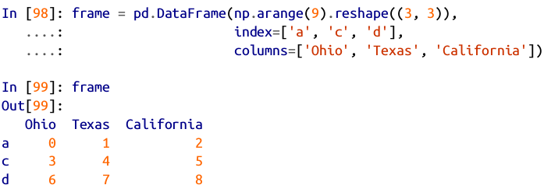
Reindexing
With DataFrame, reindex can alter either the (row) index, columns, or both.

Slide 47
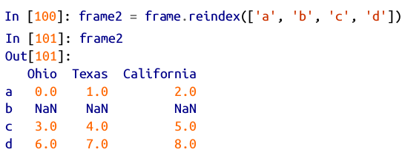
Reindexing
When passed only a sequence, it reindexes the rows in the result:

Slide 48
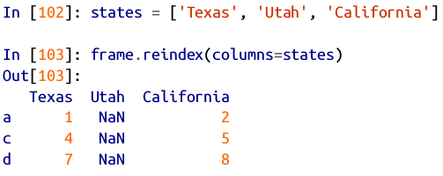
Reindexing
The columns can be reindexed with the columns keyword:

Slide 49
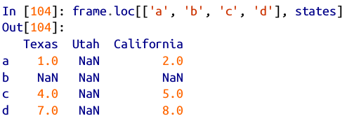
Reindexing
As we’ll explore in more detail, you can reindex more succinctly by label-indexing with loc , and many users prefer to use it exclusively:

Slide 50
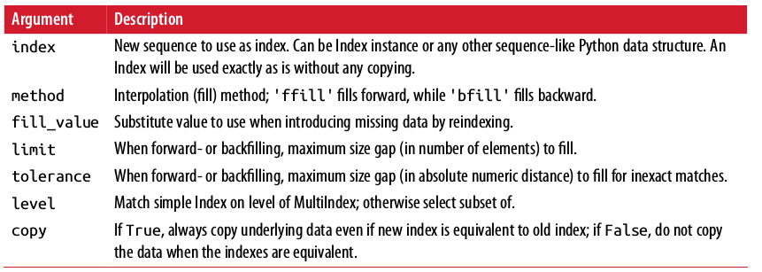
Reindex function arguments

Slide 51
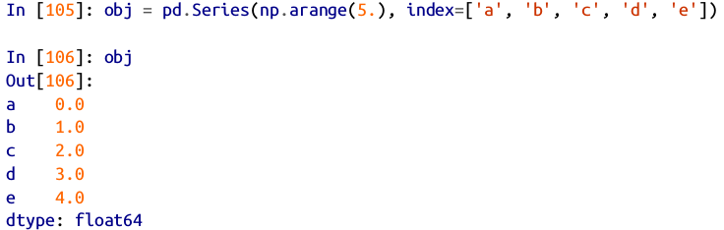
Dropping Entries from an Axis
Dropping one or more entries from an axis is easy if you already have an index array or list without those entries.
As that can require a bit of munging and set logic, the drop method will return a new object with the indicated value or values deleted from an axis:
.

Slide 52
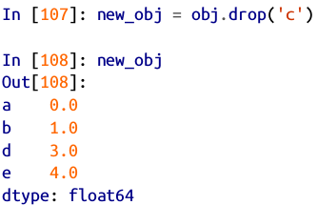

Dropping Entries from an Axis

Slide 53

Dropping Entries from an Axis
With DataFrame, index values can be deleted from either axis.
To illustrate this, we first create an example DataFrame:

Slide 54

Dropping Entries from an Axis
Calling drop with a sequence of labels will drop values from the row labels (axis 0):

Slide 55

Dropping Entries from an Axis
You can drop values from the columns by passing axis=1 or axis='columns' :

Slide 56

Dropping Entries from an Axis
Many functions, like drop , which modify the size or shape of a Series or DataFrame, can manipulate an object in-place without returning a new object:

Slide 57

Indexing, Selection, and Filtering
Series indexing ( obj[...] ) works analogously to NumPy array indexing, except you can use the Series’s index values instead of only integers.

Slide 58



Indexing, Selection, and Filtering

Slide 59


Indexing, Selection, and Filtering
Slicing with labels behaves differently than normal Python slicing in that the end-point is inclusive:

Slide 60

Indexing, Selection, and Filtering
Indexing into a DataFrame is for retrieving one or more columns either with a single value or sequence:

Slide 61

Indexing, Selection, and Filtering
Another use case is in indexing with a boolean DataFrame, such as one produced by a scalar comparison:

Slide 62

Indexing, Selection, and Filtering

Slide 63

Indexing, Selection, and Filtering
Indexing like this has a few special cases. First, slicing or selecting data with a boolean array:

Slide 64
Indexing, Selection, and Filtering
Another use case is in indexing with a boolean DataFrame, such as one produced by a scalar comparison:

Slide 65
Selection with loc and iloc
For DataFrame label-indexing on the rows, we introduce the special indexing operators loc and iloc .
They enable you to select a subset of the rows and columns from a DataFrame with NumPy-like notation using either axis labels ( loc ) or integers ( iloc ).

Slide 66

Selection with loc and iloc
As a preliminary example, let’s select a single row and multiple columns by label:

Slide 67


Selection with loc and iloc
We’ll then perform some similar selections with integers using iloc :

Slide 68

Selection with loc and iloc
Both indexing functions work with slices in addition to single labels or lists of labels:

Slide 69

Indexing options with DataFrame

Slide 70
Arithmetic and Data Alignment
When you are adding together objects, if any index pairs are not the same, the respective index in the result will be the union of the index pairs.
For users with database experience, this is similar to an automatic outer join on the index labels.

Slide 71

Arithmetic and Data Alignment
Let’s look at an example:

Slide 72

Arithmetic and Data Alignment
Adding these together yields:

Slide 73

Arithmetic and Data Alignment
In the case of DataFrame, alignment is performed on both the rows and the columns:

Slide 74

Arithmetic and Data Alignment
Adding these together returns a DataFrame whose index and columns are the unions of the ones in each DataFrame:

Slide 75
Arithmetic and Data Alignment
Since the 'c' and 'e' columns are not found in both DataFrame objects, they appear as all missing in the result.
The same holds for the rows whose labels are not common to both objects.

Slide 76

Arithmetic and Data Alignment
If you add DataFrame objects with no column or row labels in common, the result will contain all nulls:

Slide 77

Arithmetic methods with fill values
In arithmetic operations between differently indexed objects, you might want to fill with a special value, like 0, when an axis label is found in one object but not the other:
.

Slide 78

Arithmetic methods with fill values
Adding these together results in NA values in the locations that don’t overlap:

Slide 79

Arithmetic methods with fill values
Using the add method on df1 , I pass df2 and an argument to fill_value :

Slide 80

Flexible arithmetic methods

Slide 81
Operations between DataFrame and Series
As with NumPy arrays of different dimensions, arithmetic between DataFrame and Series is also defined.

Slide 82

Operations between DataFrame and Series
First, as a motivating example, consider the difference between a two-dimensional array and one of its rows:

Slide 83
Operations between DataFrame and Series
When we subtract arr[0] from arr , the subtraction is performed once for each row.
This is referred to as broadcasting.

Slide 84

Operations between DataFrame and Series
Operations between a DataFrame and a Series are similar:

Slide 85

Operations between DataFrame and Series
By default, arithmetic between DataFrame and Series matches the index of the Series on the DataFrame’s columns, broadcasting down the rows:

Slide 86

Operations between DataFrame and Series
If an index value is not found in either the DataFrame’s columns or the Series’s index, the objects will be reindexed to form the union:

Slide 87


Operations between DataFrame and Series
If you want to instead broadcast over the columns, matching on the rows, you have to use one of the arithmetic methods. For example:

Slide 88
Operations between DataFrame and Series
The axis number that you pass is the axis to match on.
In this case we mean to match on the DataFrame’s row index ( axis='index' or axis=0 ) and broadcast across.

Slide 89

Function Application and Mapping
NumPy ufuncs (element-wise array methods) also work with pandas objects:

Slide 90

Function Application and Mapping
Another frequent operation is applying a function on one-dimensional arrays to each column or row.
DataFrame’s apply method does exactly this:

Slide 91

Function Application and Mapping
In Last Example the function f , which computes the difference between the maximum and minimum of a Series, is invoked once on each column in frame .
If you pass axis='columns' to apply , the function will be invoked once per row instead:

Slide 92

Function Application and Mapping
Many of the most common array statistics (like sum and mean ) are DataFrame methods, so using apply is not necessary.
The function passed to apply need not return a scalar value; it can also return a Series with multiple values:

Slide 93
Function Application and Mapping
Element-wise Python functions can be used, too.
Suppose you wanted to compute a formatted string from each floating-point value in frame .

Slide 94

Function Application and Mapping
You can do this with apply map

Slide 95

Function Application and Mapping
The reason for the name applymap is that Series has a map method for applying an element-wise function:

Slide 96

Sorting and Ranking
Sorting a dataset by some criterion is another important built-in operation.
To sort lexicographically by row or column index, use the sort_index method, which returns a new, sorted object:

Slide 97


Sorting and Ranking
With a DataFrame, you can sort by index on either axis:

Slide 98


Sorting and Ranking
The data is sorted in ascending order by default, but can be sorted in descending order, too:
To sort a Series by its values, use its sort_values method:

Slide 99

Sorting and Ranking
Any missing values are sorted to the end of the Series by default:

Slide 100

Sorting and Ranking
When sorting a DataFrame, you can use the data in one or more columns as the sort keys. To do so, pass one or more column names to the by option of sort_values :
.

Slide 101

Sorting and Ranking
To sort by multiple columns, pass a list of names:
Ranking assigns ranks from one through the number of valid data points in an array.

Slide 102

Sorting and Ranking
by default rank breaks ties by assigning each group the mean rank:

Slide 103

Sorting and Ranking
Ranks can also be assigned according to the order in which they’re observed in the data:
Here, instead of using the average rank 6.5 for the entries 0 and 2, they instead have been set to 6 and 7 because label 0 precedes label 2 in the data.

Slide 104

Sorting and Ranking
You can rank in descending order, too:

Slide 105

Sorting and Ranking
DataFrame can compute ranks over the rows or the columns:

Slide 106

Tie-breaking methods with rank

Slide 107
Axis Indexes with Duplicate Labels
Up until now all of the examples we’ve looked at have had unique axis labels (index values).
While many pandas functions (like reindex ) require that the labels be unique, it’s not mandatory.

Slide 108

Axis Indexes with Duplicate Labels
Let’s consider a small Series with duplicate indices:

Slide 109


Axis Indexes with Duplicate Labels
The index’s is_unique property can tell you whether its labels are unique or not:
Data selection is one of the main things that behaves differently with duplicates.
Indexing a label with multiple entries returns a Series, while single entries return a scalar value:
.

Slide 110

Axis Indexes with Duplicate Labels
The same logic extends to indexing rows in a DataFrame:

